Slide 1
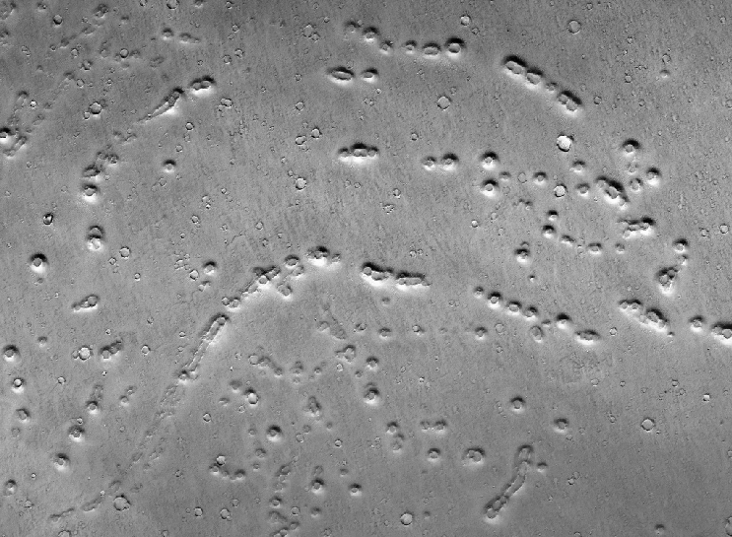
Early Hesperian Warm-Based Glaciation
in Isidis Planitia, Mars
02-06/06/2014
MPSE – Warsaw
T. Guidat, S. Pochat, O. Bourgeois, O. Soucek

Slide 2
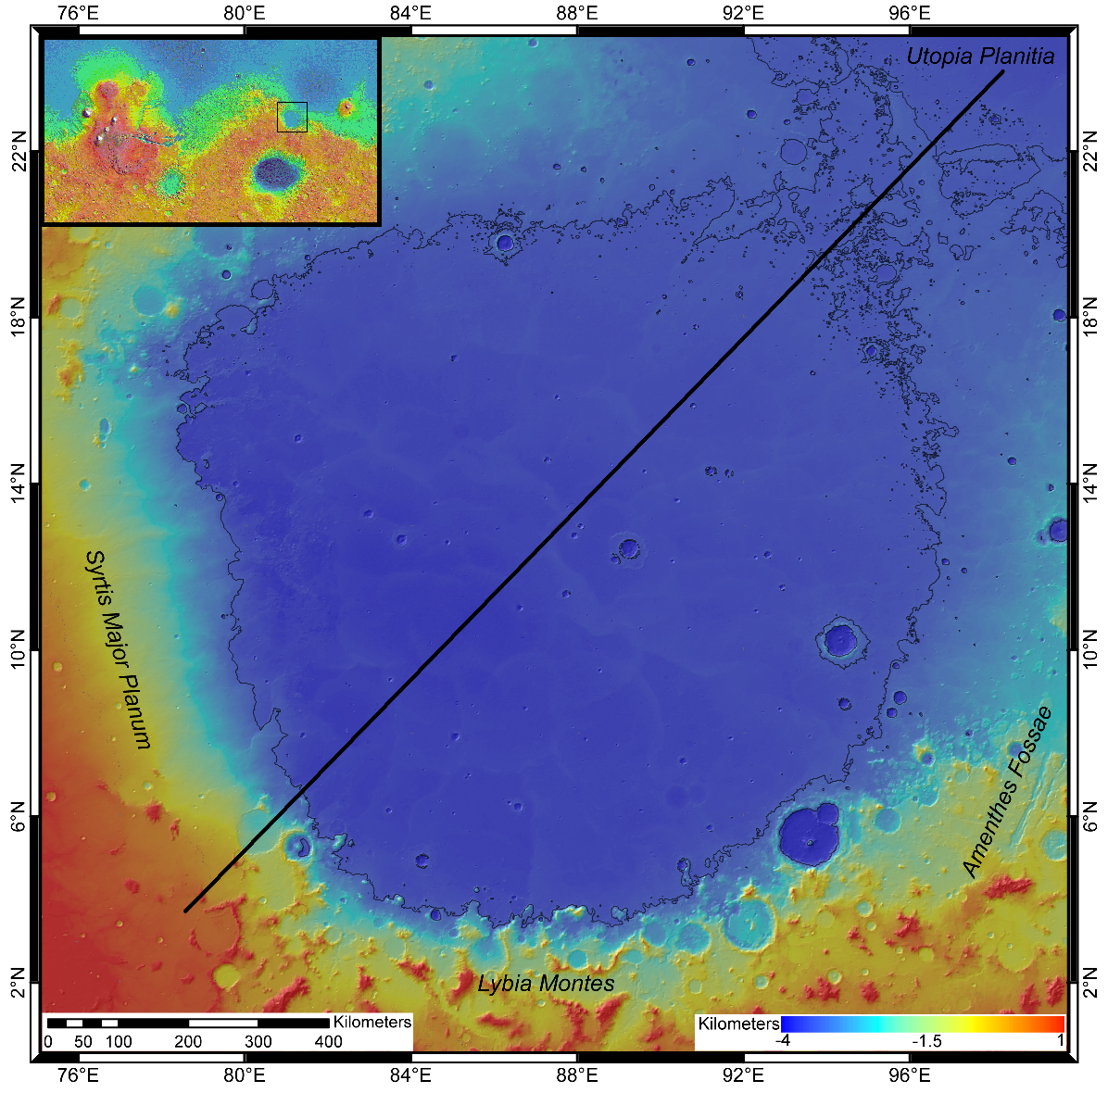
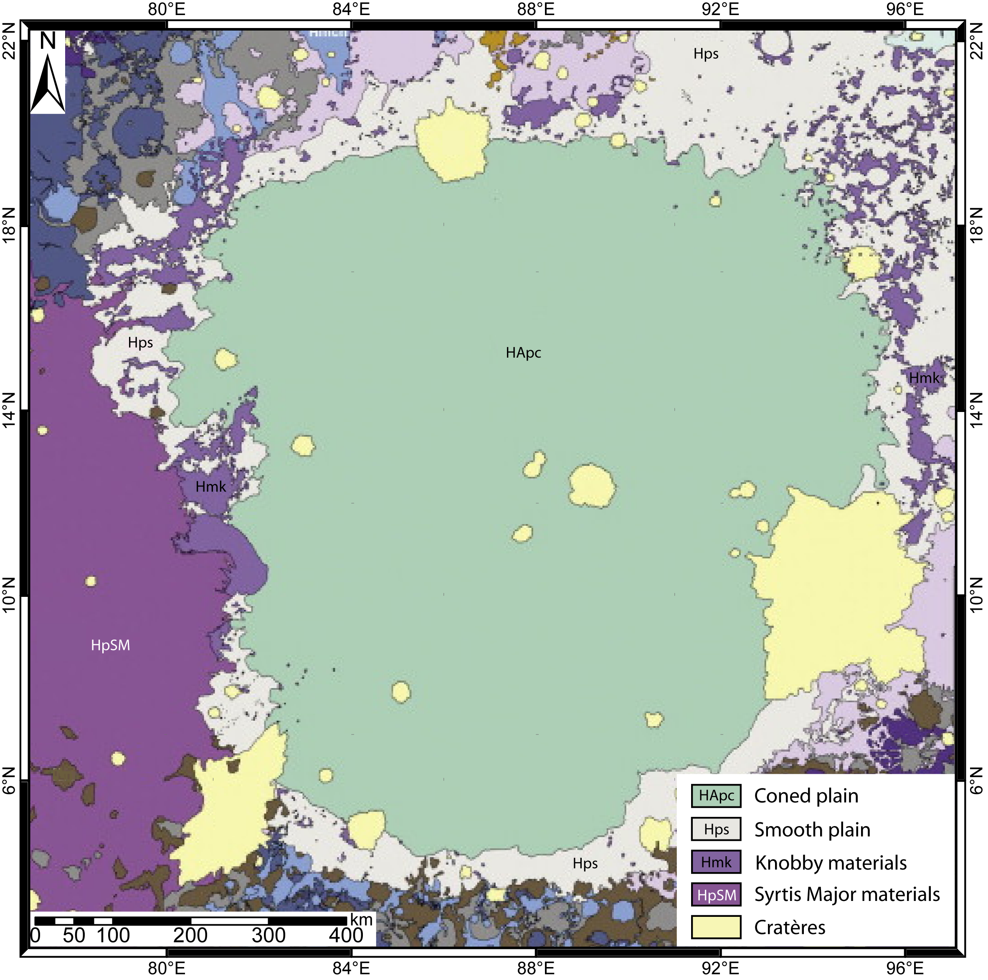
Ivanov et al (2012)

Slide 3
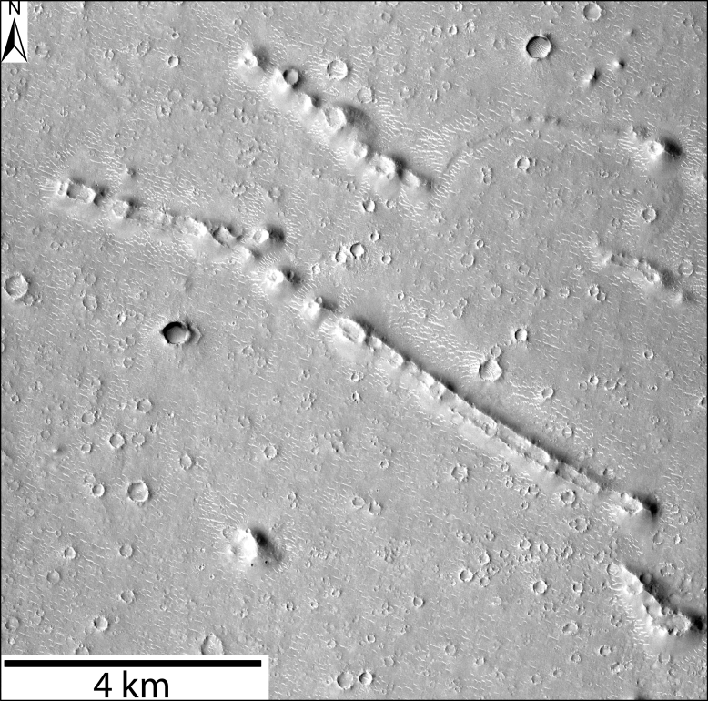
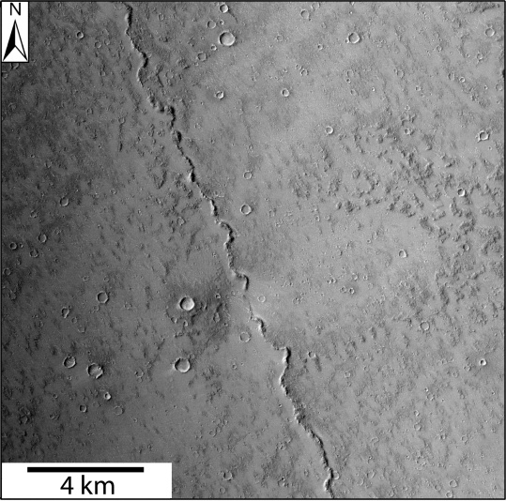
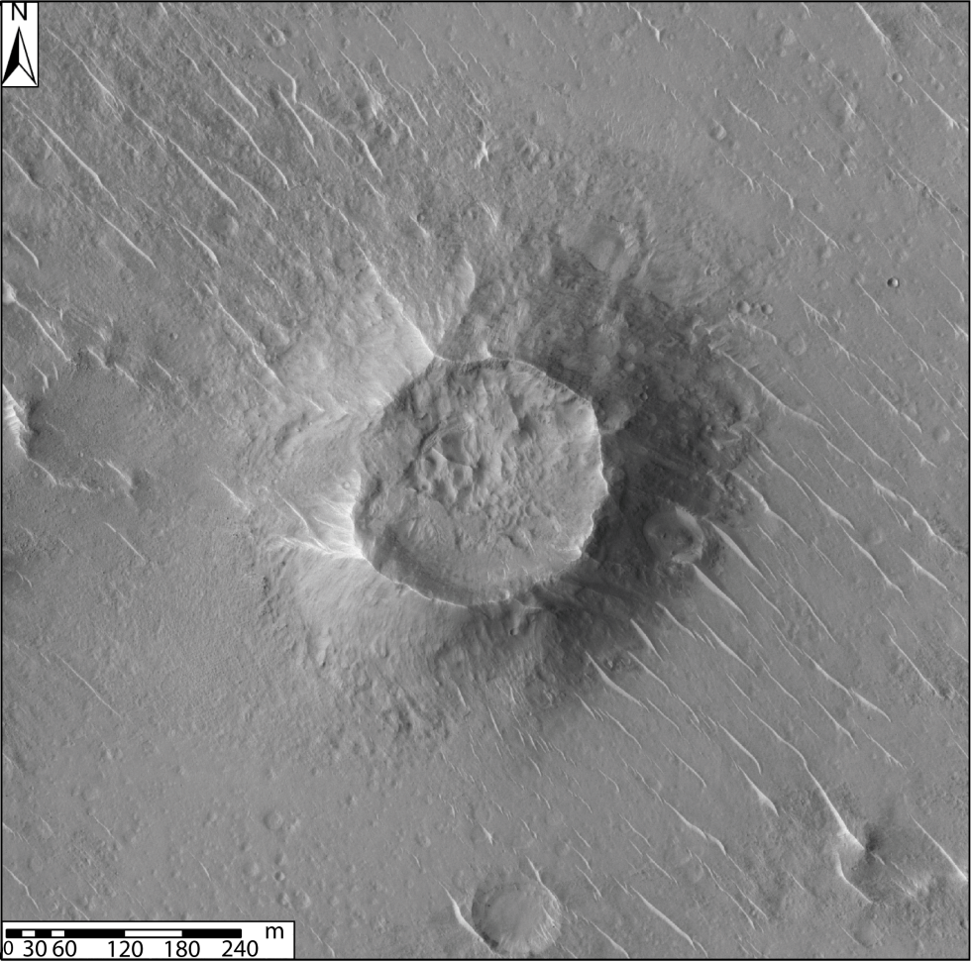
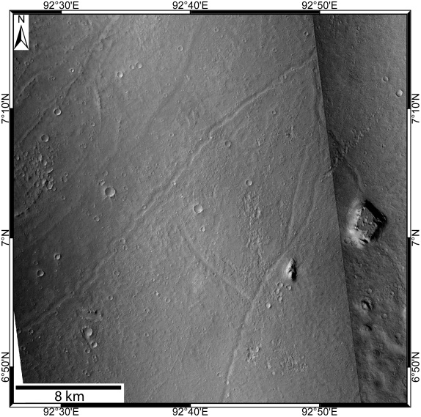
→ Aim - Determine what process has formed Isidis Planitia landforms.
→ How - Analysis of Isidis Planitia as a whole, including all different landforms:
- locally,
- globally (spatial organisation),
- inter-relationship.
→ Methods:
- High resolution mapping (CTX images – 6m/pixel),
- Comparison with terrestrial analogue,
- Cross analysis with models.

Slide 4
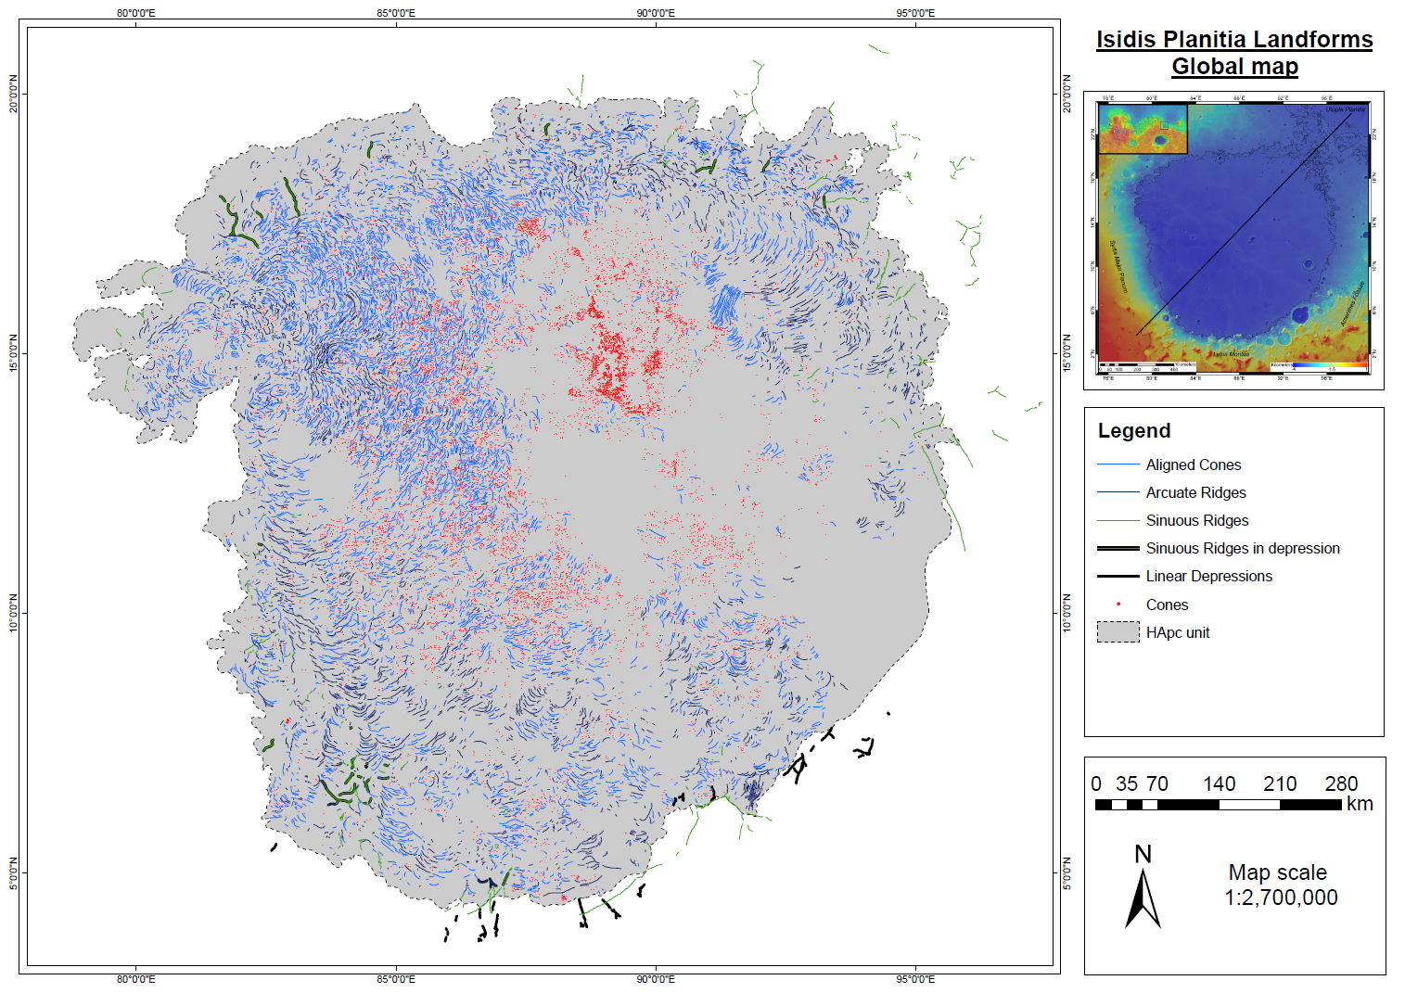

Slide 5
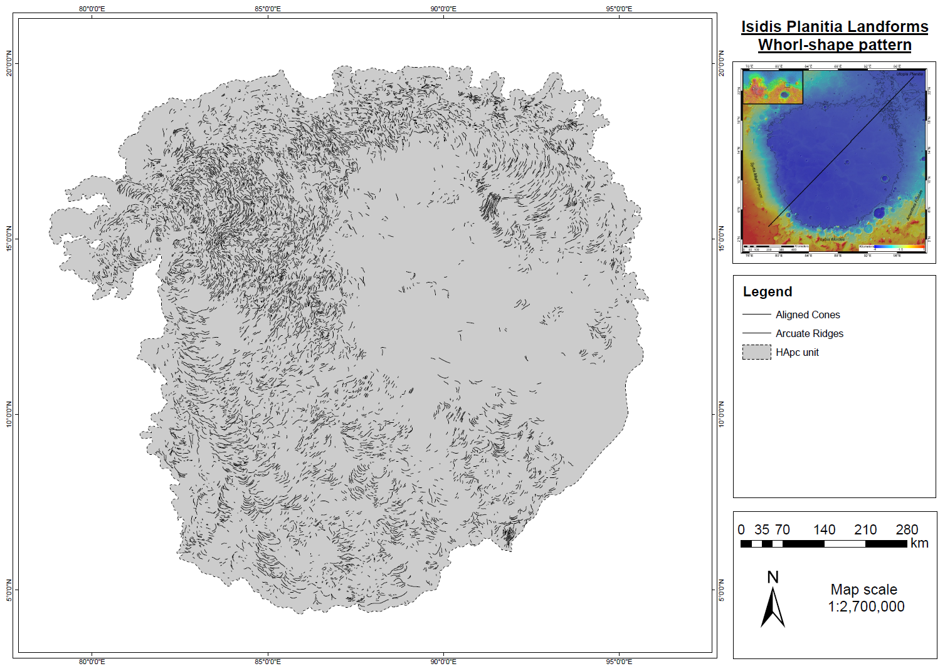

Slide 6
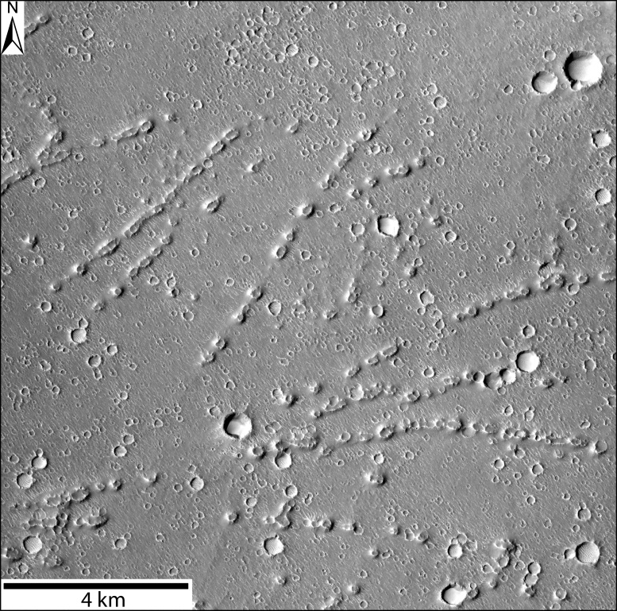
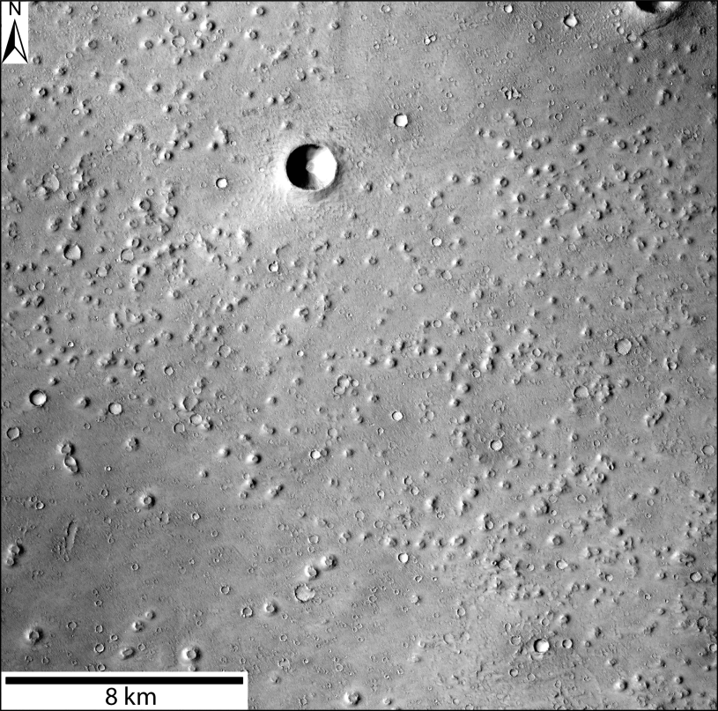
Organisation of cones
1 – Aligned Cones:
- create arcuate shape,
- extension of arcuate ridges,
- on HApc unit only.
2 – Cones not-organised:
- located between arcuate shapes,
- on HApc unit only.
3 – Field of cones:
- located in the center,
- dense organisation,
- on HApc unit only.

Slide 7
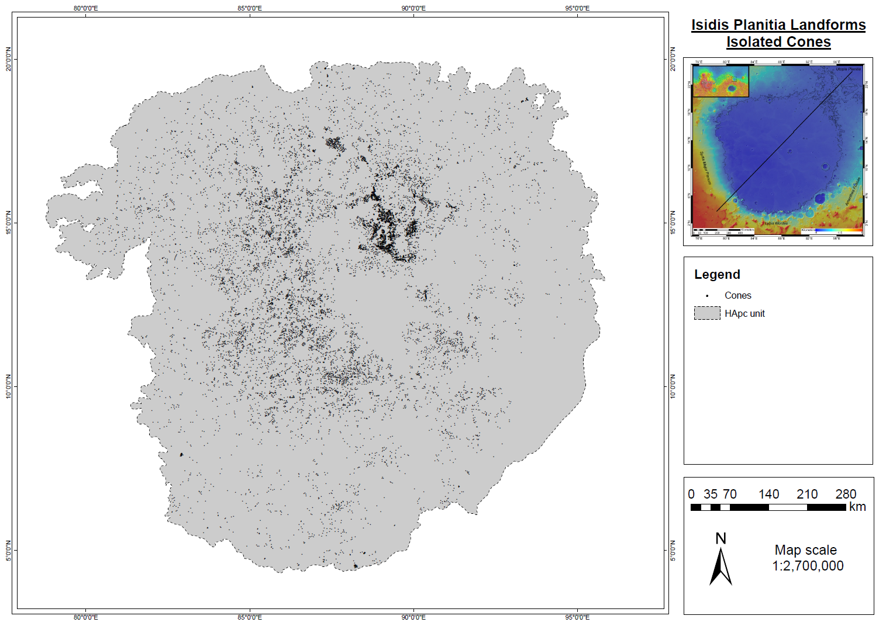
isolated
in field

Slide 8
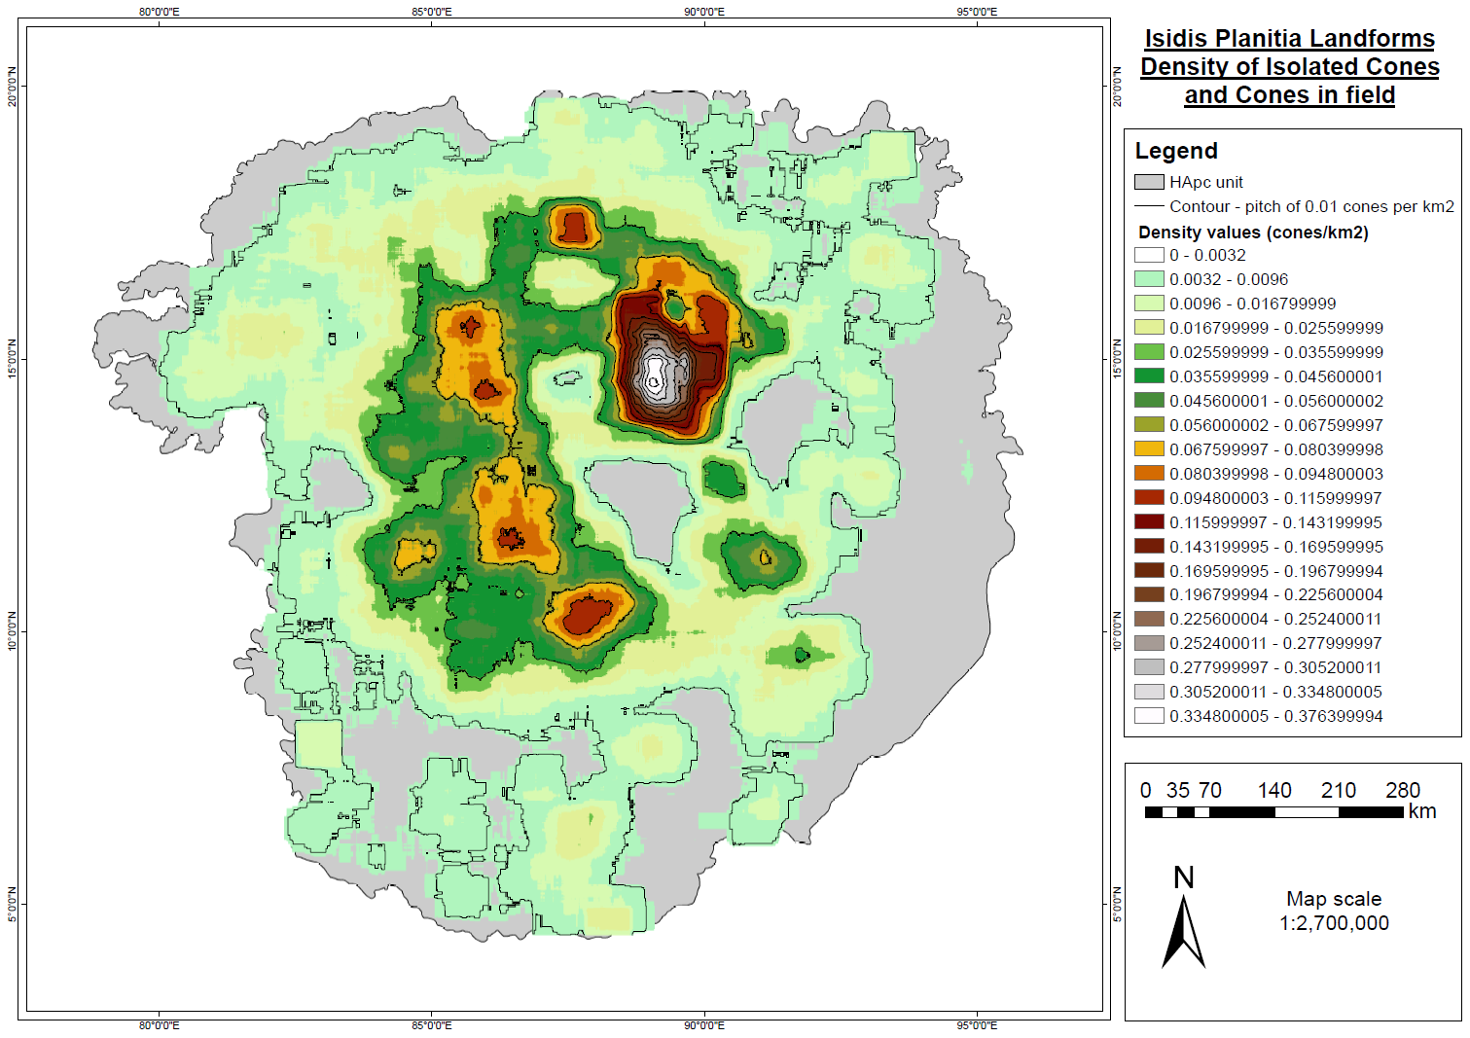

Slide 9
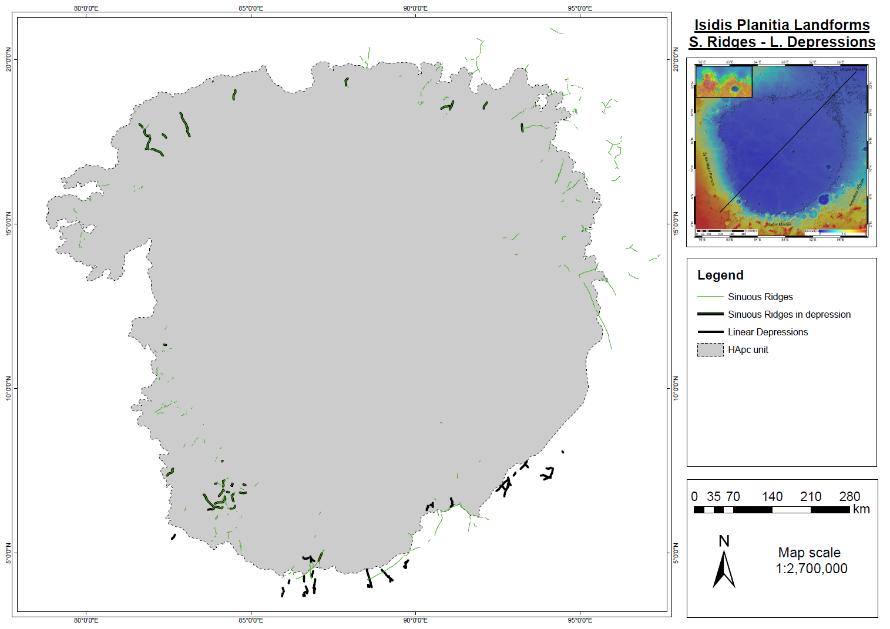

Slide 10
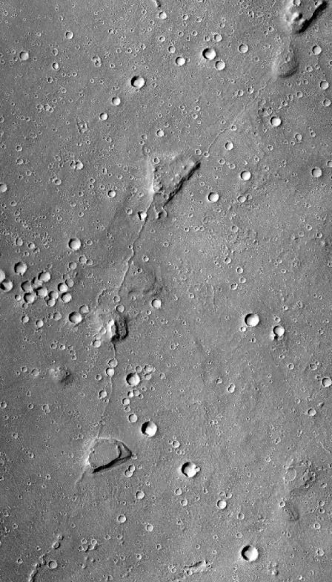
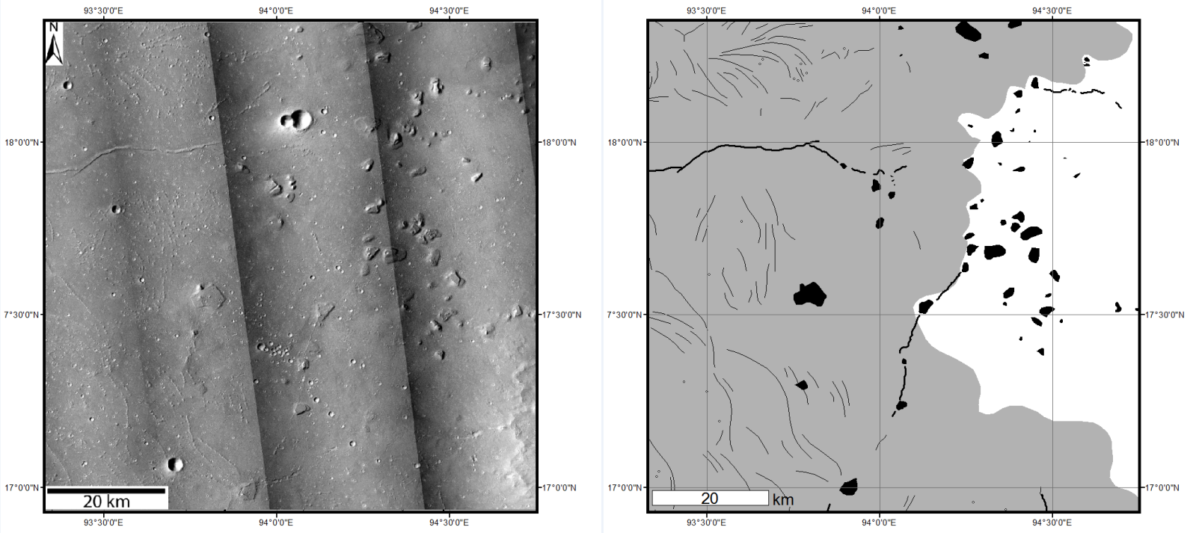

Slide 11
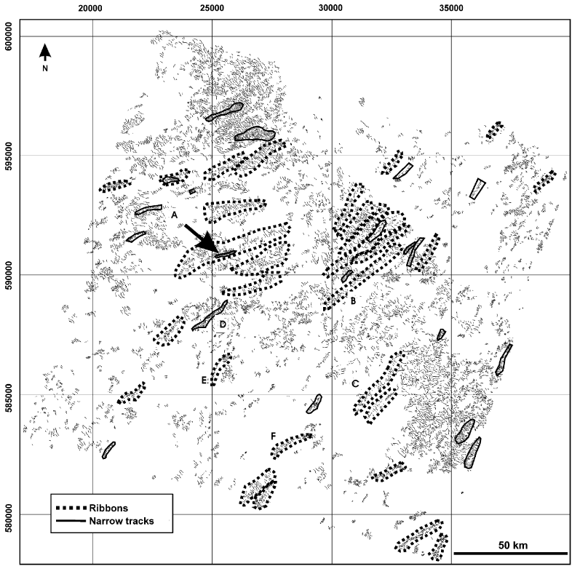
Similar spatial organisation:
form ribbons of arcuate shapes,
large field.
Similar form and scale:
arcuate down-slope shapes,
regular spacing,
similar dimension.
- Located on flat surfaces of deformable bed materials.
- Ribbed moraines = formed under warm-based ice sheet.
Dunlop and Clark (2006)

Slide 12
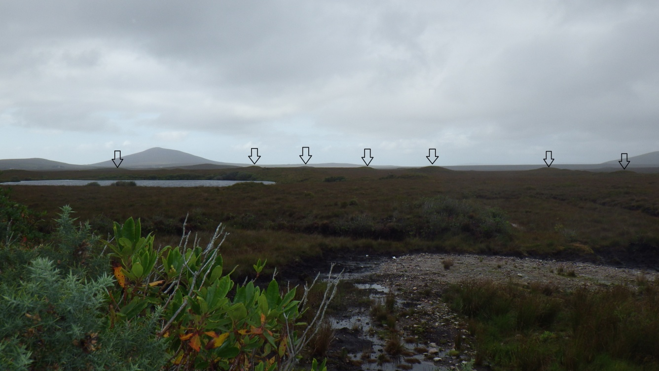
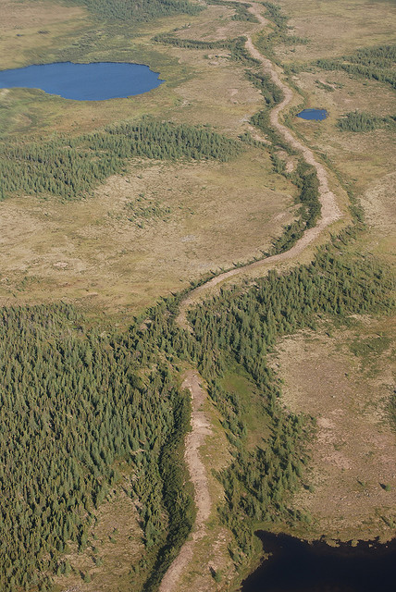
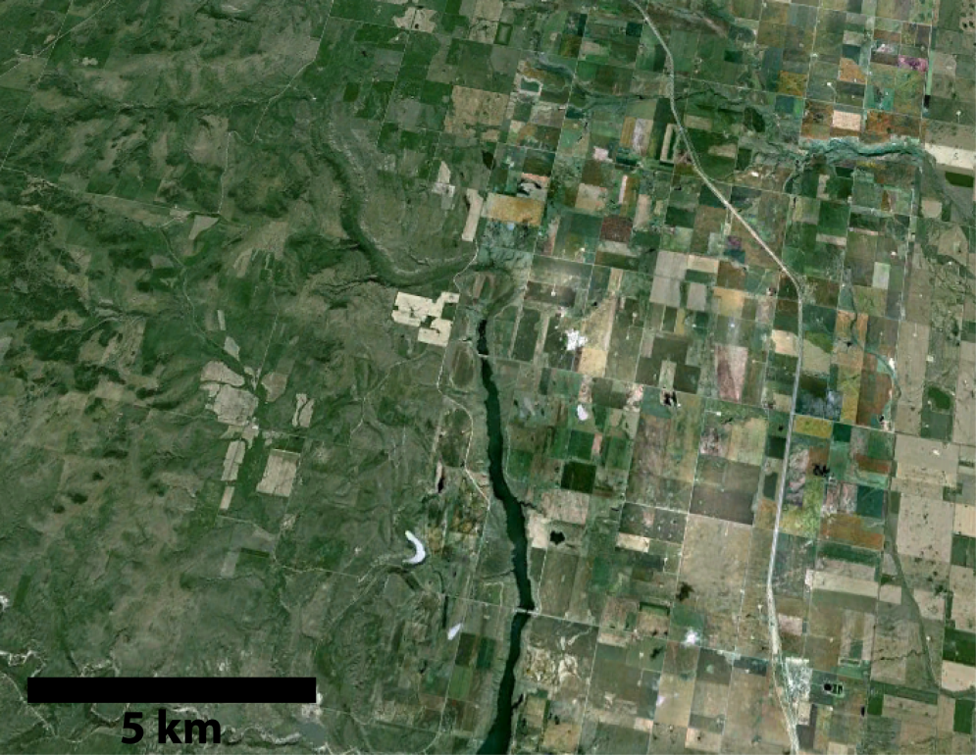
Kames in Co. Mayo, Ireland
Terrestrial Analogue
http://farm4.staticflickr.com/3303/3475078644_b1d5059f19_z.jpg
Nanton Tunnel Valley, Alberta, Canada (Google Earth)

Slide 13
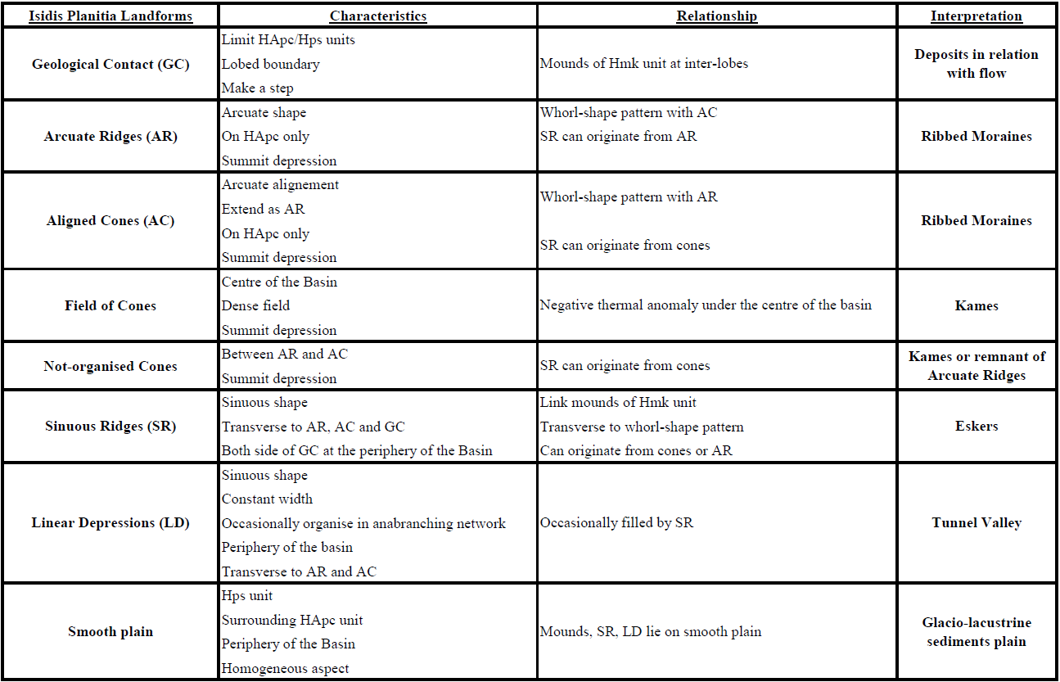
Interpretation of Isidis Planitia landforms

Slide 14
Interpretation of Isidis Planitia landforms
Kettle holes

Slide 16
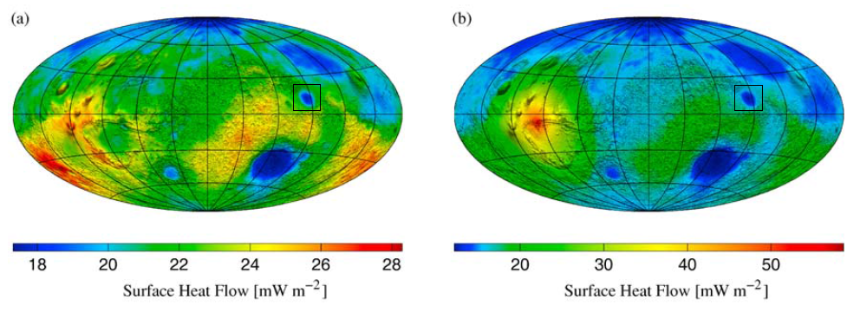
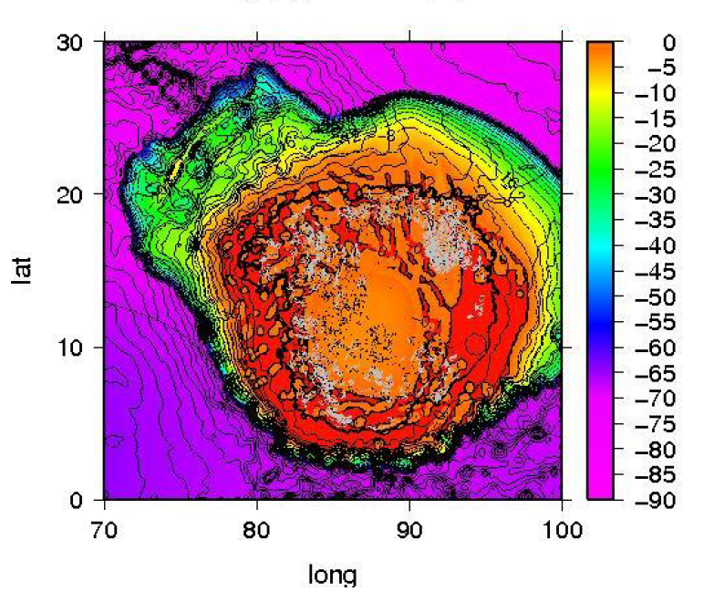
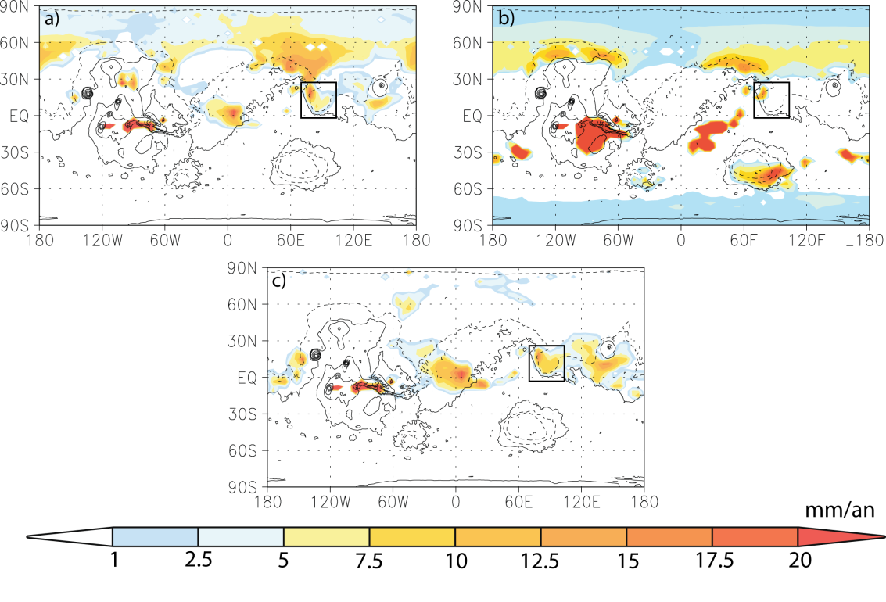
→ How can we explain the lack of Arcuate Shape in the center?
Grott and Breuer (2010)
→ How can we explain near-equator warm-based glaciation on Mars?
Madeleine et al (2009)
Soucek et al
Ice accumulation over a year for different obliquity.
Ice sheet basal temperatures.

Slide 17
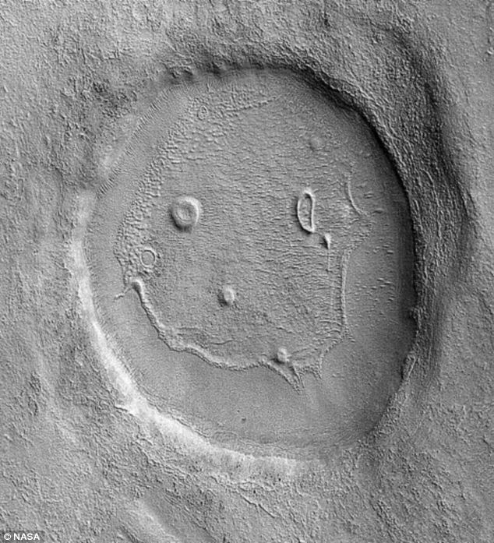
Thank you!

