Slide 1
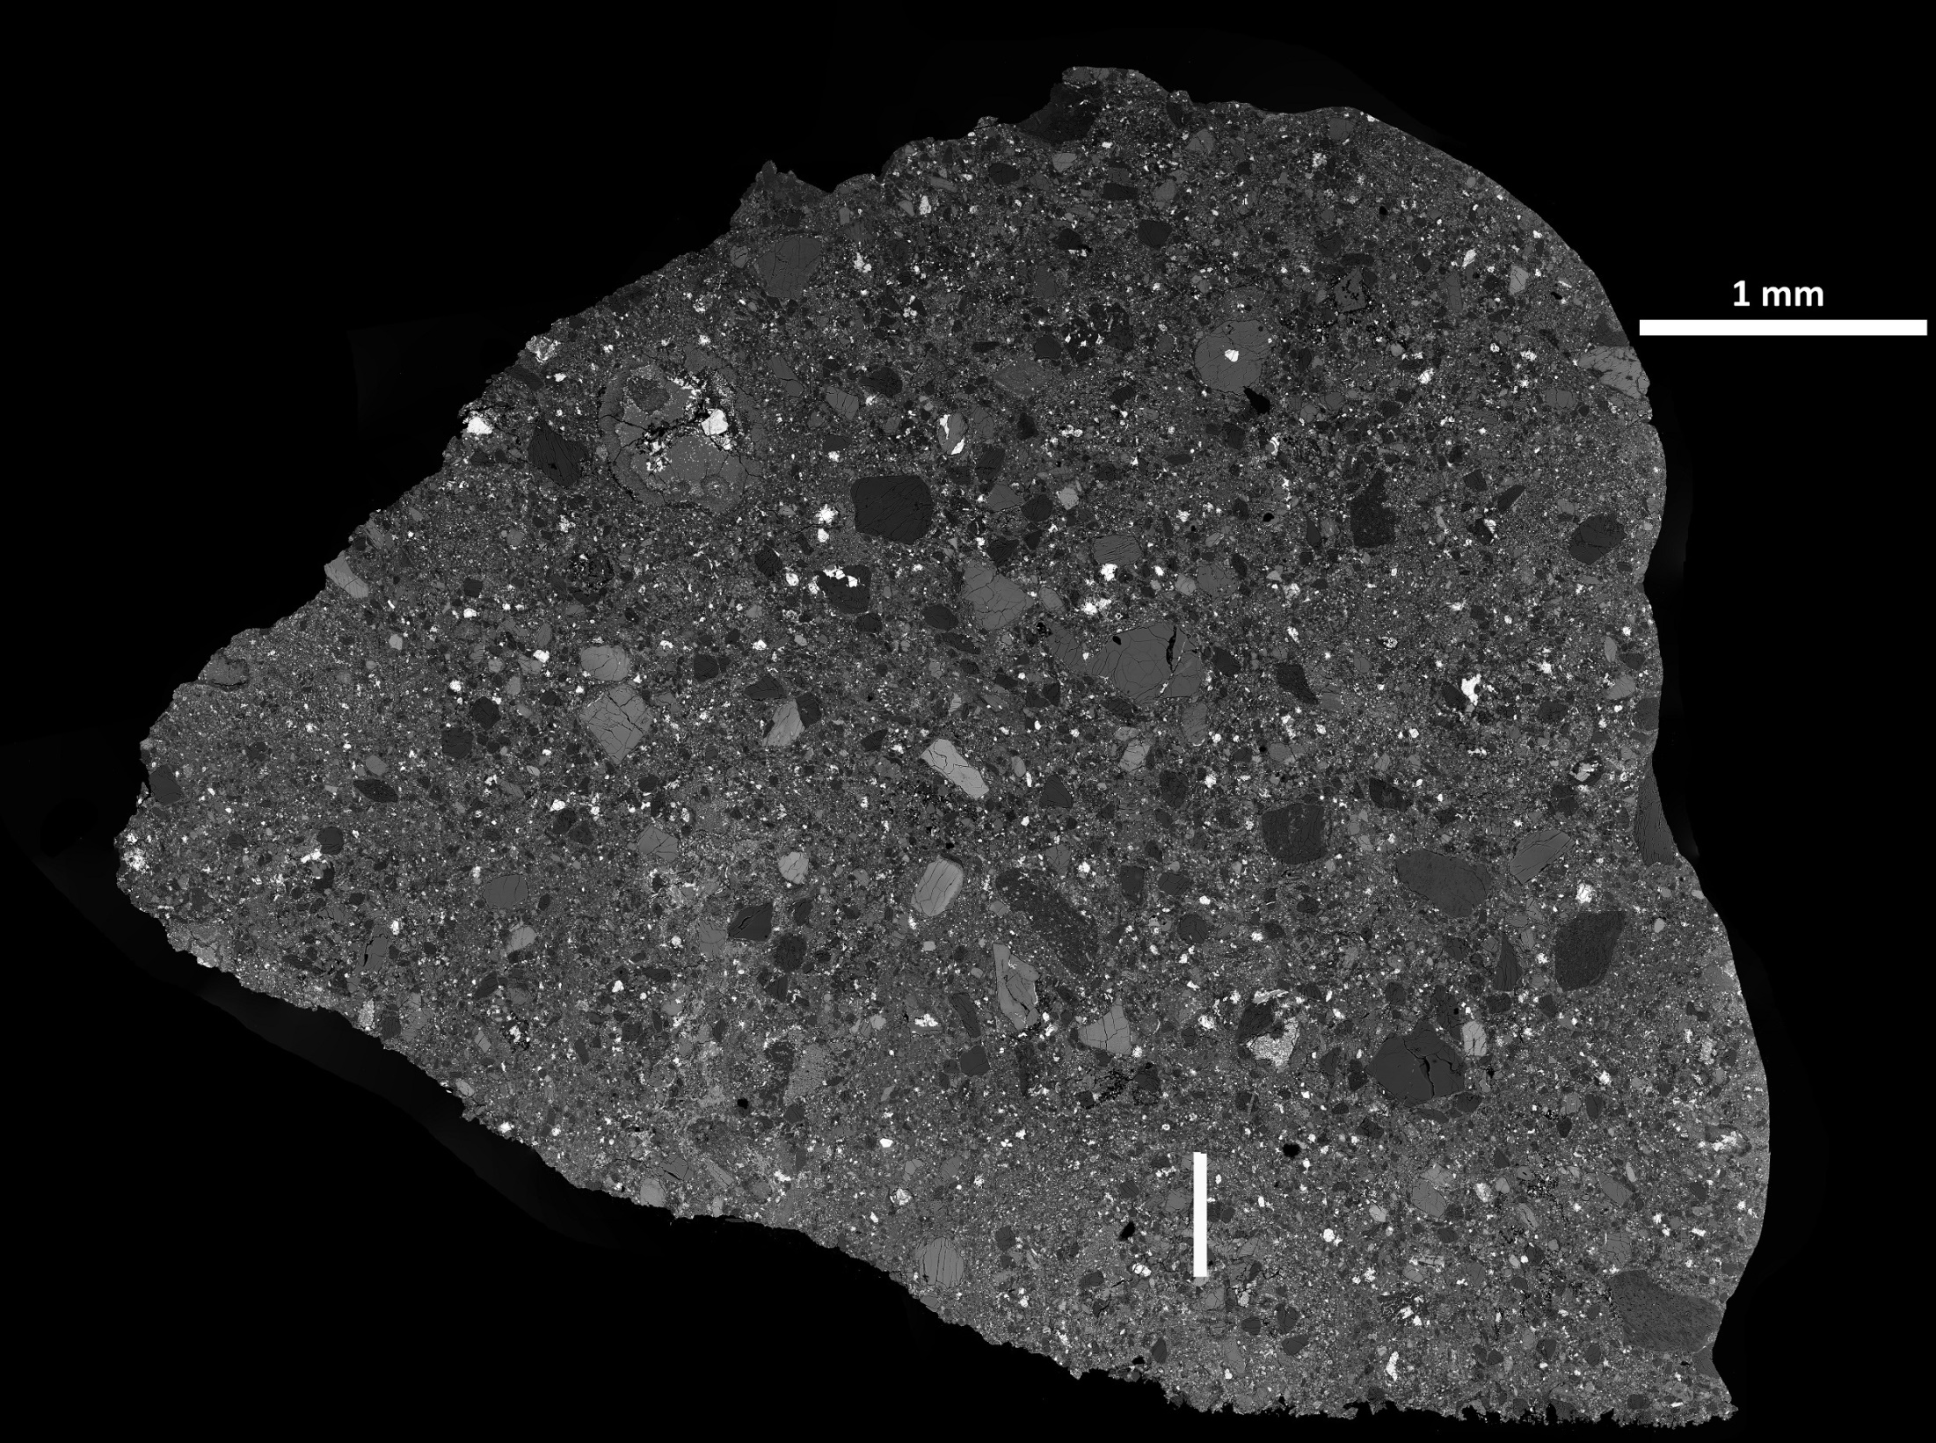

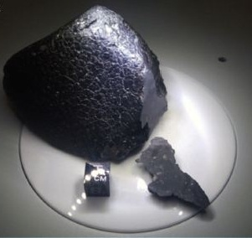
Clast classification in Martian meteorite NWA7034 / NWA8114
Image: L. Hicks
Agee et al. (2013)
J. L. MacArthur¹ and J. C. Bridges²
1. Dept. of Physics & Astronomy, University College London
2. Space Research Centre, University of Leicester
Notes:
Known as ‘Black Beauty’, this meteorite has generated significant attention in the popular media.

Slide 2
NWA7034 / NWA8114
131 achondrite SNC meteorites (Meteoritical Bulletin Database, as at 1st Jun)
NWA7034 was the first martian meteorite to be classified as a basaltic breccia (Agee et al, 2013)
NWA8114 (1.9g) has been classified and established as a pair of NWA7034 (Bridges, 2013)
Three others are established as pairs of NWA7034
Paired meteorite NWA7533: contains 4.4Ga zircons
(Humayan 2013)
Martian Meteorite | No. | Age (Ga) | Characteristics
Shergottite | 107 | 0.16-0.48 | Lherzolitic, basaltic
Nakhlite | 14 | 1.3 | Clinopyroxenite cumulates
Chassignite | 2 | 1.35 | Dunite cumulate, 90% olivine
OPX | 1 | 4.5 | ALH84001 Noachian crust
Augite basalt | 1 | ? | Olivine-bearing with magnetite, NWA8159
Basaltic breccia | 5 | 2.09 | Early Amazonian
MPSE
3rd June 2014
Notes:
Think this means Martian crust formed at the same time as Earth & Moon, also estimate of average crust thickness at 50km agrees with geophysical estimates

Slide 3
The story so far
Agee et al (2013a) “Unique Meteorite from Early Amazonian Mars: Water-Rich Basaltic Breccia NWA7034”
  First sample from early Amazonian: 2.089 ± 0.081 Ga
  REE-enriched with an alkaline, differentiated component
  Compositionally similar to basalts and average Martian crust measured by recent Rover and Orbiter missions
  Order of magnitude more water than most SNC meteorites
Agee et al. (2013b): most oxidized martian meteorite
Santos et al. (2013a) categorised clasts as phosphate, gabbroic, or melted.
Cartwright et al., (2013): CRE 5.1Ma, 11.4Ma, 5.4Ma
MPSE
3rd June 2014
Notes:
Oyxgen fugacity

Slide 4
Characterising NWA8114
By characterising clast composition and looking at possible thermodynamic models we hope to constrain possible formation theories eg volcanic or impact
Some clasts have been sent to the University of Manchester for radiometric Argon dating
Agee et al. (2013): found no outlier compositions to suggest more than one petrologic origin. Could be:
  Volcanic in origin, as fine groundmass with large phenocrysts of feldspar and pyroxene, or
  Impact breccia, one quench melt clast identified
Santos et al. (2013b) found two alkaline feldspar clasts, trachyandesitic and mugearitic, suggesting greater diversity
MPSE
3rd June 2014
Notes:
Most similar to martian crust. Agee: Found one quench melt clast which could be from shock processes – we have found one clast with possible in-situ melting – but imapct event likely to have ejected it from Mars anyway
Only meteorite dated between 4.5Ga and1.35Ga.

Slide 5
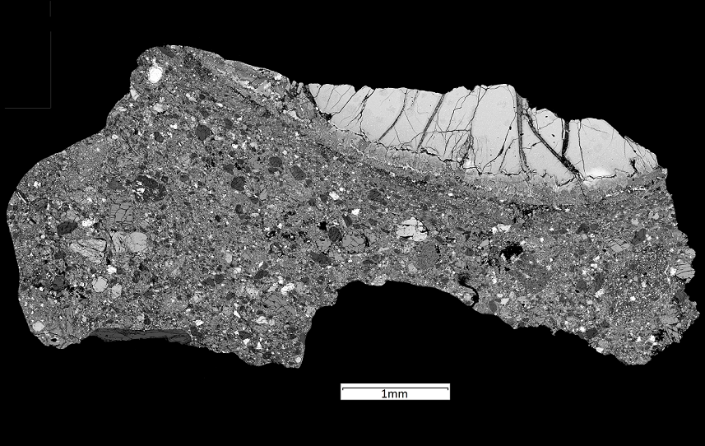
Preliminary analysis: NWA8114
3 polished sections from NWA8114 were examined using a XL30 ESEM and a Hitachi S-3600N Environmental SEM
High resolution backscatter electron images were obtained and composition was investigated using energy-dispersive X-ray spectroscopy (EDX).
MPSE
3rd June 2014
Notes:
Turn scale bar right way up

Slide 6
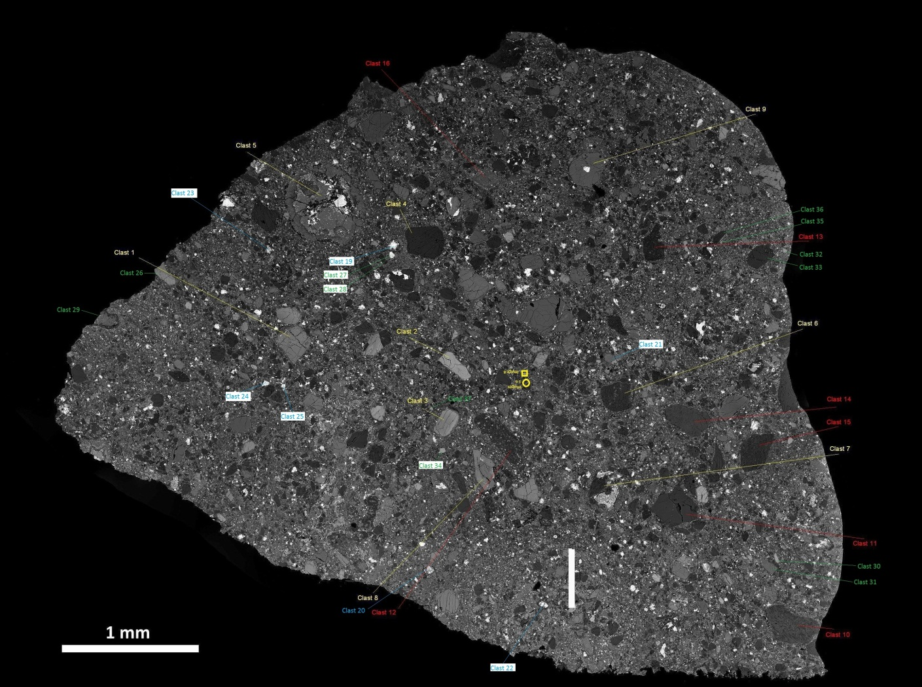
Preliminary analysis: NWA8114
Image:
L. Hicks
MPSE
3rd June 2014
Notes:
Turn scale bar right way up

Slide 7
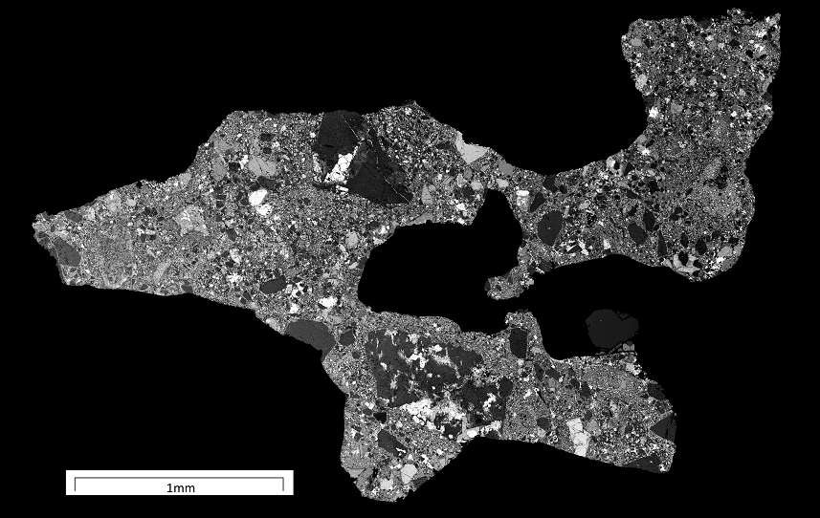
Preliminary analysis: NWA8114
MPSE
3rd June 2014
Notes:
Turn scale bar right way up

Slide 8
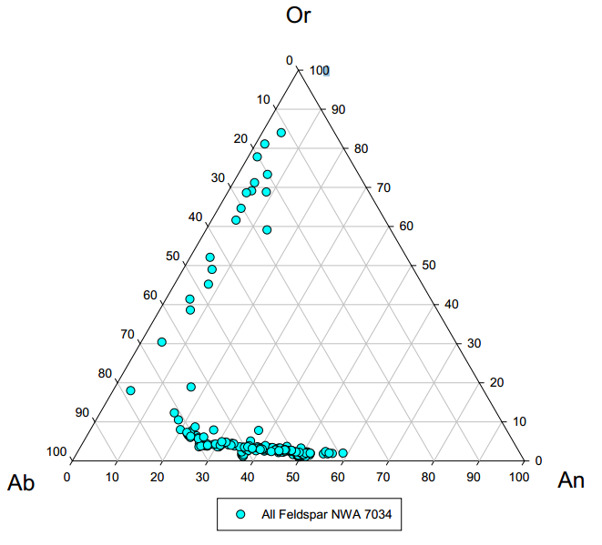
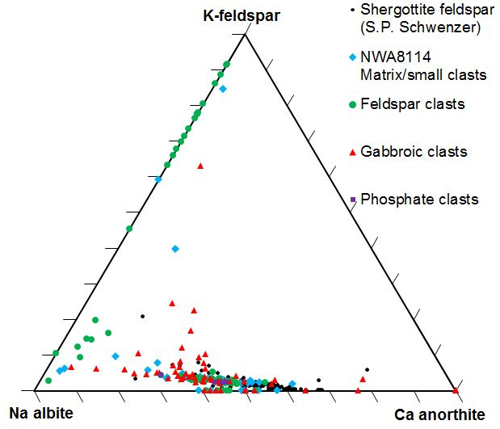
Feldspar ternary
1200°C
800°C
1000°C
400°C
Agee et al. (2013)
MPSE
3rd June 2014
Notes:
Feldspar compositions broader than shergottites, but matches Chassigny (per Agee) (could indicate diff colour on my plot from database if time)
Low temp alkaline igneous

Slide 9
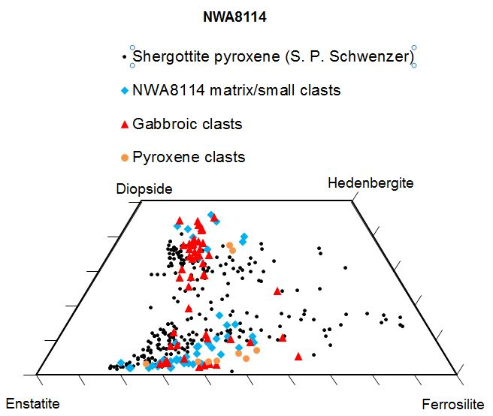
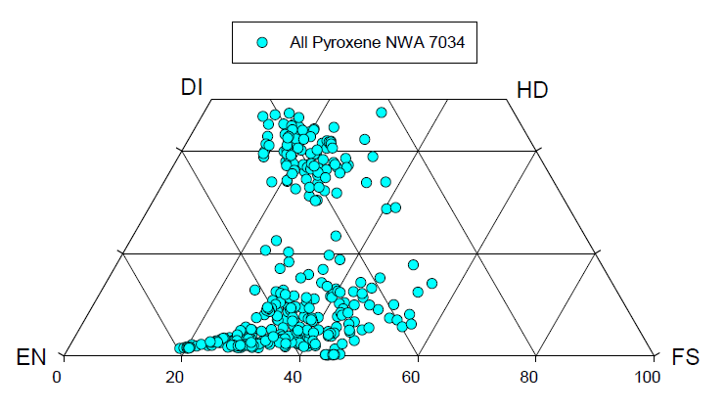
Pyroxene quadrilateral
Agee et al. (2013) noted the two main clusters:
High-Ca augitic
Low-Ca orthopyroxene, becoming pigeonite with more ferrosilite
Agee et al. (2013)
MPSE
3rd June 2014
Notes:
Looked to see if certain Px’s were specific to certain clast types

Slide 10
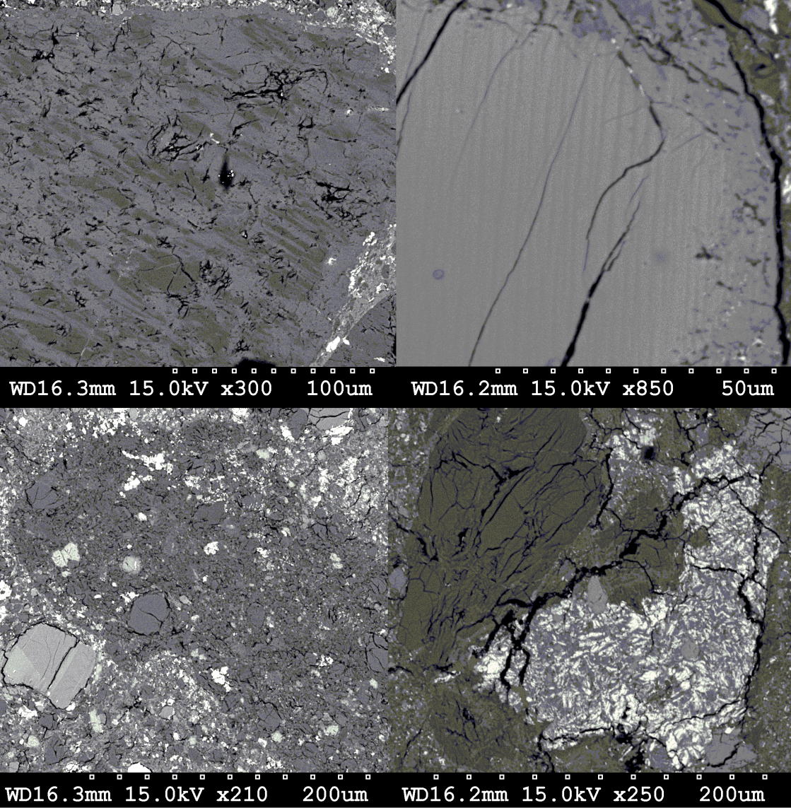
Clasts identified
MPSE
3rd June 2014

Slide 11
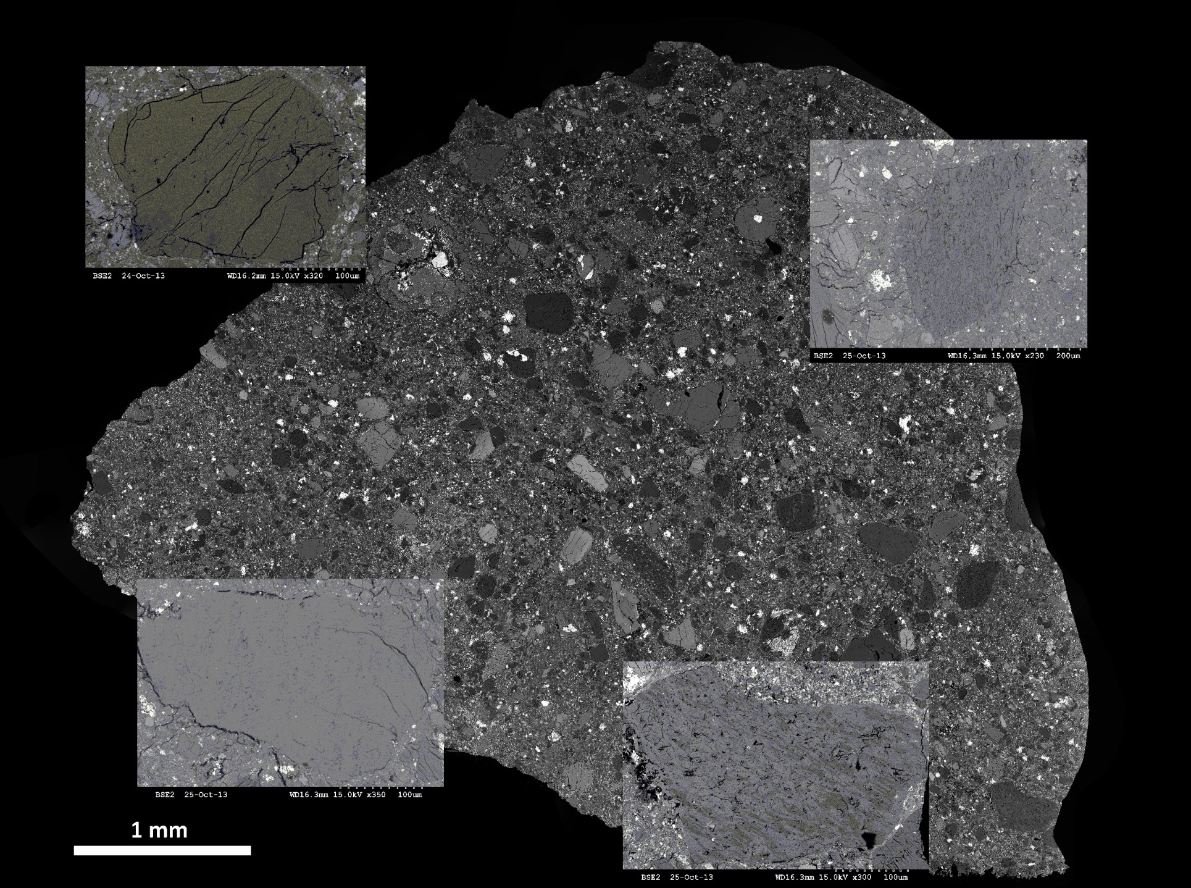
Feldspar Clasts
MPSE
3rd June 2014
Notes:
Redo if time

Slide 12
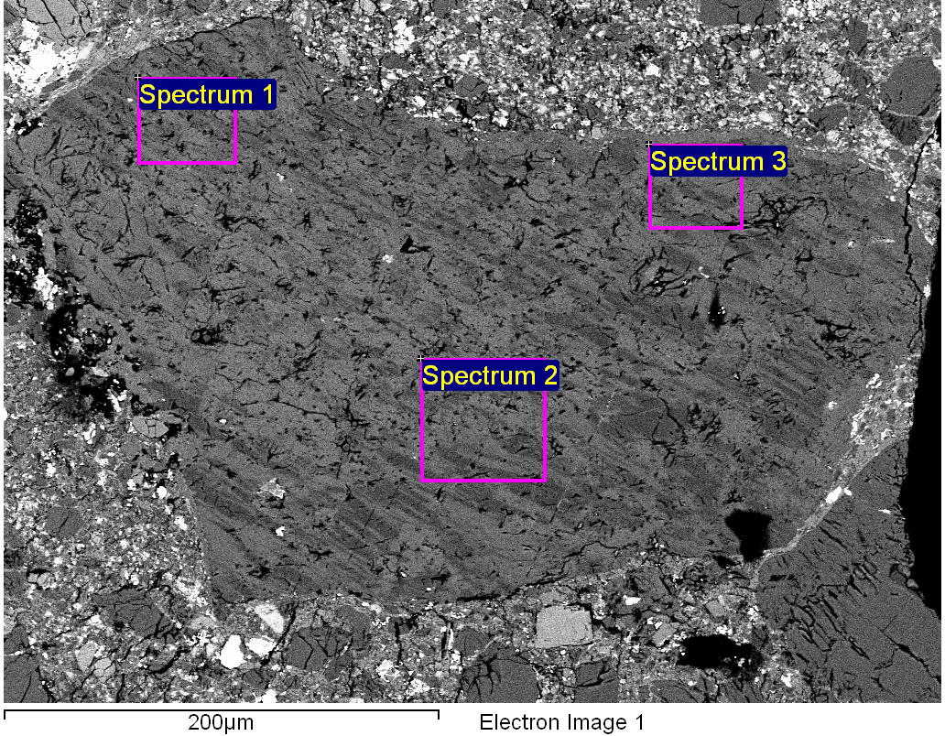
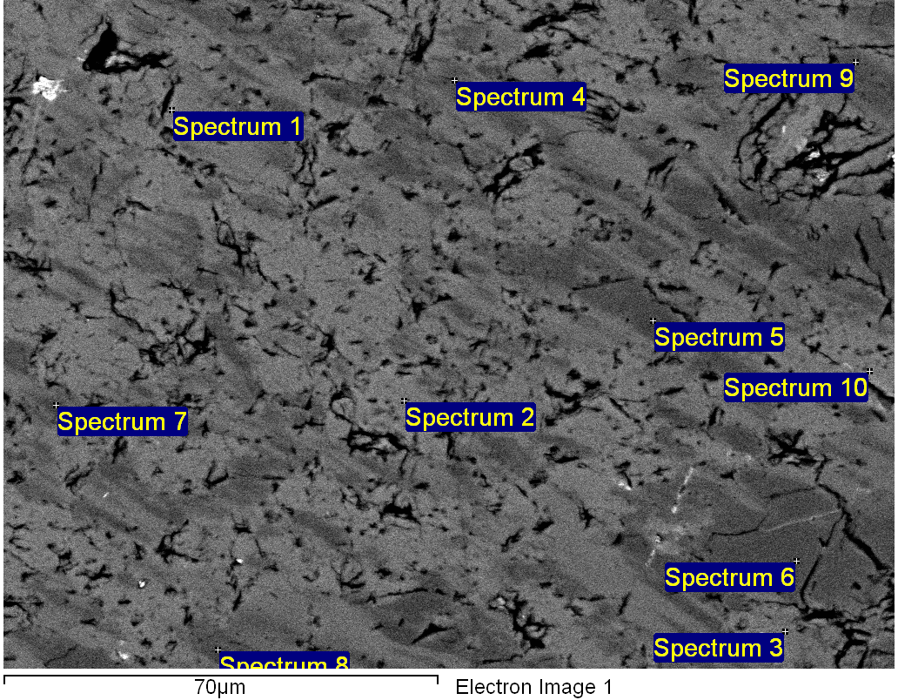
Feldspar Clast
Example clast analysis:
  1) Take bulk composition area spectra at different points in clast
  2) Use higher magnification to take specific point spectra
Spectra shows more K than Na
1
2
Atomic weight %
Spectrum | Na | Al | Si | K | O
Spectrum 1 | 2.6 | 7.4 | 23.4 | 5.0 | 61.7
Spectrum 2 | 2.7 | 7.6 | 23.3 | 4.7 | 61.7
Spectrum 3 | 2.5 | 7.7 | 23.1 | 5.2 | 61.6
MPSE
3rd June 2014
Notes:
Cryptoperthite intergrowth: sanidine (K-spar) & albite. Cooled slowly, >70% one or other.

Slide 13
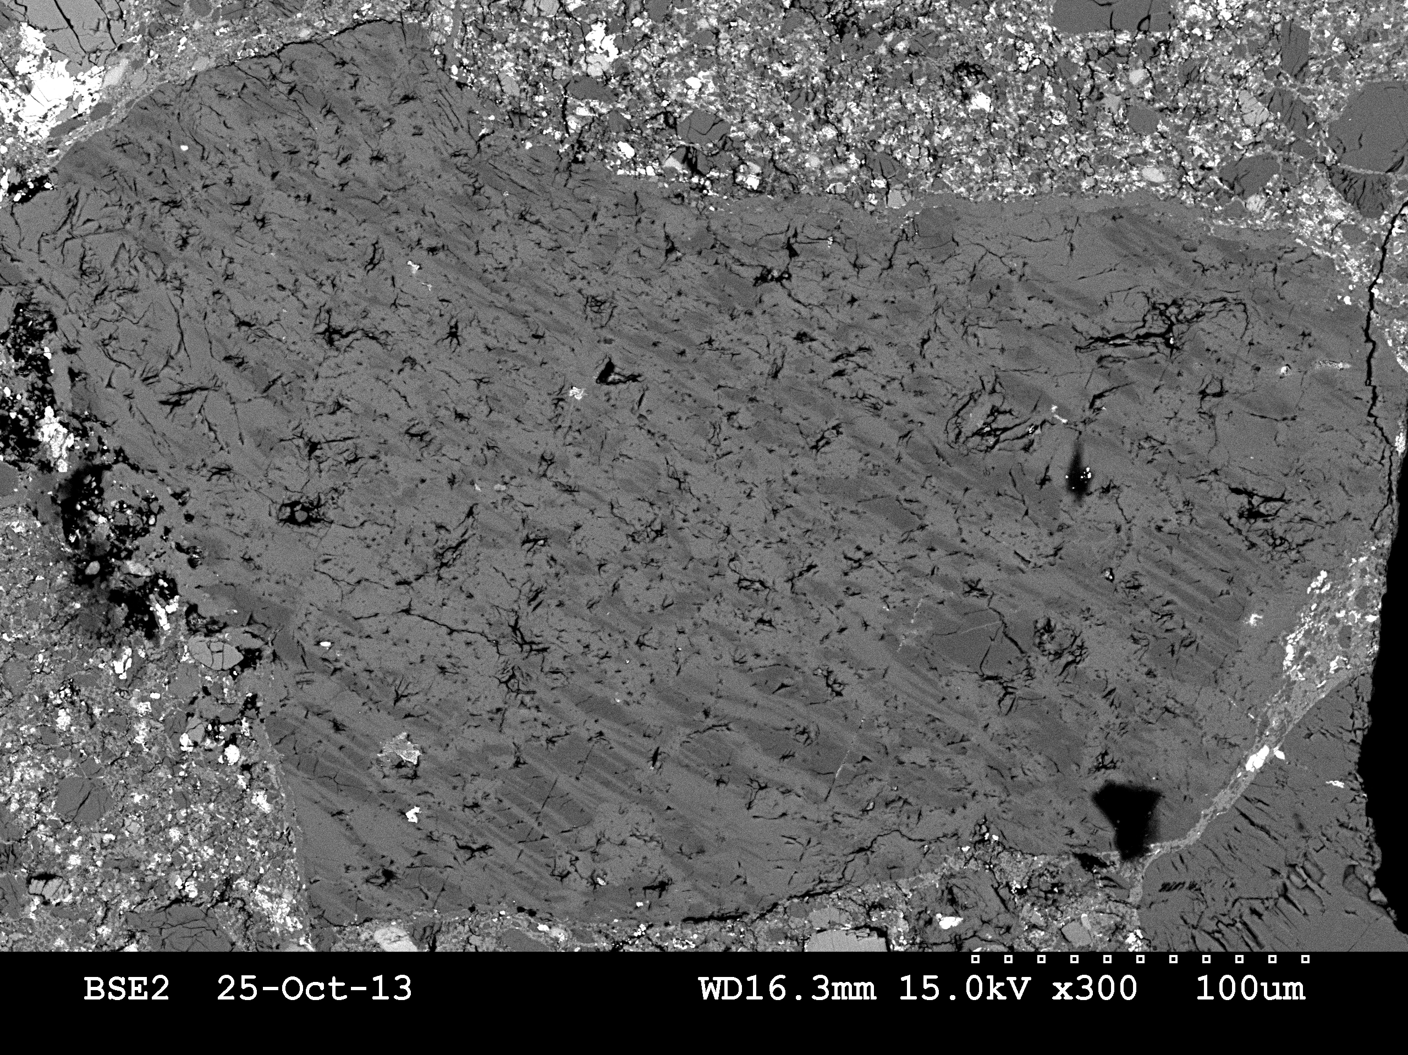
Feldspar Clast
albite
sanidine
MPSE
3rd June 2014
Notes:
Cryptoperthite intergrowth: sanidine (K-spar) & albite. Cooled slowly, >70% one or other.

Slide 14
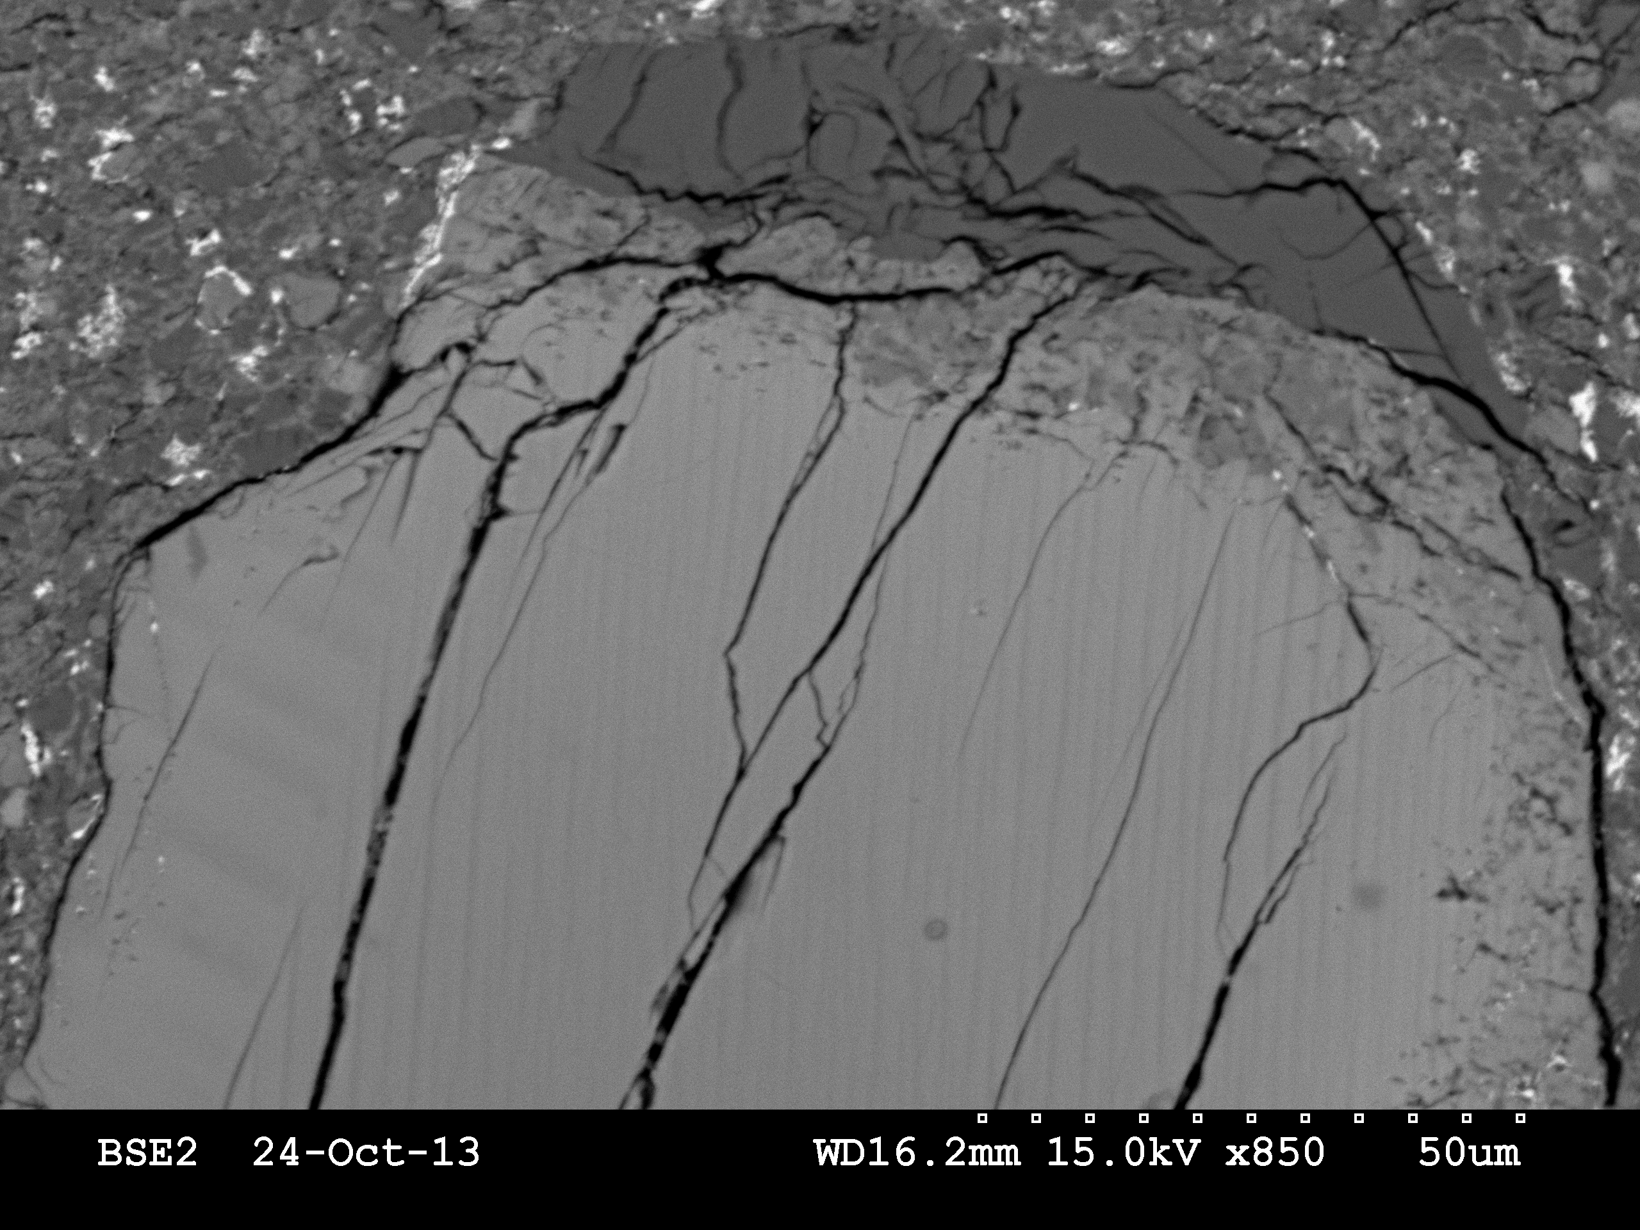
Pyroxene clast
Albite₅₈₋₆₀
pyroxene
En₃₆₋₄₄Fs₄₆₋₅₃Wo₉₋₁₁
MPSE
3rd June 2014

Slide 15
Pyroxene clasts
MPSE
3rd June 2014

Slide 16
Pyroxene clasts
MPSE
3rd June 2014

Slide 17
Pyroxene clasts
MPSE
3rd June 2014

Slide 18
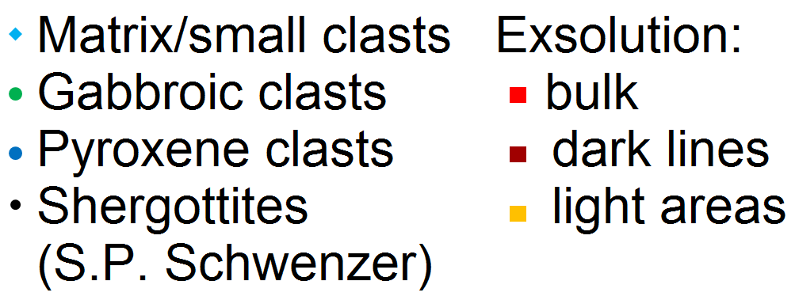
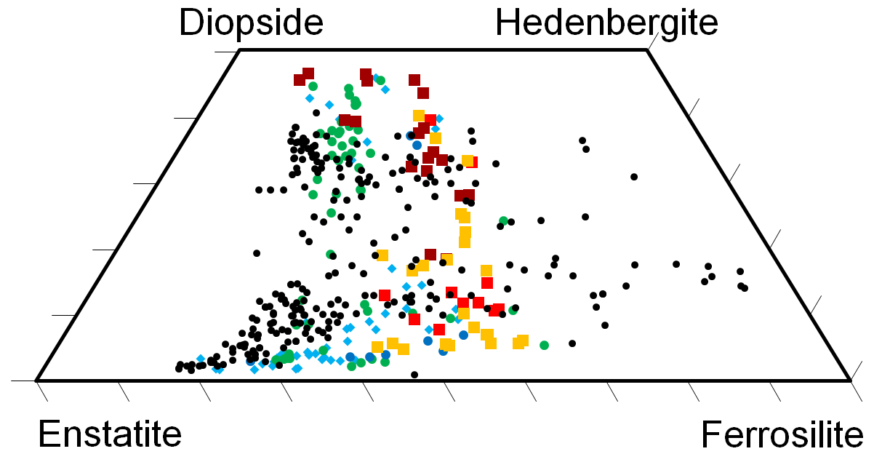
Exsolution composition
MPSE
3rd June 2014
Notes:
Iron rich pigeonite

Slide 19
Iron oxide clast
MPSE
3rd June 2014

Slide 20
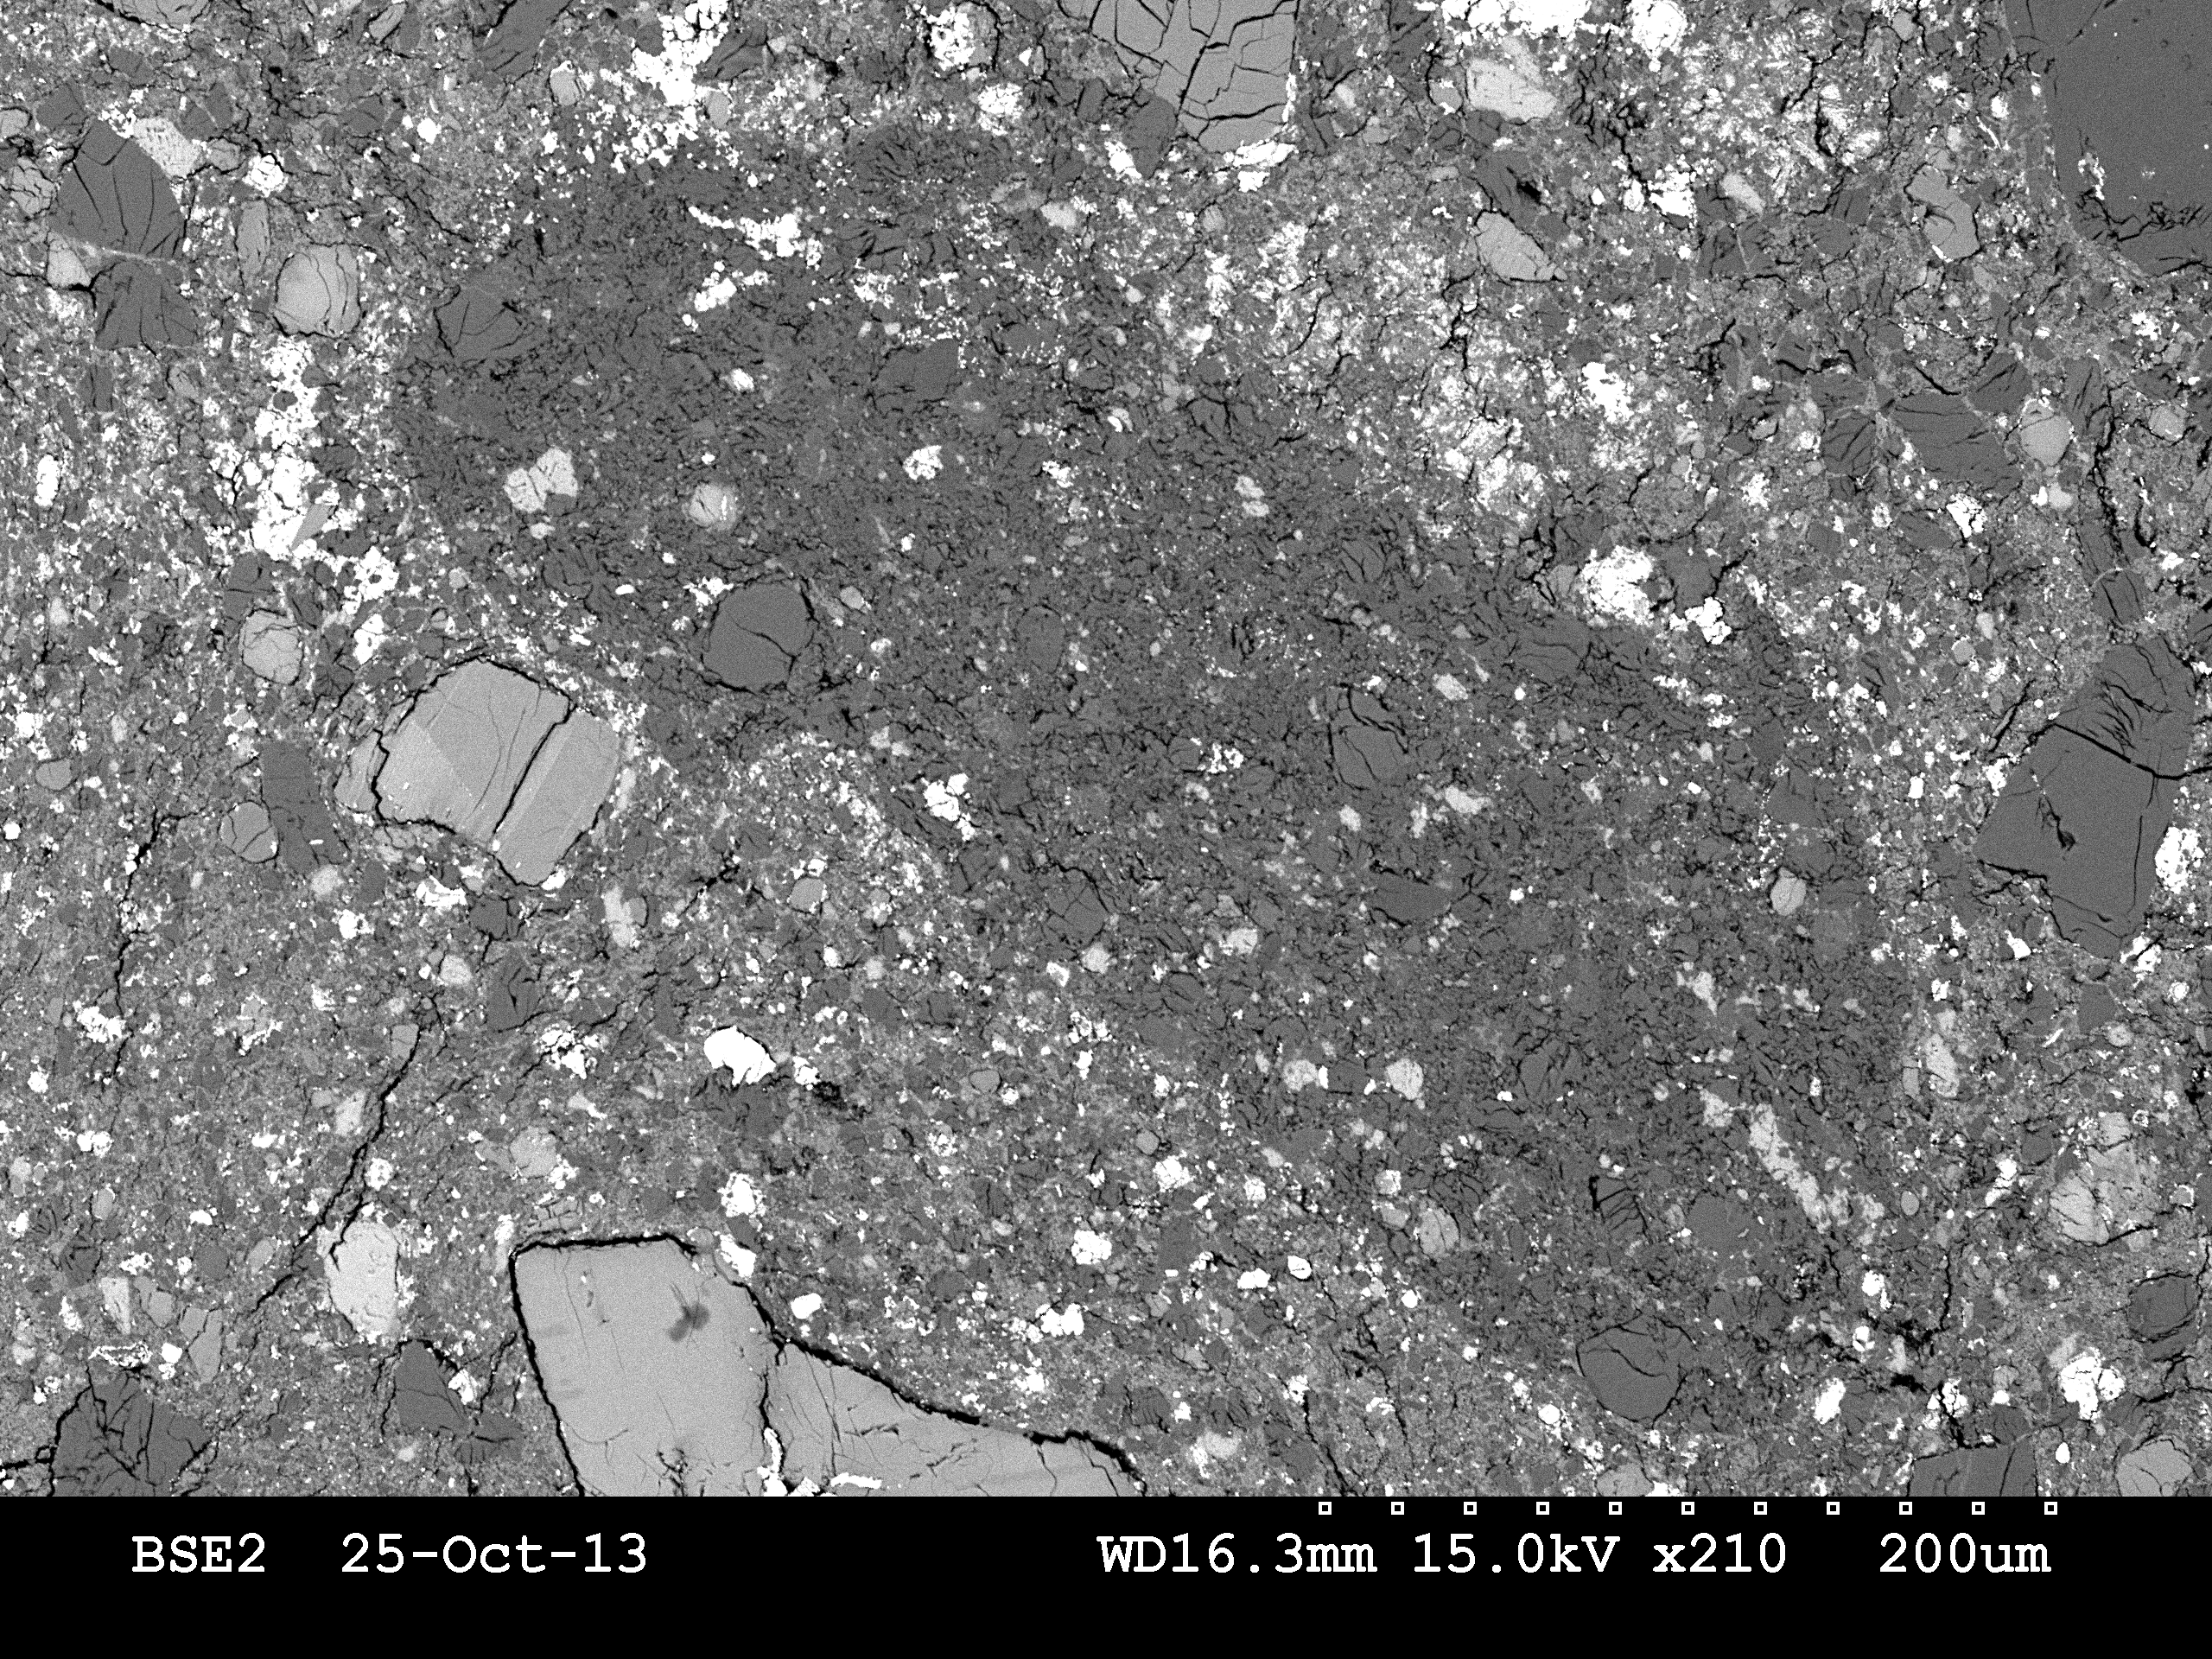
“Gabbroic” Clast
An₂₀₋₄₅
alkali-feldspar
low-Ca pyroxene En₅₅₋₇₀
Cl-apatite.
MPSE
3rd June 2014

Slide 21
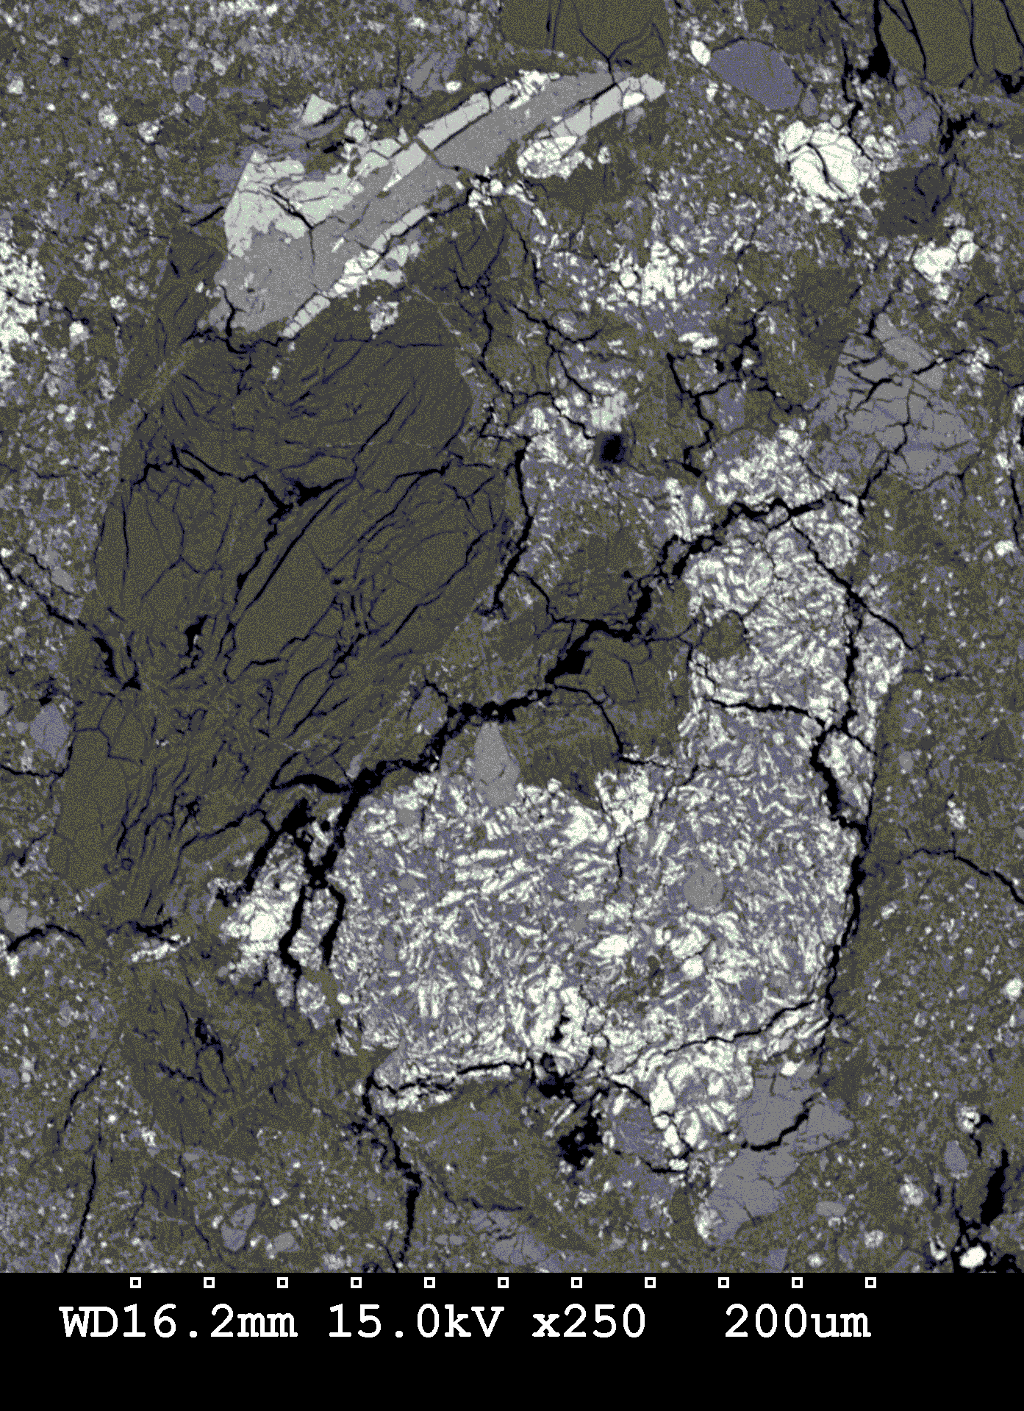
“Gabbroic” Clast
Composition :
Cl-apatite
augite
En₃₉₋₅₄Fs₁₆₋₂₇Wo₂₀₋₄₄
iron oxide
intergrown with a feldspar clast of composition An_{40-45.}
MPSE
3rd June 2014

Slide 22
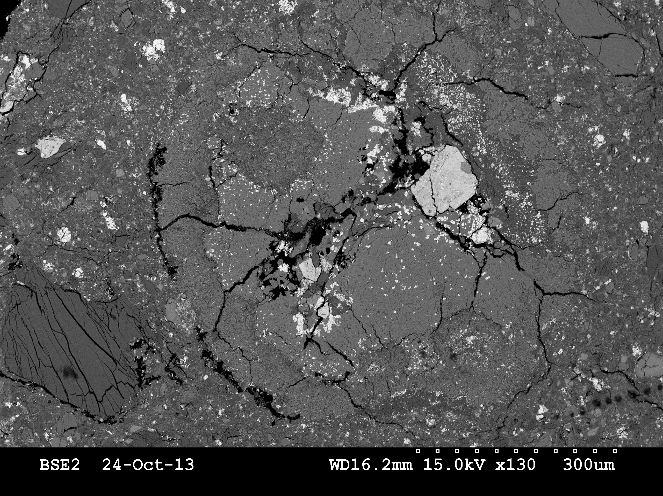
Zoned Clast (1)
MPSE
3rd June 2014

Slide 23
Zoned Clast (2)
A, B, D and E are augitic (En₄₀₋₄₅Fs₁₈₋₂₅Wo₃₃₋₃₈)
Boundaries of A/B and B/C show feldspar (An₃₄₋₄₀)
C contains pyroxene with feldspar
F is iron oxide
MPSE
3rd June 2014

Slide 24
Summary
So far results have closely matched Agee et al (2013) and Santos et al. (2013)
Different clast types identified – albite intergrowth, reaction rims, zonation
Ar-Ar radiometric dating will give more insight into zircon ages and provide mineralogical context
Alkaline igneous composition found, similar to JakeM identified by MSL Curiosity
Unique Martian meteorite breccia
Building a model of temperature evolution.
MPSE
3rd June 2014

Slide 25
Further work
Continue to classify and compare pyroxenes, feldspars, phosphates and oxides in different clasts and the matrix
Look for zonation textures and any evidence of shock
Compile modal percentage of different clasts by volume
Consider temperature evolution of clasts and thermodynamics of possible reactions and temperatures to suggest formation model
Consider the role of water
Examine further thin sections to look for further clast variety
Use electron microprobe for further detail on minor elements
Use TEM to look at crystal structure
Laser ablation
MPSE
3rd June 2014

Slide 26
Thank you!
MPSE
3rd June 2014

Slide 27
References
Agee, C. B. et al., 2013a. Unique Meteorite from Early Amazonian Mars: Water-Rich Basaltic Breccia NWA7034. Science, Volume 339, pp. 780-785.
Agee, C. B. et al., 2013b. Oxide Phases and Oxygen Fucacity of Martian Basaltic Breccia NWA7034. LPSC XLIV, 2965.
Agee C. et al, 2013, Northwest Africa 7034, Meteoritical Bulletin 100 & 101
Bridges, J. C., 2013, Northwest Africa 8114. Meteoritical Bulletin 102.
Cartwright, J.A. et al, 2013, NWA7034 Contains Martian Atmospheric Noble Gases, LPSC XLIV, 2314
Humayun, M et al., 2013, Origin and age of the earliest Martian crust from meteorite NWA 7533, Nature 503, 513-516.
Nyquist, L. E., Shih, C. Y., Peng, Z. X. & Agee, C., 2013. NWA 7034 Martian Breccia : Disturbed Rb-Sr systematics, preliminary ~4.4 Ga Sm-Nd age. 76th Annual Meteoritical Society, 48(s1), 5318
Santos, A. R. et al., 2013a. Examination of Lithologic Clasts in Martian Meteorite NWA7034. LPSC XLIV, 2533.
Santos, A. R. et al., 2013b. Martian Breccia NWA7034: Basalt, Mugearite and Trachyandesite Clasts. 76th Annual Meteoritical Society, 48(s1), 5284.
MPSE
3rd June 2014

