Slide 1
Origin of the observed deformation in Valles Marineris: an equatorial fossilised glacier system and no regional tectonics
Daniel Mège, Olivier Bourgeois, Marine Gourronc
Frédéric Gueydan, Olga Kromuszczyńska, Magdalena Makowska, Stéphane Pochat Krzysztof Dębniak, Joanna Gurgurewicz
WROONA Group, Institute of Geological Sciences PAS, Wrocław, Poland
Planetology and Geodynamics Laboratory, Nantes, France
Montpellier Geosciences, France
Space Research Centre PAS, Warsaw, Poland

Slide 2
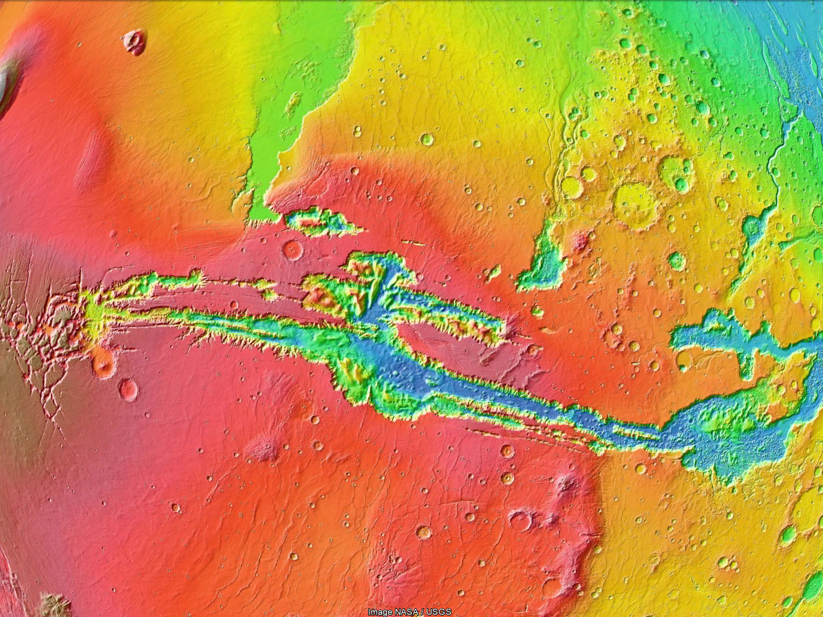
1000 km

Slide 3
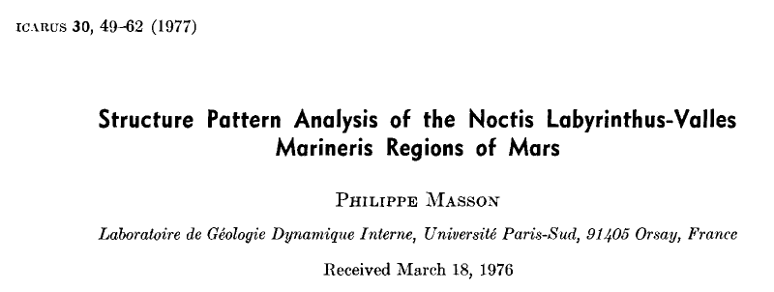
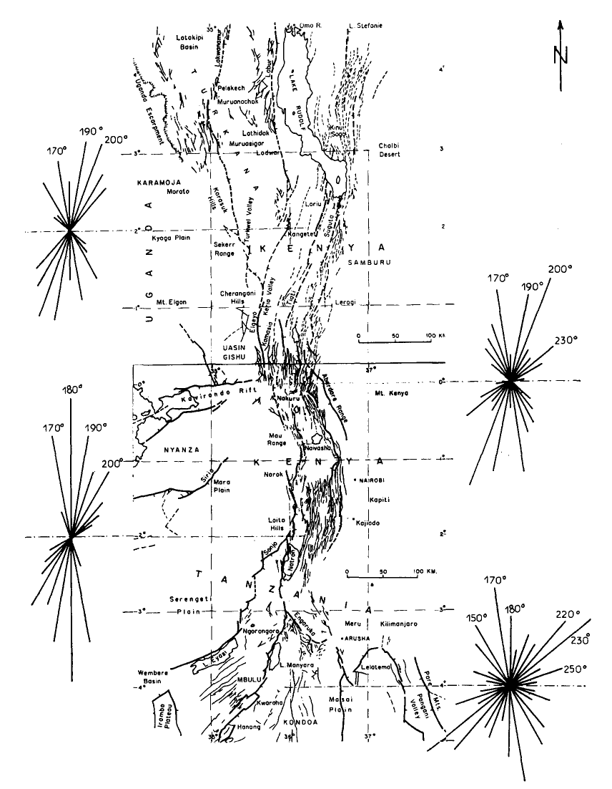
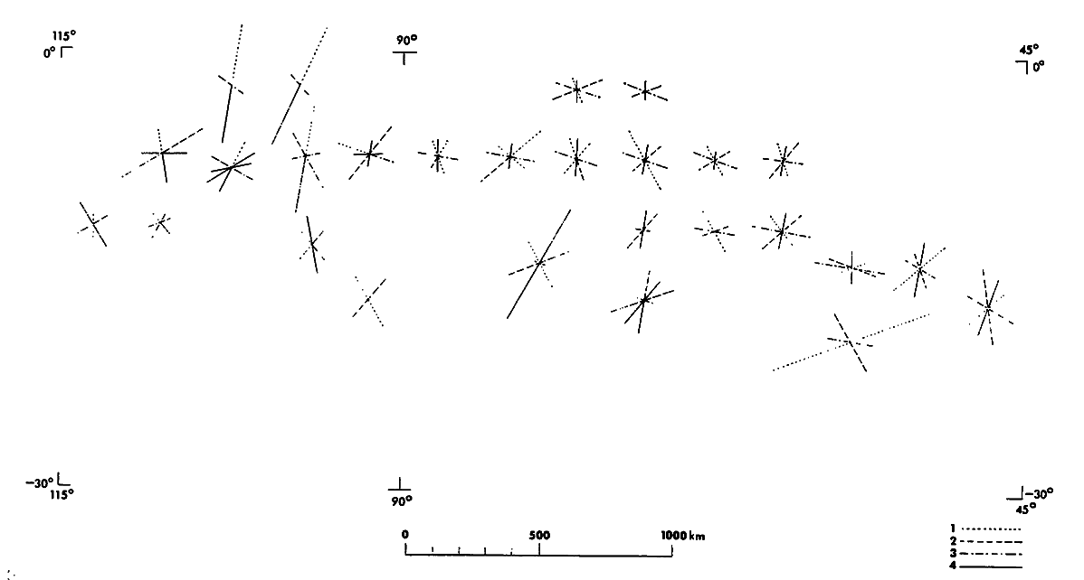
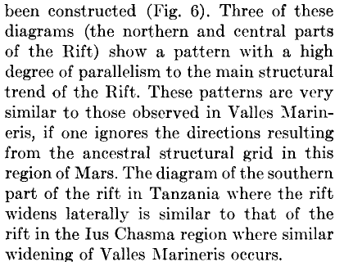

Slide 4
Evidence of faults from surface observations

Slide 5
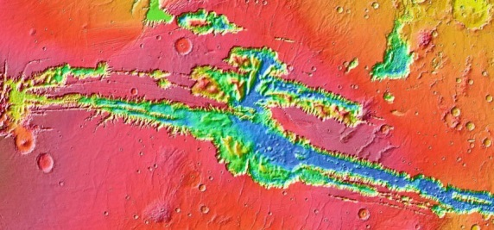
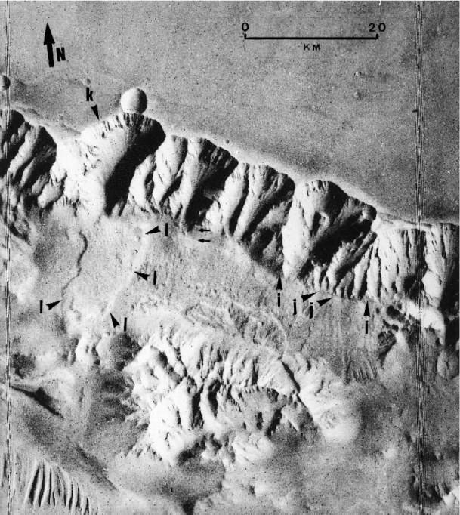
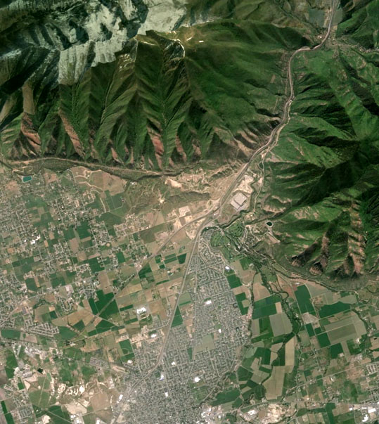
Triangular faceted spurs
Peulvast et al., 2001
Wasatch fault (Spanish Fork), Utah

Slide 6
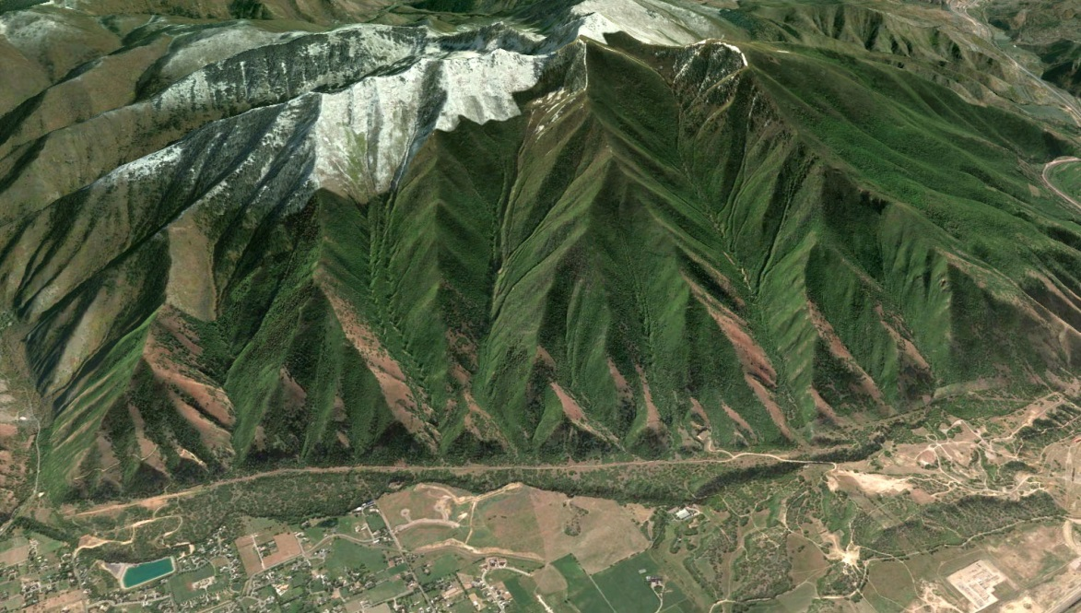
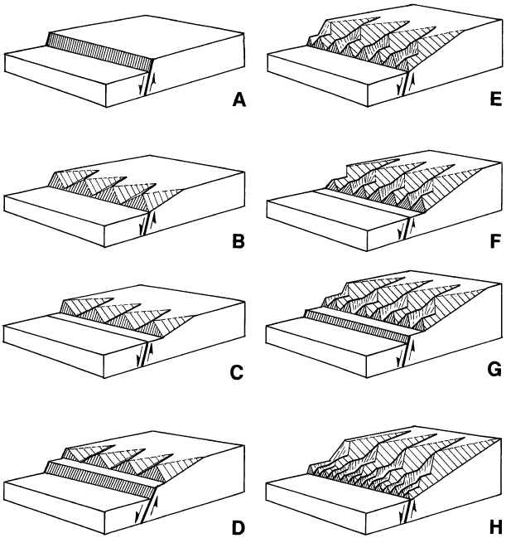
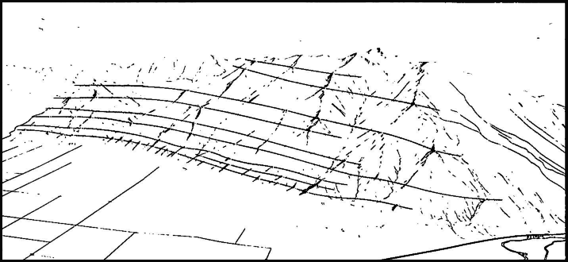
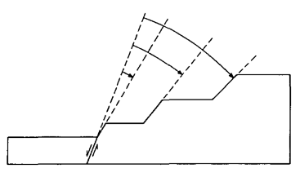
Cycles of fault activity/tectonic quiescence and erosion
Hamblin, 1976 (redrawn)
Hamblin, 1976
Hamblin, 1976

Slide 7
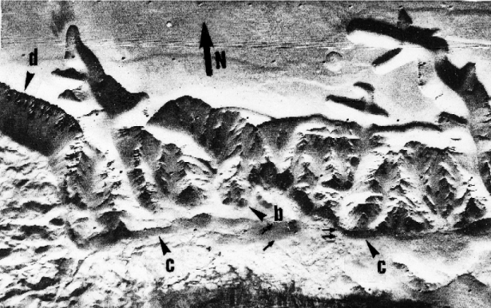
Scarplets
Peulvast et al., 2001

Slide 8
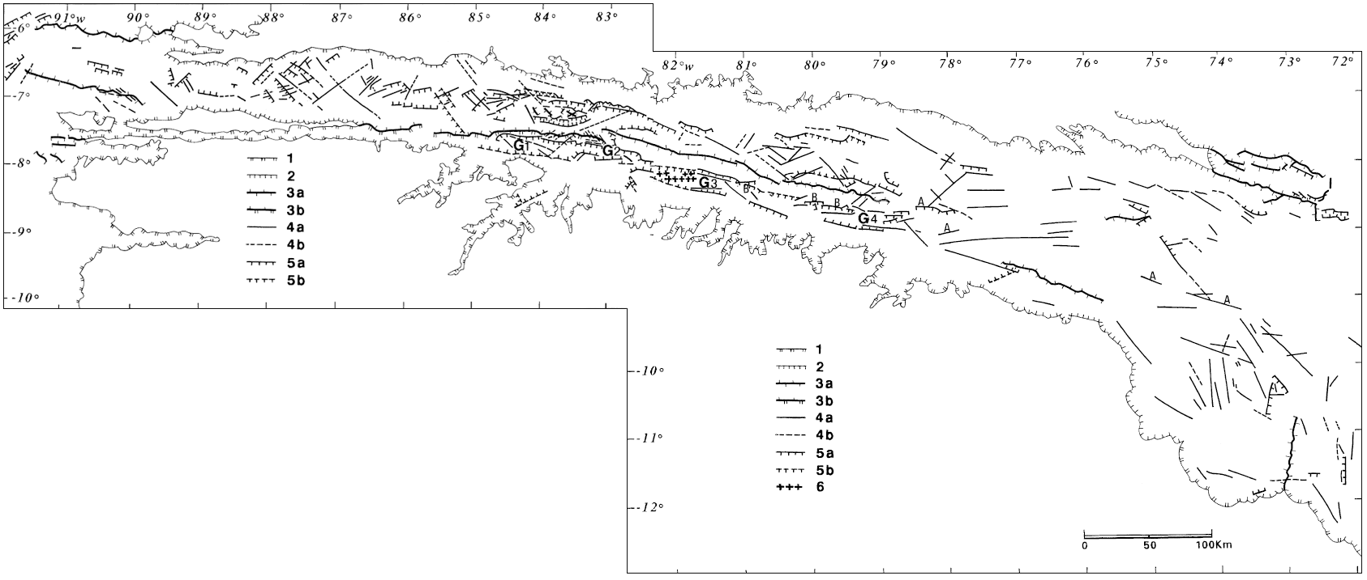
Graben segmentation
Peulvast et al., 2001 (mapped in 1992)
Viking data (panchromatic CCD + orbitography)

Slide 9
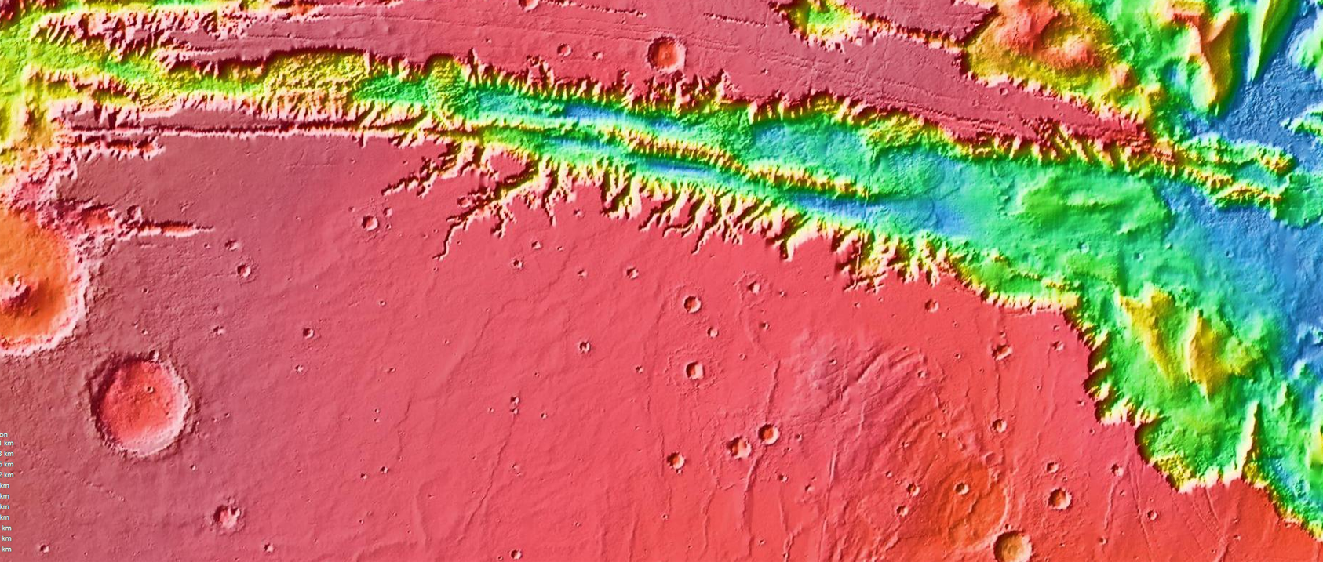
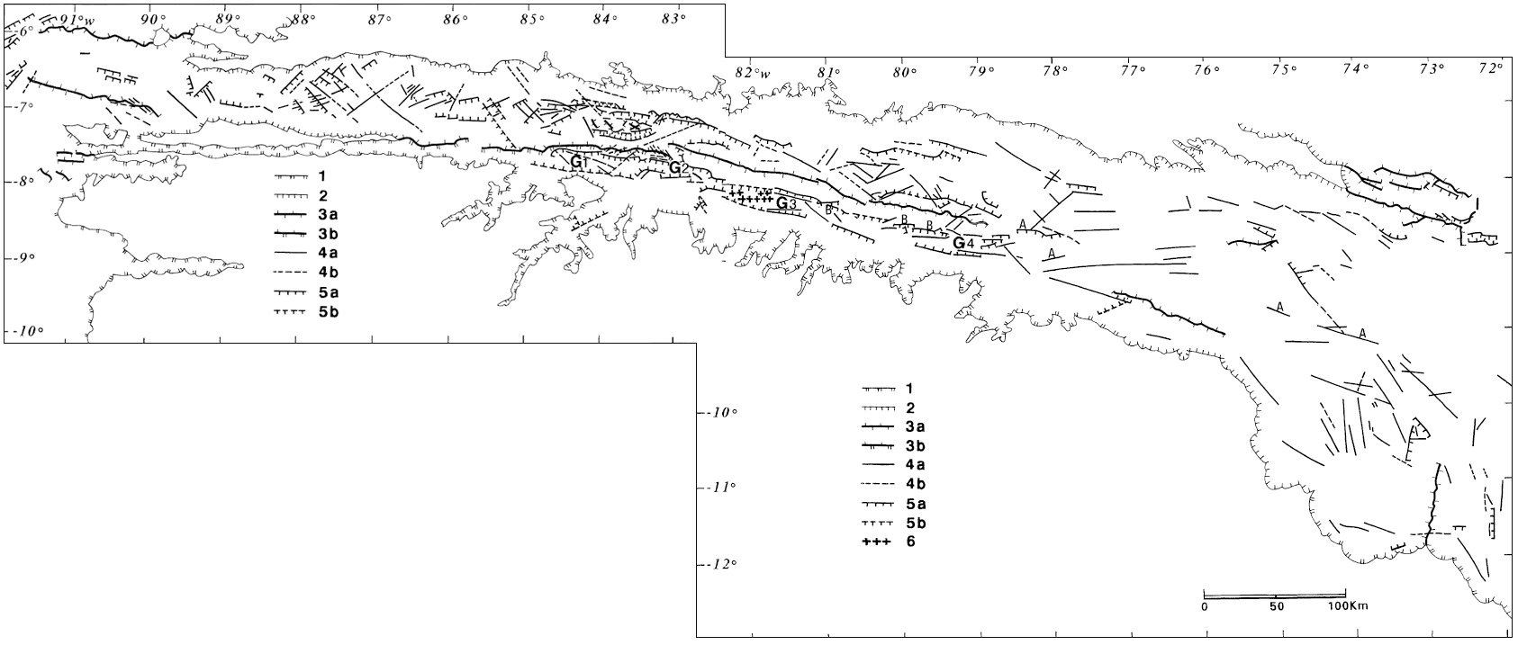
Graben segmentation
Peulvast et al., 2001 (mapped in 1992)
With MOLA

Slide 10
Are the 'Viking' graben margin faults
observed on more recent datasets?

Slide 11
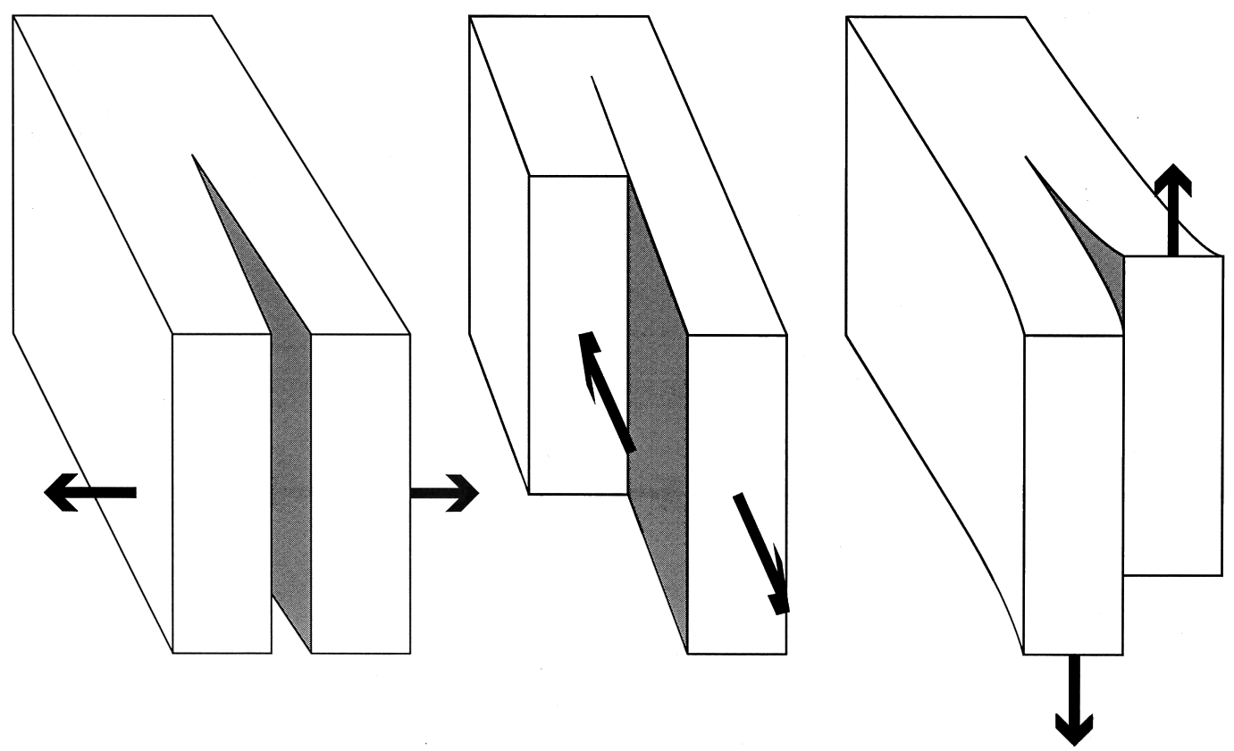
Back to school - the three basic fracturing modes
opening
shearing
shearing (tearing)
displacement
decreases to 0
normal fault
central zone
normal fault
end zone
Faults end.

Slide 12
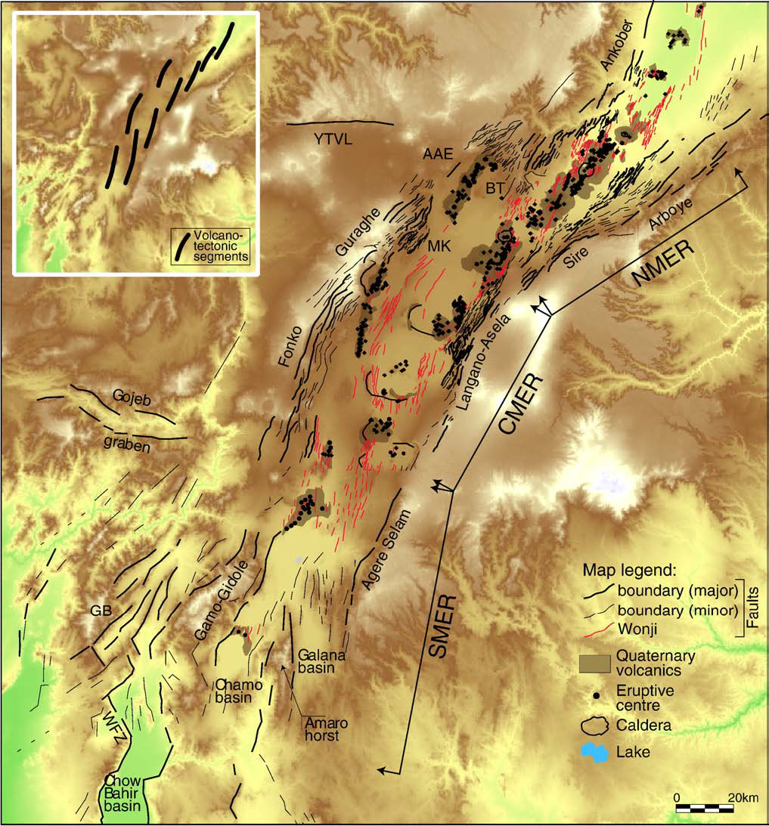
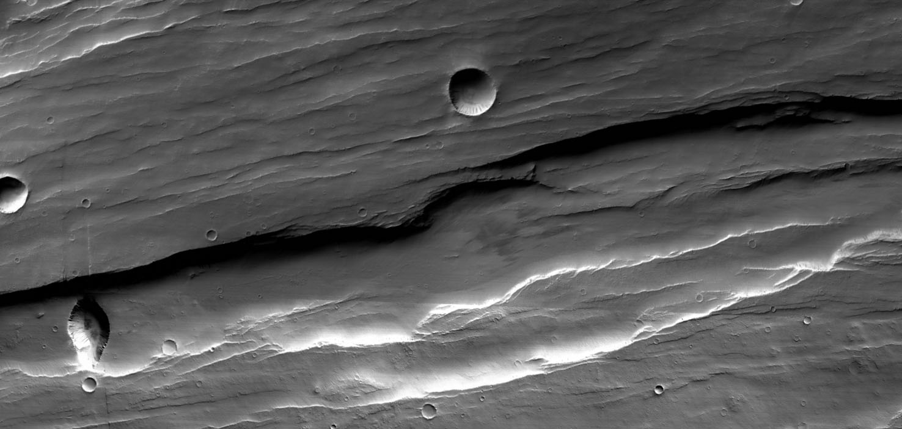
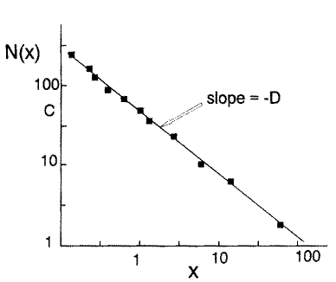
Ulysses Fossae
(CTX/JPL/NASA)
Jackson and Sanderson, 1992
cumulated number of faults
20 km
Hauber and Kronberg, 2001, 2005
Mège et al., 2003
Corti, 2009
fault length
Some narrow grabens on Mars share more features of terrestrial rifts than Valles Marineris
East African Rift System (Main Ethiopian Rift)
Faults are many and segmented.

Slide 13
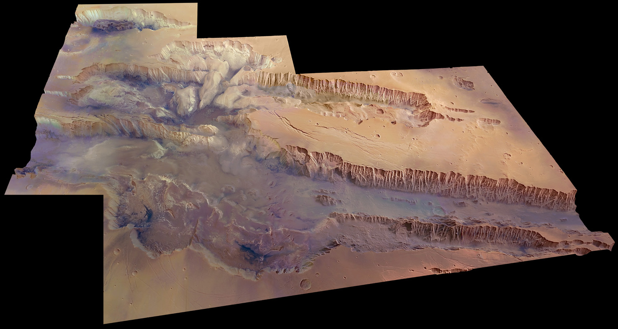
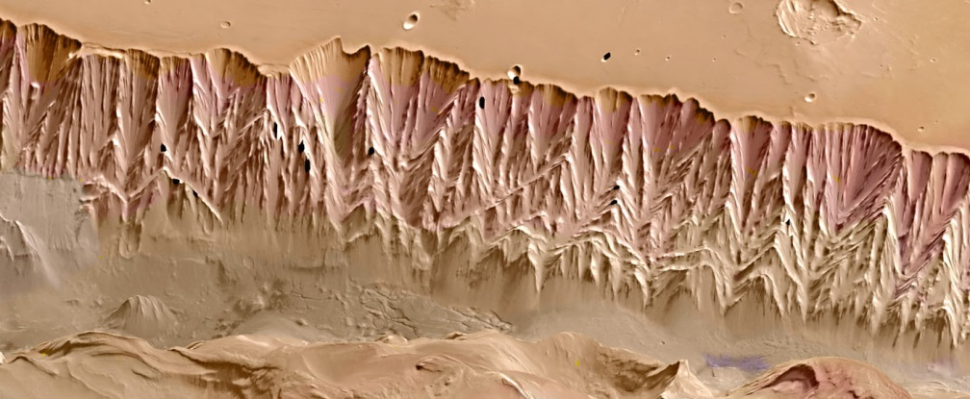
Single and continuous scarp
ESA/DLR/FU Berlin
No segmentation
HRSC digital elevation model, Valles Marineris

Slide 14
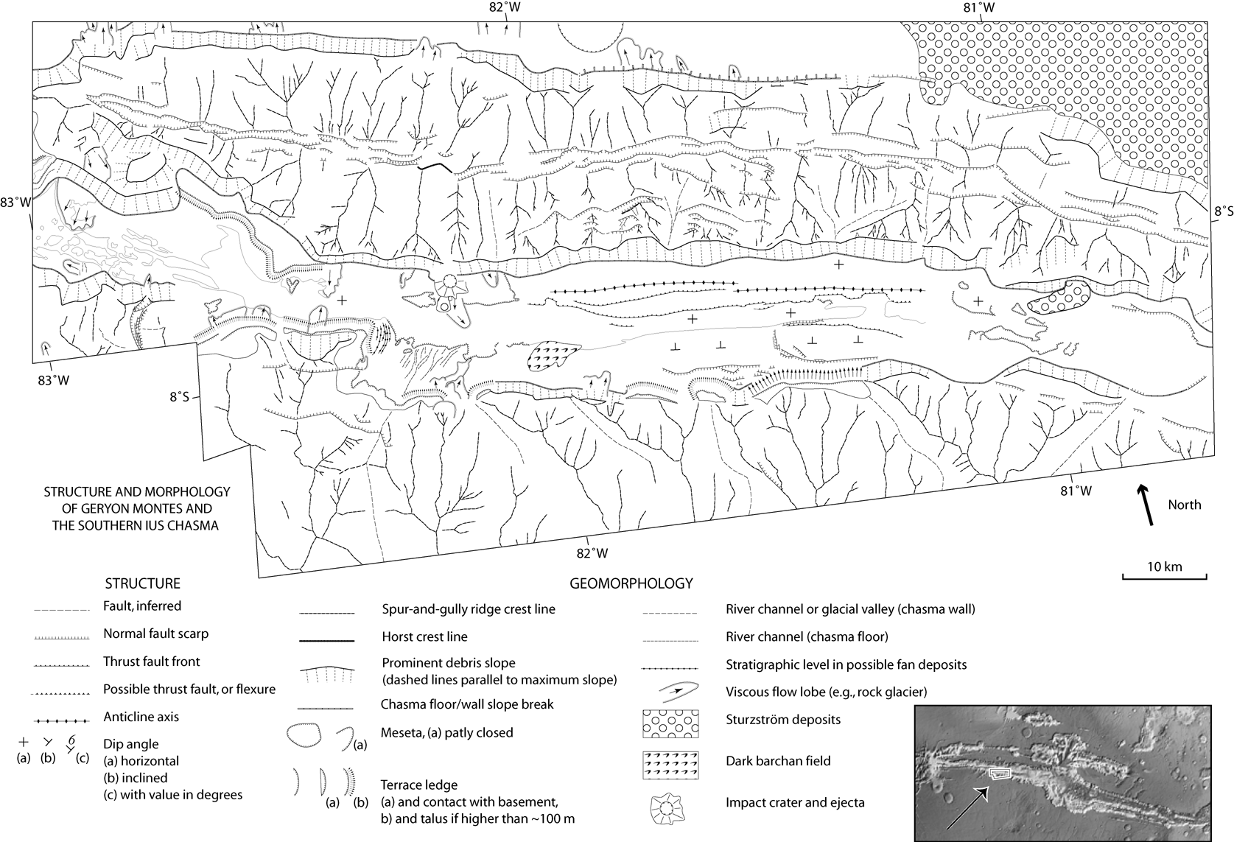
Very long such continuous lines, no end zones and no segmentation
I
U
S
landslide
deposits
G
E
R
Y
O
N
M
O
N
T
E
S
I
U
S
C
H
A
A
S
M
F
L
O
O
R
10 km

Slide 15
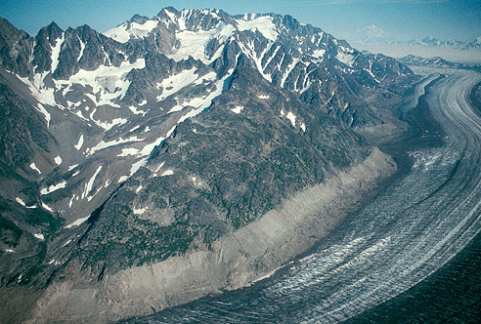
Continuous lines in similar landforms on Earth
supraglacial spur and
gully morphology
trimline
(highest extent of glacier)
subglacial scarp
valley glacier
Molnia, 2004
Tana glacier, Alaska

Slide 16
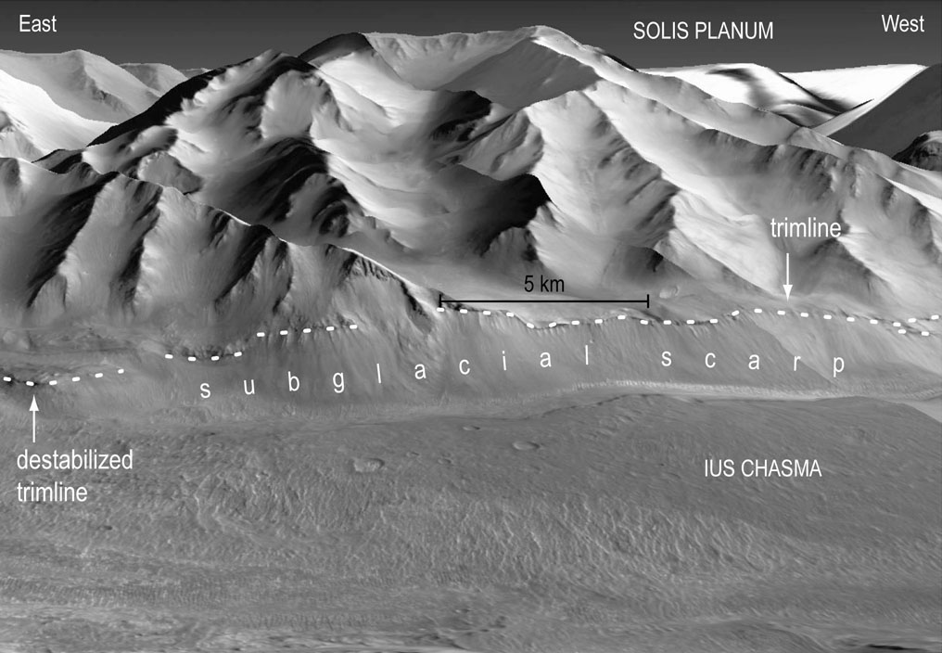
In Valles Marineris
supraglacial spur and
gully morphology

Slide 17
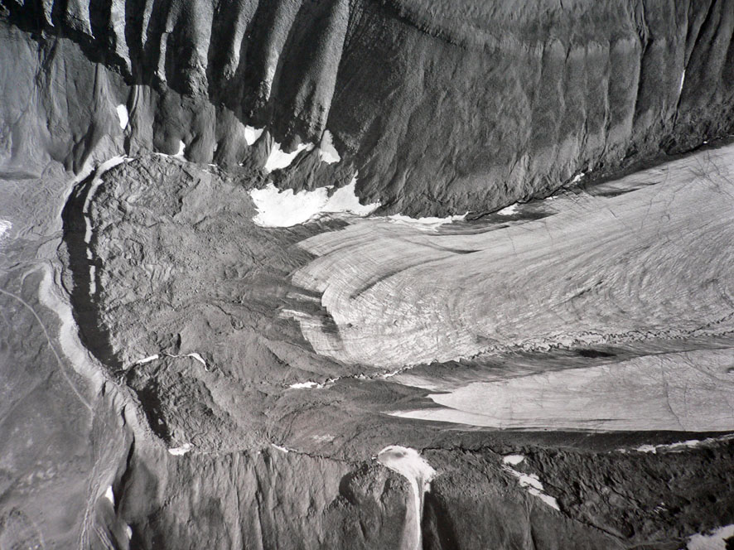
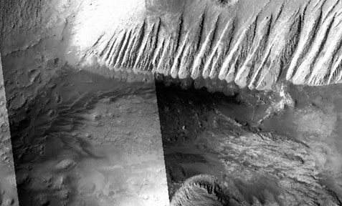
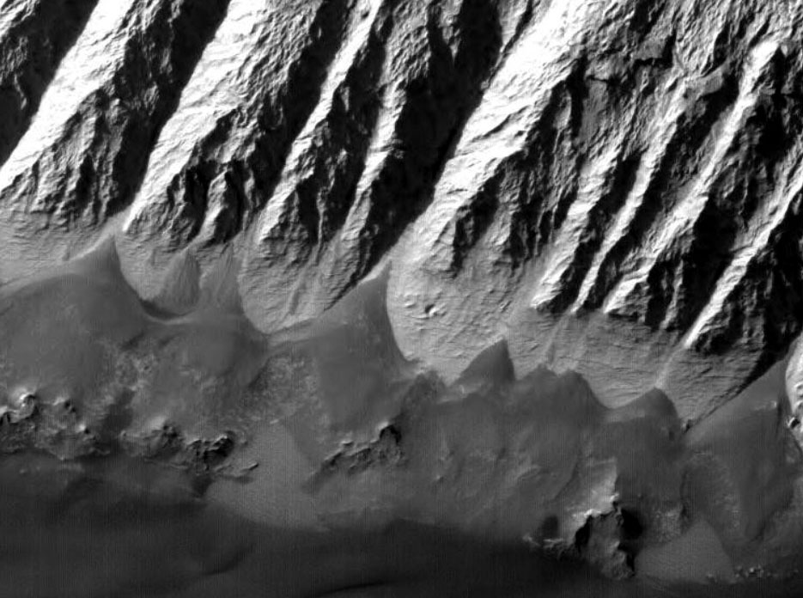
trimline
?
Svalbard
Candor Chasma
5 km
(Longyearbreen glacier)
Evans, Quat. Sci. Rev., 2009
Glacial receding since Little Ice Age
trimline
subglacial polished rocks
600 m
Thrilling Candor Chasma
floor analogue in Svalbard
chasma floor
500 m

Slide 18
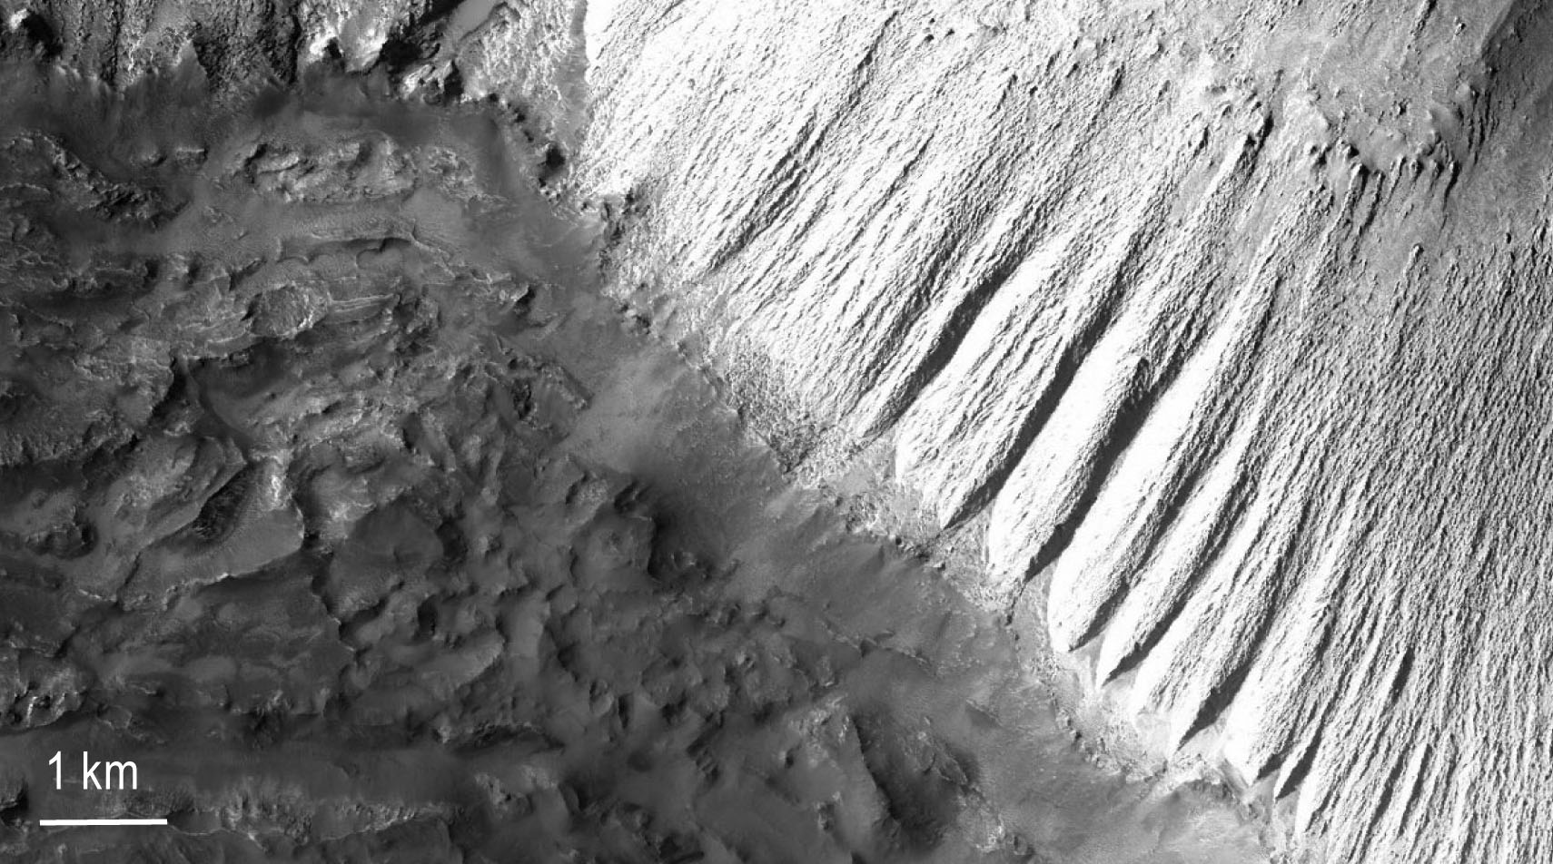
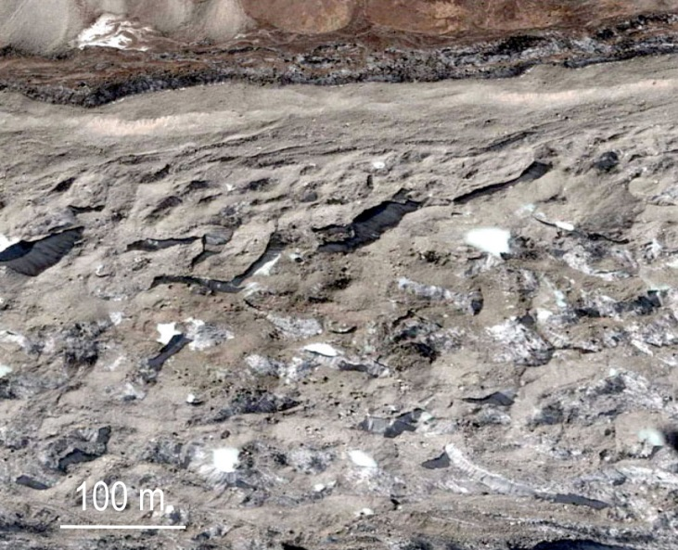
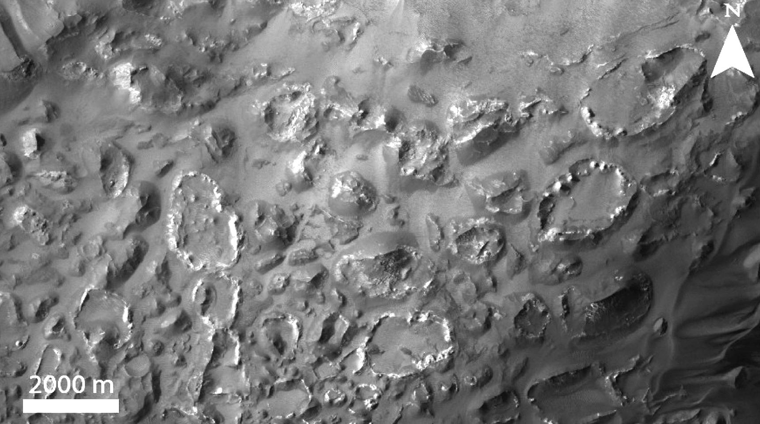
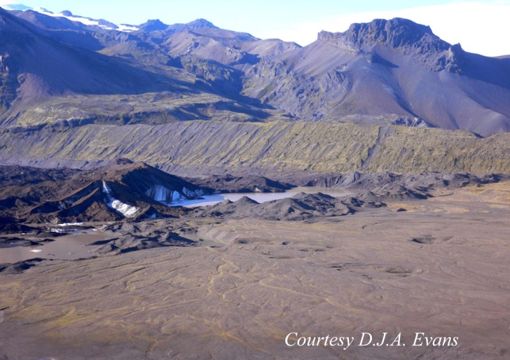
Candor Chasma floor
Terrestrial ablation till
Humocky terrain, Candor Chasma
Humocky terrain, Himalayan glacier
Closed depressions
Kettle holes, Iceland

Slide 19
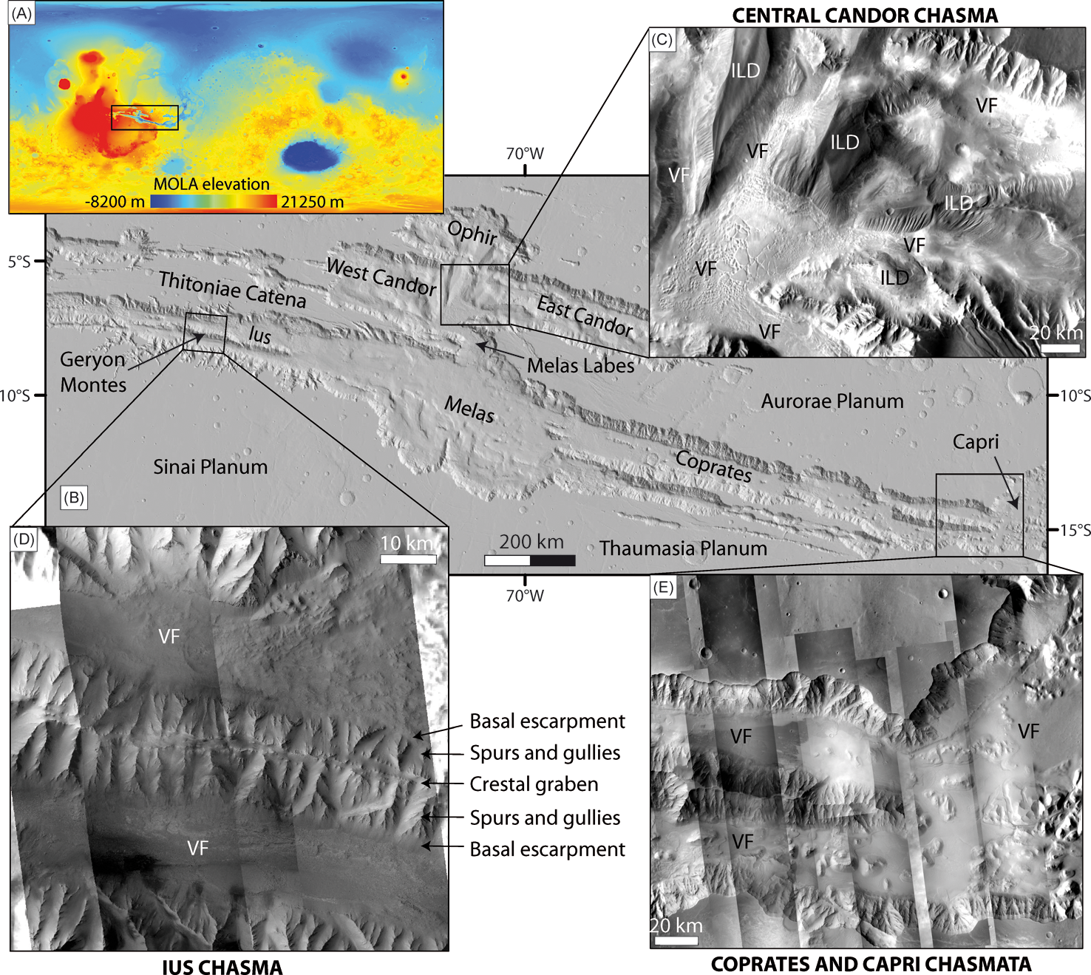
A few regional
examples
Gourronc et al., 2014

Slide 20
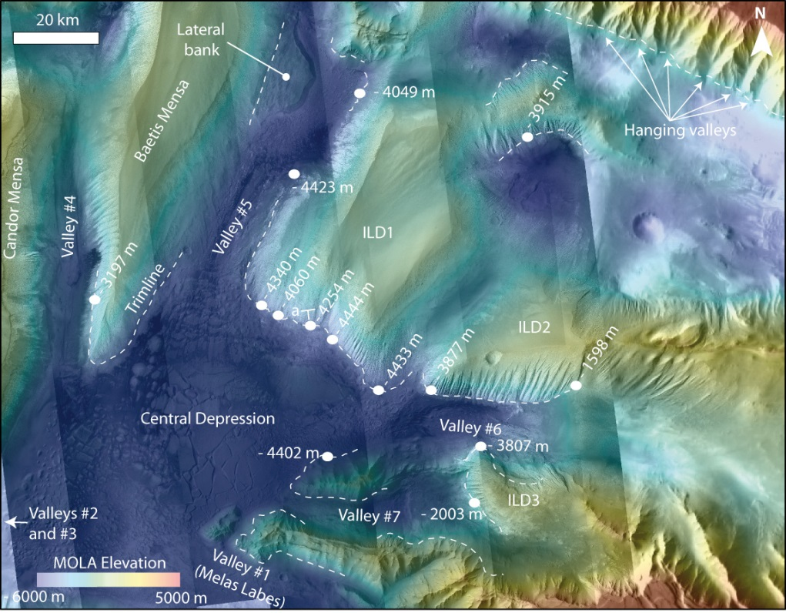
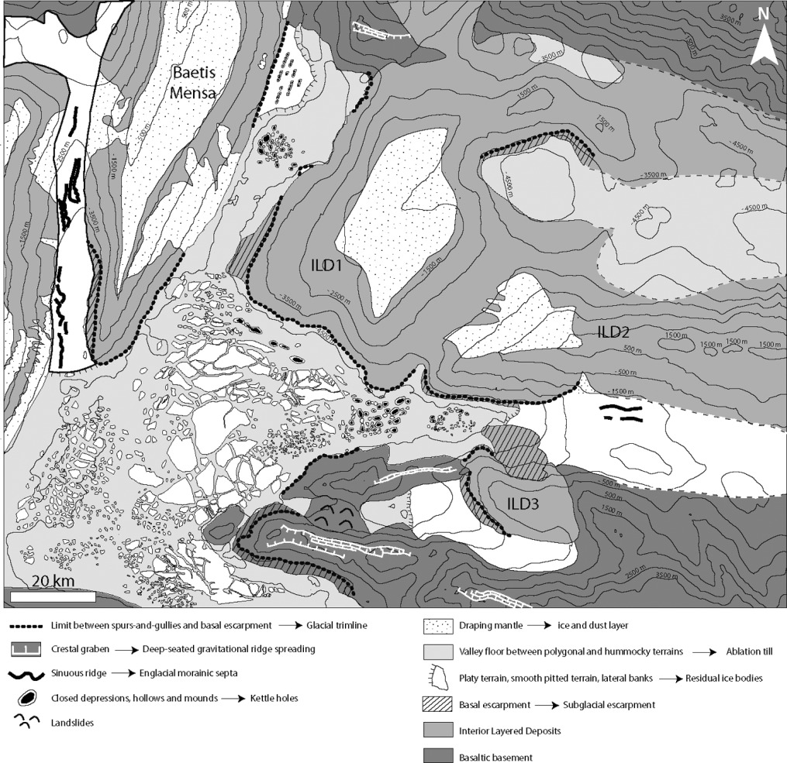
Glacial landforms in Candor Chasma
Gourronc et al., 2014

Slide 21
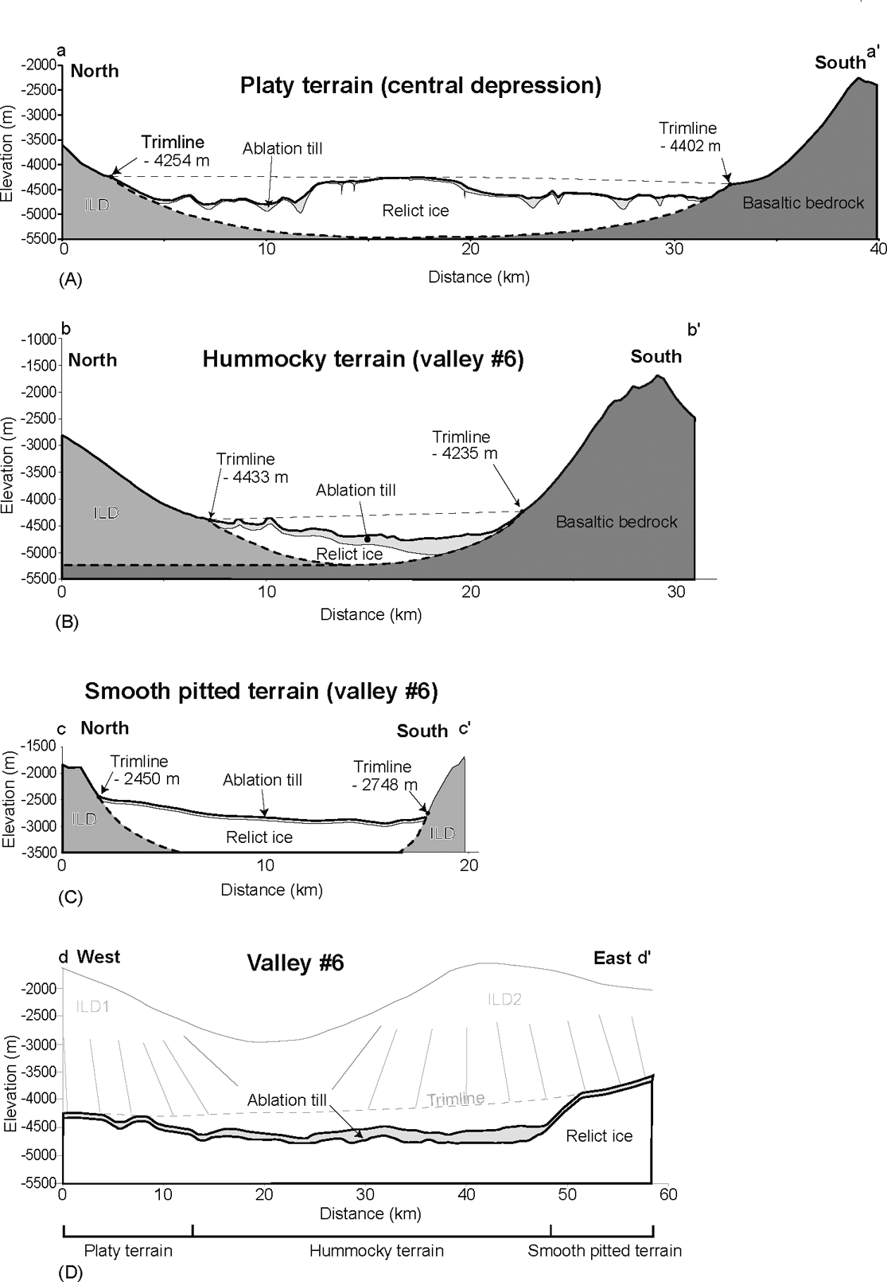
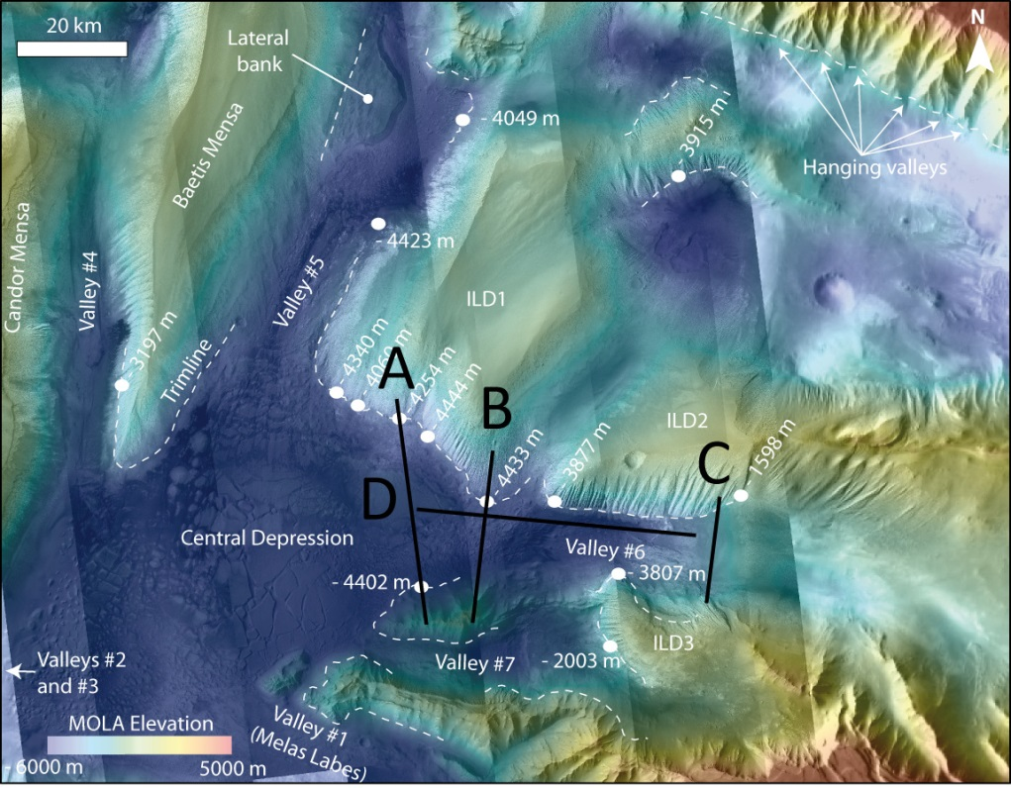
Glacial landforms in Coprates Chasma
Gourronc et al., 2014

Slide 22
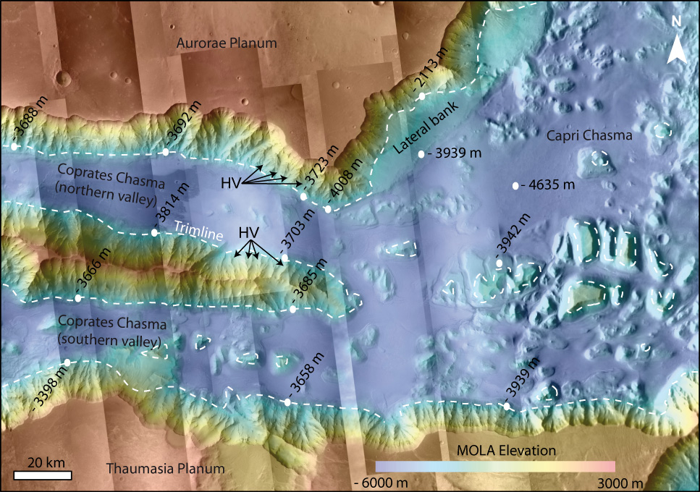
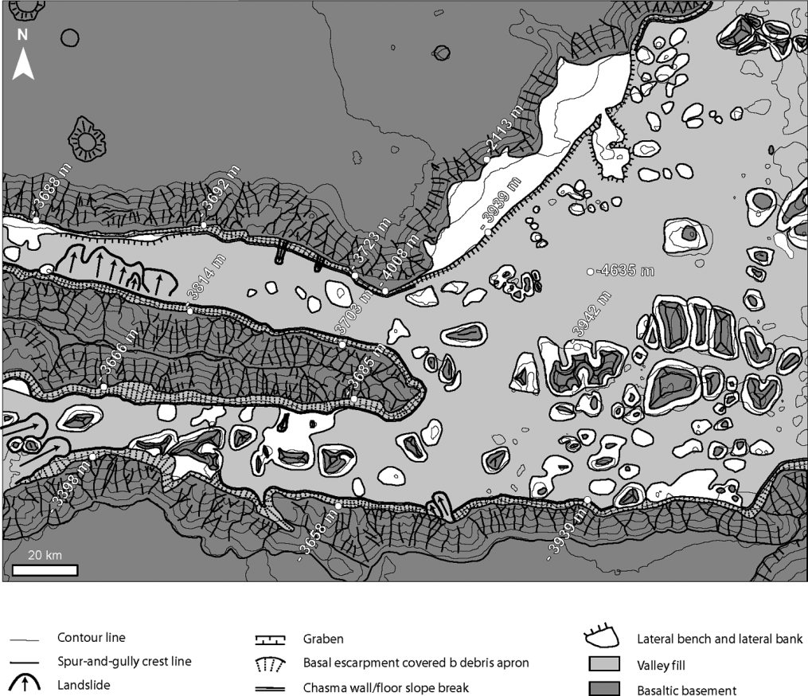
Glacial landforms in Coprates Chasma
Gourronc et al., 2014

Slide 23
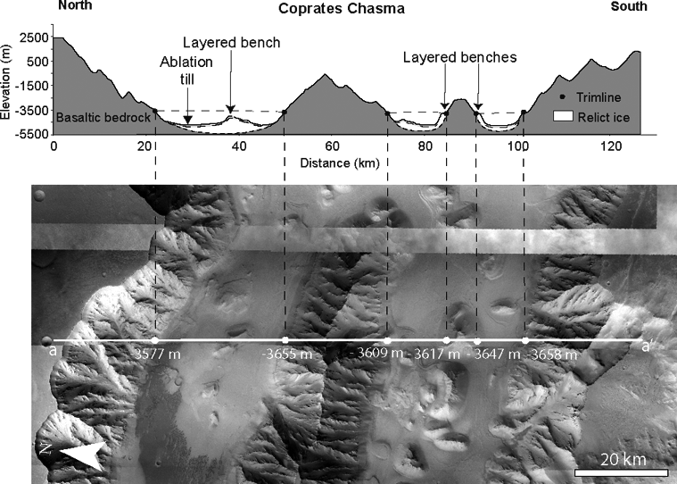
Glacial landforms in Coprates Chasma
Gourronc et al., 2014

Slide 24
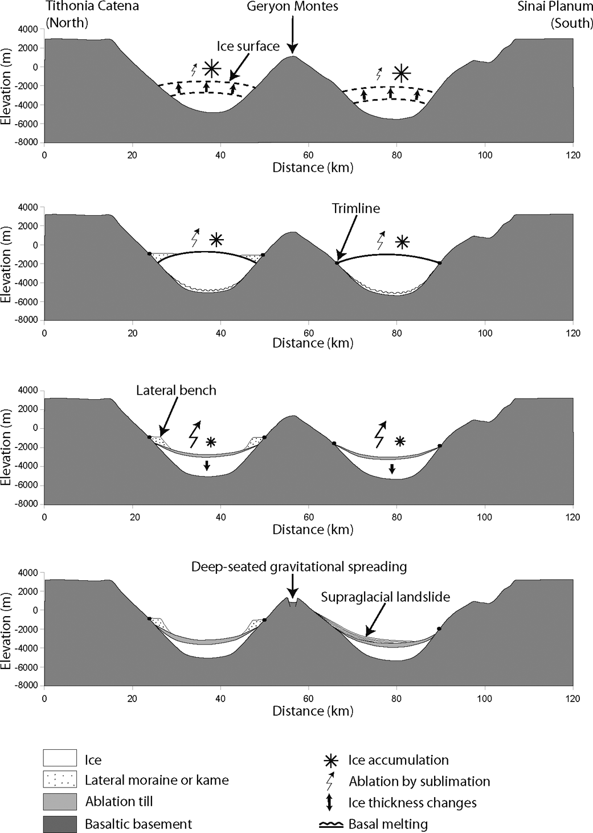
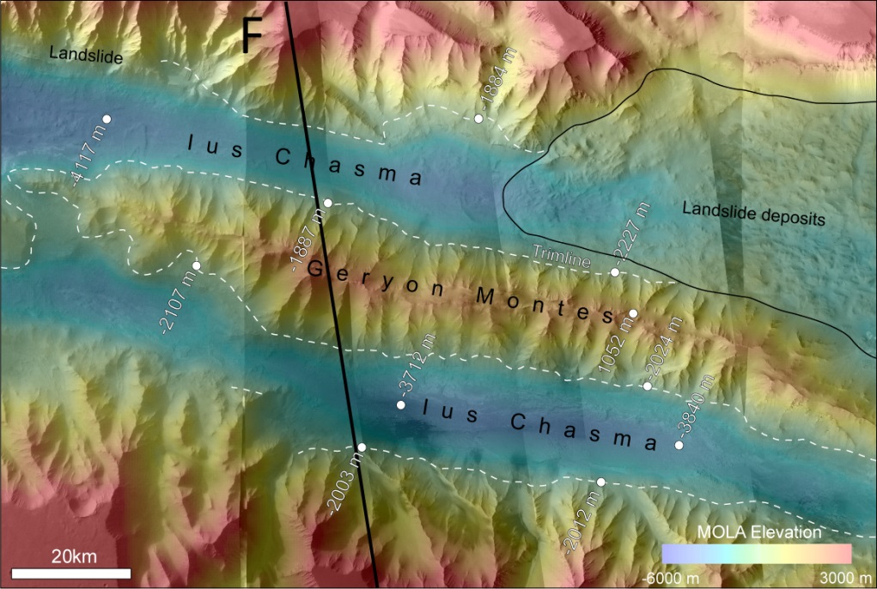
Glacial landforms
in Coprates Chasma
Gourronc et al., 2014

Slide 25
'Rifting' may have occurred,
but any direct evidence of faulting
has been removed
by glacial and postglacial processes.
Postglacial processes include gravitational tectonics.

Slide 26
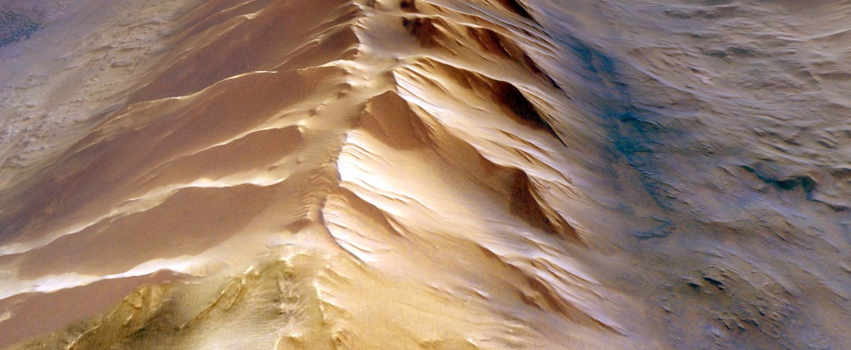
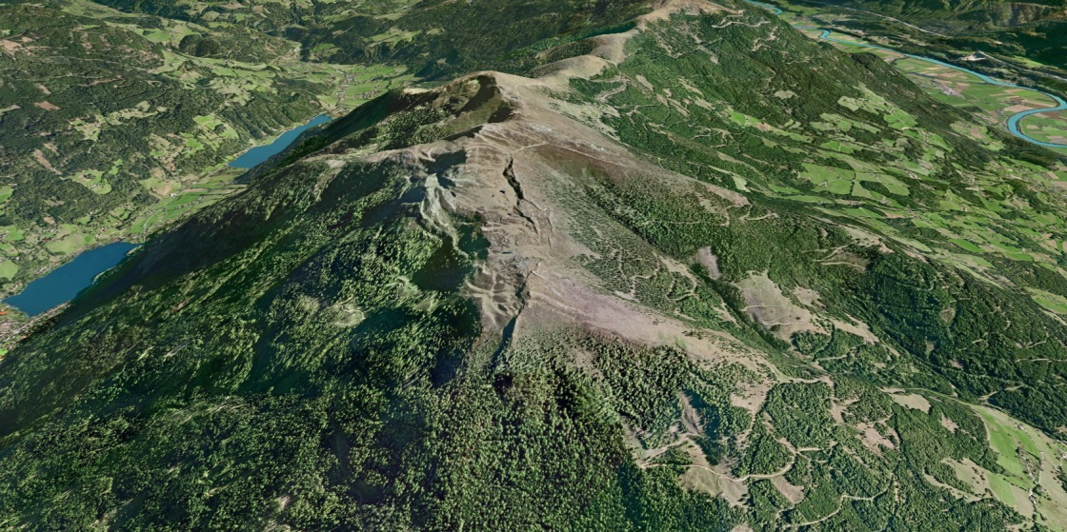
Normal faults are observed, but not along the chasma margins.
They are located within the Valles Marineris hillslopes.
They do not appear to be related to rift tectonics.
1. Ridge-top splitting
I U S
C H A S M A
5 km
glacial valley
glacial valley
B O D E N E C K
Austrian Alps
2 km

Slide 27
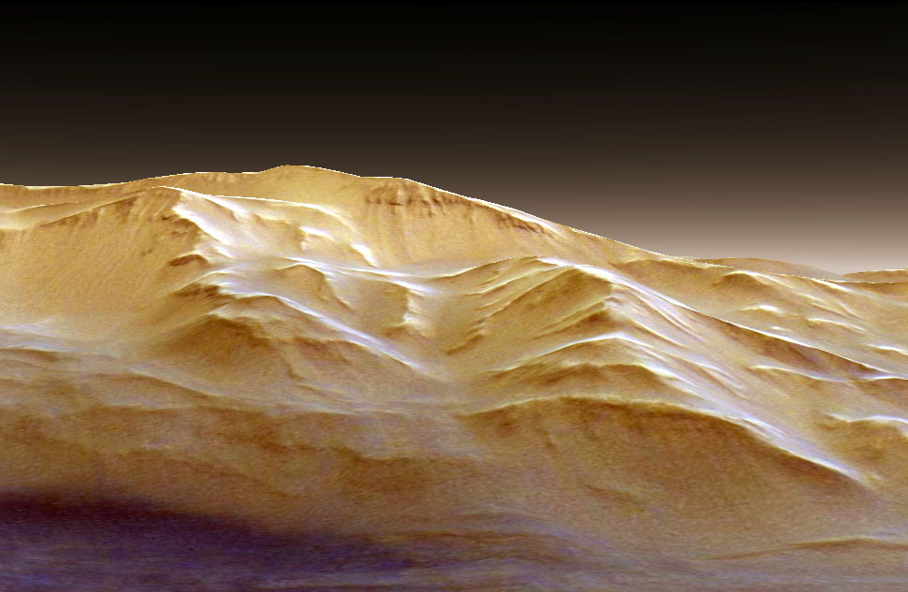
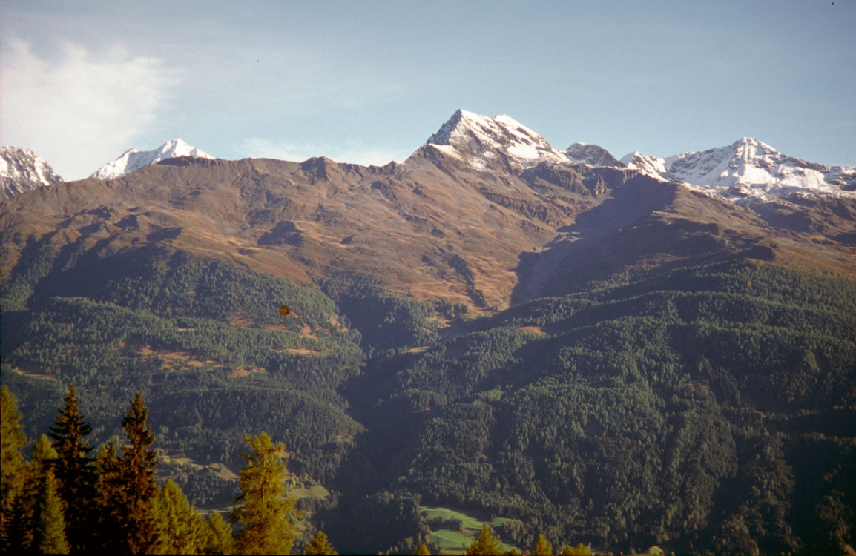
2. Uphill-facing scarps
C A N D O R C H A S M A
uphill-facing scarps
M E L A S C H A S M A
Oberes Törl
1 km
Hoher Trog
Austroalpine nappes
Austrian Alps
Courtesy by Jürgen Reitner

Slide 28
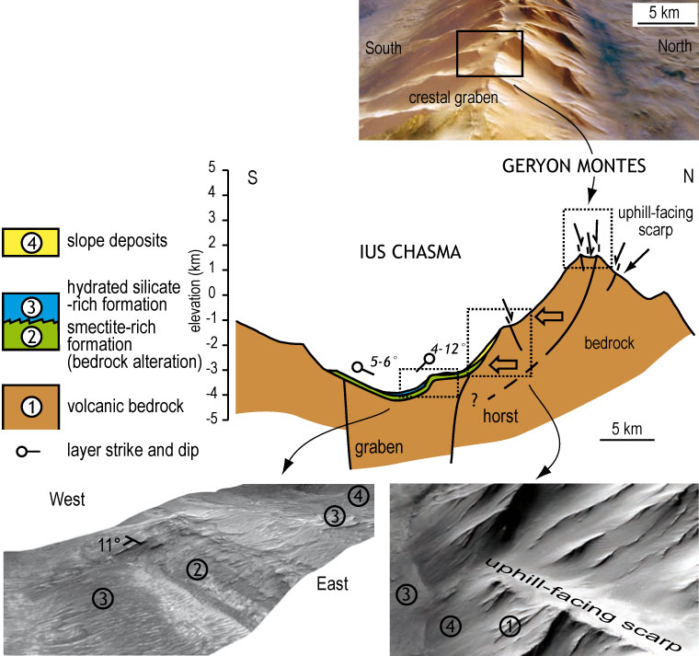
3. Basal bulging
Hillslope deformation
mineralogy from
hyperspectral
modelling
after Roach et al., 2010
Mège and Bourgeois, 2011

Slide 29
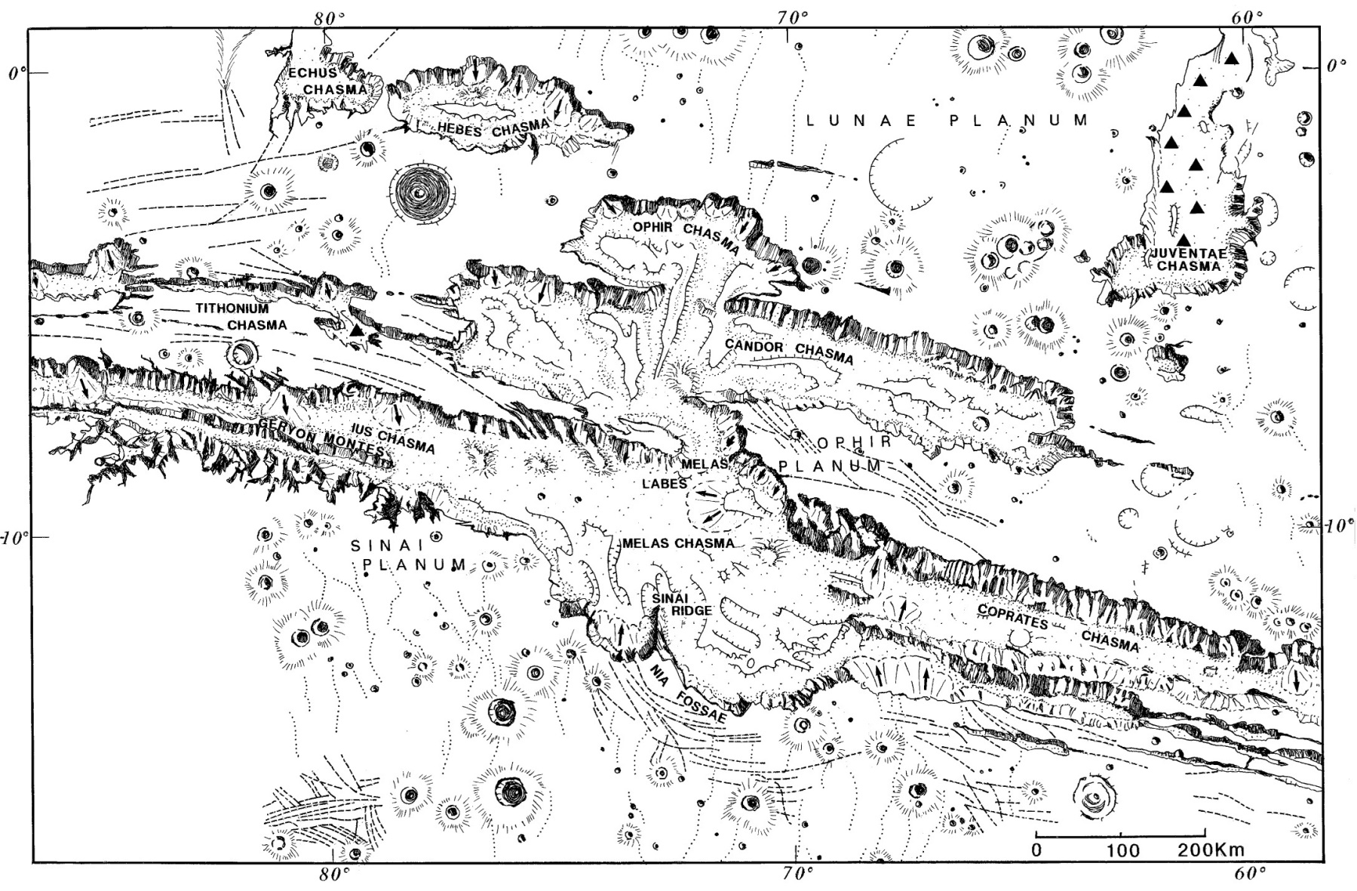
Hillslope deformation is systematically observed
on the side of glacial valleys
(more)
inter-chasma ridge
IUS
MELAS
intra-chasma ridge
(more)
chasma wall

Slide 30
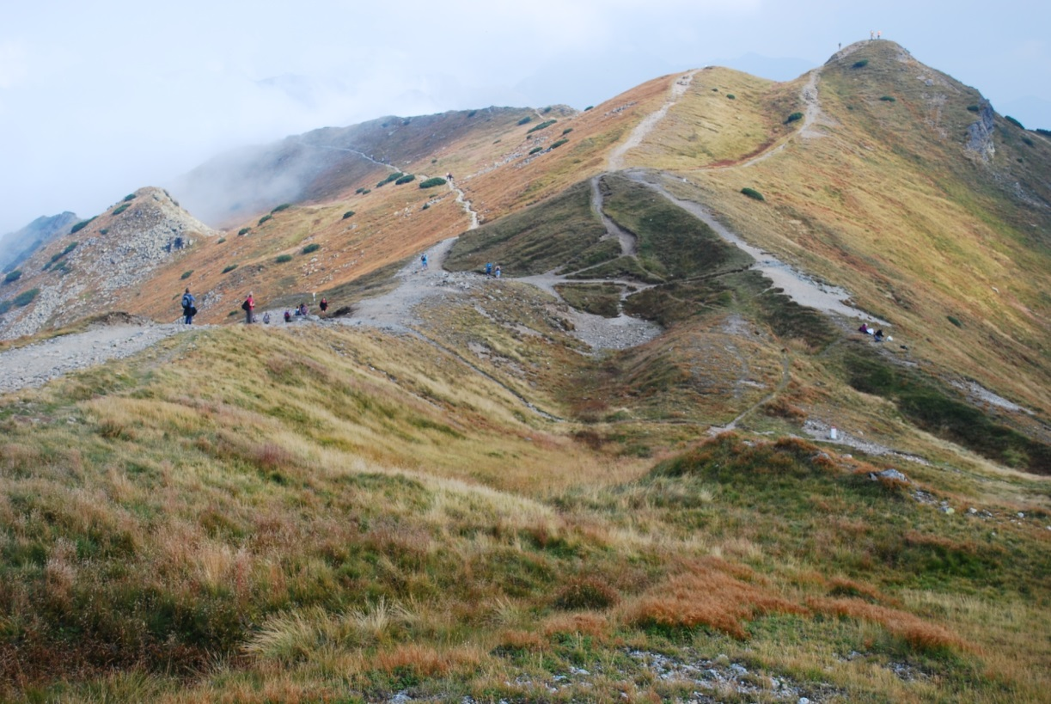
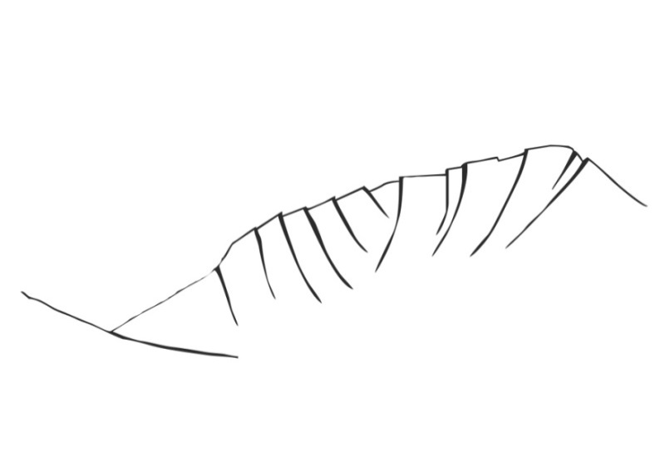
On Earth, ridge-top splitting, uphill-facing normal faut scarps
and ridge basal bulging characterize postglacial slope destabilisation
Mège and Bourgeois, 2011
Comparison with terrestrial deep-seated gravitational slope
deformation in the Tatra Mountains of Poland and Slovakia
Talk Olga
Kromuszczyńska
photo K. Dębniak

Slide 31
On Earth, ridge-top splitting, uphill-facing normal faut scarps
and ridge basal bulging characterize postglacial slope destabilisation
Mège and Bourgeois, 2011
Finite element modelling of deep-seated gravitational slope deformation
following glacier valley retreat
[MPa]
0,1
0,08
0,06
Talk Magda
Makowskaka
0,04
0,02
6,0x10⁻⁴
Plastic strain

Slide 32
Ice stability

Slide 33
Surface ice is currently not stable at the equator of Mars.
Very high obliquity results in cyclic periods of ice stability at low latitudes
Laskar et al., 2002
Levrard et al., 2004
1 m
BASALTIC REGOLITH
BASALTIC REGOLITH
~1000 years
ICE
Deeper ice or ice below less porous rock can stay until the last major obliquity change.
Bryson et al., 2008
Ice under e.g. supraglacial moraine might be stable for an indefinite period of time.

Slide 34
Conclusions
There is indirect evidence of formation of some Valles Marineris troughs by extensional tectonics
Triangular faceted spurs
Graben imprint in the present topography
Trough border scarps frequently interpreted as fault scarps are rather glacial scarps that loosely copy the geometry of older grabens
Systematic destabilisation of topographic ridges in Valles Marineris is the dominant mechanism involved in the observed tectonics

Slide 35
Talk Kromuszczyńska et al.
Talk Makowska et al.
Talk Wiśniewski et al.
Poster Mège et al.

Slide 36
Additional slides

Slide 37
Correlation with hyperspectral modeling results
I U S C H A S M A
deep-seated gravitational slope deformation zone
Roach et al., 2010
smectite + massive hydrated silicates
at base of sagging ridge
sulfate (kieserite + polyhydrated)
+ massive hydrated silicates
Ridge cohesion loss by
groundwater flow
Sublimation residue of
ice+volcanic aerosol mixture
weathering products
Kobayashi, 1956
Niles and Michalski, 2009
Similar inferences can be made from hyperspectral modeling in Candor Chasma
Gendrin et al., 2005, Le Deit et al., 2008
Notes:
Finally, the minerals identified at the bottom of the spreading ridges are consistent with the minerals that would be expected in a glacial setting. In Ius Chasma, the ridge spreading slopes are associated with hydrated silicates and phyllosilicates. Phyllosilicates may result from ridge alteration by groundwater flow along the sackung normal faults, and transportation of the eroded materials downslope, this has been first noticed at sackung ridges in the Japanese Alps by Kobayashi in 1956. The presence of sulfates is also consistent with the alteration of volcanic rock particles in ice, as shown by Niles and Michalski in 2009.

Slide 38
Mineralogy from hyperspectral modeling
Roach et al., 2010
wallrock
(sagging slope)
hydrated silicates
(altered smectites?)
smectite
Ridge alteration and cohesion loss by groundwater flow
Kobayashi, 1956
Similar inferences can be made from hyperspectral modeling in Candor Chasma
Gendrin et al., 2005, Le Deit et al., 2008

Slide 39
Mineralogy from hyperspectral modeling
Roach et al., 2010
wallrock
(sagging slope)
polyhydrated sulfate
-bearing formation
hydrated silicates
(altered smectites?)
MgSO₄·H₂O-bearing
formation (kieserite)
Sublimation residue of ice+volcanic aerosol mixture weathering products
Niles and Michalski, 2009

Slide 40
Is a glacier still present in Candor Chasma?
+1200 m
-4000 m
-4200 m
lower layered deposits
-4500 m
-3000 m
DUST-COVERED
GLACIER?
TRIMLINE
EXPOSED SUBGLACIAL ROCKS
ablation moraine
2 km
Notes:
This is an astonishing comparison between a glacier snout in Svalbard and Candor Chasma. Note first the morphology of the valley walls, which in the Candor case is ILDs. In Svalbard we can see two things: first glacial retreat since the Little Ice Age, which leaves a frontal moraine and hummocky material, and an exposed trimline. In Candor Chasma the same morphologic features are observed, and in addition we see the trimline very well exposed on the West, whereas it becomes buried by chasma floor material on the East, as if this material were still masking an underlying glacier.

Slide 41
sun light
MRO/HiRISE image 25 cm/pixel
FAULT SCARP
Field work would hardly
reveal any fault plane outcrop!
50 m
JPL/NASA/AU

Slide 42
Viking fault scarps

Slide 43
Viking fault scarps

Slide 44
I U S
C H A S M A
2 km
J A M N Í C K E S E D L O
Slovakian Tatras

