Slide 1
office.astripolska@astripolska.pl
www.astripolska.pl

Slide 2








Created in 2010.
Joint Venture (50%/50%)

Slide 3
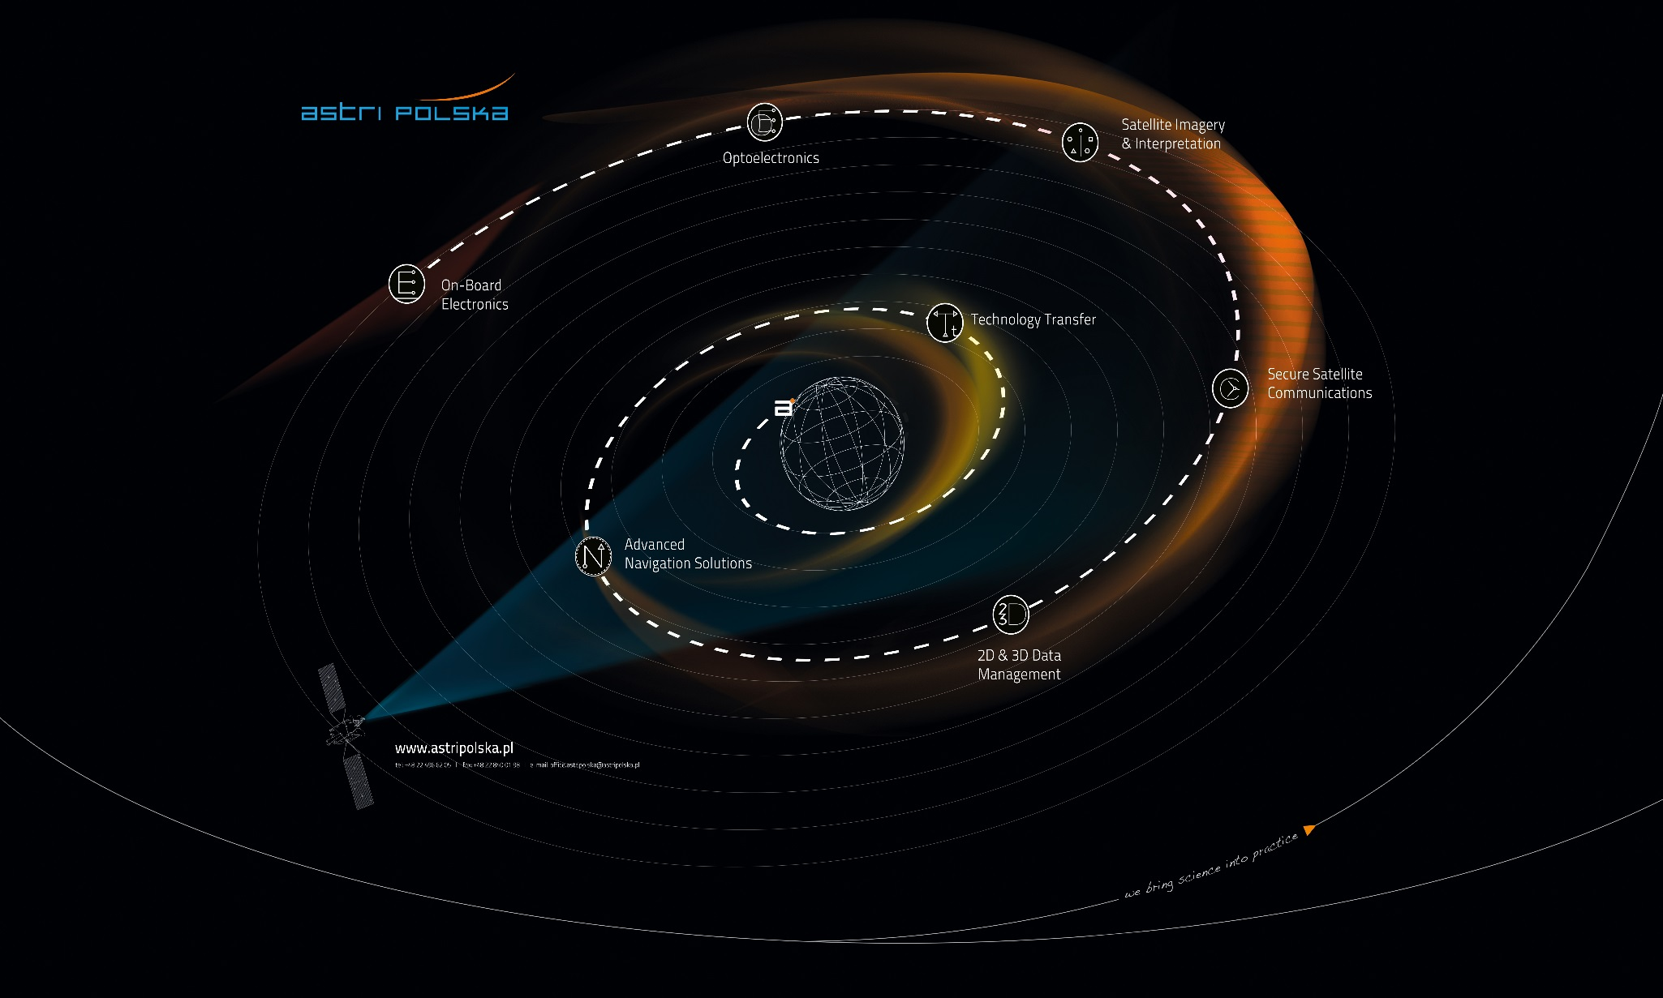

Slide 4
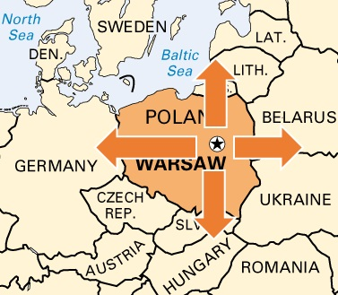
About the company
Based in Warsaw, Poland: central place in Europe.
1st space company in Poland.
Involved in 8 FP7 projects.
A complete team of qualified specialists and young engineers (about 25 for now).
Regularly takes part in international events such as EU Carpathex and recently PRACTICE.

Slide 5
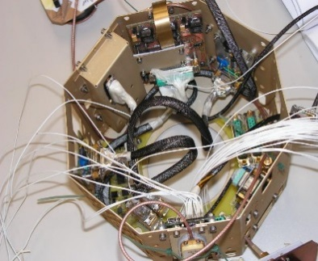
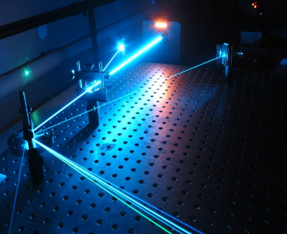
Our mission:
Our mission is to promote and to actively participate in the development of space applications and technologies in cooperation with major Polish and international stakeholders including numerous public and private space-oriented organisations.
The main objective is to become one of the major players in the Polish space industry supporting the overall development of the space sector in Poland.

Slide 6
Company Structure

Slide 7
Research Technologies and Systems Division
Electronics Unit
Main Activities and projects:
  On-Board Electronics;
  ASIC Design Office;
  Small-size and Small-series Equipment.

Slide 8
On-Board Electronics:
Background and competences
Digital circuit design (FPGA, µC or both);
VHDL implementation of data processing algorithms;
Deep knowledge of DPR;
Knowledge of computer and processor architectures;
Hardware-near programming;
PCB design;
Basic DC/DC converter design.

Slide 9
On-Board Electronics:
Main activities
High-performace Computing for Space Applications (HPC)
Picosatellite Computer Architecture Development (PICARD)
Integrated FPGA and Passive Components Module for Rapid Design (FAMILIAR)
Power Conditioning Unit for coronagraph control box for PROBA-3

Slide 10
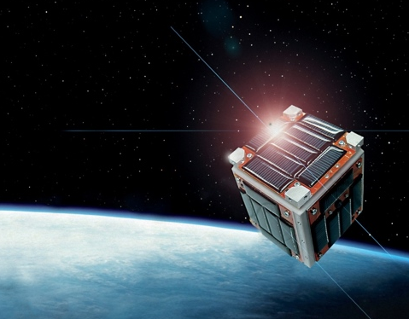
Picosatellite Computer Architecture Development
Project objectives are to design and prototype implementation of a system consisting of microprocessor (8bit architecture ATmega, PIC, or 32bit architecture ARM, SPARC or equivalent) and a low-power SRAM
FPGA on one board,
mechanically compliant
with Cubesat standard.

Slide 11
ASIC Design Office:
Background and competences
ASIC design skills;
VHDL implementation of data processing algorithms;
Knowledge of integrated circuit manufacturing.

Slide 12
ASIC design activities:
Main activities
X-fab technology study
MISAC
Mixed-signal ASIC technology harmonization
ERATO/DEMETER

Slide 13
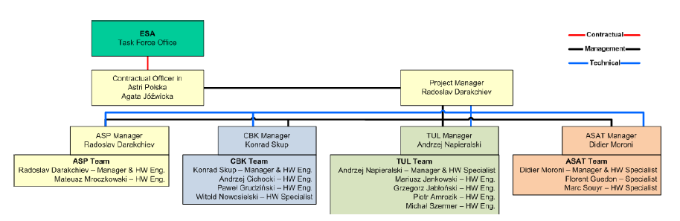
MISAC
Mixed-signal ASIC controller for DC/DC power converters
Preparatory study for 99 948,61 EUR
Duration: 6 months
Start: 15th MAY

Slide 14
Small-size and Small-series Equipment:
Background and competences
µC-based cricuit design;
Hardware-near programming;
PCB design;
Experience in using µCs for GNSS and radio applications (including SDR).

Slide 15
Small-size and Small-series Equipment:
Main activities
PAS/ROHAN
SatBubble/SNIPER
ANCHOR
THRUST
GLUCOSE

Slide 16
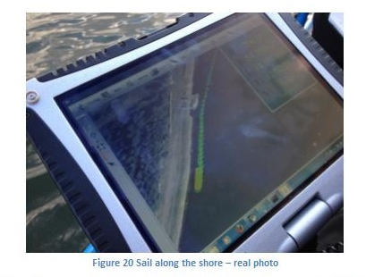
ANCHOR
EU Bonus project
Improving safety over the Baltic sea area
Concept includes ROHAN as well as environmental sensors and usage of Galileo GNSS.
Real usage of Pilot Assist module on a ship.

Slide 17
Applications and services department:
Involved in providing solutions using the latest satellite technologies, for the most accurate answer to your needs.
Producing on demand:
  Crisis managements systems.
  3D city (cities presentation over the internet).
  GNSS design and prototyping.
  Telecommunications by satellite.
  Earth observations.

Slide 18
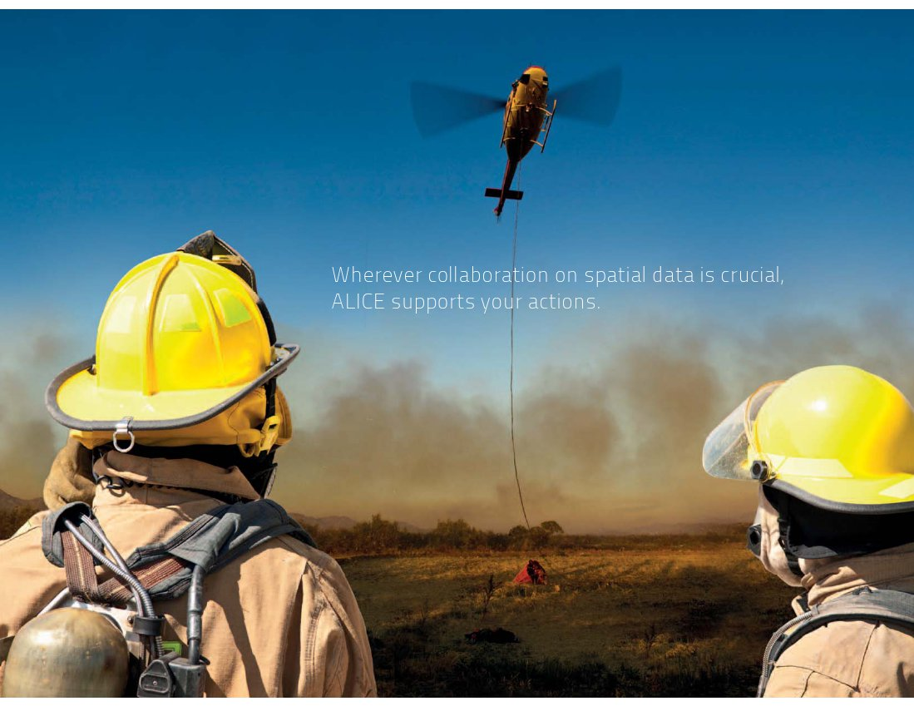

Slide 19
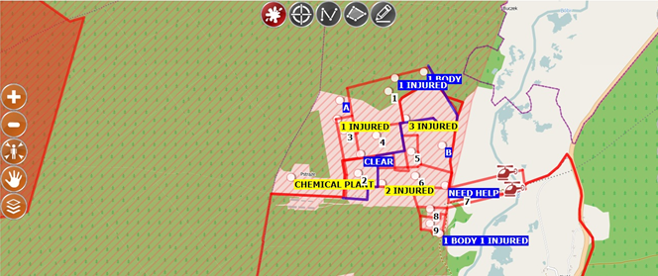
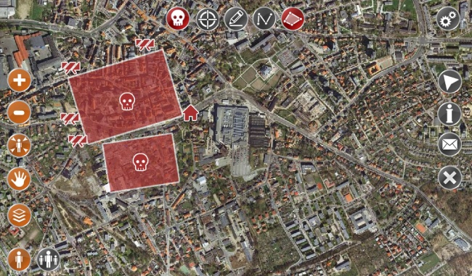
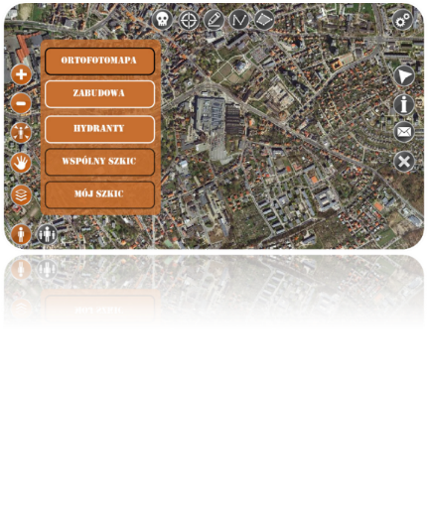
To share operational picture and to support decision shared geographic environment is essential.
The system allows:
  Overlay all types of geographical data.
  Exchange information with the field units.
  Track vehicles and show their localisation to all other units.
  Perform analysis on different levels.
  Feed the system in real time with pictures, video, UAV’s data,
  satellite images, new GIS layers.
  Could be used also by simple WWW interface on Smartphone/laptop.
  Could be shared over internet with external decision makers and beneficent.
  Record history.

Slide 20
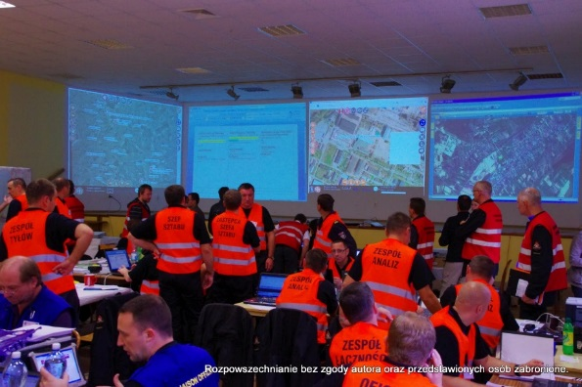
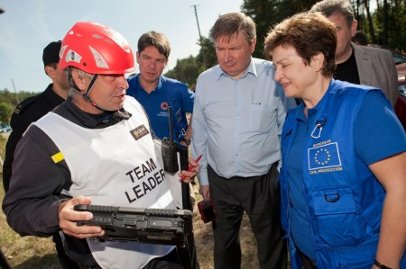
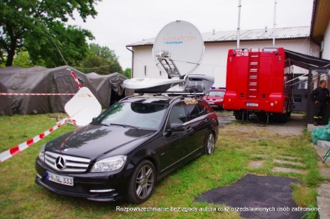
ALICE „in action” – Carpathex 2011
Over 500 participants from: Poland, Ukraine, Czech Republic, Hungary.
Observers from the whole Europe, including representatives of EC and EU Commissioner for International Cooperation, Humanitarian Aid and Crisis Response.

Slide 21
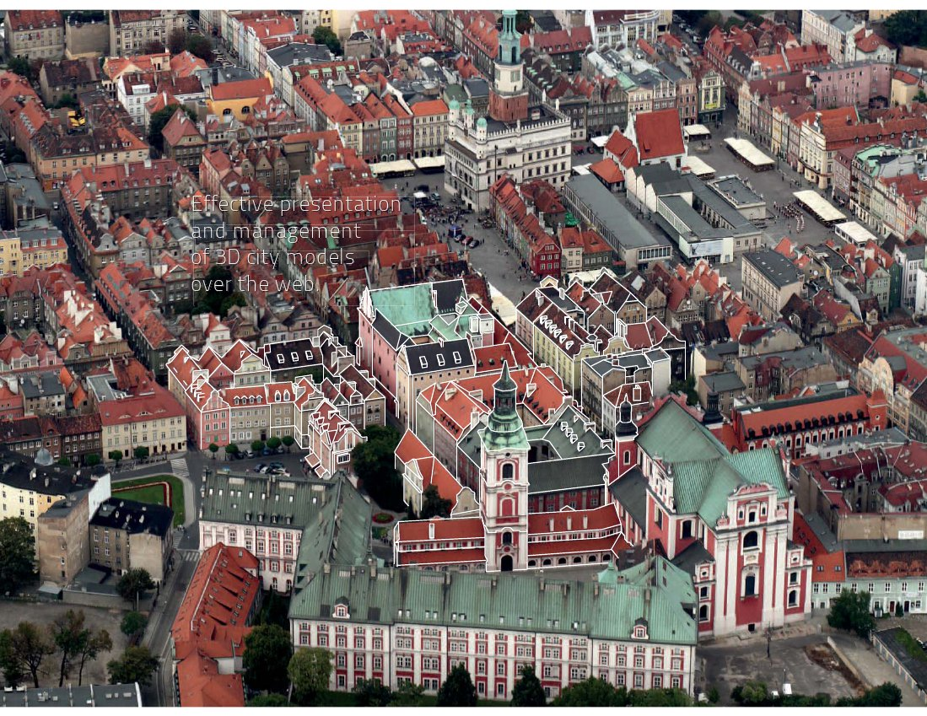

Slide 22

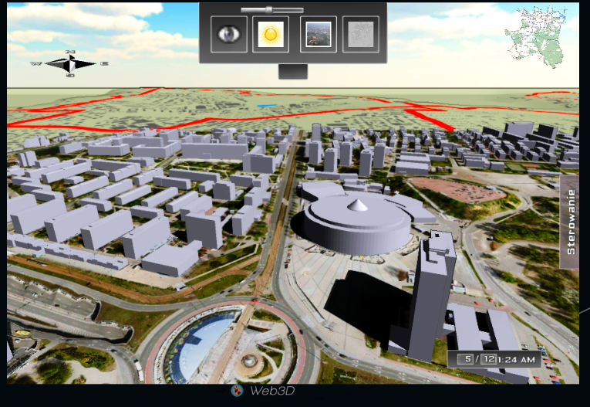
Astri Polska can provide you a 3D visualization of a city on the internet. Compatible with all the internet devices and browsers, thanks to our unique graphic engine.
System allows:
  Usrbanisation, tourism
  security or crisis management use.
  Different lyers, with high quality
  satellites images.
  Dynamic effects (smoke, water, shadows).
  Field of view analysis.

Slide 23
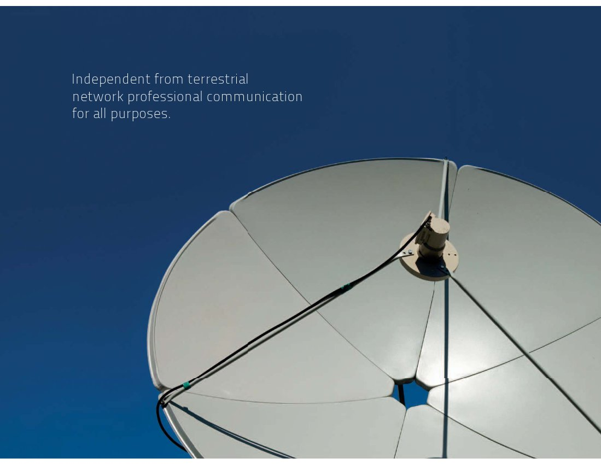

Slide 24

Astrium unique competences and assets in Secure Satellite Communication allows Astri Polska’s customers to receive a communication solution tailored to their precise needs.
System’s features/technical parameters:
Network architecture, creation and management in C, Ku and X-band.
Access to a wide range of terminals, including transportable, maritime, airborne and communication on the move.
Independence from terrestrial infrastructure.
Advanced services including well organized welfare system on satellite link, including network access, voice connection and GSM roaming for individual soldiers.
Astri Polska engineers support for all types of network.
Complete solutions from design, through implementation and training.
Access to the largest commercially available X-band satellite capacity via Astrium’s satellites.
Availability of number of professional hub stations for customer network anchoring.

Slide 25

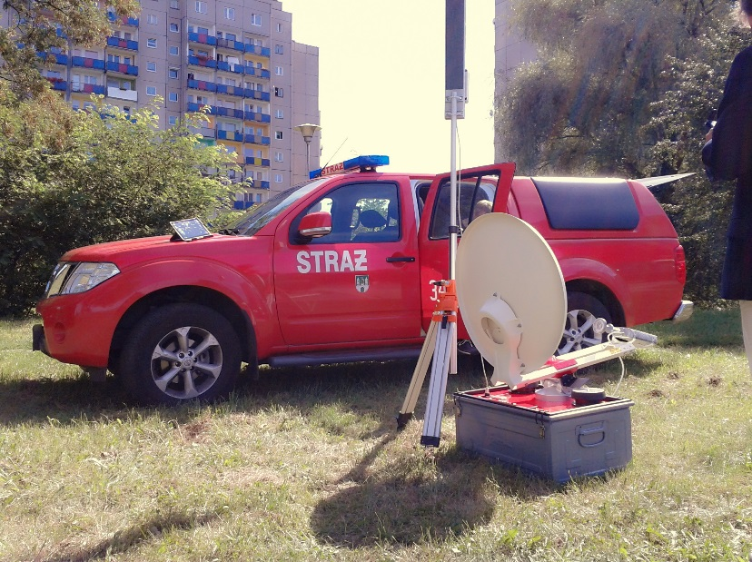
In the domain of satellite communications,
Bubble is a low cost, easy to use and fast deploying solution,
totally independent from terrestrial networks.
System’s features/technical parameters:
  Extreme range wifi network.
  Compatible with all wifi devices.
  Easily transportable, with a motorized antenna
  for a fast deployment.
  Wifi power modulation, for legal restrictions,
  or crisis management.

Slide 26
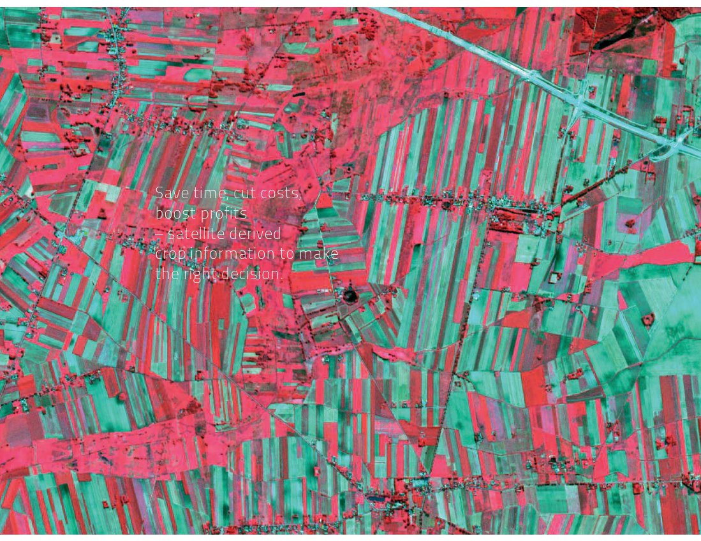

Slide 27

Commercial agriculture relies more and more on a wide range of modern technological solutions. Thanks to the agriculture monitoring solution, Astri Polska offers a solution to control, analyze and improve the crop management, in order to increase efficiency and profitability
System’s features/technical parameters:
  Satellite vision of crops for a fast evaluation.
  Analysis of the ground movement.
  Analysis using infrared imagery to observe plants before it becomes apparent to human eye.
  Precise fertilizing.
  A useful help to detect damaged areas.

Slide 28
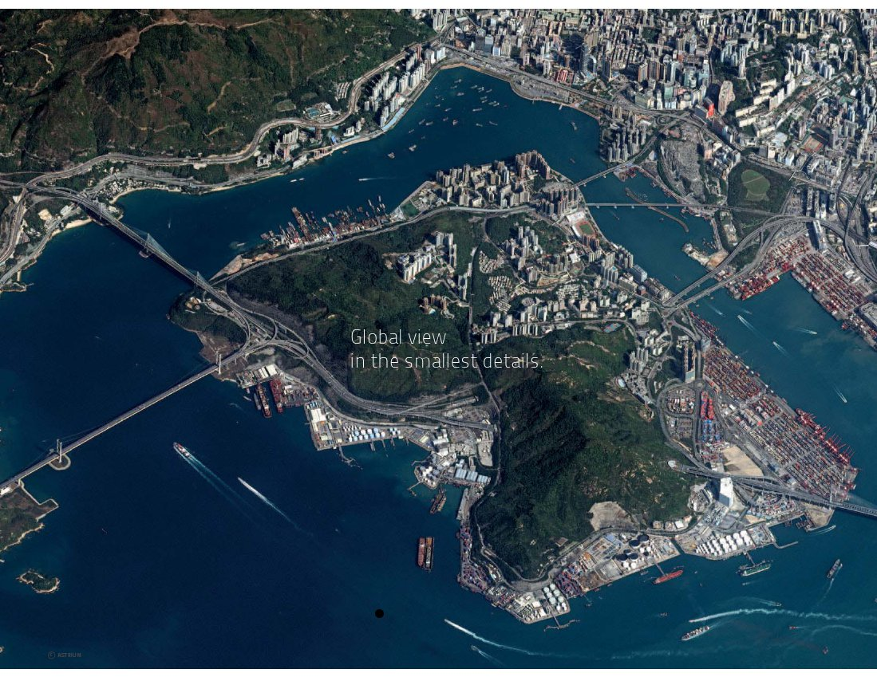

Slide 29

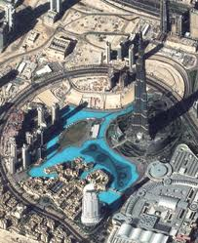
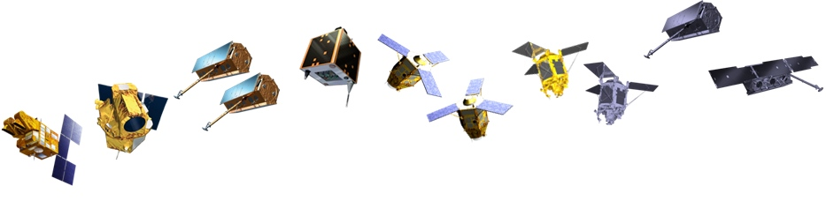
Access to Airbus defense and space’s earth observation system, thanks to the imaging process expertize of Astri Polska.
System’s features/technical parameters:
Many fields of application (agriculture, crisis management, environment, urbanization…)
Resolution down to 50cm thanks to Pléiades Satellites Constellation.
Full interpretation chain of images.
Many devices (including twin satellites) with a daily revisit for all kind of observations and budget.

Slide 30
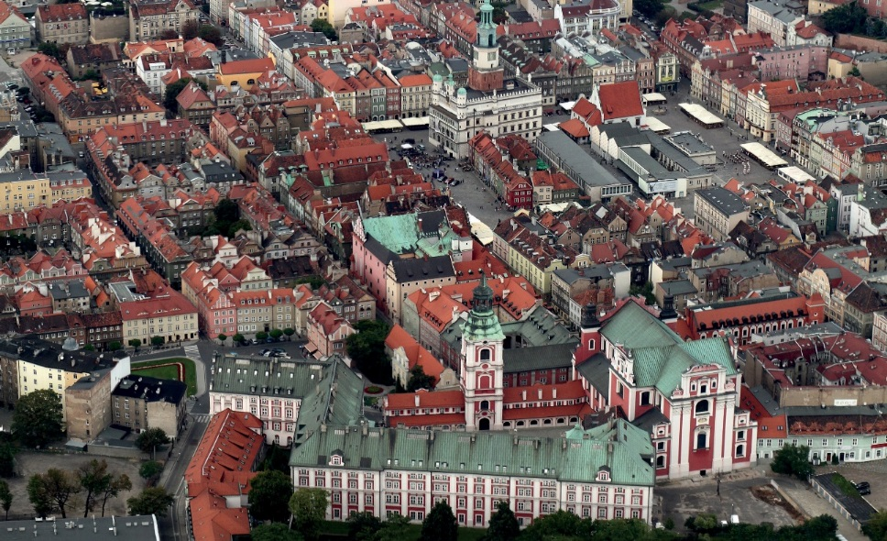

Thank you for your attention
Contact:
Astri Polska Sp. z o.o.
Bartycka 18a 00-716 Warsaw
P: +48 (22) 49 66 205
F: +48 (22) 84 00 198
E-mail: office.astripolska@astripolska.pl

Slide 31
Back up

Slide 32
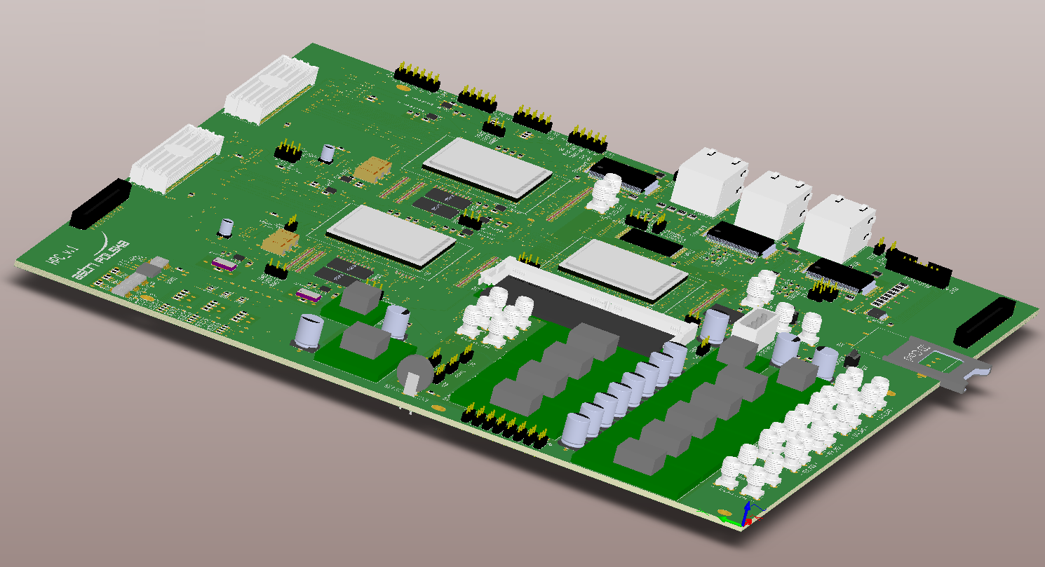
High-performace Computing forHPC Space Applications
HPC
High-performance and reconfigurable OBC.
3 FPGAs working in several configurations.
high real-time data processing capability.

Slide 33
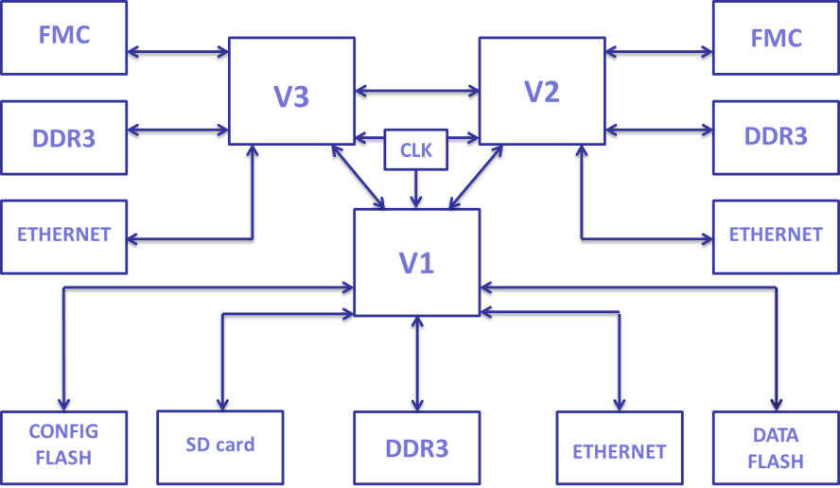
High-performance Computing for Space Applications
3 interconnected Virtex 6 FPGAs;
Expected real-time data processing capability: 2,5 GB/s (i.e. for image processing);
Up to 10 GB of RAM;
Various types of communication interfaces (high speed serial links, Ethernet, ect.)

Slide 34
Picosatellite Computer Architecture Development
Telecommands execution
On-board telemetry gathering and reporting
Power control
Payload control and data processing
Implementation of attitude control system and Software Defined Radio algorithms
Common fieldbus communication links (CAN, I2C, UART)
Additional fast serial communication links (up to 3 Gbps per link)
Hardware and software mechanisms for radiation induced errors mitigation

Slide 35
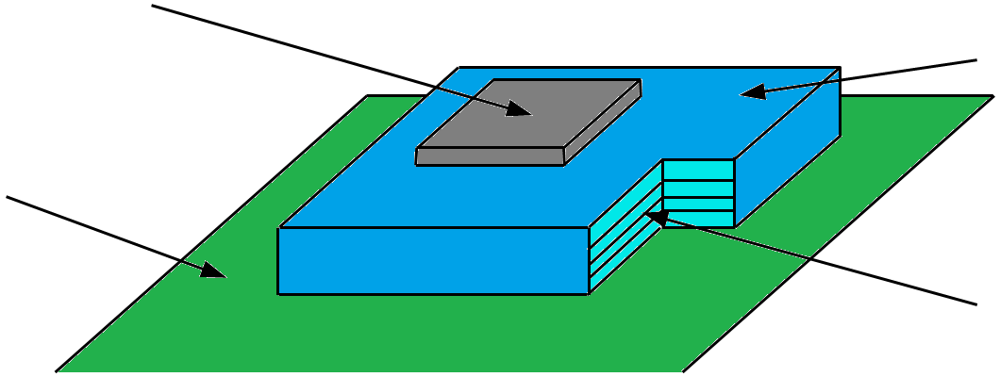
FAMILIAR
FPGA
module’s substrate
PCB
passive components on internal layers

Slide 36
FAMILIAR
Pre-designed FPGA circuits;
A fanout from the FPGA that is already designed and manufactured;
A pre-soldered FPGA onto a PCB, so the end-user needs less sophisticated soldering technology;
Blocking capacitors already in the structure of the product;
Thermal parameters, that will allow the FPGA to resist to important temperature changes in space environment.

Slide 37
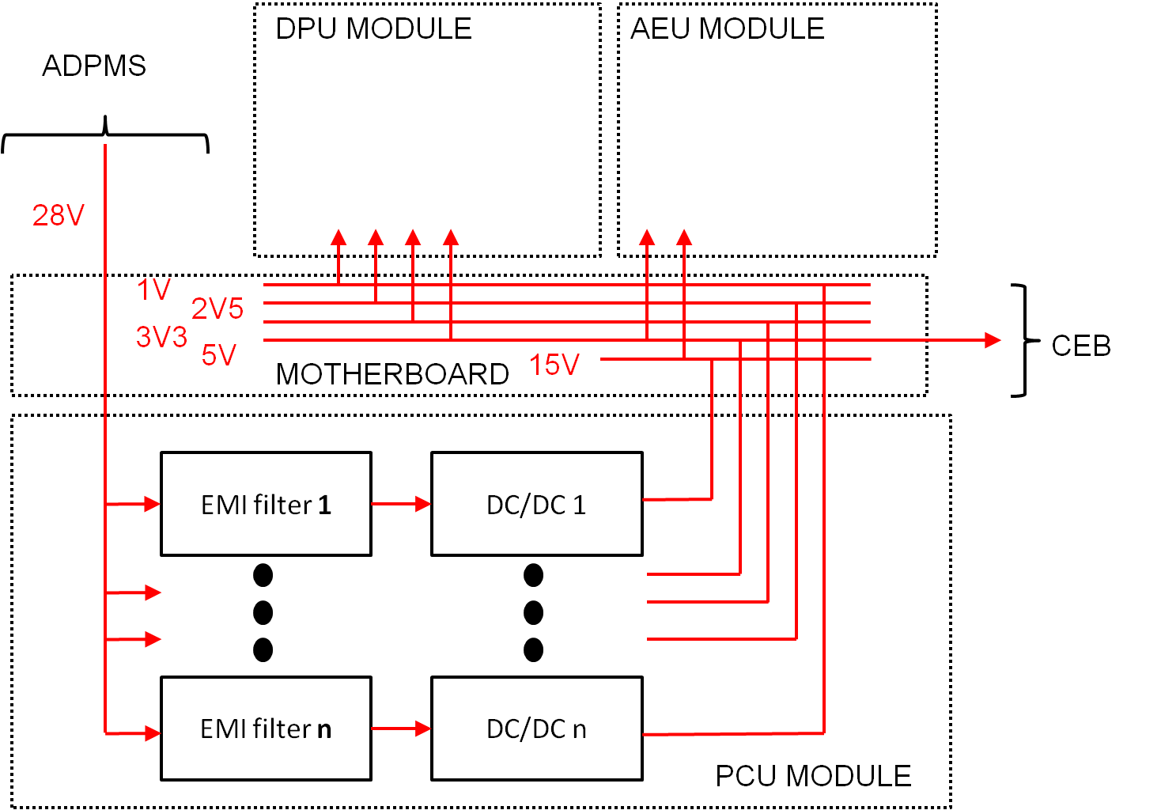
Power Conditioning Unit for PROBA-3

Slide 38
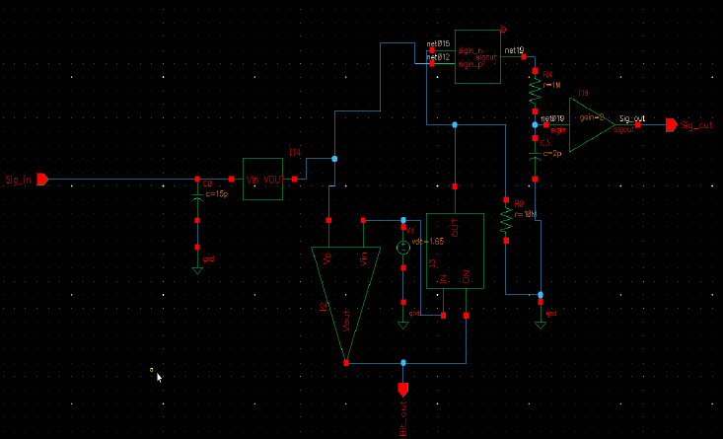
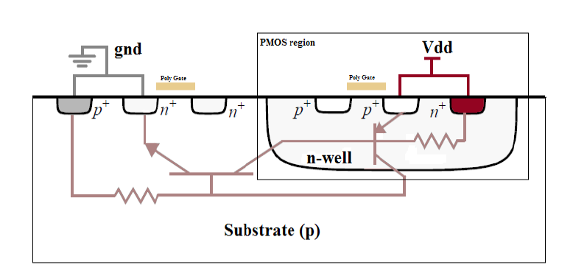
X-fab technology study
Collaboration with Lodz University of Technology

Slide 39
Mixed-signal ASIC technology
ITT answered in collaboration with ISD
Astri Polska would analyse State-of-the-Art

Slide 40
DEMETER
        JU ENIAC activity
        Making Europe independent from US sources of space-grade FPGA’s
Astri Polska will prepare the demonstration platform
Astri Polska budget is 745 200 EUR

Slide 41
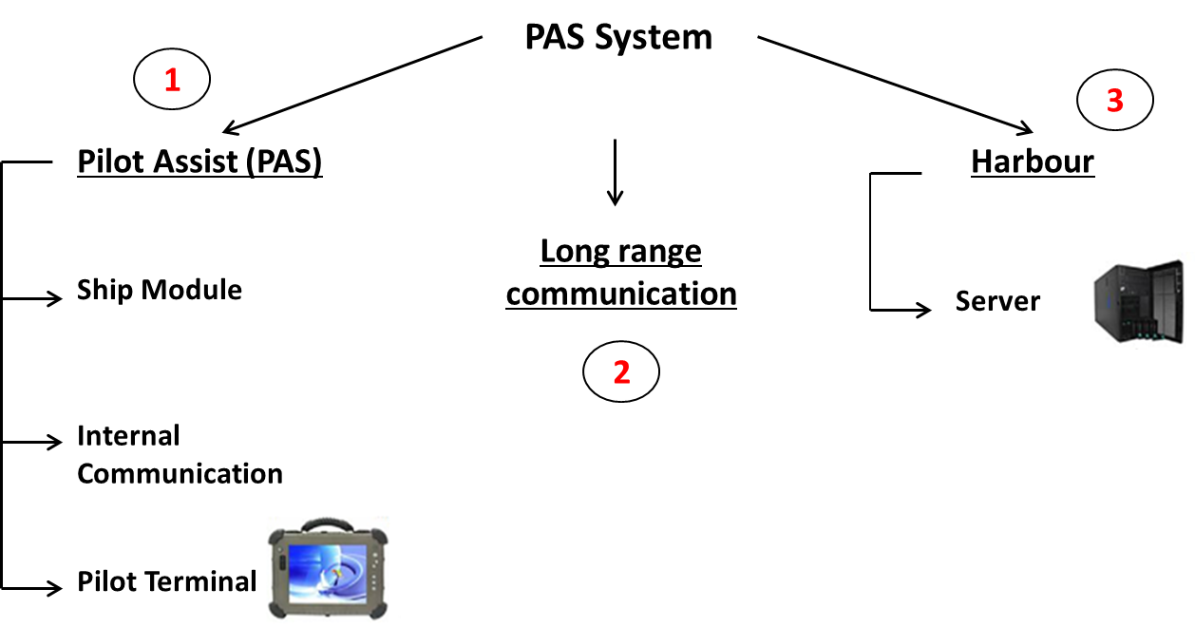
PAS/ROHAN
Pilot Assist for Ships/Robust Harbour Navigation
Help for pilots to enter a harbour with big ship

Slide 42
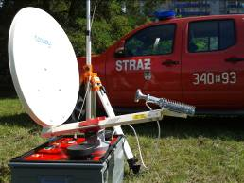
SatBubble/SNIPER
Assistance for crisis management
Establishing Internet access in field
Satellite internet distributed through WiFi
Real usage of SatBubble.

Slide 43
THRUST/GLUCOSE
Identification of jamming/spoofing of GNSS signal
Processing Galileo PRS signal on a qualified server, using non-qualified receivers

