Slide 1
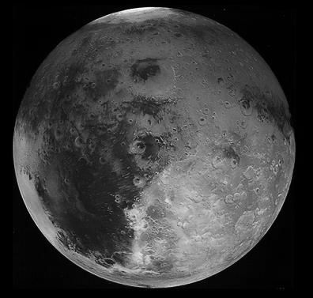
Mars - Connecting Planetary Scientists in Europe, Warsaw 3-5 June 2014
Mechanical modelling of deep-seated gravitational spreading in Valles Marineris, Mars
Magdalena Makowska,
Daniel Mège¹
Frédéric Gueydan²
¹Institute of Geological Sciences, Polish Academy of Sciences,
Wrocław, Poland
²Géosciences Montpellier, Université de Montpellier 2, France

Slide 2
Outline
What I am looking for?
Deep – seated gravitational slope deformation on Earth and analogs on Mars
Data
Working Hypothesis
Reference model
Results
Summary and Perspective

Slide 3
What I am looking for?
Crestal graben
Uphill-facing scarps

Slide 4
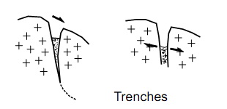
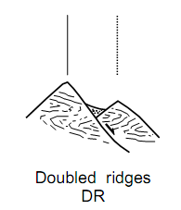
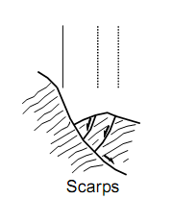
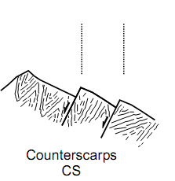
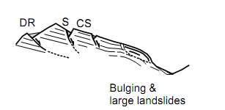
Deep-seated gravitational slope deformation on Earth and analogs on Mars
Data
Working Hypothesis
Reference model
Results
Summary and Perspective
Definition of deep-seated gravitational slope deformation
Defined in different ways → slope movements occurring in high relief energy hillslope, with size comparable to the whole slope and small displacement.
Origin
Active faults? (Forcelle and Orombelli, 1984)
Glaciation ?(Nemcok and Pasek, 1969)
Geology ?(Agilard and Crosta and Zanchia, 2001)
Diagnostic features of deep-seated gravitational slope deformation
Agilardi F., Crosta G., Zanchia A., 2001. Structural constrains on deep-seated slope deformation kinematics. Engineering Geology 59, 82-102.

Slide 5
Deep-seated gravitational slope deformation on Earth and analogs on Mars
Data
Working Hypothesis
Reference model
Results
Summary and Perspective
Earth
Mars
a
b
Crestal graben
c
d
Uphill-facing scarps
Fig. 1 Comparison of deep-seated gravitational slope deformation on Earth and Mars. a, Tatra Mountains near Kondracka Kopa, Poland. b, crest of Geryon Montes, Valles Marineris, Mars. c, View of Chabenec ridge, Tatra Mountains, Slovakia. d, View of crest in Melas Labes, Valle Marineris Mars (all figures satellite image made avaible by google earth)

Slide 6
Deep-seated gravitational slope deformation on Earth and analogs on Mars
Data
Working Hypothesis
Reference model
Results
Summary and Perspective
Earth
Mars
Fig. 2 a, View of crestal graben at Bodeneck, Austrian Alps. b, view of crestal graben at Geryon Montes, Mars. c, Uphill-facing fault scarps in Tyrol,Austria. d, Uphill-facing fault scarps in Melas – Candor Chasma. e, same as c, prependicular view. F, Uphill-facing fault scarps in Candor – Ophir. Mege D., Bourgeois O., 2011. Equtorial glaciation on Mars revealed by gravitational collapse of Valles Marineris wallslopes. Earth and Planetary Science Letters 310. 182-191

Slide 7
Deep-seated gravitational slope deformation on Earth and analogs on Mars
Data
Working Hypothesis
Reference model
Results
Summary and Perspective
Ophir Chasma
Ophir Chasma
260⁰
270⁰
Geryon Montes
280⁰
290⁰
300⁰
310⁰
320⁰
0⁰
5 km
5 km
5 km
9⁰
Coprates Chasma
Melas Chasma
Candor Chaos
5 km
JMars
5 km
5 km
5 km

Slide 8
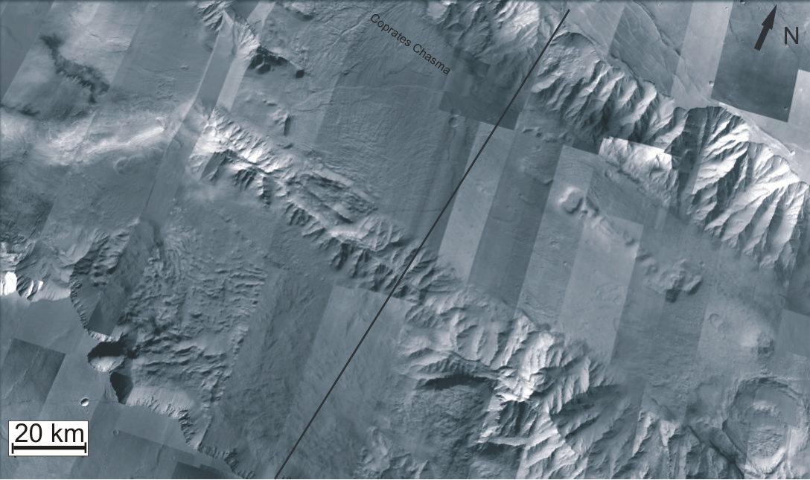
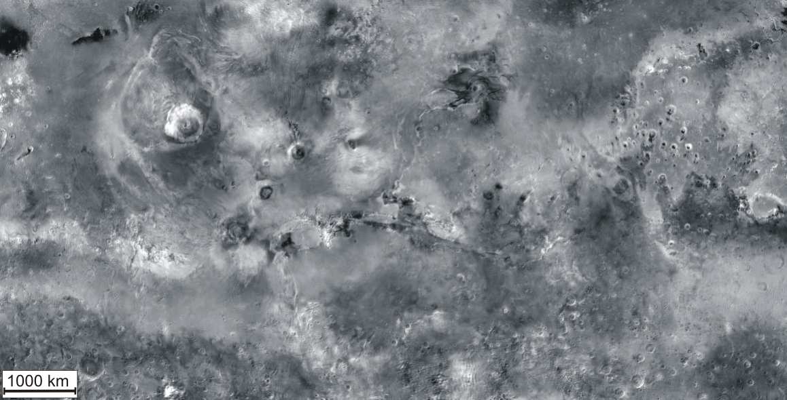
Deep-seated gravitational slope deformation on Earth and analogs on Mars
Data
Working Hypothesis
Reference model
Results
Summary and Perspective
N
S
Plateau
Internal ridge
Hummocky terrain
Valley
Google Mars
Google Earth

Slide 9
Deep-seated gravitational slope deformation on Earth and analogs on Mars
Data
Working Hypothesis
Reference model
Results
Summary and Perspective
N
Double crest
[m]
Trimline
?
5 km
[km]
Kromuszczyńska O. et al. (2012). Giant sackung scarps in Valles Marineris. 43rd LPSC, 1161.pdf.

Slide 10
Deep-seated gravitational slope deformation on Earth and analogs on Mars
Data
Working Hypothesis
Reference model
Results
Summary and Perspective
Simplified Situation
?
Glacier loading then unloading
Activation of pre-existing faults, joints, pore water pressure
Geological discontinuities

Slide 11
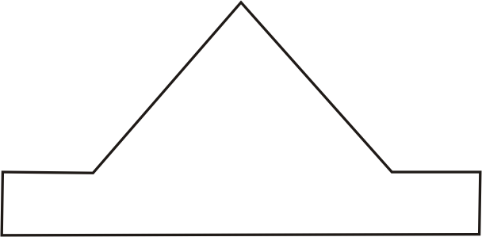
Deep-seated gravitational slope deformation on Earth and analogs on Mars
Data
Working Hypothesis
Reference model
Results
Summary and Perspective
Destabilization due to glacier loading and unloading
Activation of pre-existing faults, joints, pore water pressure
Pressure
VARIABLES
φ – friction angle
c – cohesion
CONSTANT
Young Modulus = 2,89 GPa
Poisson ratio = 0,25
Density = 2,8 g/cm³
Time
Slope α = 30⁰, angle of friction φ = 15⁰, cohesion c=3,0 MPa
2D Finite Element Code created and developed by Jean Chéry and Riad Hassani, results are displayed using xadeli software.

Slide 12
Deep-seated gravitational slope deformation on Earth and analogs on Mars
Data
Working Hypothesis
Reference model
Results
Summary and Perspective
Destabilization due to glacier loading and unloading
Geological discontinuities
Pressure
VARIABLES
φ – friction angle
c – cohesion
CONSTANT
Young Modulus = 2,89 GPa
Poisson ratio = 0,25
Density = 2,8 g/cm³
Time
Slope α = 30⁰, angle of friction φ = 15⁰, cohesion c=3,0 MPa
2D Finite Element Code created and developed by Jean Chéry and Riad Hassani, results are displayed using xadeli software.

Slide 13
Deep-seated gravitational slope deformation on Earth and analogs on Mars
Data
Working Hypothesis
Reference model
Results
Summary and Perspective
Cohesion c
3.0
6.0
[MPa]
1.25
Slope angle 30 ⁰ Final Step
[MPa]
[MPa]
[MPa]
0,1
0,1
0,1
10⁰
0,08
0,08
0,08
0,06
0,06
0,06
0,04
0,04
0,04
0,02
0,02
0,02
6,0x10⁻⁴
6,0x10⁻⁴
6,0x10⁻⁴
[MPa]
[MPa]
[MPa]
0,1
0,1
0,1
15⁰
0,08
0,08
0,08
0,06
0,06
0,06
0,04
0,04
0,04
Effective friction angle φ
0,02
0,02
0,02
6,0x10⁻⁴
6,0x10⁻⁴
6,0x10⁻⁴
[MPa]
[MPa]
[MPa]
0,1
0,1
0,1
20⁰
0,08
0,08
0,08
0,06
0,06
0,06
0,04
0,04
0,04
0,02
0,02
0,02
6,0x10⁻⁴
6,0x10⁻⁴
6,0x10⁻⁴
[MPa]
[MPa]
[MPa]
30⁰
0,1
0,1
0,1
0,08
0,08
0,08
0,06
0,06
0,06
0,04
0,04
0,04
0,02
0,02
0,02
6,0x10⁻⁴
6,0x10⁻⁴
6,0x10⁻⁴

Slide 14
Deep-seated gravitational slope deformation on Earth and analogs on Mars
Data
Working Hypothesis
Reference model
Results
Summary and Perspective
Cohesion c
3.0
6.0
[MPa]
1.25
Slope angle 30 ⁰ Final Step
[MPa]
[MPa]
0,1
0,1
10⁰
0,08
0,08
0,06
0,06
0,04
0,04
0,02
0,02
6,0x10⁻⁴
6,0x10⁻⁴
[MPa]
[MPa]
[MPa]
0,1
0,1
0,1
15⁰
0,08
0,08
0,08
0,06
0,06
0,06
0,04
0,04
0,04
Effective friction angle φ
0,02
0,02
0,02
6,0x10⁻⁴
6,0x10⁻⁴
6,0x10⁻⁴
[MPa]
[MPa]
[MPa]
0,1
0,1
0,1
20⁰
0,08
0,08
0,08
0,06
0,06
0,06
0,04
0,04
0,04
0,02
0,02
0,02
6,0x10⁻⁴
6,0x10⁻⁴
6,0x10⁻⁴
[MPa]
[MPa]
[MPa]
0,1
0,1
0,1
30⁰
0,08
0,08
0,08
0,06
0,06
0,06
0,04
0,04
0,04
0,02
0,02
0,02
6,0x10⁻⁴
0,0006
0,0006

Slide 15
Deep-seated gravitational slope deformation on Earth and analogs on Mars
Data
Working Hypothesis
Reference model
Results
Summary and Perspective
Summary:
Modelling showed evolution of instability with time depending on different set-ups.
Accumulation of plastic strain in the top part of the model (first case) probably leads to ridge top-splitting.
The bulged morphology produced in first case is not observed on Mars hillslope at present time.
The most important parameter influencing slope stability are: cohesion, angle of internal friction and slope angle.
Presences of geological discontinuities (second case) decreased rock strength and complicate the situation therefore it’s harder to predict how instability will develop. Prediction of how instability will develop requires therefore accurate observational constraints.
Perspective:
Test a different symmetry of the model:
Asymmetric wallslope
Downslope incision
Apply this method to the Earth conditions.

