Slide 1
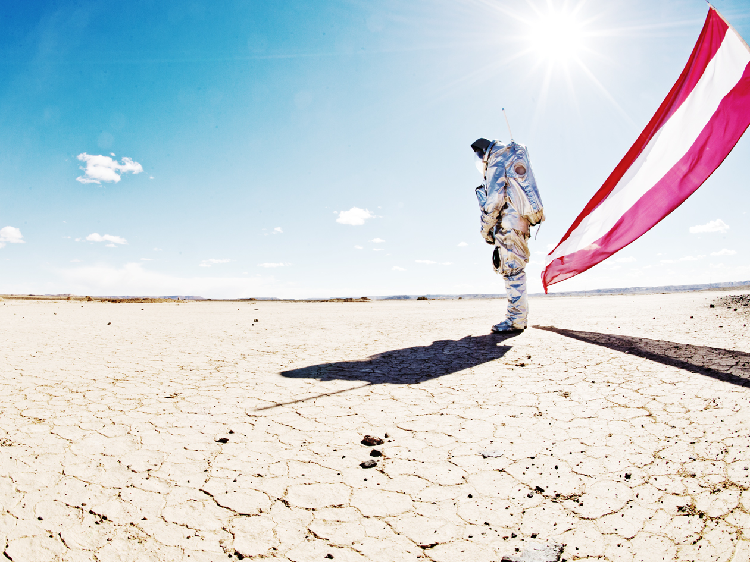
Highlights from the MARS2013 Mars Analog Expedition
Gernot Groemer, Anna Losiak
and the MARS2013 team
Austrian Space Forum

Slide 2
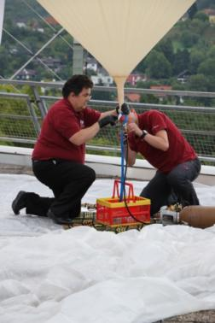
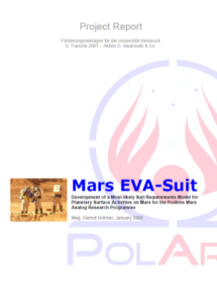
PolAres research programme
Passepartout stratospheric ballon & Pegasus sat. h/w
Phileas rover
Aouda spacesuit simulator
Goal: preparing exploration strategies for a human-robotic Mars expedition with a focus on planetary protection.
PolAres reference mission architecture

Slide 3
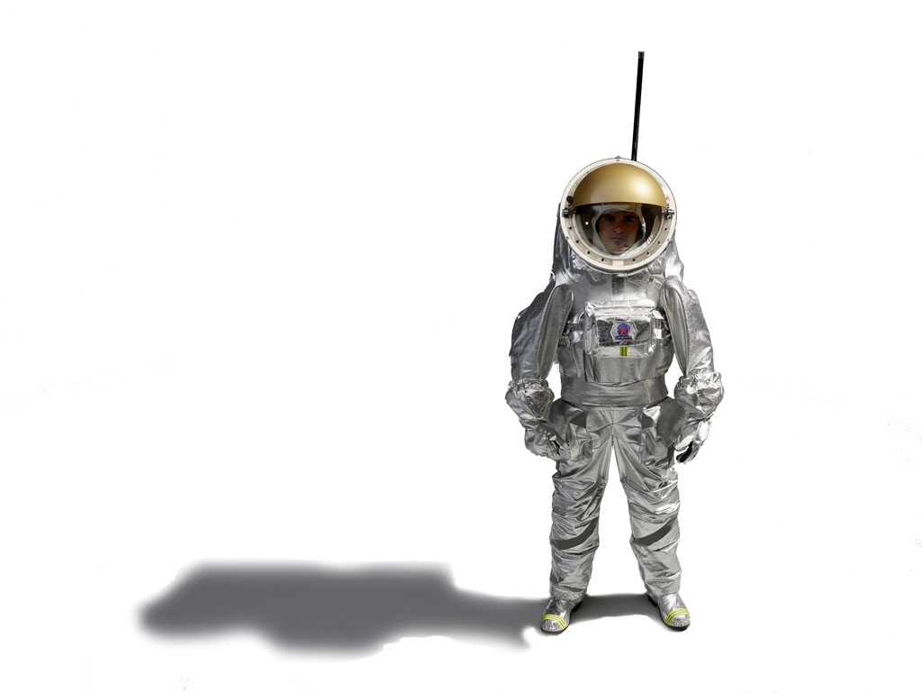
Aouda.X spacesuit simulator prototype
Based upon NASA DRM 5.0 & Aurora
NASA Human-System Standard STD-3000 & MIL-STD-882c
<45 kg, unpressurized, Hard-Upper Torso, custom-built OBDH and advanced human-machine-interface
Outer layer optimized for planetary protection, 4-6 hours field operations
Broadband telemetry
Groemer et al., 2012, The Aouda.X space suit simulator and its applications Astrobiology. February 2012, 12(2): 125-134.

Slide 4
Previous system integration field tests
Field-Test 1 – Comissioning - July 2009, Kramsach, Austria
Field-Test 2 - Pasterze-Glacier, August 2009, Austria
Field-Test 3 - Cryo-Test, September 2009, Seefeld, Austria
Field-Test 4 – Eifel-region, September 2009, Germany
Field-Test 5 – Koppenbrueller-Cave, January 2010, Austria
Field-Test 6 - Innsbruck,May 2010, Austria
Field-Test 7 – Kaunertal Glacier, July 2010, Austria
Field-Test 8 – Rio Tinto Integrated Sim, April 2011, Spain
Field-Test 9 – Dachstein Ice Caves, May 2012, Austria
Field test complexity

Slide 5
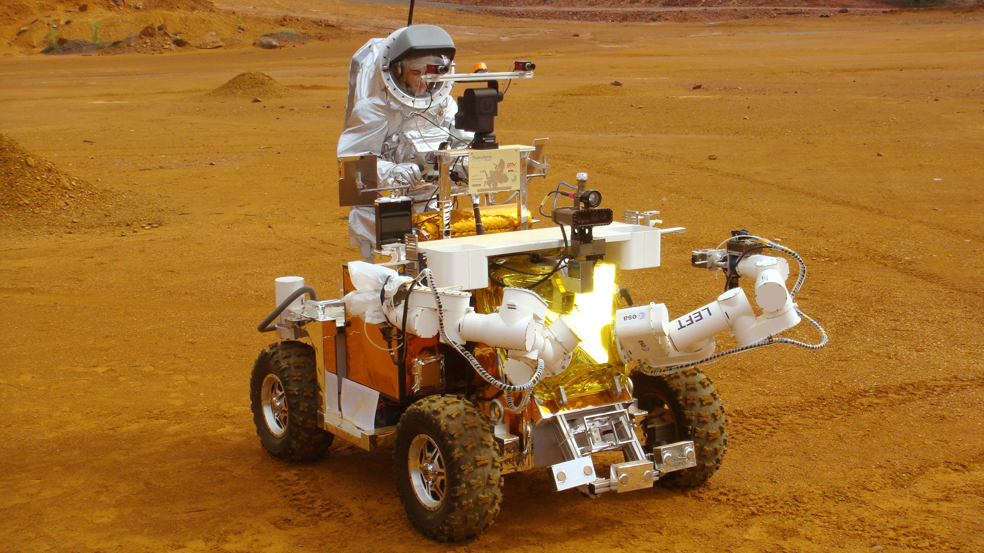

Slide 6
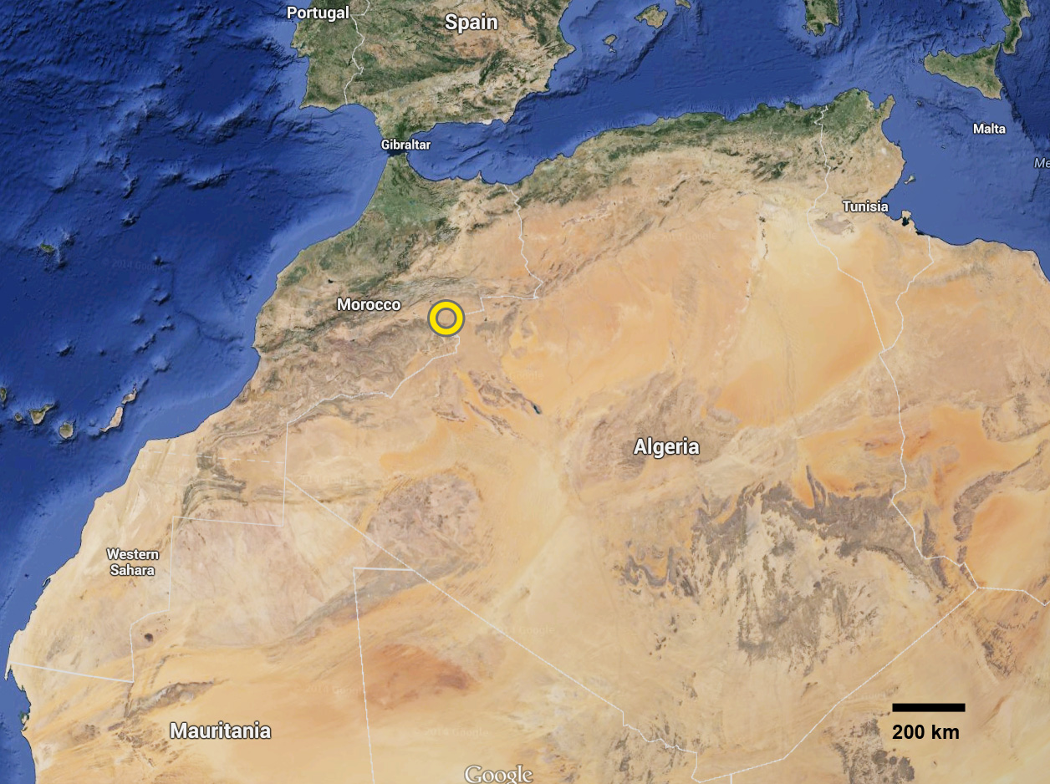

Slide 7
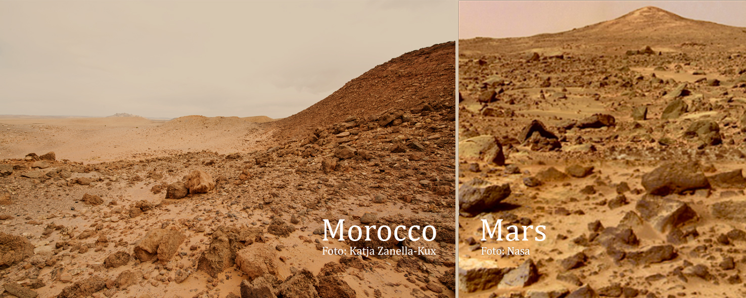
Groemer, G. et al. (2014) The MARS2013 Mars analog mission. Astrobiology 14:360–376.

Slide 8
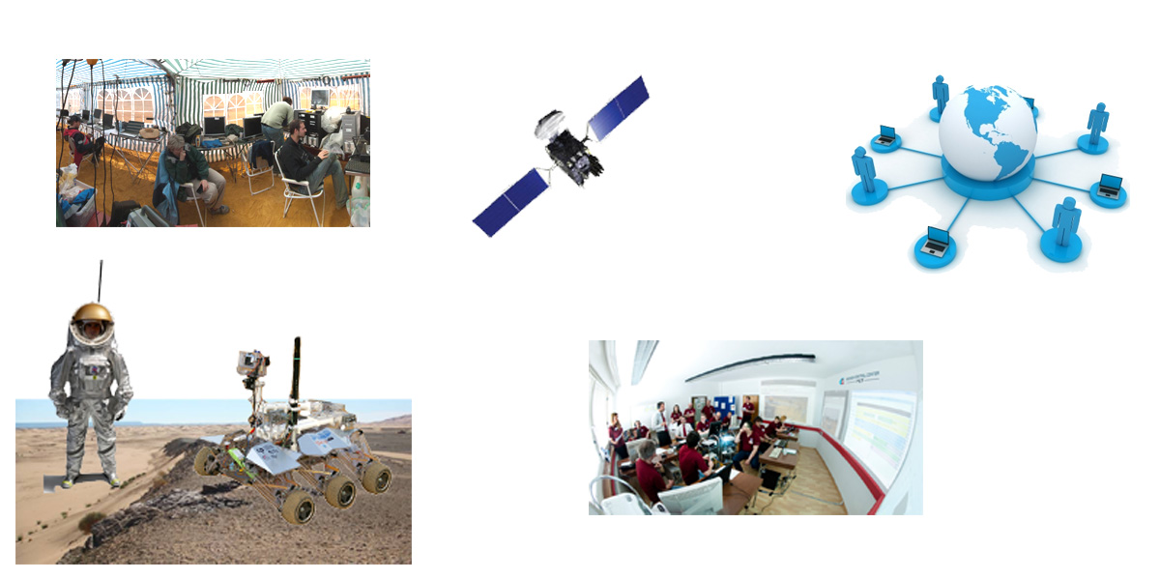
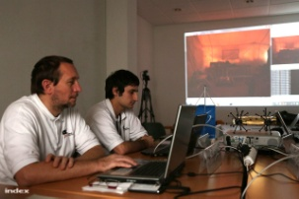
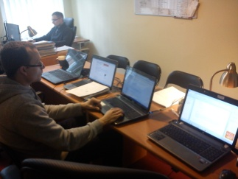
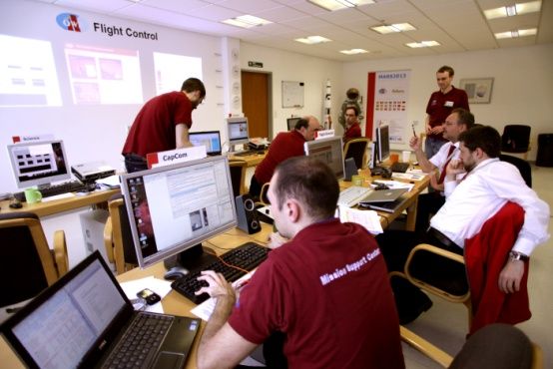
Field operations („OPS“)
Remote Sci. Teams/Public
Satellite link
Mission Support Center
Field crew & experiments

Slide 9
Experiment | Description | Organisation, PI
AMFS-MEDINC | MEDical emergency database with recording of INCidents and near-incidents in all participants during Analog Mars Field simulations (multi-mission project) | Medical University Innsbruck, T.J. Luger
AMFS-SEG | Stress, emotion and group dynamics of the crew in the field and the members of the MSC during Analog Mars Field simulations (multi-mission project) | Medical University Innsbruck, T.J. Luger
ANTIPODES | Antipodes is an operations experiment where a loss of communication to Earth was simulated. A parallel landing party on the other side of Mars is requested to take over the coordination of an ongoing Extra-Vehicular Activity. | Kiwispace, New Zealand. H- Mogosanu
Aouda MAT | Medical Data Acquisition under various physical workload conditions & biomedical data Telemetry (multi-mission study) | Medical University Innsbruck, T.J. Luger
AOUDA.X/.S | Operational and engineering tests with two spacesuit simulators | Austrian Space Forum, AT, G. E. Groemer
CLIFFBOT CRV | Cliff Reconnaissance Vehicle: a human-guided steep terrain explorer | Association Planète Mars, FR, A. Souchier
DELTA | Human factors - work economics, time delay for an analog astronaut with and without Aouda.X | Austrian Space Forum, AT, A. Soucek
Deployable Shelter | Deployable Emergency Shelter suitcase for astronauts | University of Technology, Vienna, AT, S. Haeuplik-Meusburger
ERAS C3 | Command & Control software project for data processing in the field | Mars Society Italy, F. Carbonari
Geosciences | Geoscience remote science support experiments; included the management of all geophysical and astrobiological research activities as well as a mapping study | University of Budapest & University Innsbruck, C. Orgel. M. Rampey, I. Gołębiowska
Hunveyor-4 | Surveyor-class robotic lander with remote access | Eötvös Loránd University Budapest, HU, G. Hudoba
LTMS-MOROCCO | Long term medical monitoring system, biomedical chest vest | CSEM, CH, M. Correvon
Magma-White Rover | Pathfinder-class rover system, mobility & human-robotic interaction | ABM Space Education, M. Józefowicz
MAT-EP | Routine medical survey during OEWF field campaigns; includes a field incident reporting system | Medical University Innsbruck, T.J. Luger
MEDIAN | Methane Detection by In-Situ Analysis with Nano-Landers | University College London, UK, J. McArthur
microEVA | Luminescence detection of viable bacterial spores and terbium microspheres to study contamination vectors during EVAs. | NASA JPL, California Institute of Technology, A. Ponce
OPS-Box-White | An ergonomics and thermodynamics test for a foldable computer workplace | Austrian Space Forum, AT, G. Groemer
Peniculus | A student-led experiment on the efficiency of a cleaning mechanism for solar power cells | Austrian Space Forum, AT, G. Groemer
Puli-Rover | Mobility tests for the Hungarian Google Lunar X-Prize rover | GLXP Space Technologies, HU, T. Pacher

Slide 10
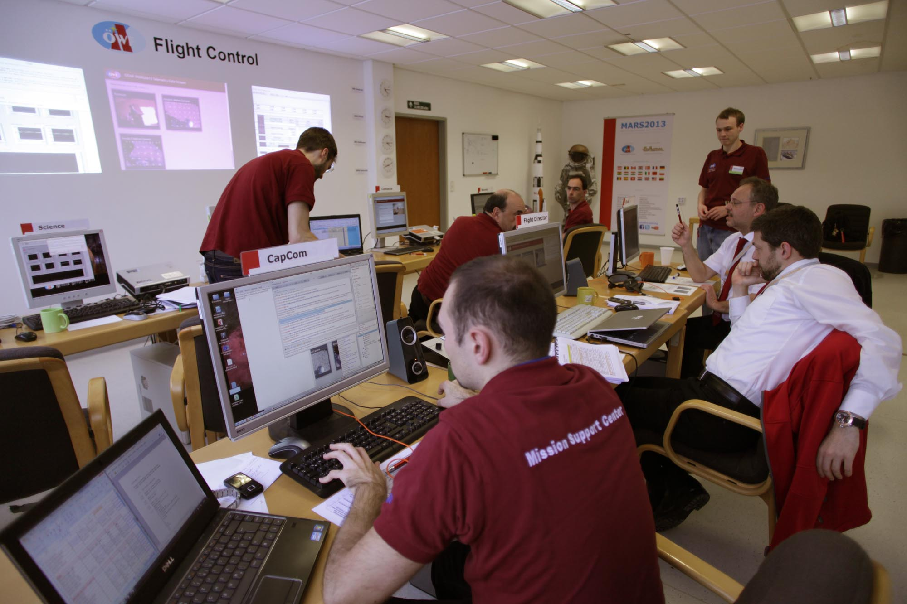

Slide 11
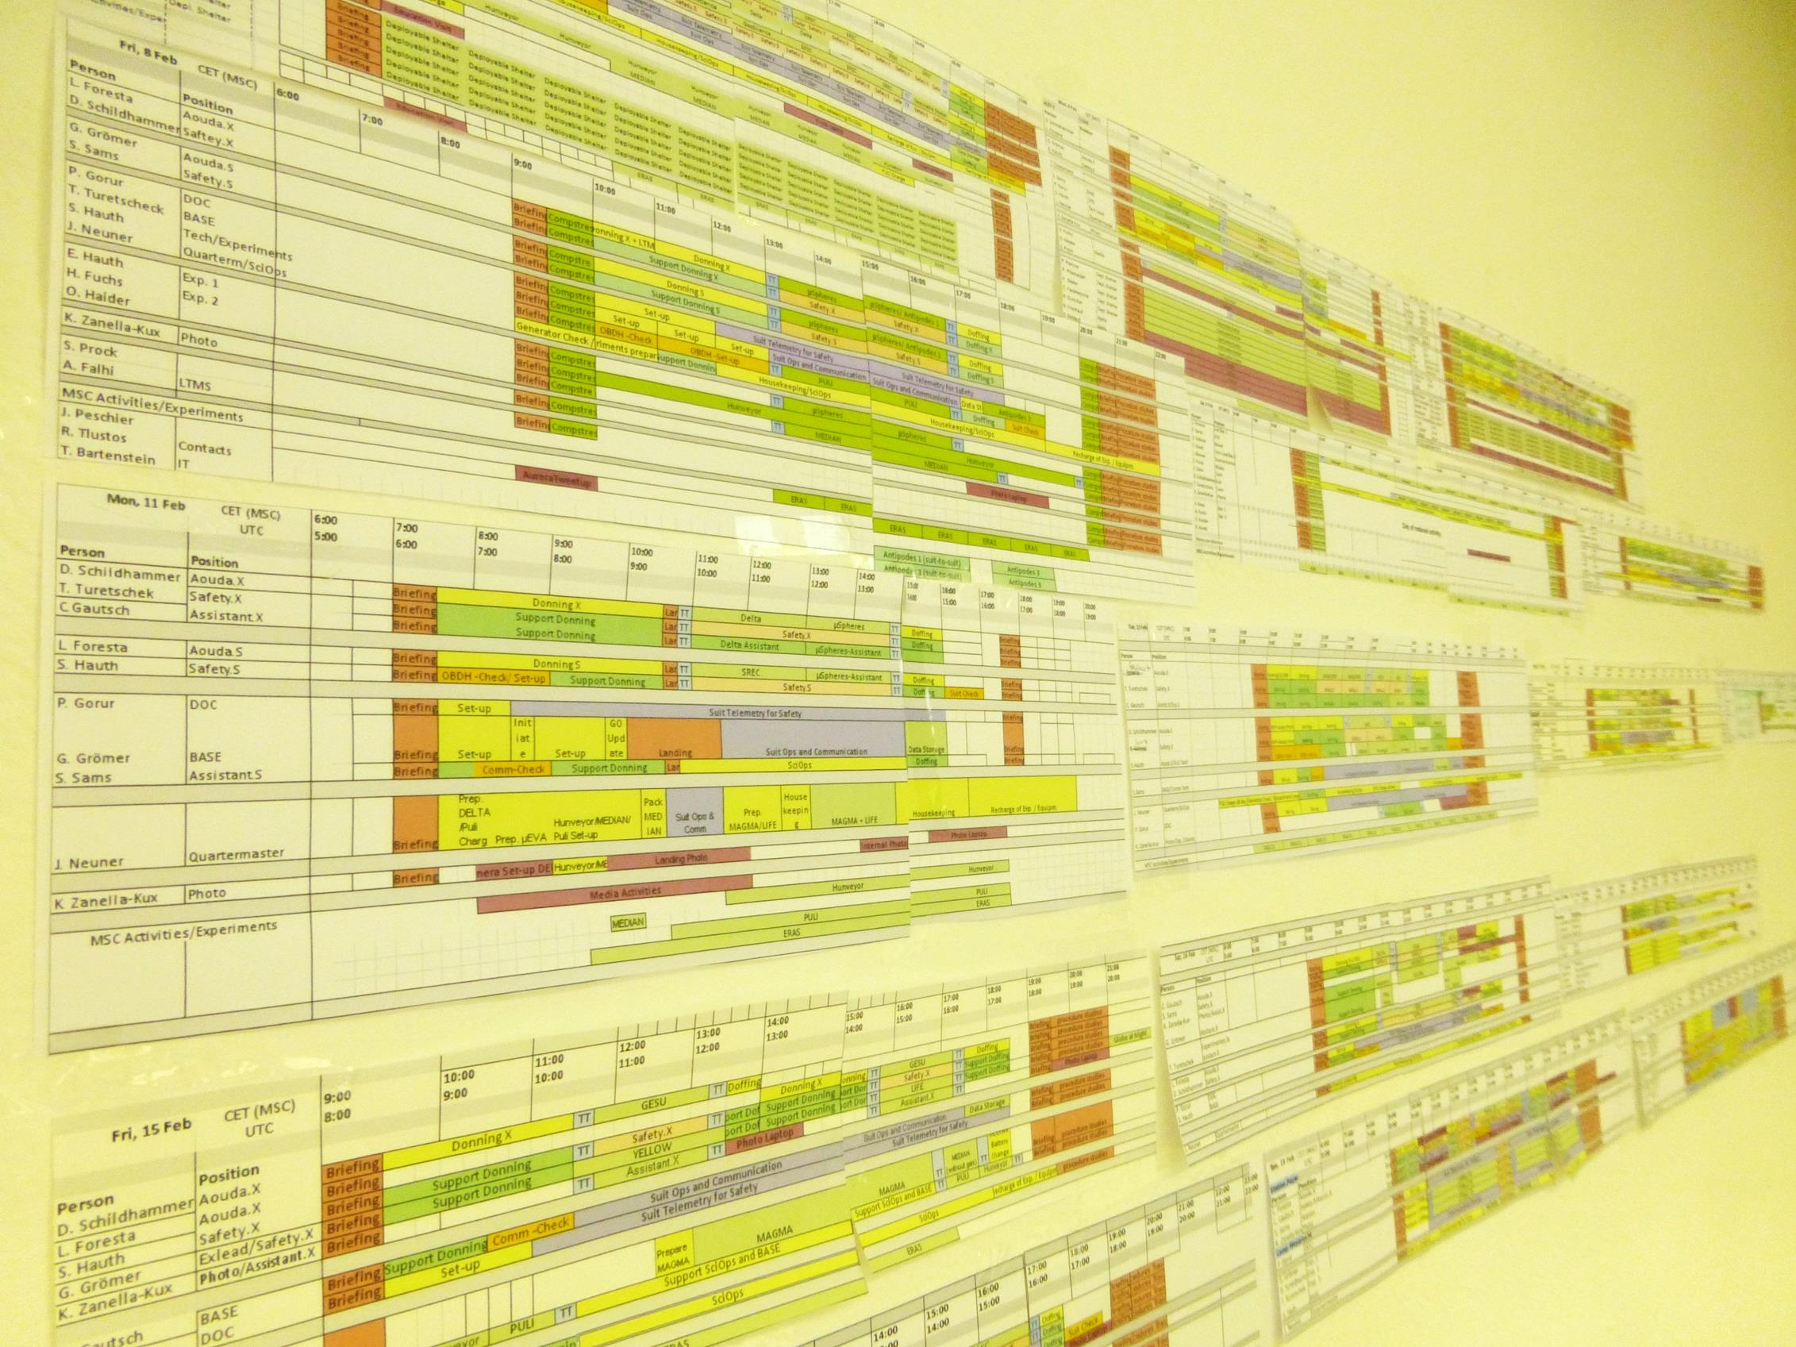
RSS and Flightplan
Flightplan
Activity & Ressources planning
Traverse planning
Remote Science Support
Preparation of maps before mission (using existing satellite imagery & DEMs)
Geolocation & Georeferencing of data
Experiments: Responding to needs of field crew, interaction with experiment PIs
Receiving, assessing and compiling data / Science Archive
Statistics of planned vs executed experiments
Hettrich, S. et al. (2014) Efficiency analysis of the MARS2013 planning strategy. Astrobiology 14:377–390.
Dole S. (1967) Contingency planning for space-flight emergencies [AIAA Paper No. 67-825]. In 4th Annual Meeting and
Technical Display, American Institute of Aeronautics and Astronautics, Reston, VA.

Slide 12
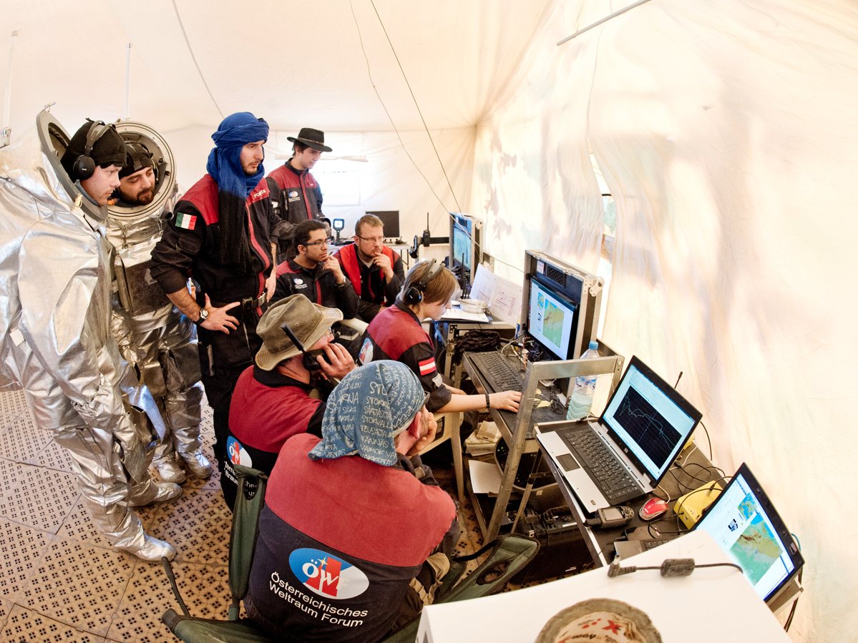
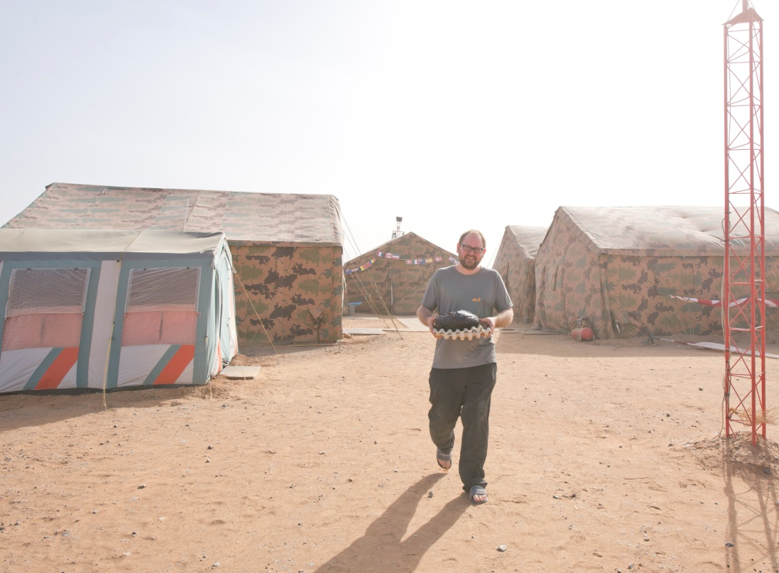
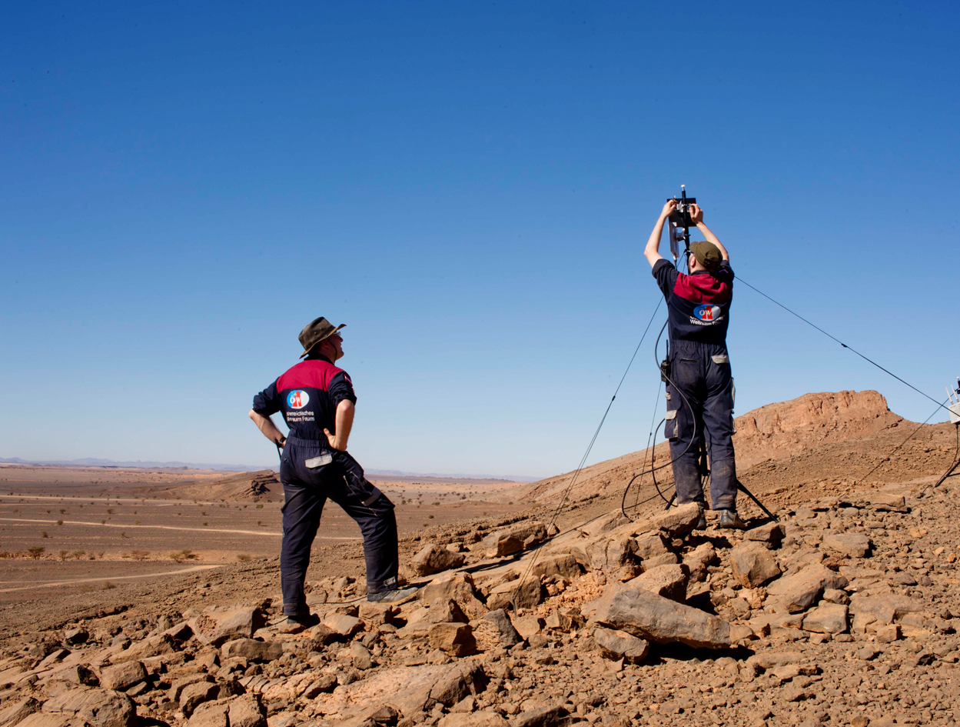

Slide 13
Mission
Experiments

Slide 14
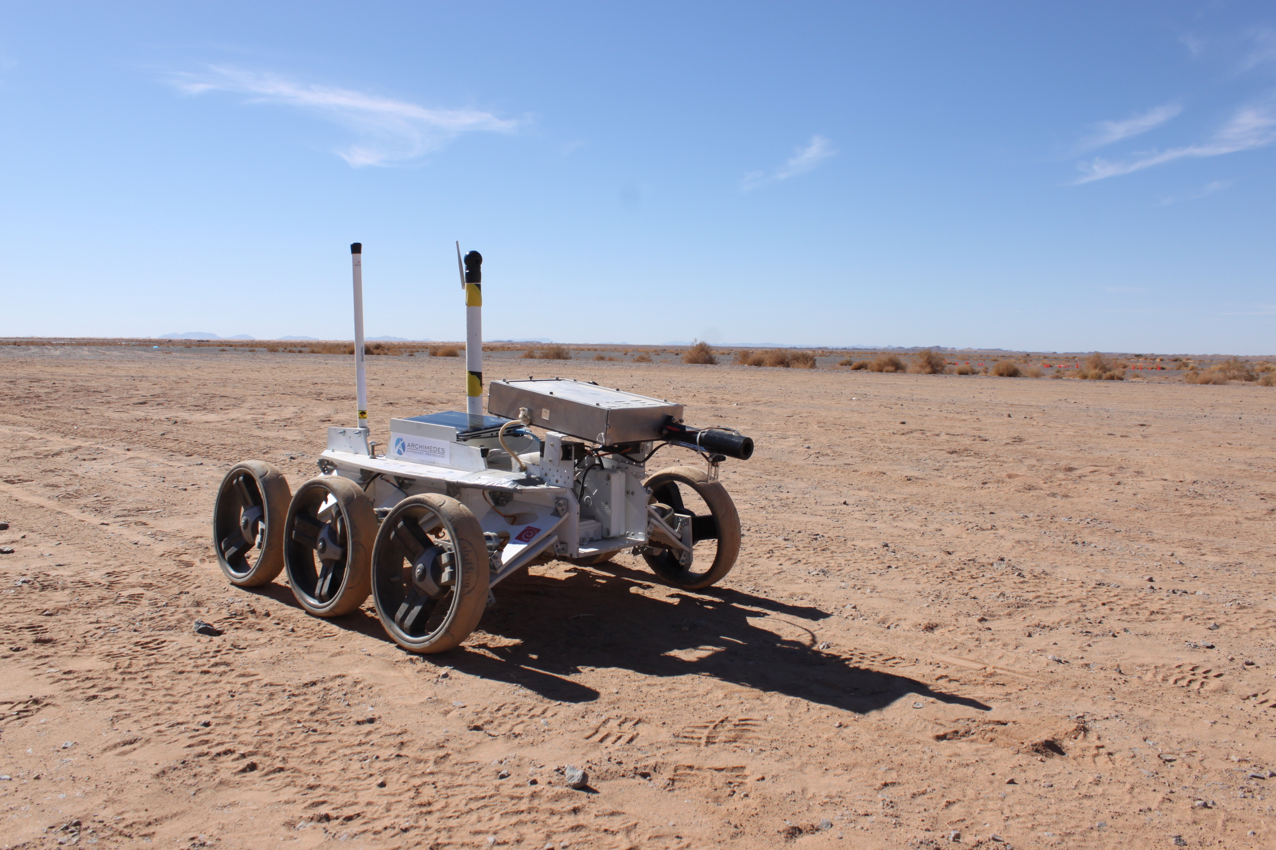
Groemer, G., … Jozefowicz, M., Meszynski, S., et al.(2014) Field trial of a dual wavelength fluorescent emission (L.I.F.E.) instrument and the Magma White rover during the MARS2013 Mars analog mission. Astrobiology 14:391–405.
MAGMA (ABM Space & Polish MS)
L.I.F.E. (Univ. Innsbruck)

Slide 15
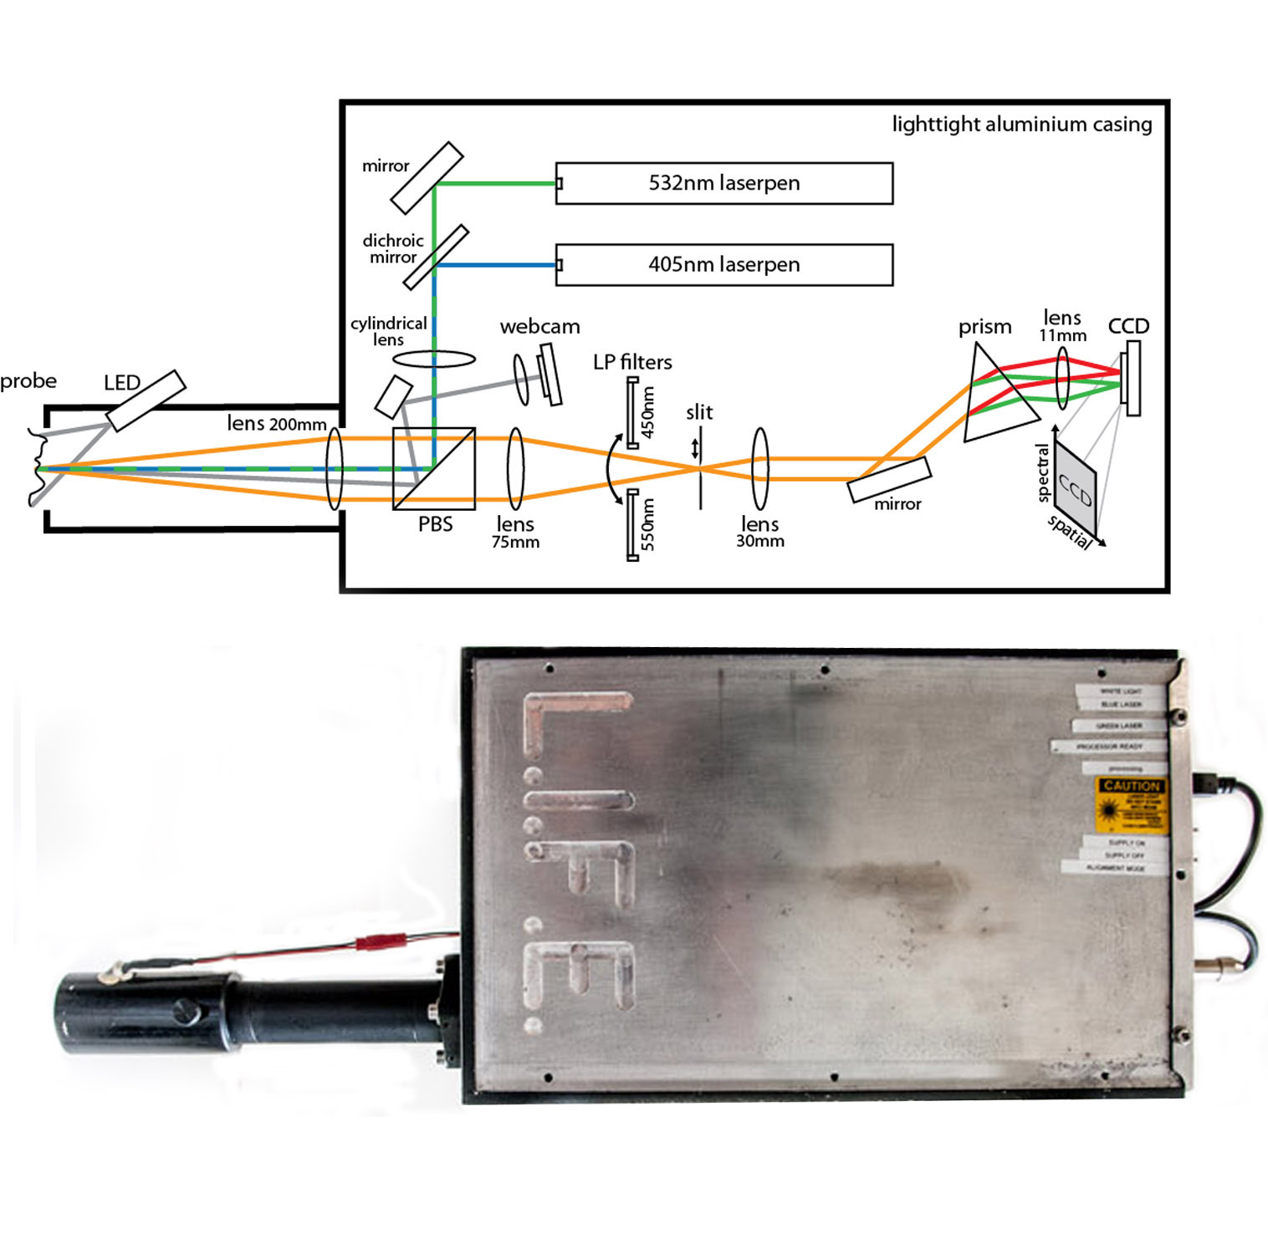

Slide 16
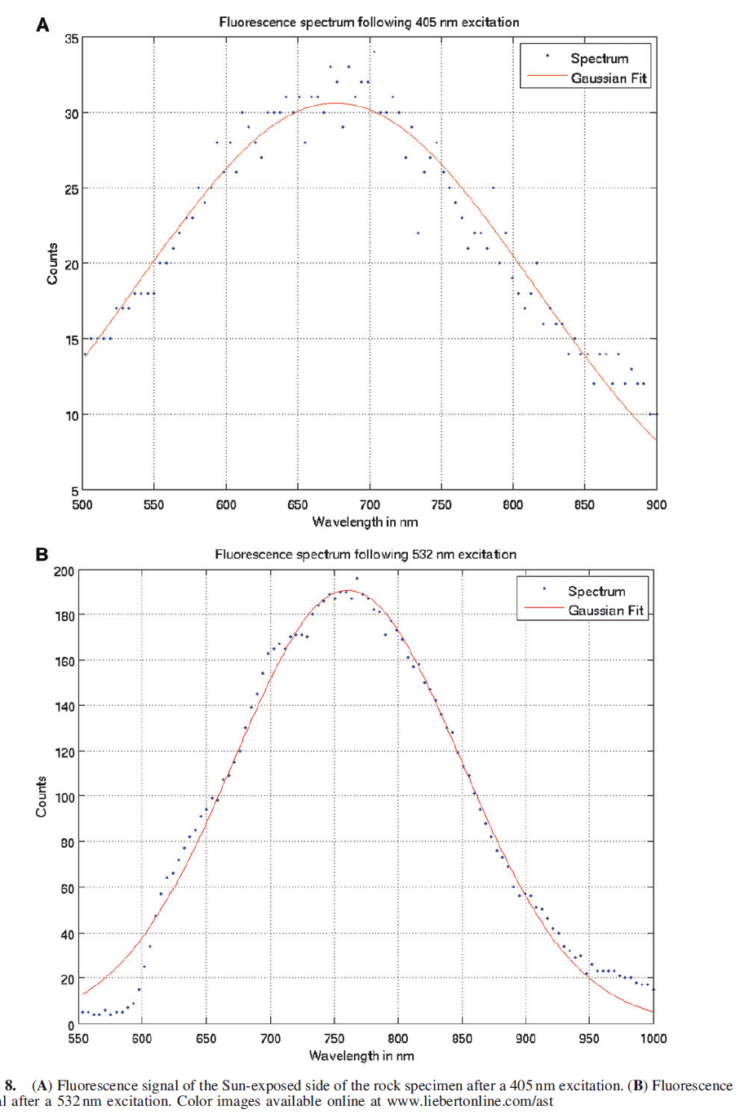
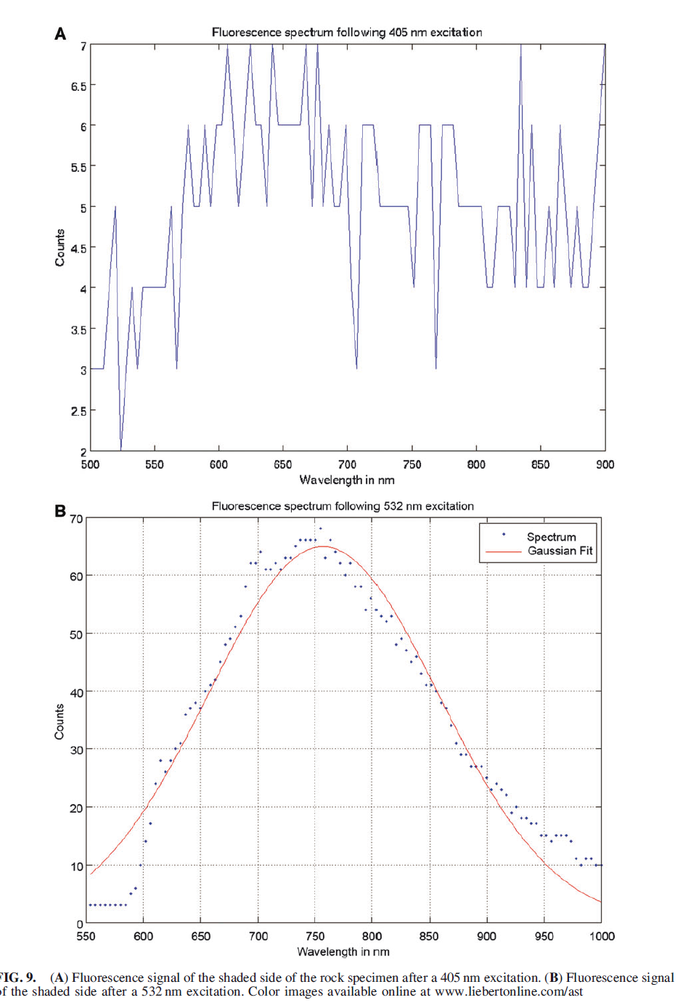
405 nm
Chlorophyll(s)
532 nm
Phycobiliproteins
Sun exposed side
Sun-shaded side

Slide 17
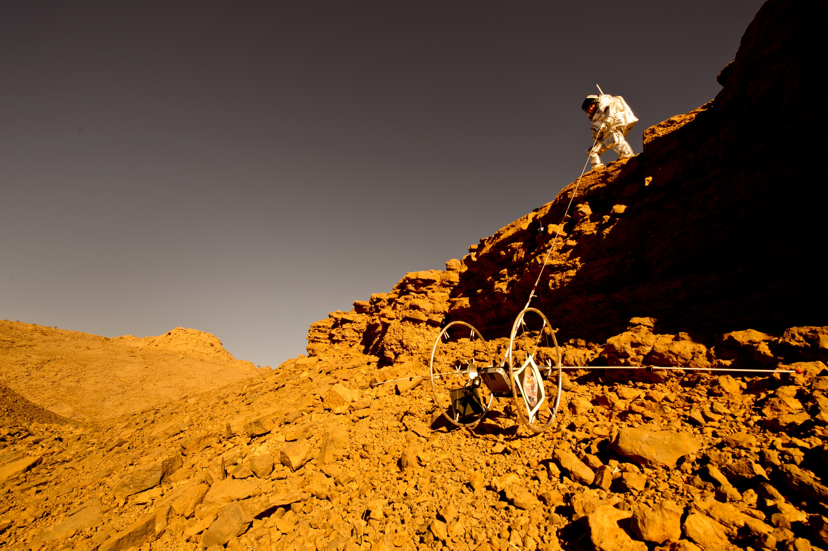
CRV Reconnaissance (French MS)
Souchier, A. (2014) The Cliff Reconnaissance Vehicle: A Tool to Improove
Astronaut Exploration Efficiency, Astrobiology 14(5): 406-17

Slide 18
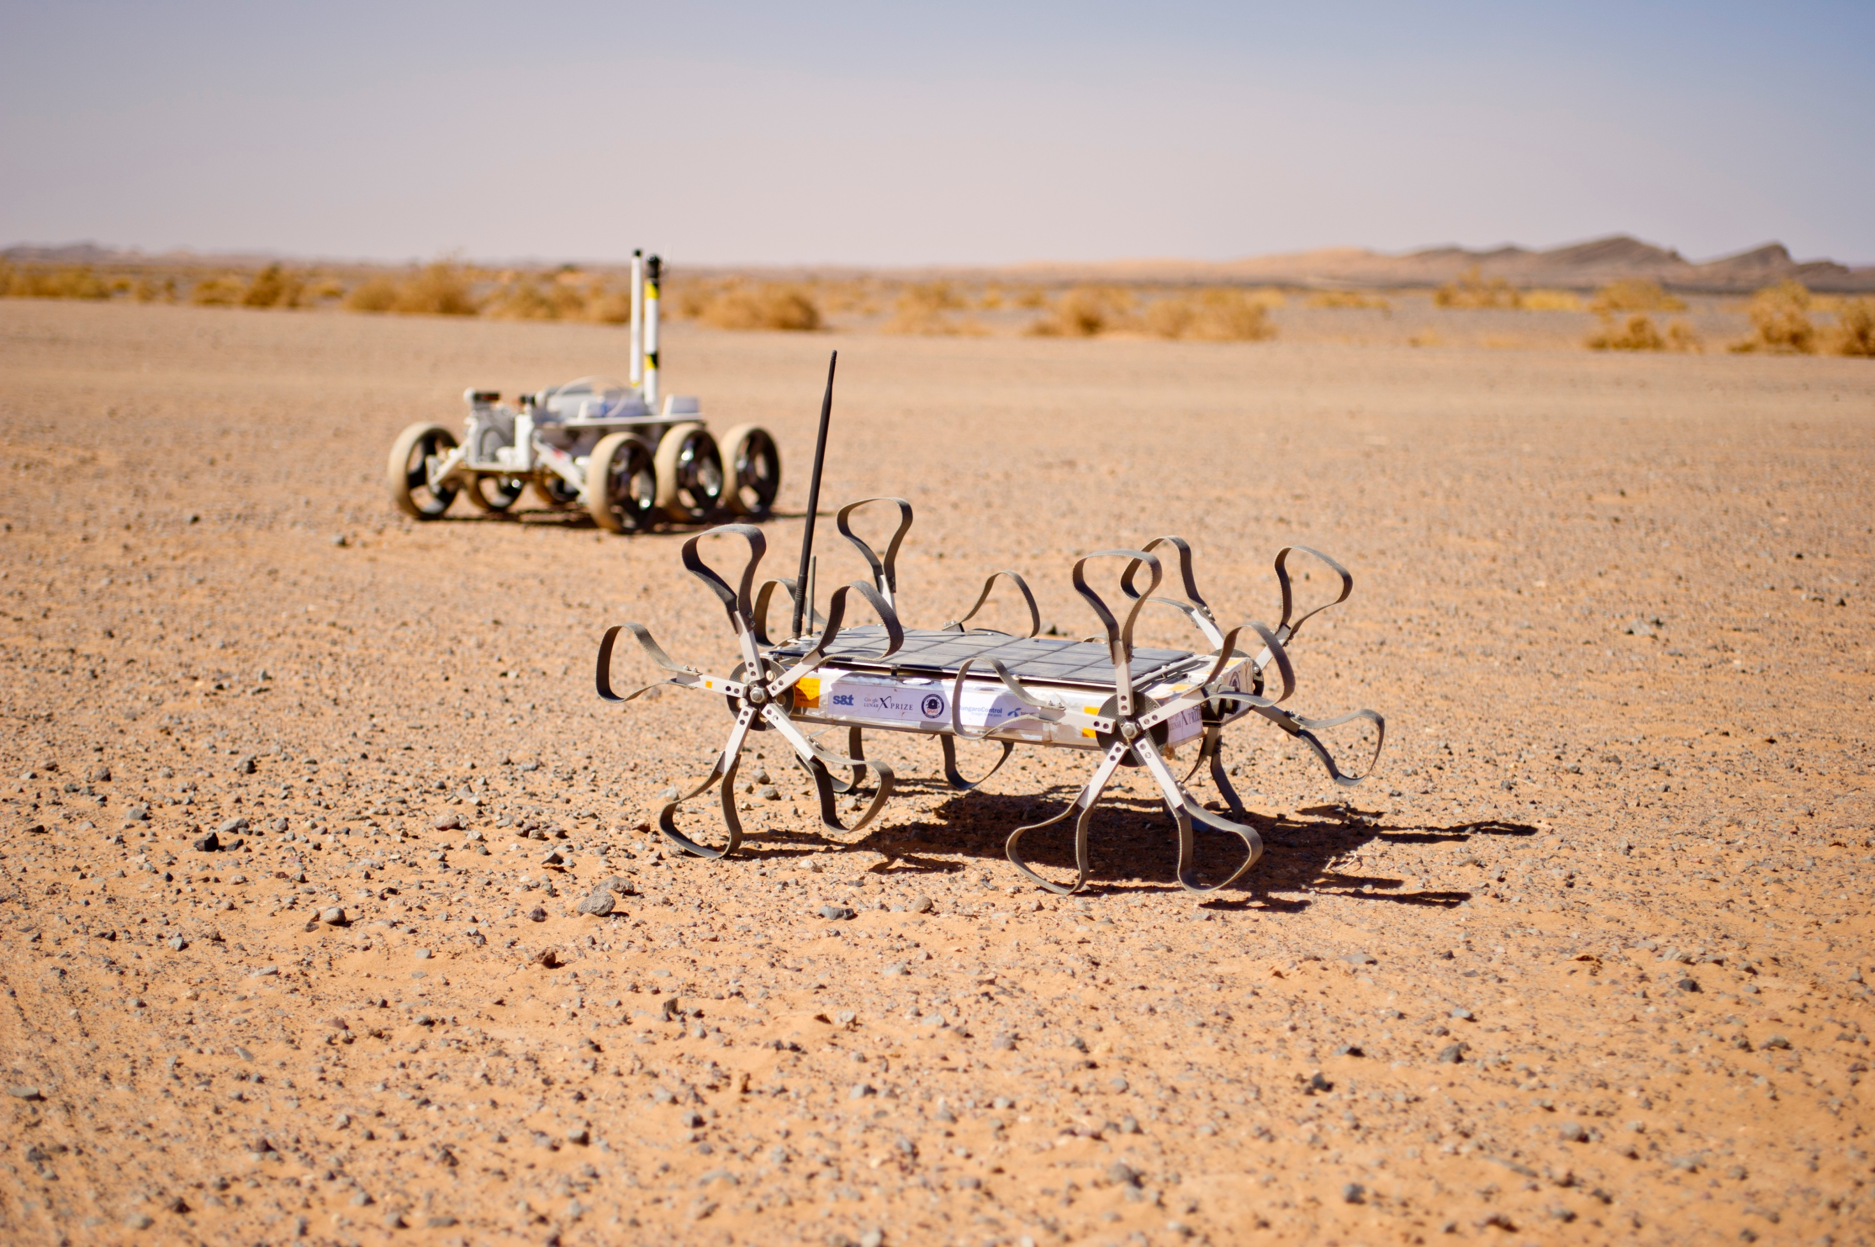
PULI Rover (GLXP-team Hungary)

Slide 19
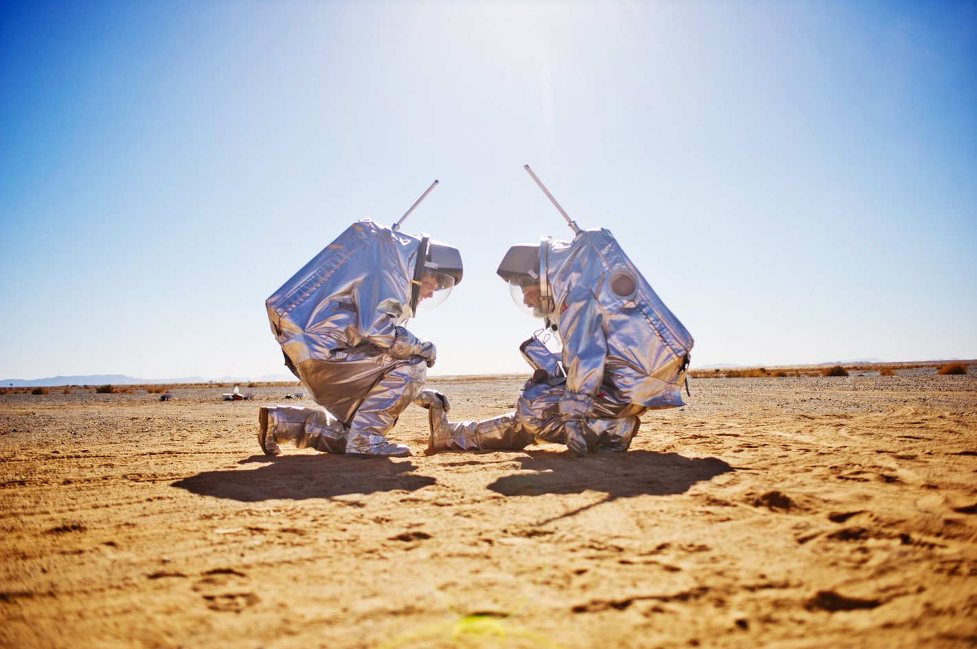

Slide 20
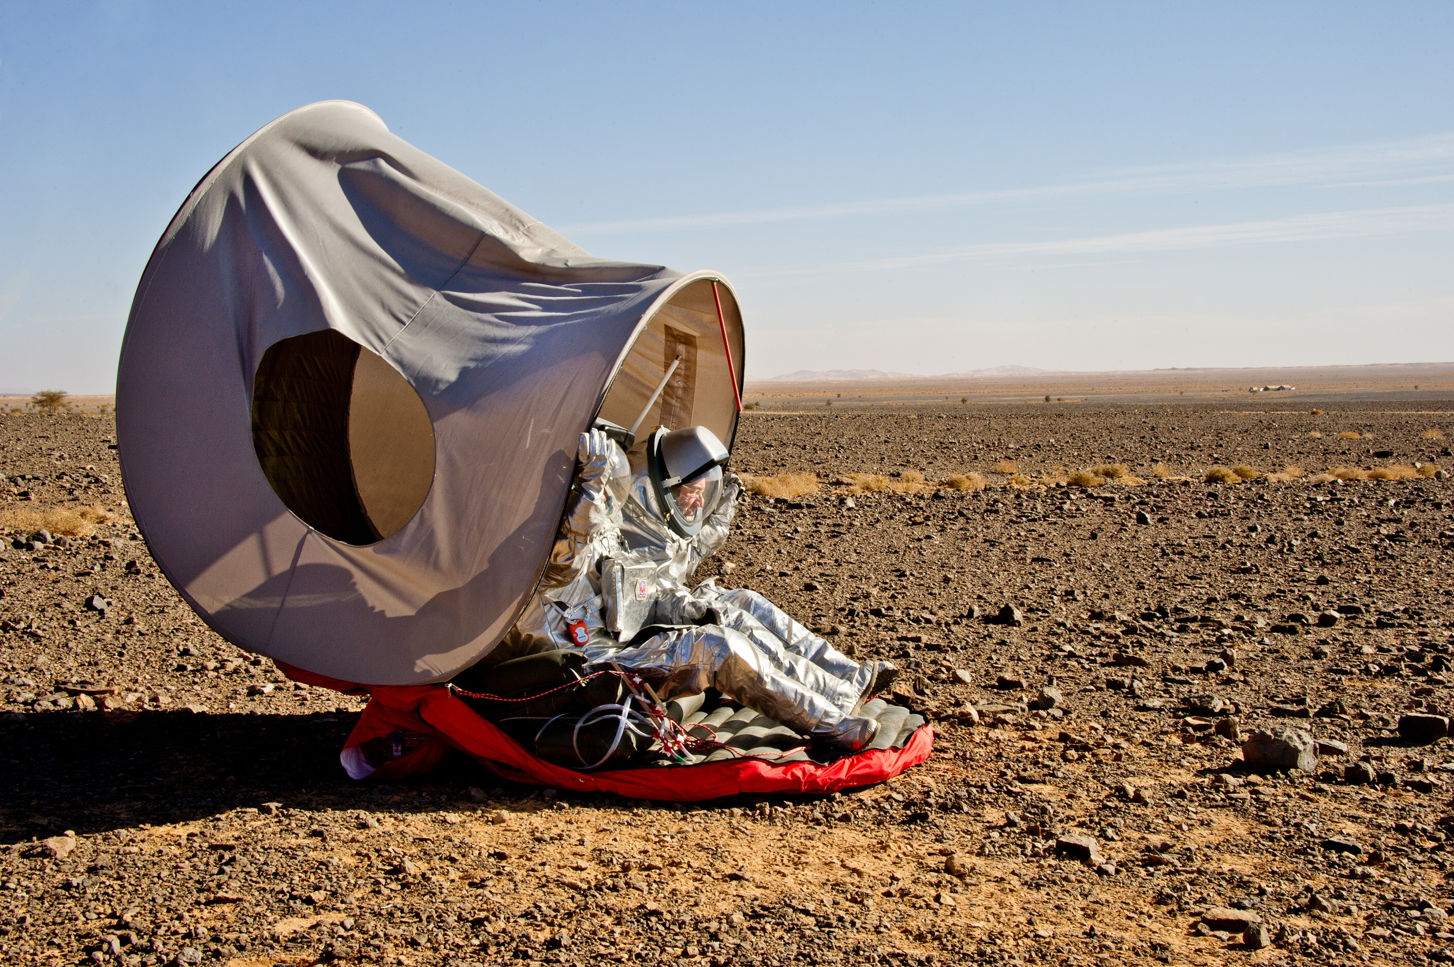
Deployable Shelter
(Techn. Univ. Vienna/OeWF)
Haeuplik-Meusburger, S., Sommer B., and Aguzzi, M. (2009) Inflatable technologies: adaptability from dream to reality.
Acta Astronautica 5–6:841–852.

Slide 21
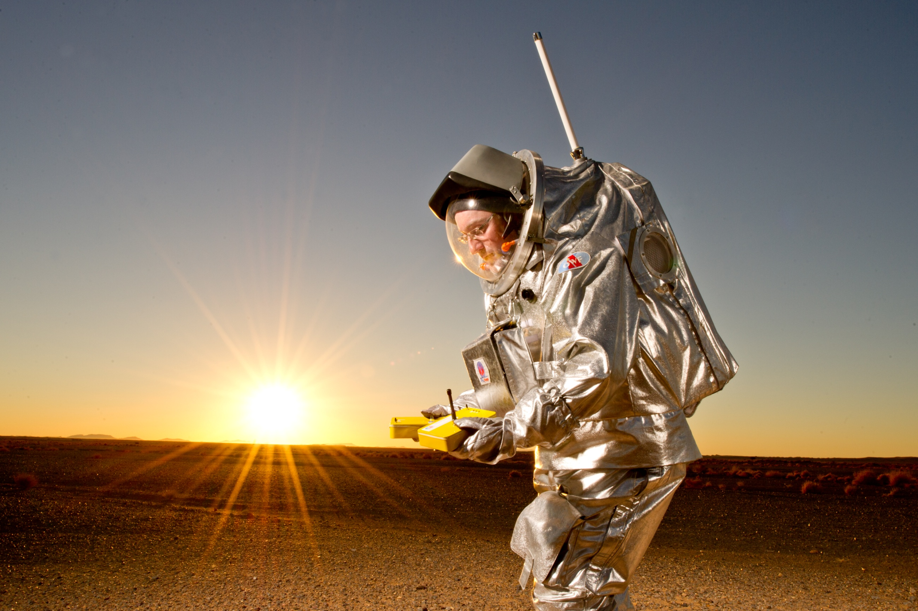
Yello-positioning system
Ragonig, C. (2013): GPS-freies Navigationskonzept
für die bodengebundene planetare Exploration,
MSc thesis, Univ. of Applied Sciences Mittweida.

Slide 22
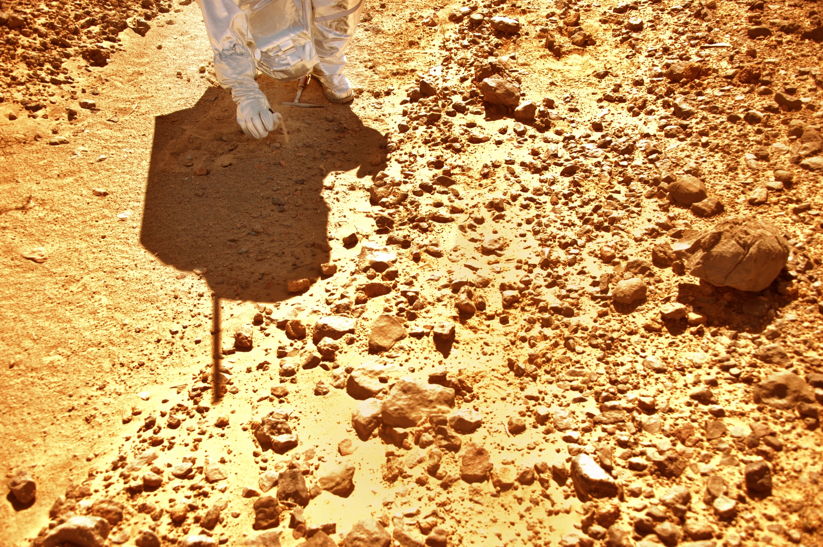

Slide 23
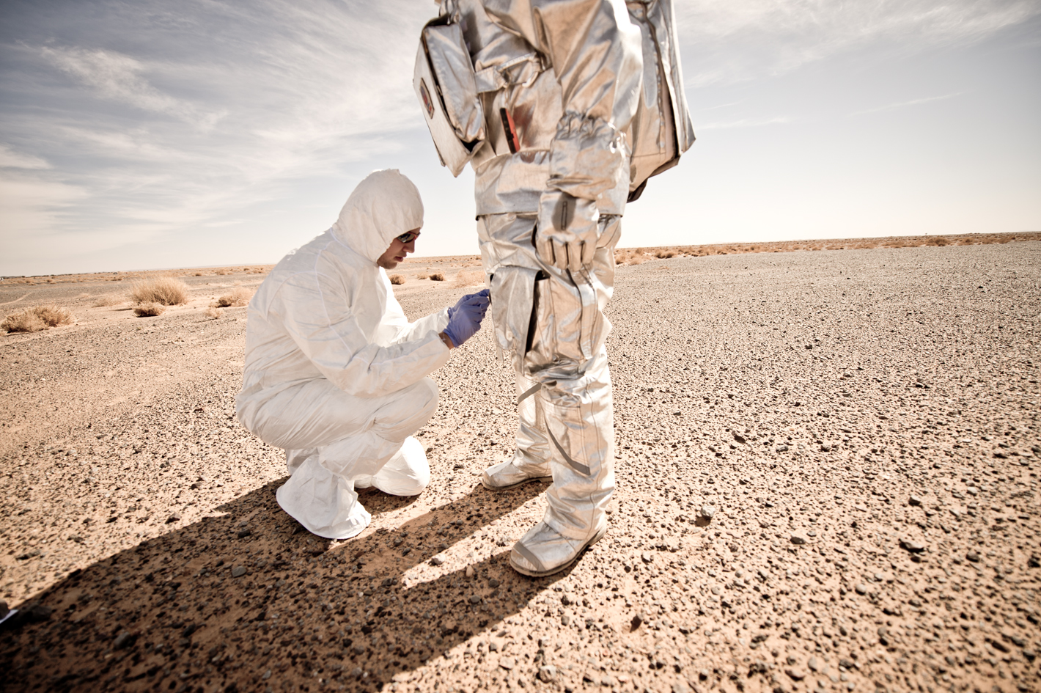
microEVA
NASA Jet Propulsion Laboratory &
Austrian Space Forum

Slide 24
Selected results
Despite limitations of high-fidelity analog-research and without prior in-situ knowledge of site, previous water activity was identified.
“potential biological activity“ 300 Myrs ago.
Measurement of work speed suited vs unsuited: 1.3-fold
Thermal inertia measurements as a field method for detecting cave entrances
Three robotic vehicles, the deployable shelter successfully tested
Risc assessement of actual injuires: MSC vs field crew: w.r.t. traumatic injuries 1:4

Slide 25
Mission dataset - on site images
Aouda X. camera picture, GESU experiment

Slide 26
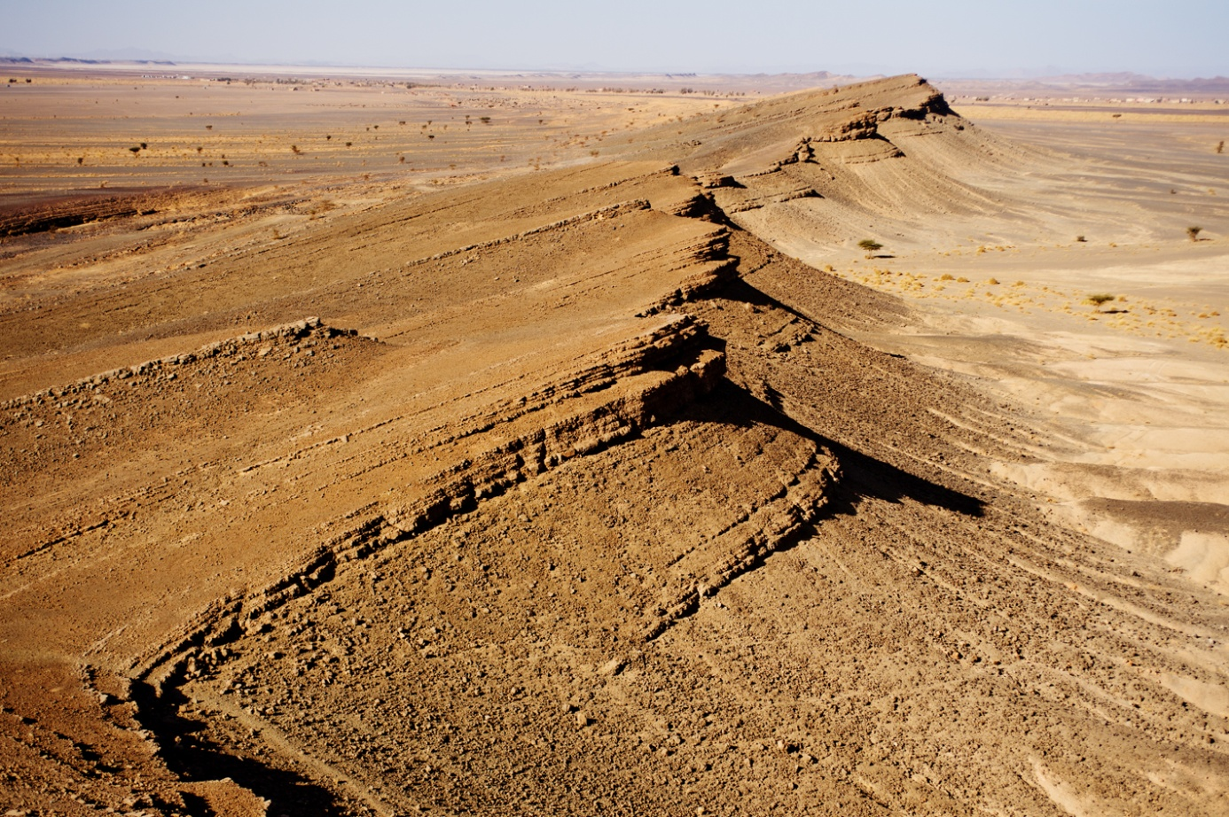
100 m

Slide 27
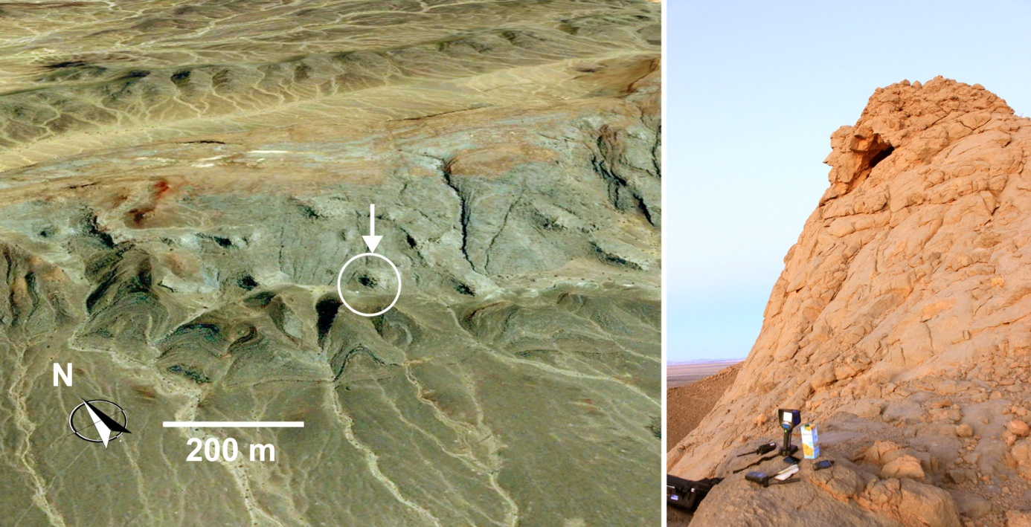
Mounji, D., Bourque, P.-A. and Savard, M.M. (1998) Hydrothermal origin of Devonian conical mounds (kess-kess) of Hamar Lakhdad Ridge, Anti-Atlas, Morocco, Geology, December, 26:1123-1126
Cavalazzi, B., Barbieri, R., Ori, G.G. (2008) Chemosynthetic microbialites in the Devonian carbonate mounds of Hamar Laghdad (Anti-Atlas, Morocco), Sedimentary Geology, 200: 73-88

Slide 28
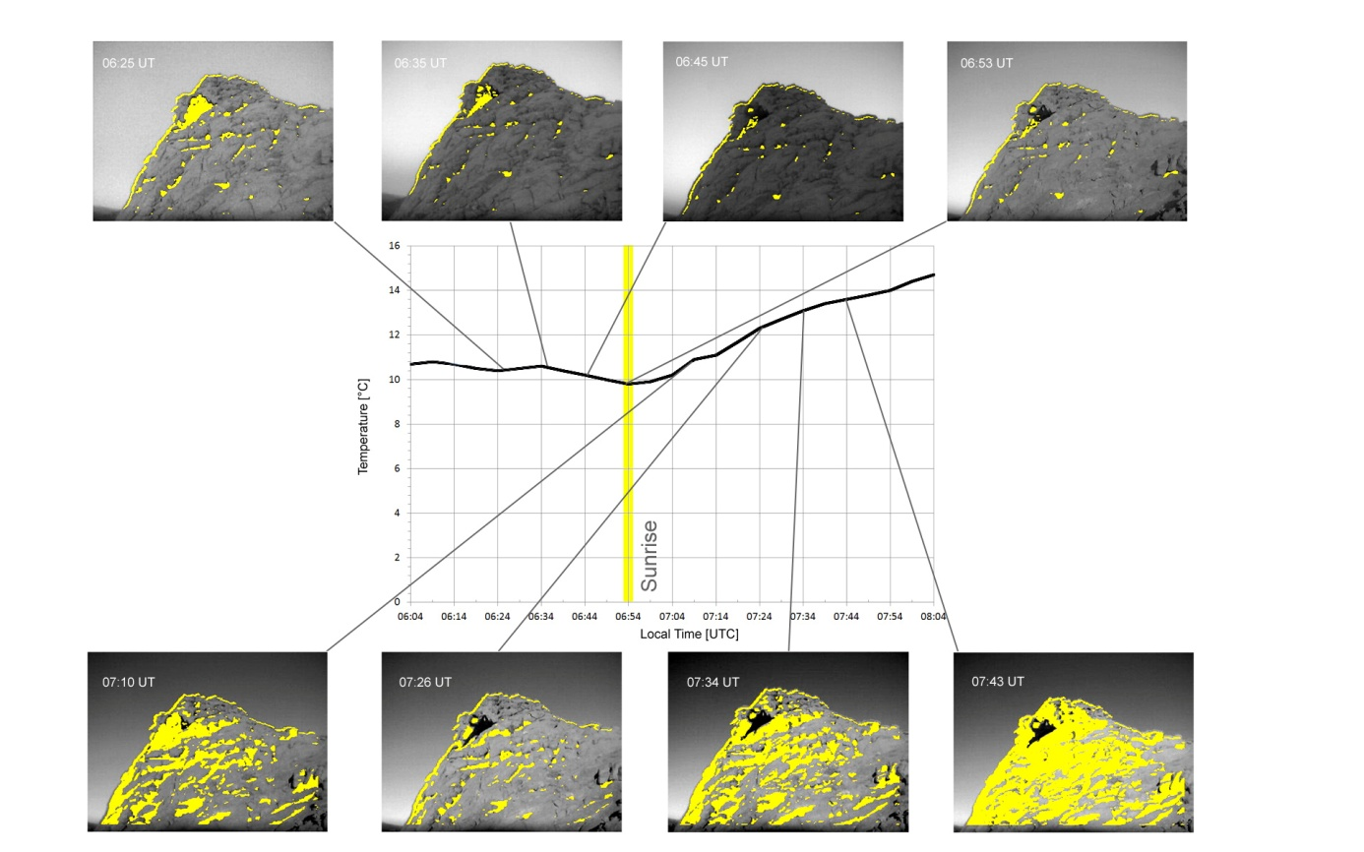
Ambient air temperatures are shown together with the thermal threshold imagery. Regions above the threshold temperature are shown in yellow, superimposed on the optical context image. Threshold was set at 12°C until thermal equity with the ambient surface was reached at 07:26 UTC, then set at 15°C to identify the cooler cavity entry whilst the environment was heated above 15°C.

Slide 29
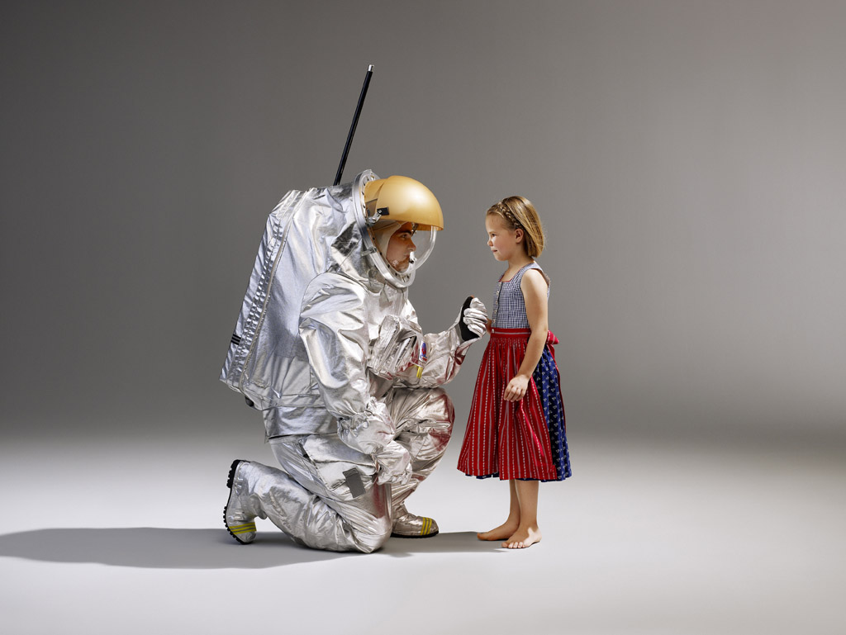
gernot.groemer@oewf.org
Rock Glacier Mission-Simulation
August 2015
(AO: July 2014?)

