Slide 1
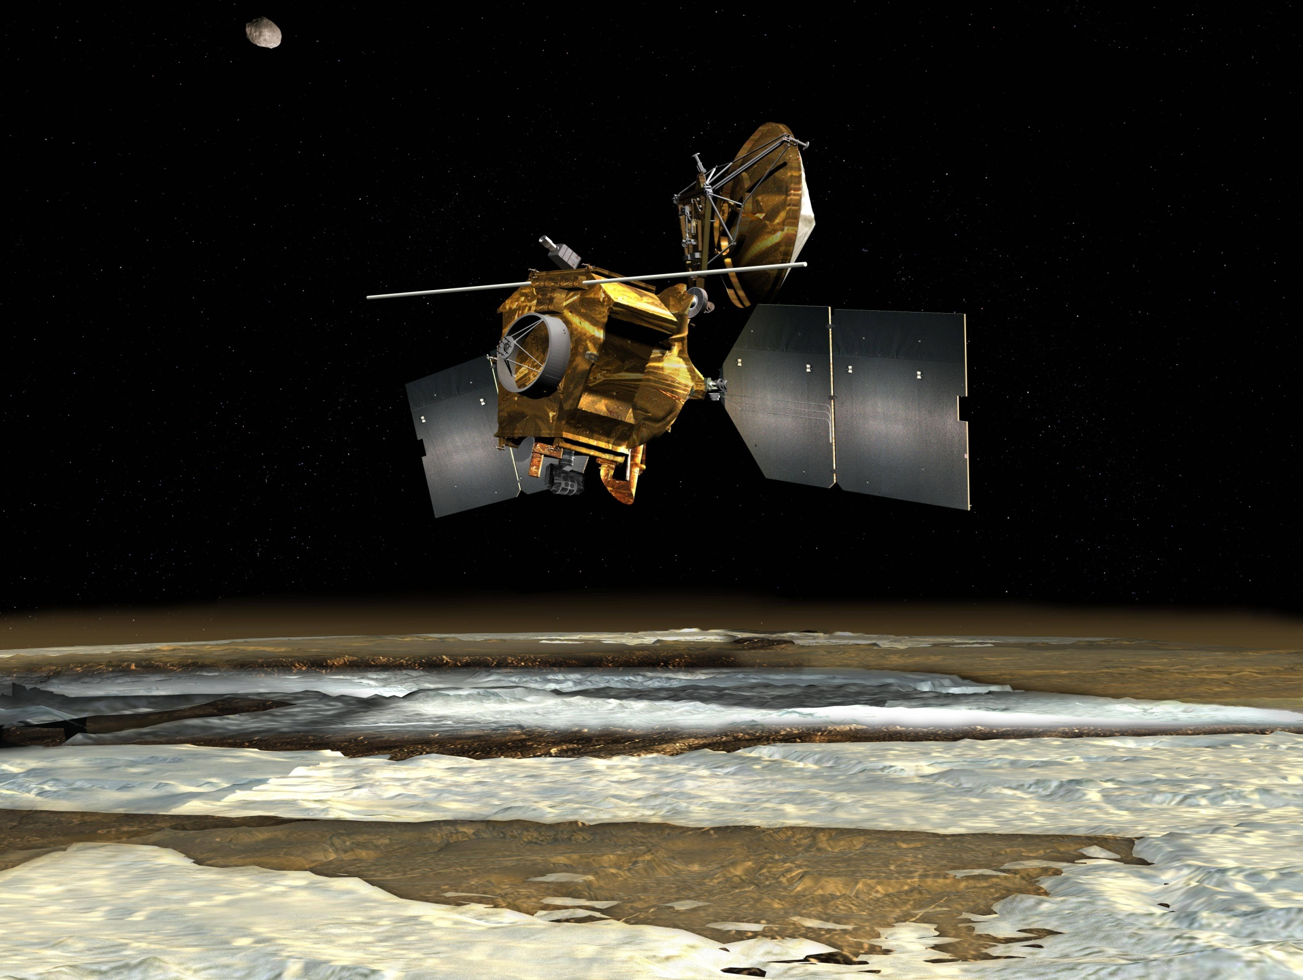

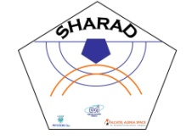



MPSE 2014 - Mars Connecting Planetary Scientists in Europe
SHARAD Data Mapping for Surface Ice Detection
3-5 June 2014
Warszawa
Dr. Luigi Castaldo

Slide 2
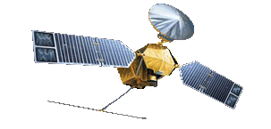
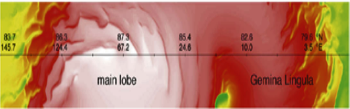
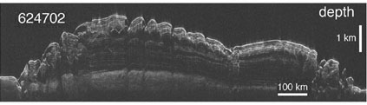
Spaceborn subsurface sounders
Rarad signal form spacecraft
Power
Return signal form surface
21
17
1
Return signal from a subsurface
20
16
2
Return signal form surface
Return signal from a subsurface
19
15
3
18
14
4
17
13
5
6
16
12
Time
7
1 3 5 7 9 11 13 15 17 19 21 23
15
11
8
14
10
9
13
9
10
12
11
11
12

Slide 3
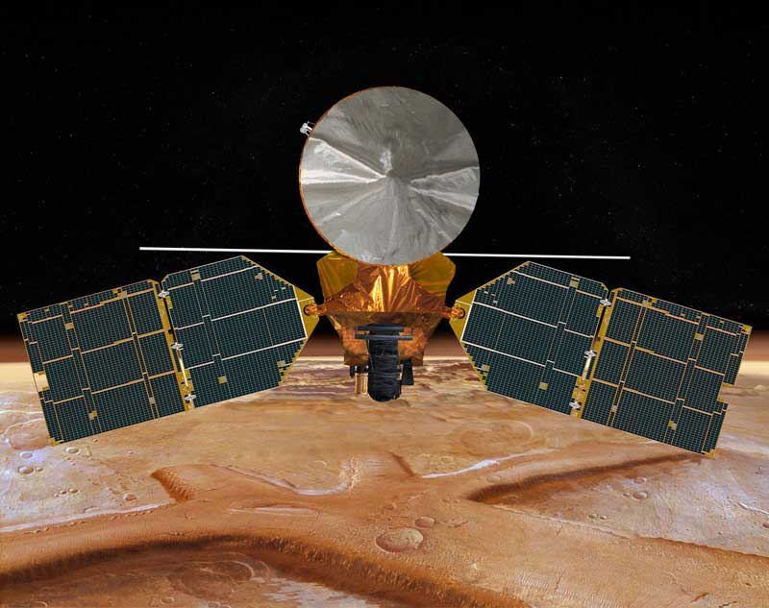
Sharad
Shallow Radar (SHARAD) is a radar sounder.
It transmits and receives through a 9 m dipole.
frequency of 20 MHz with a bandwidth of 10 MHz with vertical resolution of 15m in free space, alongtrack resolution of 300-1000 m, across-track resolution of 1500-8000 m depending on spacecraft altitude and terrain roughness.
SHARAD transmit a chirped waveform to achieved high range resolution and S/N with the low power available on a spacecraft.
Synthetic aperture processing is employed to further increase S/N and improve horizontal resolution.
Notes:
3

Slide 4
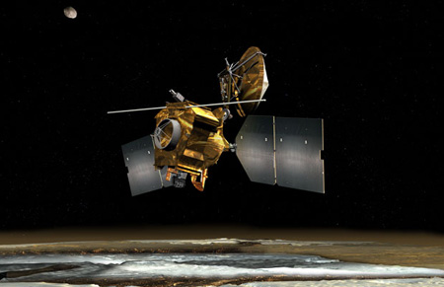
Sharad Main scientific Goals
Detection of dielectric discontinuities in the subsurface of Mars, and the interpretation of these discontinuities in terms of presence of ice, water, rock or regolith.
Interpetation of the first meters of the Martian Surface in terms of composition.

Slide 5

Sharad Scenarium
Sun elevation
SHARAD
Ionosphere ➔ f_{pm}
Magnetic Field
Mars Surface
SurfaceClutter
Visible Zone ➔ S/N>0
Sub Surface Material
Not Visible Zone ➔ S/N<0

Slide 6
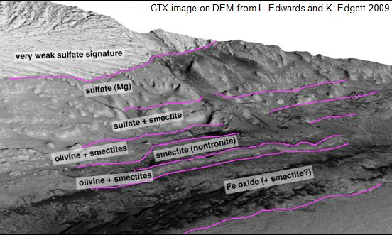
MARS Calibration and surface inversion
The pattern of the dielectric values is highly related to the knowledge of the global topography and geology stratification of Mars.
It is not always feasible to discern surface dielectric constant with estabilished method of time delay compensation
A new method has been developed:
automathically extract the Sharad Power Surface
models the surface by FBM
gives the Dielectric Constant Map of the area under investigation

Slide 7
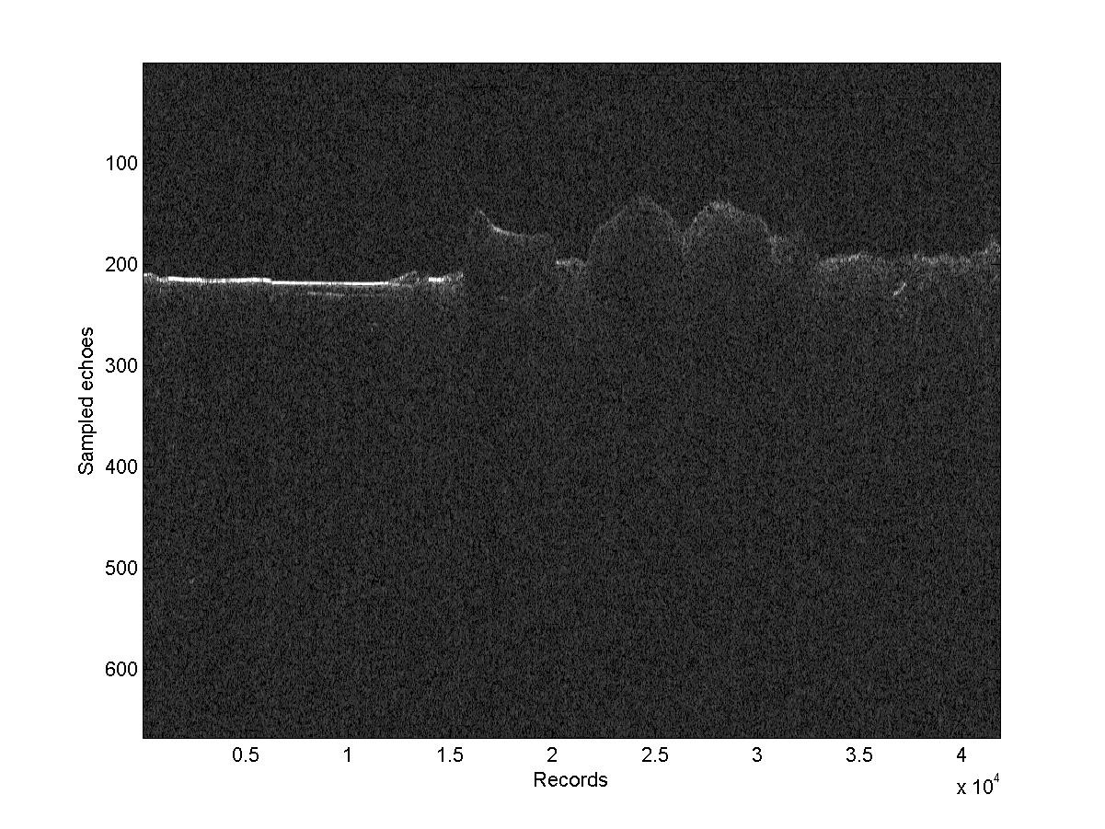
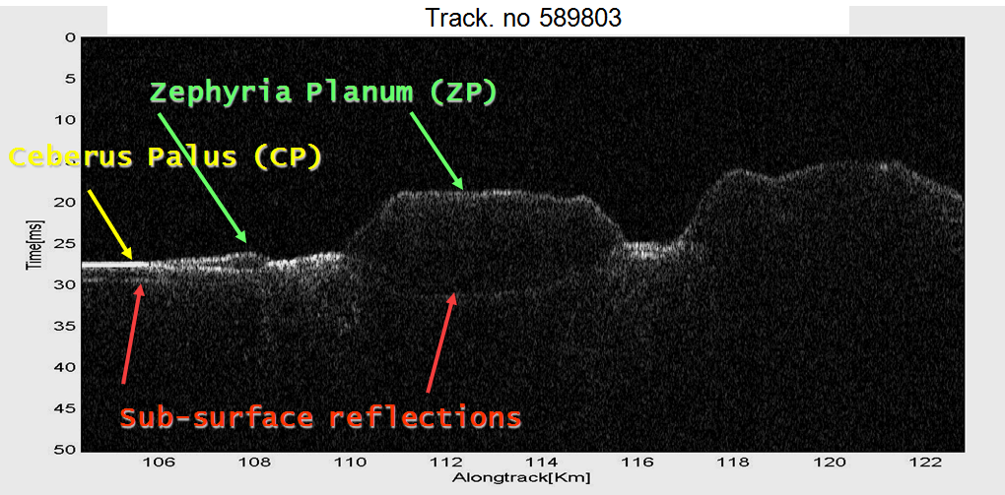
MARS Level 1 B
The nocturnal set of data has been used to avoid Ionosphere noise
SHARAD Data Product is aggregation of SHARAD Data Blocks
Data Blocks: processing of one or more received echoes of the same OP
Echoes coherently summed on-board in groups: Pre-summing
Pre-summing 1 (no pre-summing), 2, 4, 8, 16, 28, 32
Pre-summing "N" : the samples from N sequential PRIs are summed sample-by-sample thus reducing the data rate by a factor N
Track. no 589803
300 m
10 km
Sharad Images from Alberti G., Castaldo L., J.G.R. 01/2012

Slide 8
Importance of Dielectric constant
Materials can be classified according to their Dielectric constant ε
Relative Dielectric constant
materials at room temperature under 1 kHz on earth (corresponds to an electromagnetic wave with wavelength of 300 km)
Material | ε_{r}
Vacuum | 1 (by definition)
Air | 1.00058986 ± 0.00000050 (at STP, for 0.9 MHz),^{[2]}
Rock low porosity | 15
Rock high porosity | 2.5
Carbon disulfide | 2.6
Volcanic ash | 6
ICE | 3.14
Rubber | 7
Diamond | 5.5–10
Salt | 3–15
Graphite | 10–15
Water | 88, 80.1, 55.3, 34.5 (0, 20, 100, 200 °C) for visible light: 1.77
Natural materials (e.g. snow, ice, soil, vegetation...) are generally a mixture of materials that exhibit different dielectric characteristics (Sihvola and Kong, 1988)
Water ice ε dependent on temperature
210 K [Mellon et al., 2004]

Slide 9
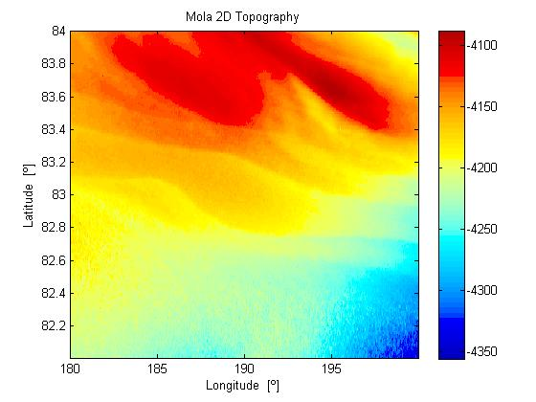
Chosen calibration area
(84°N-82°N, 180°E-200°E)
The area consists of primarily water-ice with a few percent dust
The radargrams show the minimum registered noise in Surface Power Echo
The choice is made over an area sufficiently flat
MOLA (Mars Orbiter Laser Altimeter) topographic data to estimate topographic parameters
(Topothesys and Hurst)
Spatial resolution 460 m smaller than SHARAD horizontal resolution (about 6 km).

Slide 10

Sharad Data Model: Backscattering
The backscattering is evaluated using the statistical parameters estimation along the orbit with the fractal theory for a monostatic radar configuration using the Mola data
Backscattering coefficient at Nadir in case of fBm
where

Slide 11
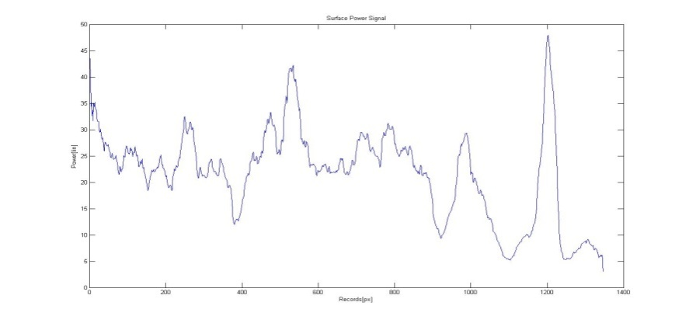
Sharad Data Model: Hypotheses
Hypotheses
two interfaces are considered, open space and surface with negligible local slope values
The second interface is supposed to be a homogeneous and non- dispersive rough medium
effective area at 3dB
where
broadening factor
estimated for linear polarizations
Due to the not ideal matched filter used in azimuth compression and to displacement sampling of data for operation mode used
.
Surface Power Echo in linear scale from the observation 0659501 001 SS19 700A, low-pass filtered and weighted with linear least squares with a 2nd degree polynomial model

Slide 12
Sharad Data Mode: Procedure
Surface Relative Permittivity is evaluable from the inversion of Fresnel Equation
The Calibration constant must be calculated over the whole records of the North Polar chosen Area

Slide 13
Sharad Calibration: Operational mode
All controls necessary for the operation of SHARAD are sent to the satellite by means of the OST (Operational Sequence Table):
the PT (Parameter Table)
ODT (Orbital Data Table).
The OST contains instructions on the radar operation to perform.
The PT contains all the operating parameters and engineering of
SHARAD:
Configuration Parameters
Orbit SS04
Four typical configurations
SS04 SS05 SS11 SS19
Orbit SS19
The corrections to be applied to the signal are provided with data and are related with magnitude of it.
Pixel cross section
res.=0.5°
Equator 30Km

Slide 14
Results: Map of the signal
Map of Mars Dielectric constant [res.=0.5°]

Slide 15
Results: Maps of statistics
Map of the Standard deviation Dielectric constant [res.=0.5°]
Mean Global std=0.6
Map of the ratio Standard deviation and Dielectric constant [res.=0.5°]

Slide 16
Results: Map of the signal
Map of Mars Dielectric constant of possible presence ICE [res.=0.5°]
ε = ε_{ice} Global std

Slide 17
Results: Map of statistics
Map of the Standard deviation Dielectric constant for ICE [res.=0.5°]

Slide 18
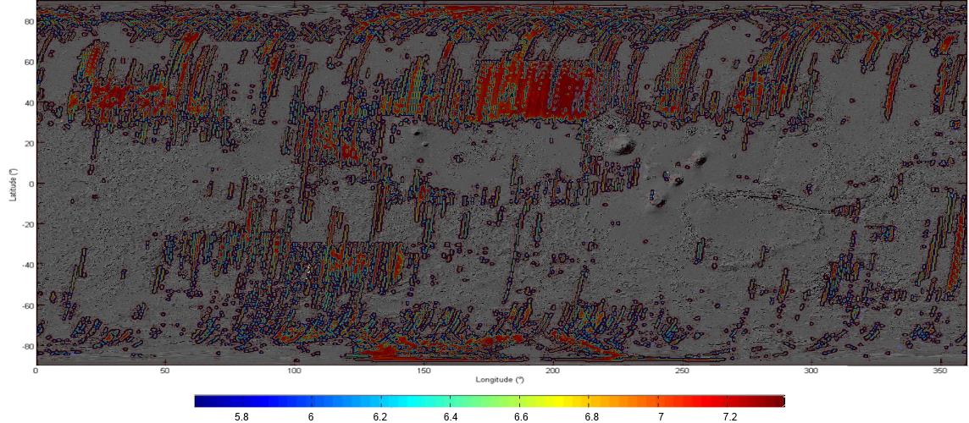
Results: Map of Shallow ice
Map of the Shallow Ice observe[res.=0.5°] (measured in m.)

Slide 19
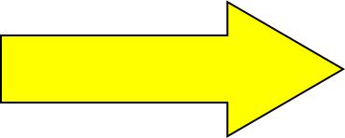
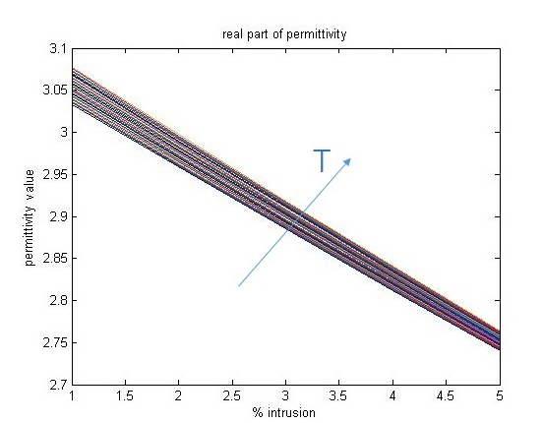
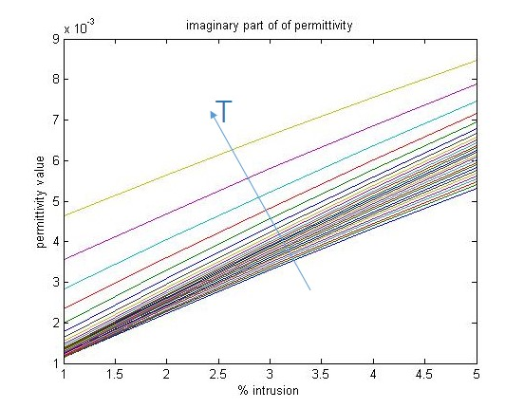



Results: Ice Model
$ε_{min}=$2.6
$$ε_{eff}=ε_{r}±0.6$$
$ε_{max}=$3.7
C.F. Chyba et al.,(1998)"Radar detectability of a subsurface ocean on Europa", Icarus 134, 292-302
300 K
300 K
140 K
140 K

Slide 20
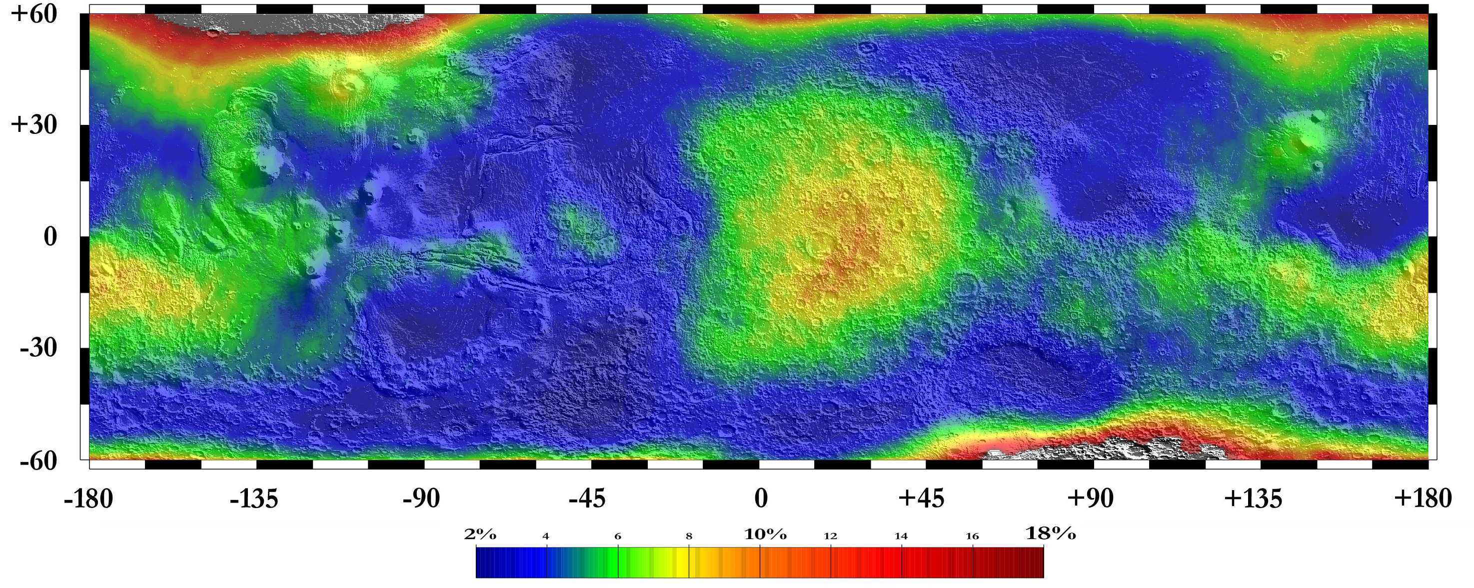
Discussion of Results
Map of Gamma Ray Spectrometer for Water Equivalent Abundance by Los Alamos Laboratory
Presence of Hydrogen implies the presence of Water

Slide 21
Conclusions data Calibration
The dielectric constant of the surface of Mars has been extracted from the echoes of the subsurface sounding radar SHARAD
- the effects of surface roughness are modeled using the MOLA topographic dataset
- The resulting information provides insight on the nature of the materials constituting the Martian surface
Of particular interest is the extraction form the general map of the area where the dielectric content could imply the presence of ice compared to the Hydrogen map
Future
higher resolution of the Maps
test of other inter-calibration methods
Detailed Maps for Geological areas of interest
Castaldo L., G. Alberti, G. Cirillo, R. Orosei, Scientific Calibration of Sharad Data over Martian Surface , SIGNAL PROCESSING SYMPOSIUM - 4-7 June 2013, , Jachranka Village, Poland, 978-1-4673-6319-8/13/S31.00 c 2013 IEEE /ISBN COPYRIGHT REG. NO. ISBN 978-1-4673-6318-1
L. Castaldo et al, Calibration over North Polar Caps of SHARAD data, 2012 Geophysical Research Abstracts, Egu Wien 22 - 28 April 2012, Vol. 14, EGU2012-10155, EGU General Assembly 2012 ISSN 1607-7962

Slide 22
Thank you for your kind attention
luigi.castaldo@twarda.pan.pl

Slide 23
Backup

Slide 24
Sharad Calibration: Schematic Model
Calibration constant
evaluation
Calibration
procedure
Sharad
Level1b
data
Low Noise
Area Extraction
Sharad
Level1b
data
Choosing of the
dataset to
calibrate
Calibration
constant
Extraction of
surface power
Extraction of
surface power
Dielectric
constant
Fractal Parameters
Estimation
Fractal Parameters
Estimation
Backscattering evaluation
using fractal theory
Backscattering evaluation
using fractal theory
Dielectric constant
estimation
Calibration
constant
Calibrated
Sharad
Level2 data

Slide 25
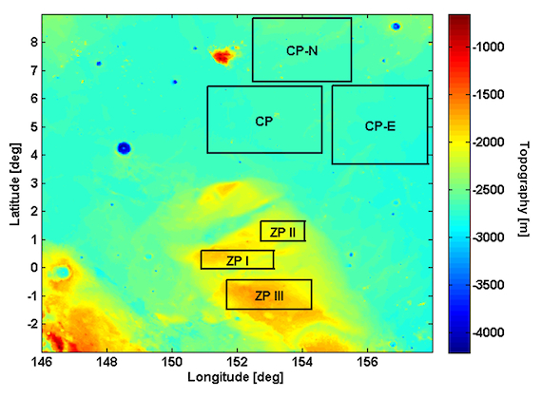
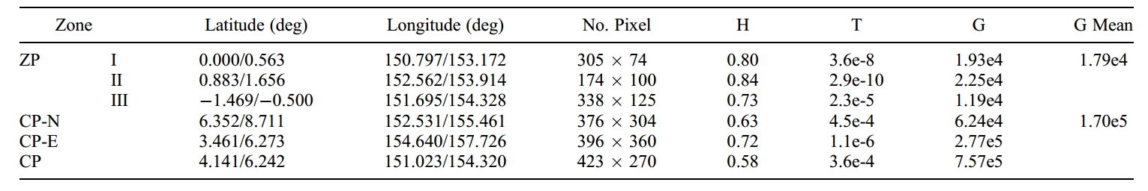
Fractal parameters evaluation
MOLA Digital Elevation Model (DEM)
MOLA Laser altimeter
Spatial resolution 460 m smaller than SHARAD horizontal resolution (about 6 km).
Flattest zone
Ceberus Palus (CP)
Rougher zone
eastward (CP-N) northward (CP-E)
Hill zone
Zephira Palum
(ZP-I, ZP-II and ZP-III)
Notes:
25

