Slide 1
Variable fluorescence imaging for life detection – promising tool or not?
Jana Kvíderová
Centre for Polar Ecology, Faculty of Science, University of South Bohemia, České Budějovice, CZ
Institute of Botany, AS CR, Třeboň, CZ

Slide 2
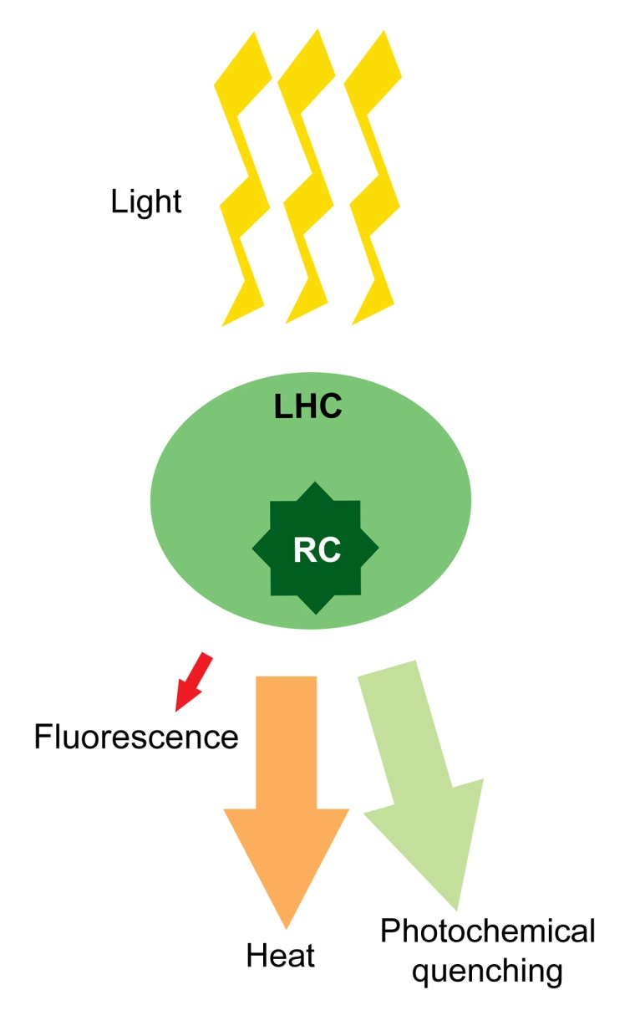
What is variable chlorophyll fluorescence?
fluorescence signal is ~1- 2 % of incoming radiation
90 % of fluorescence signal originates in PSII
fast, sensitive and non-invasive method for screening of actual physiological status of photosynthetic (micro)organisms

Slide 3
Variable chlorophyll fluorescence methodology
Many parameters and protocols depending on experiment requirements
e.g. Roháček et Barták (1999), Maxwell et Johnson (2000), Roháček (2000), Kromkamp et Forster (2003)…
Fast kinetics - OJIP transitent x Slow kintetics - quenching analysis
Basic parameter – maximum quantum yield (F_{V}/F_{M})
Measurement procedure
    Set-up of measurement pulse intensity
    Set-up of saturation pulse intensity and duration
    Dark adaptation (min 15 min)
    Measurement
    Data analysis and export

Slide 4
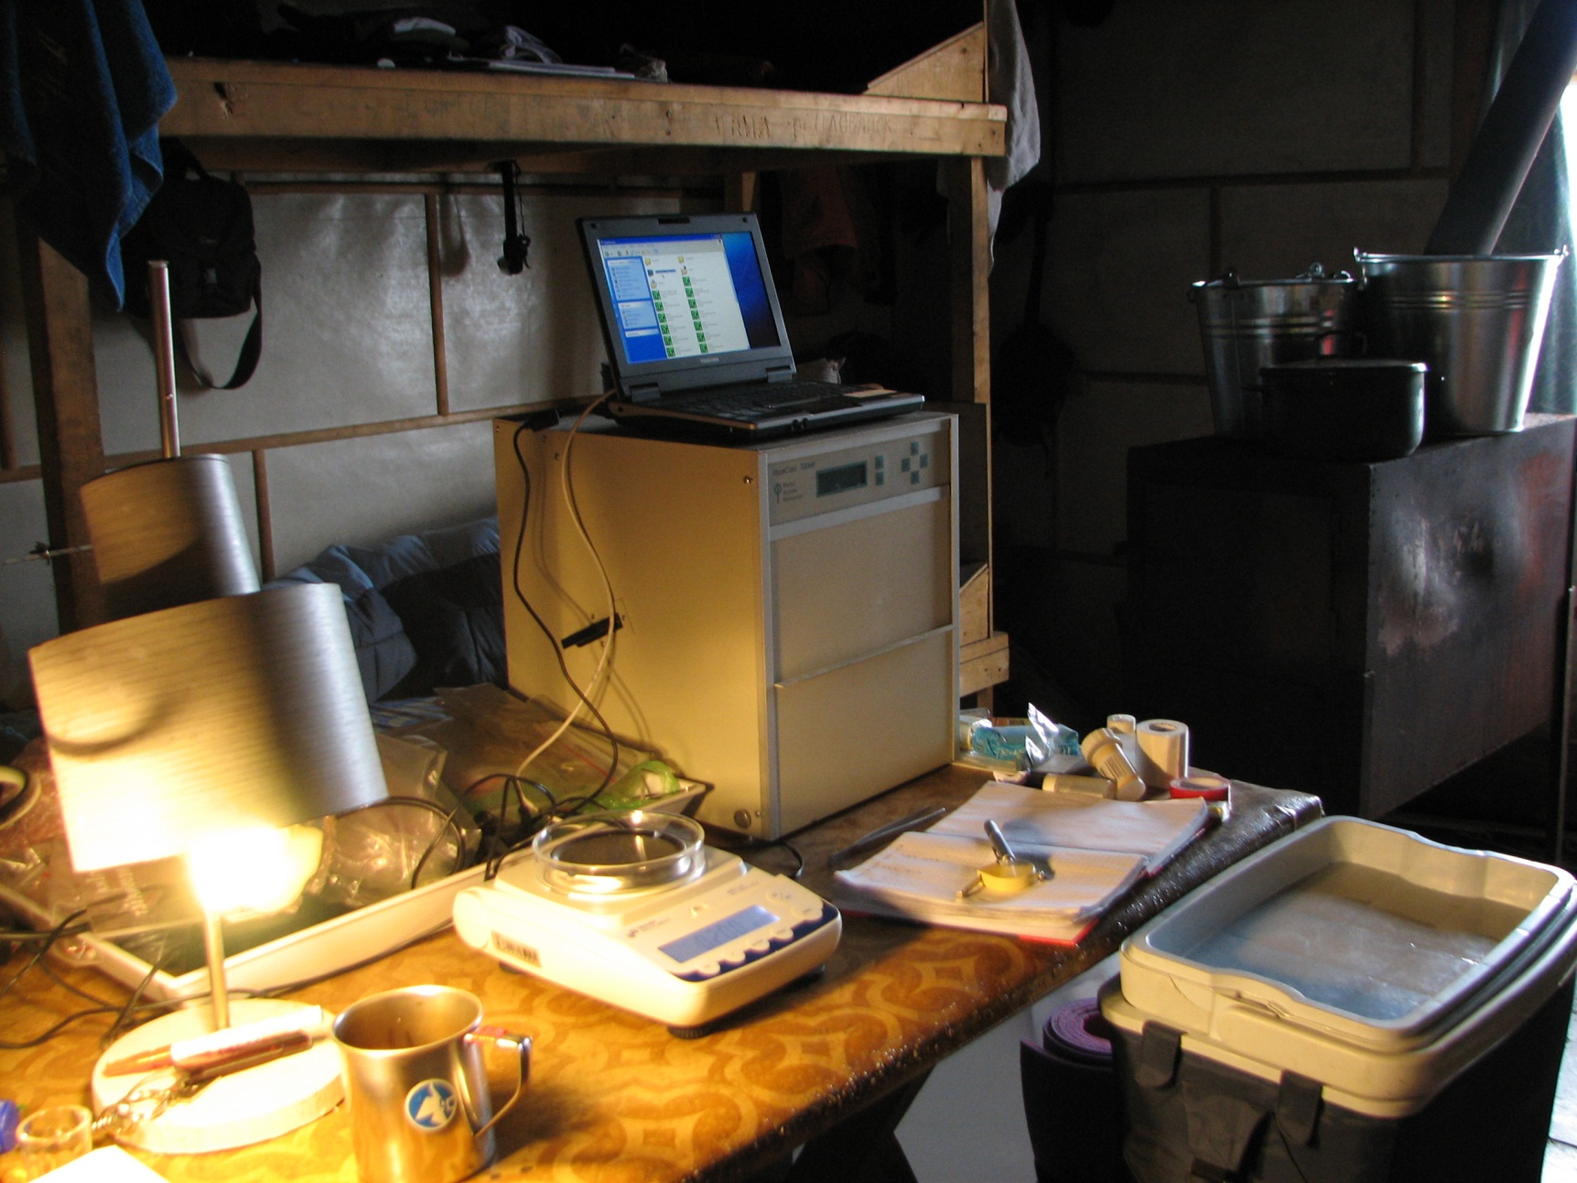
Fluorescence imaging camera FluorCam (Photon Systems Instrument, Czech Republic)
Estimation of growth of Nostoc colonies using FluorCam at Svalbard.

Slide 5
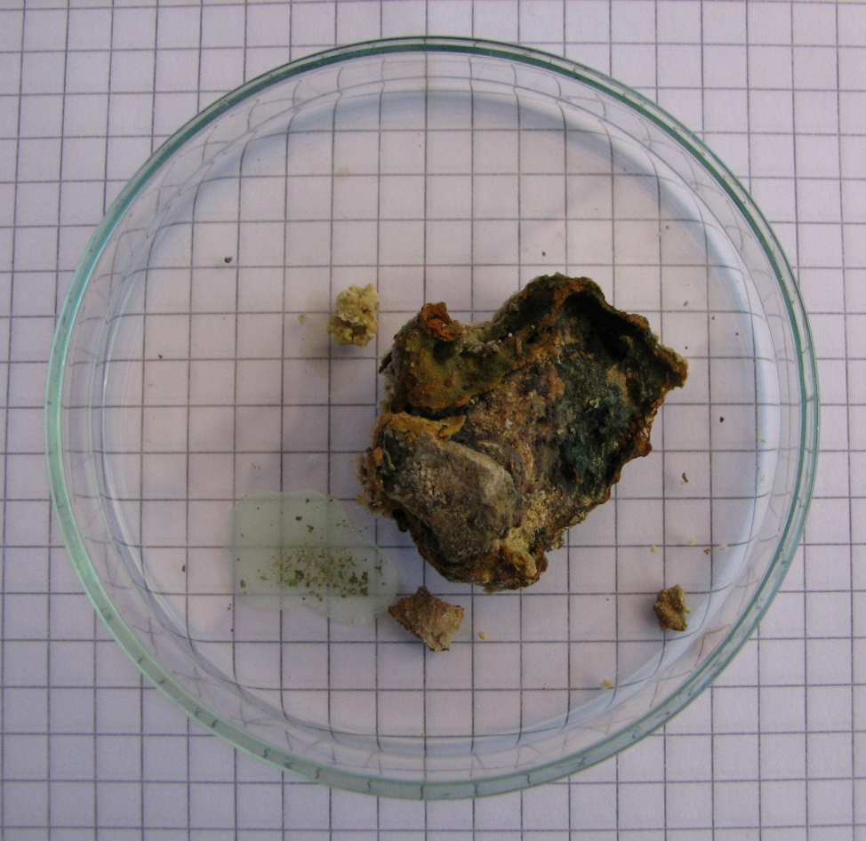
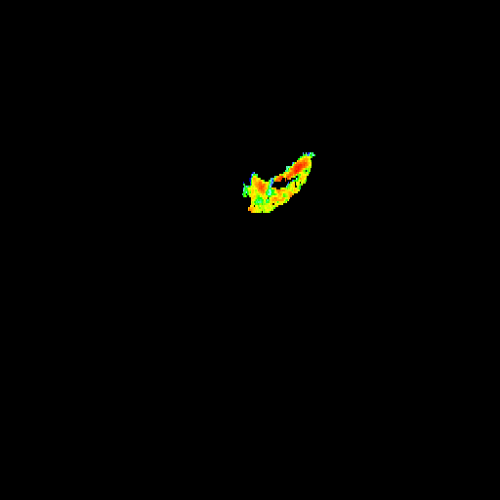

Photochemistry of Cyanidium biofilms
Stone F_{V}/F_{M}
Stone sample. Gómez et al (2011) Int J Astrobiol
The florescence image of Stone sample. Gómez et al (2011) Int J Astrobiol
Is it possible to detect endolithic communities and their physiological status?

Slide 6
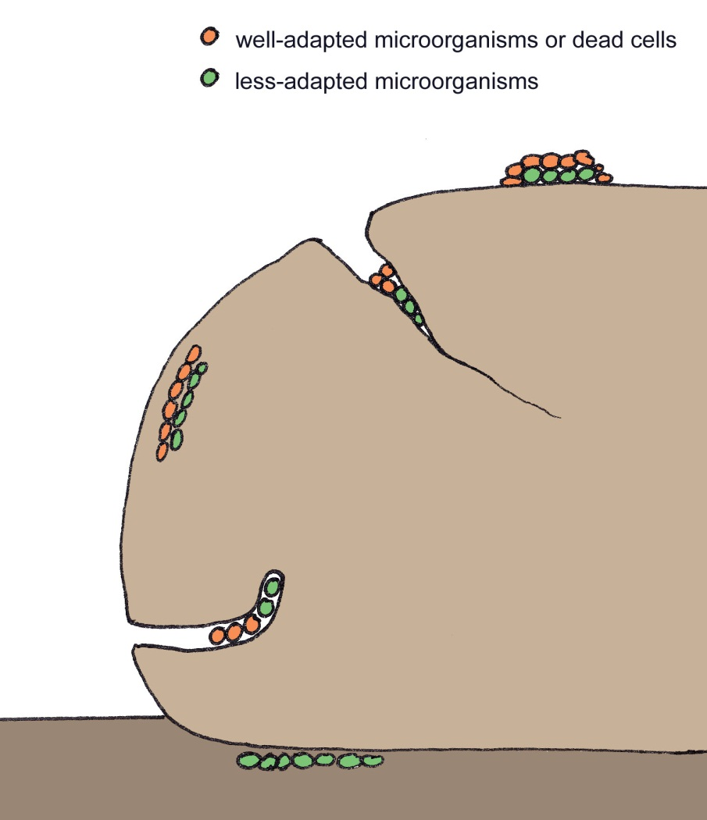
Rock-associated communities and Mars exploration
Types of rock-associated communities
  Epilithic
  (on the surface)
  Endolithic
    Chasmolithic
    (in cracks)
    Cryptoendolithic
    (among grains)
    Euendolithic
    (active penetration)
  Hypolithic
  (under the stone)
Proposed as Mars microbial habitat by Friedmann (1982) Science
Water
ΔT
Light

Slide 7
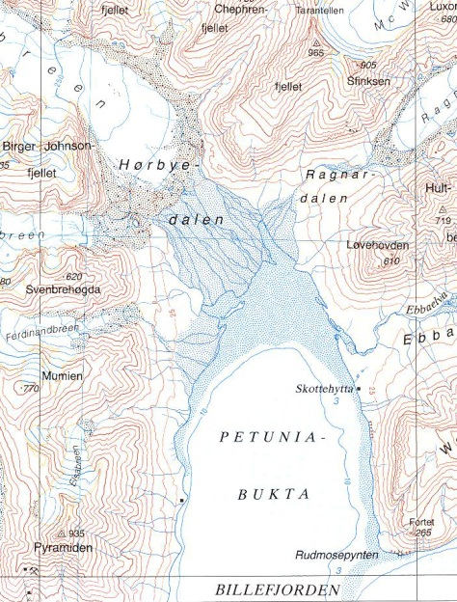
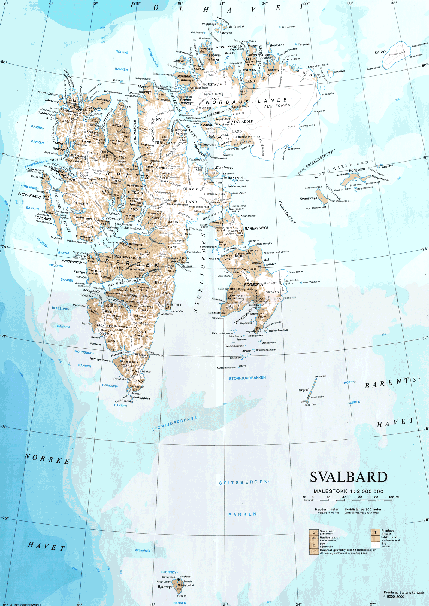
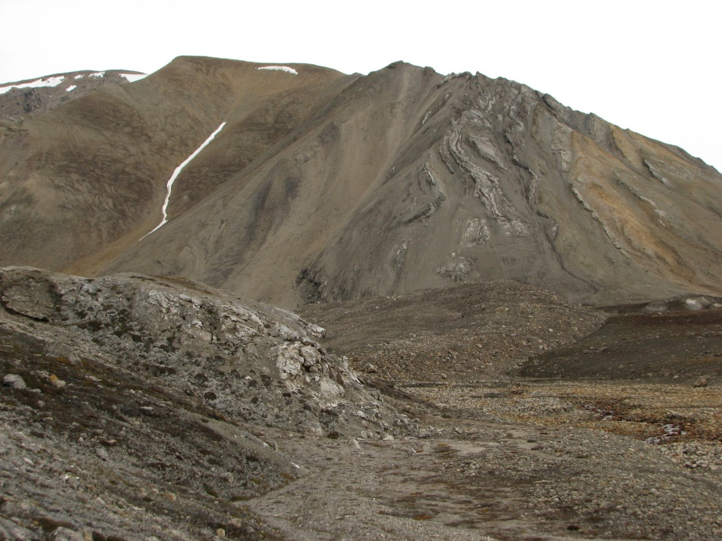
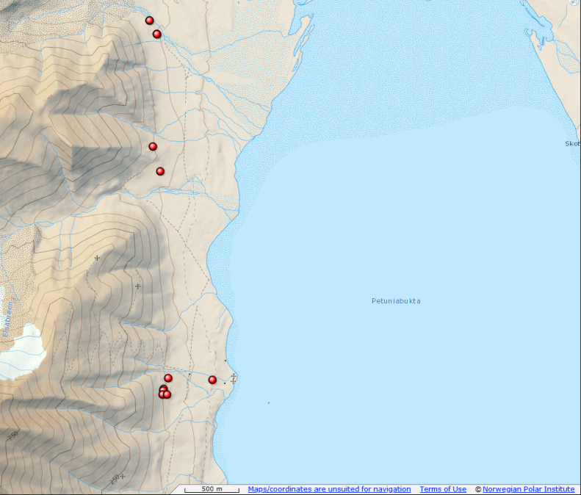
Svalbard endolithic communities
Sandstone/calcite/gypsum layers
11 samples evaluated for species composition
4 samples used for fluorescence imaging

Slide 8
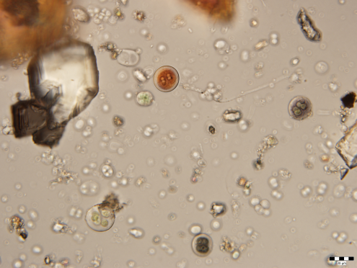
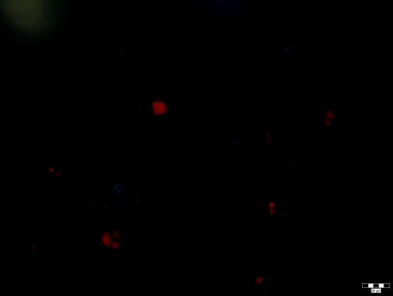
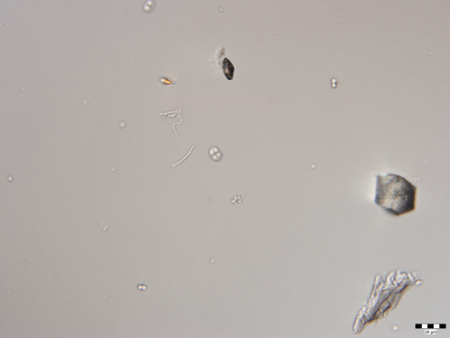
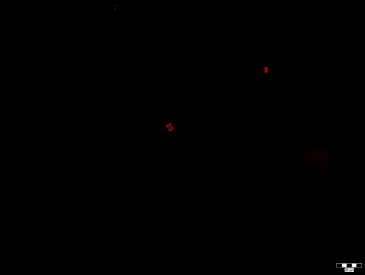
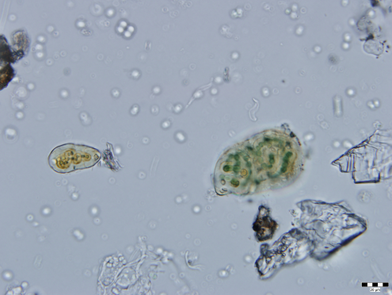
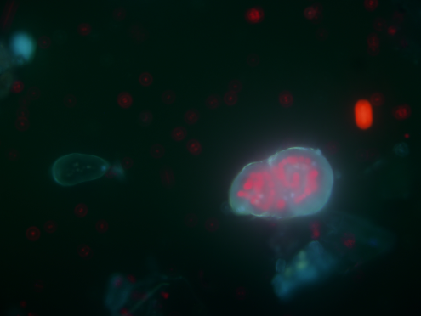
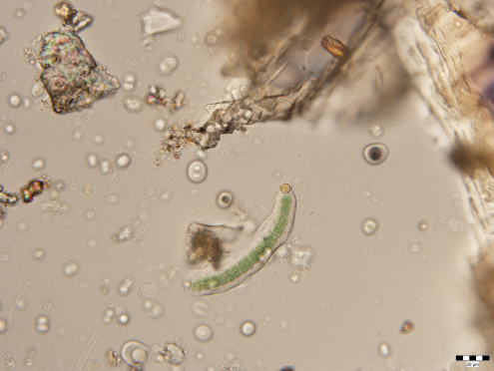
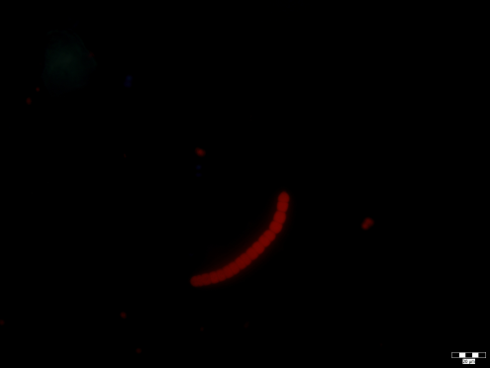
Diversity
Taxons observed
  Aphanothece sp.
  Aphanocapsa sp.
  Chroococcidiopsis sp.
  Cyanosarcina sp.
  Gloeocapsa sp.
  Gloeocapsa atrata
  Gloeocapsa sanguinea
  Gloeocapsa nigrescens
  Gloeothece sp.
  Nostoc sp.
  Tolypothix sp.
  Trichocoleus sp.

Slide 9
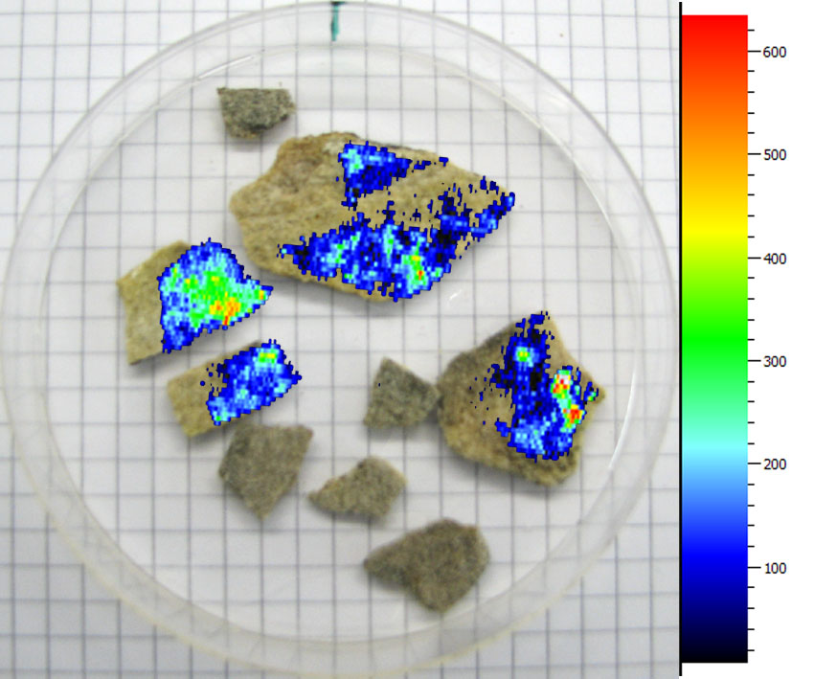
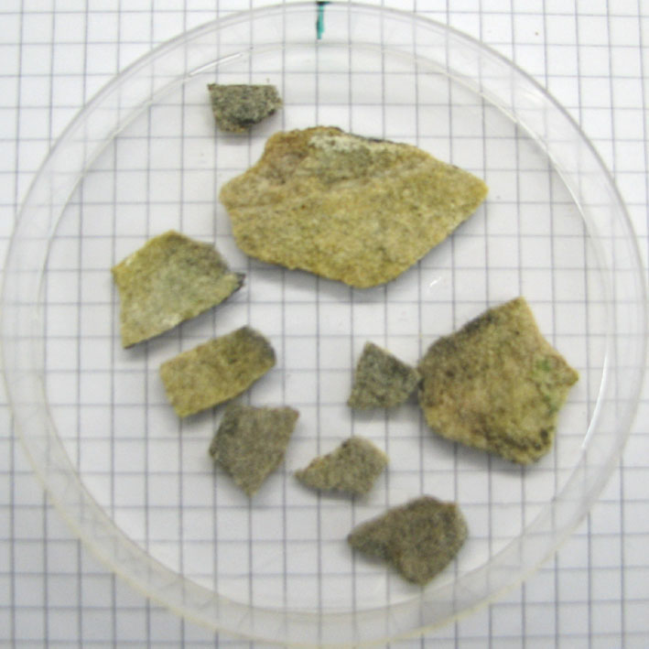
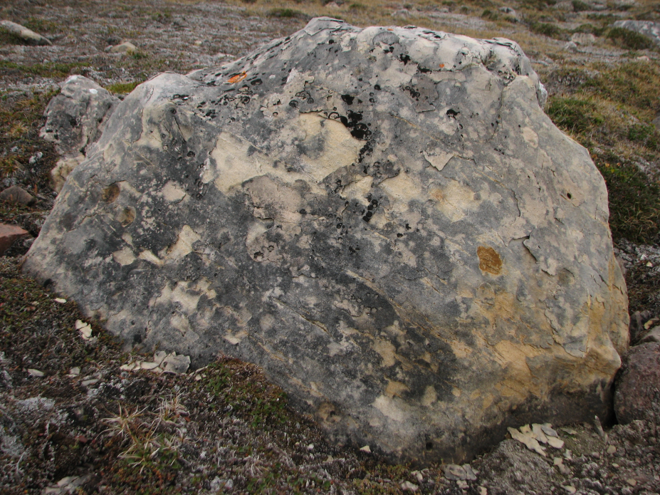
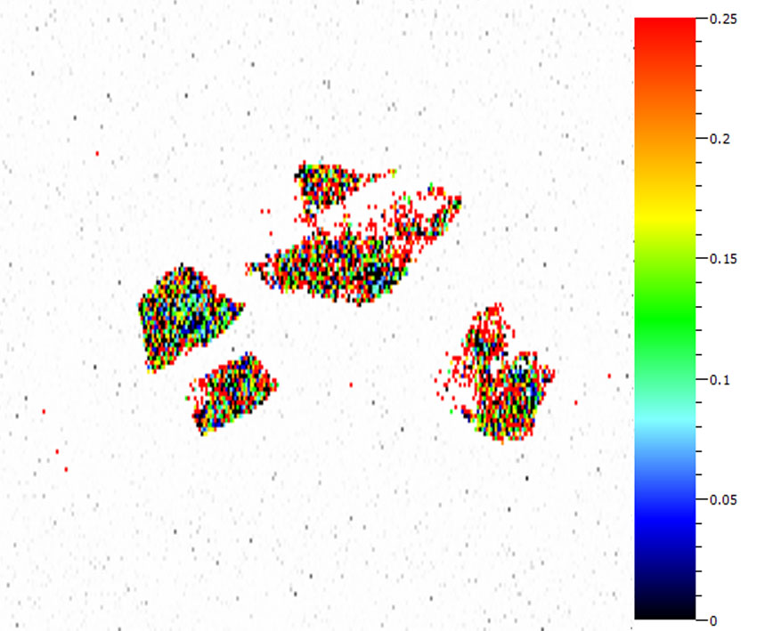
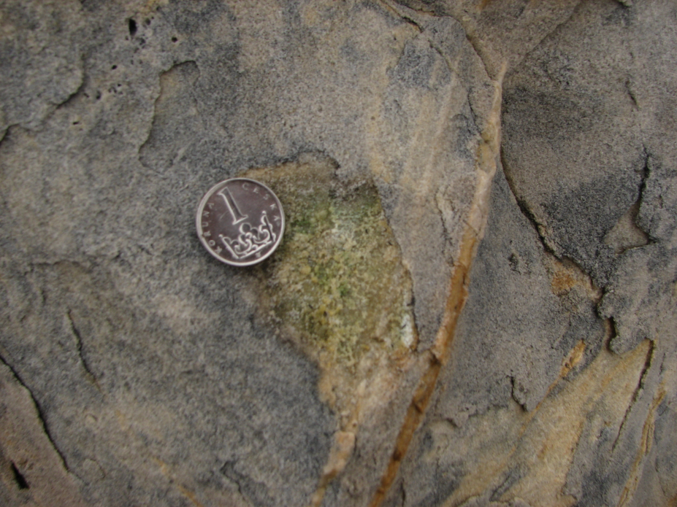
JQ1205
Substrate: sandstone
F_{V}/F_{M}: 0.16
F₀ - Biomass
F_{V} /F_{M} - Physiology

Slide 10
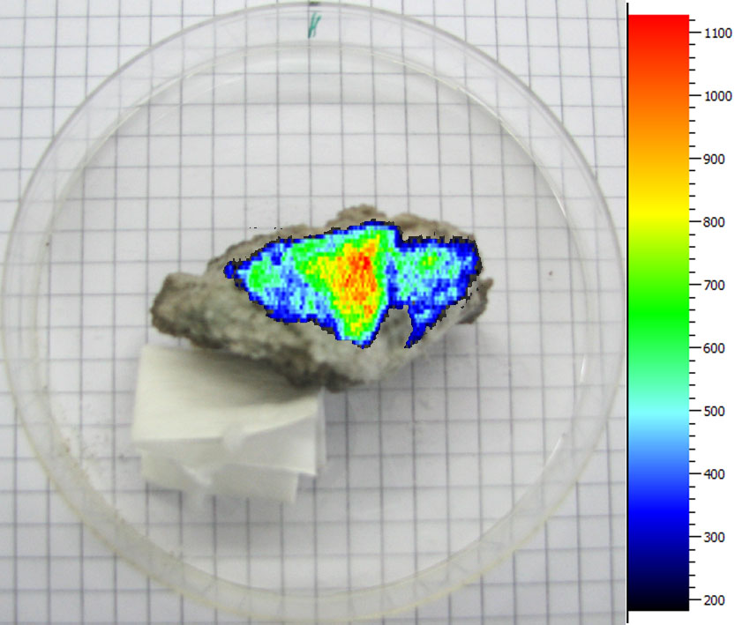
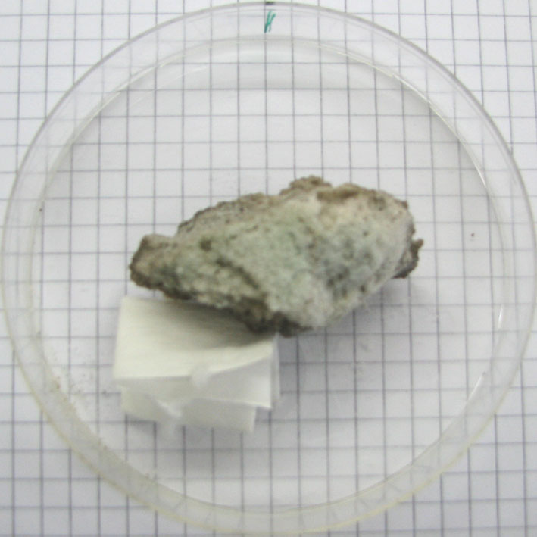
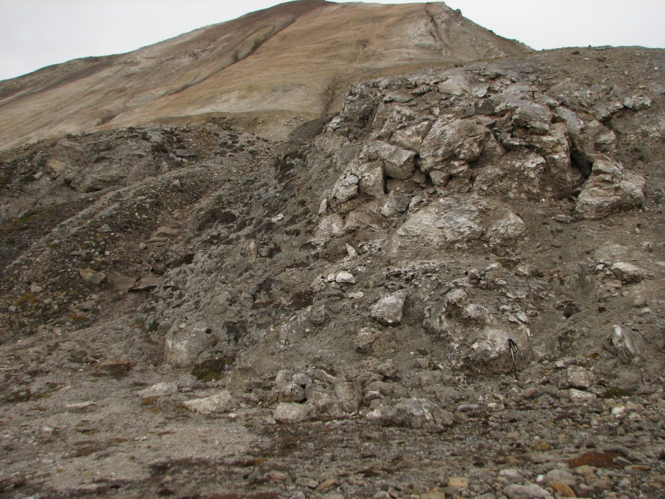
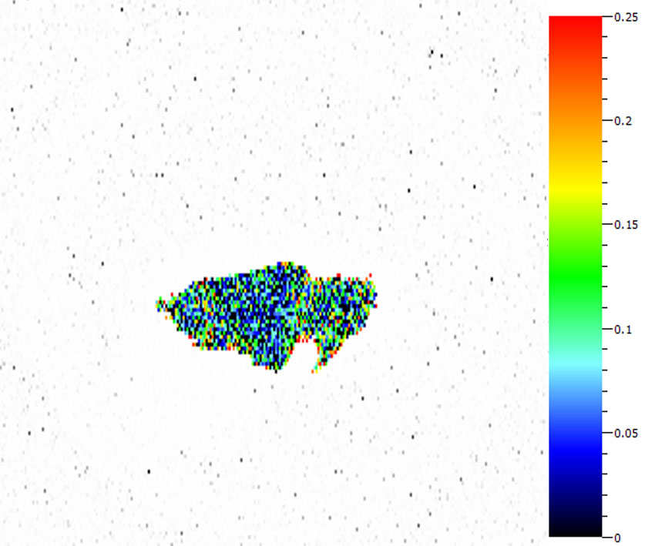
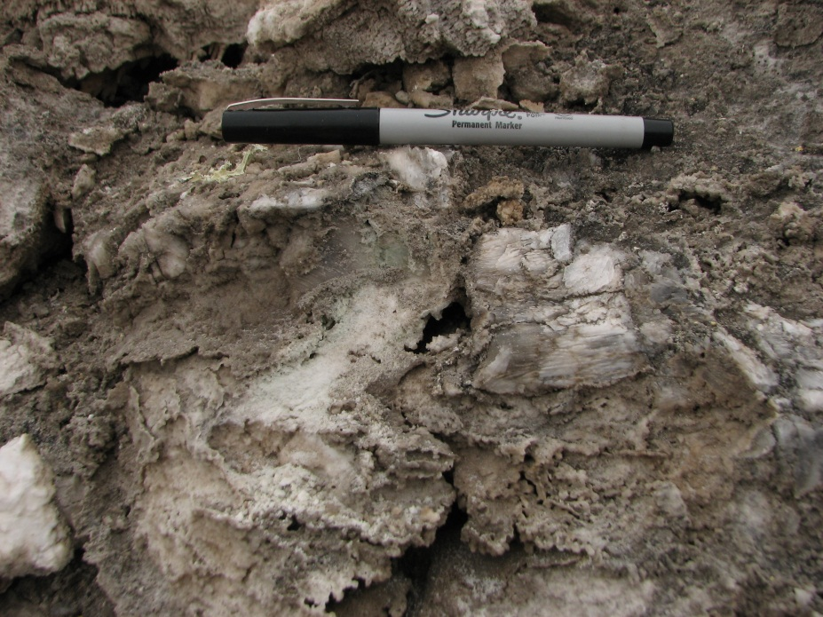
JQ1206
Substrate: gypsum
F_{V}/F_{M}: 0.07
F₀ - Biomass
F_{V} /F_{M} - Physiology

Slide 11
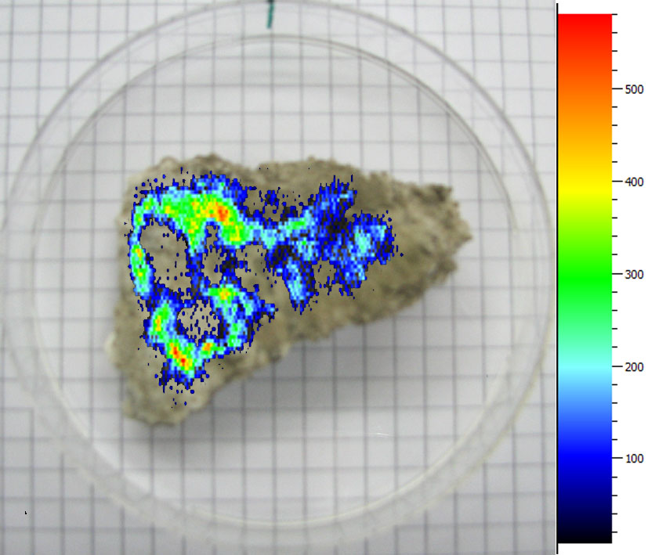
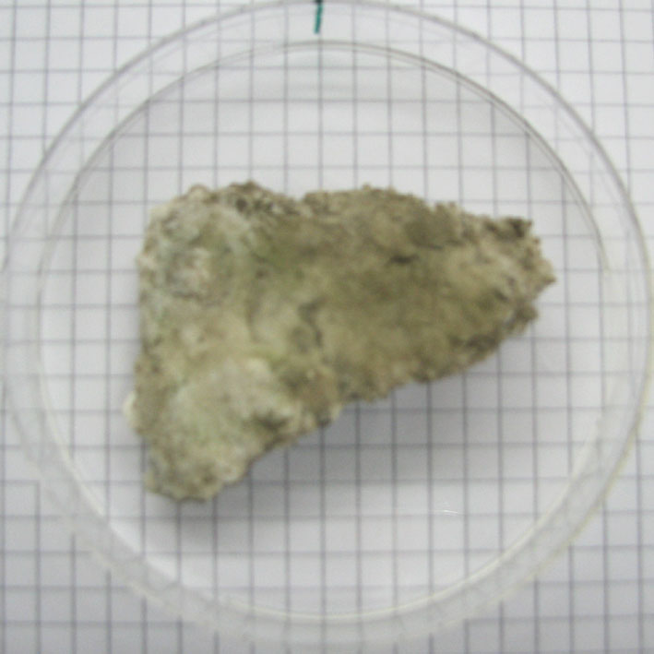
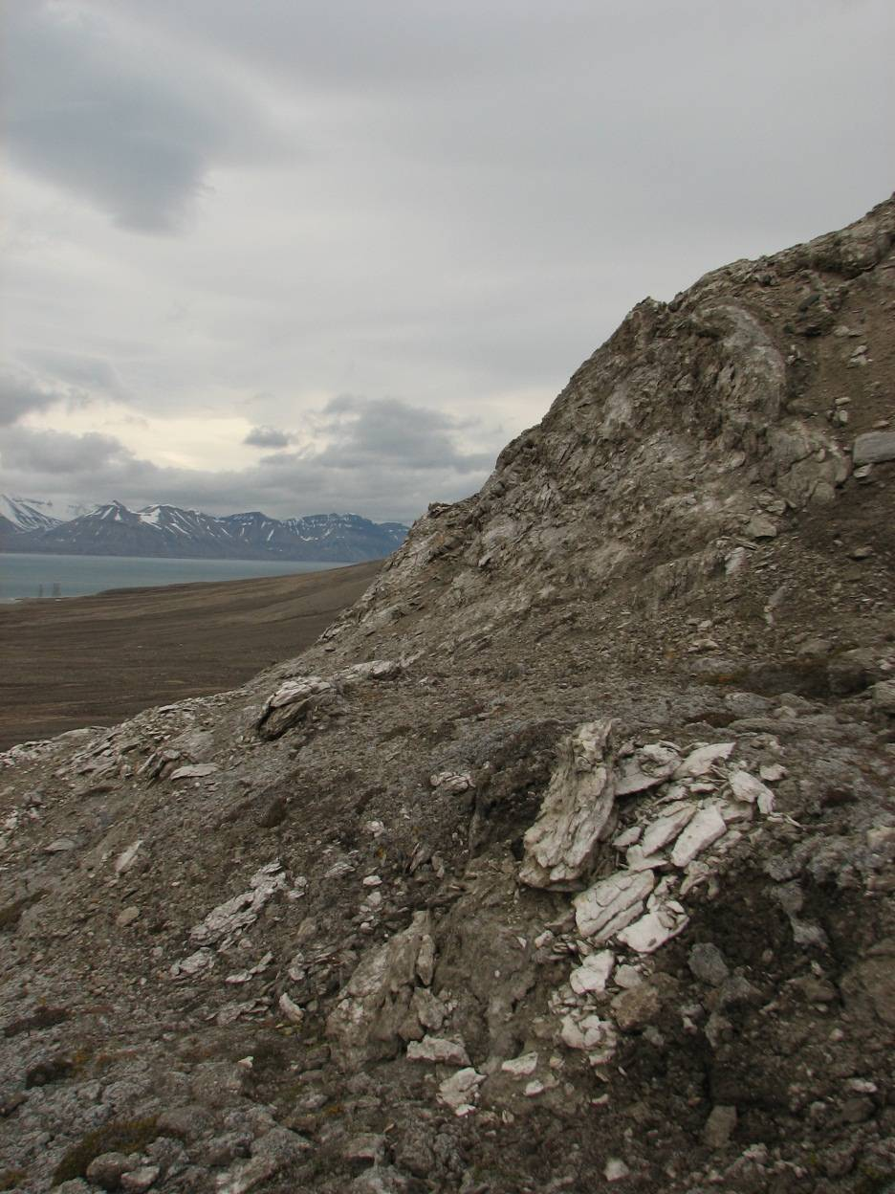
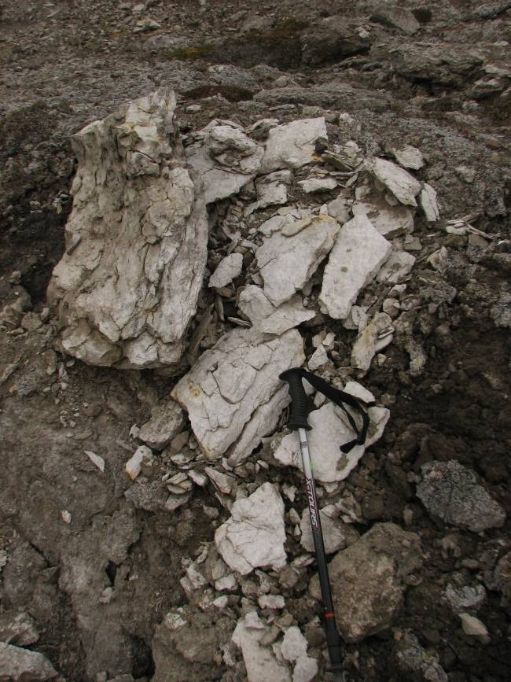
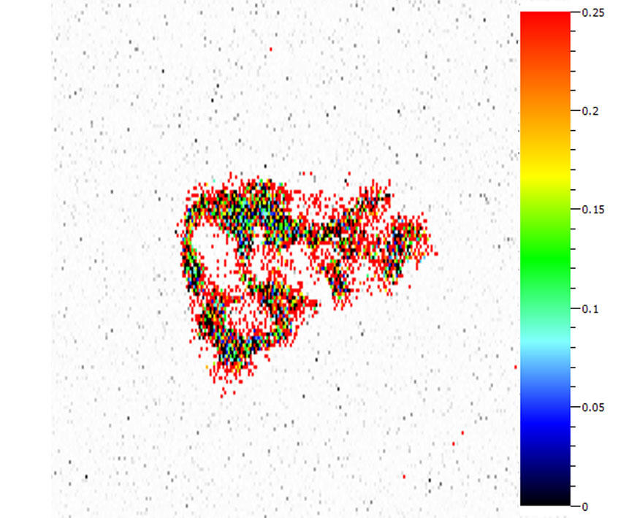
JQ1207
Substrate: gypsum
F_{V}/F_{M}: 0.23
F₀ - Biomass
F_{V} /F_{M} - Physiology

Slide 12
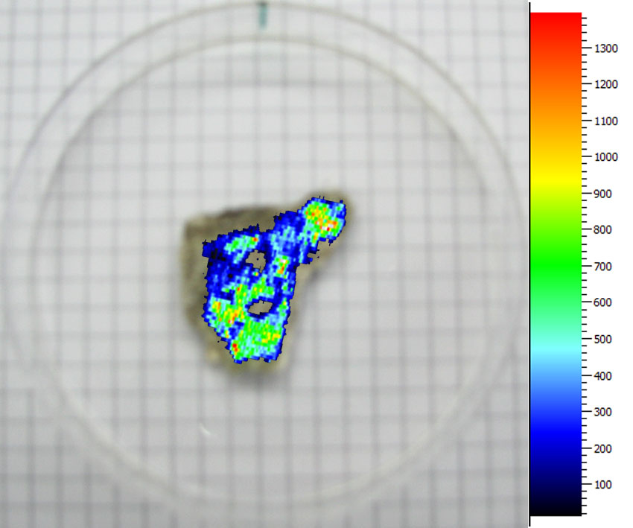
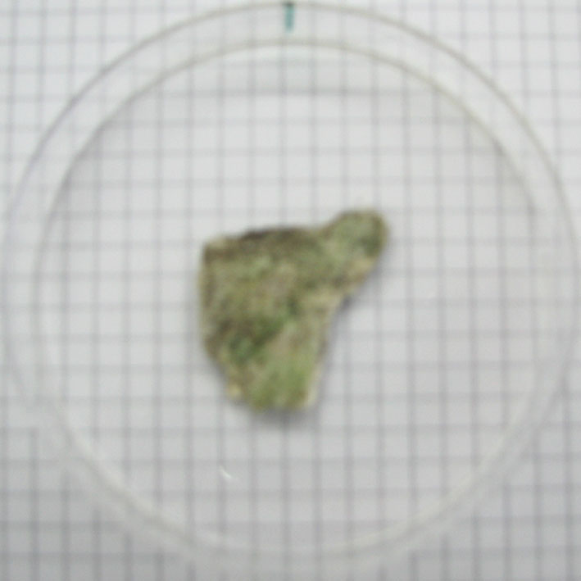
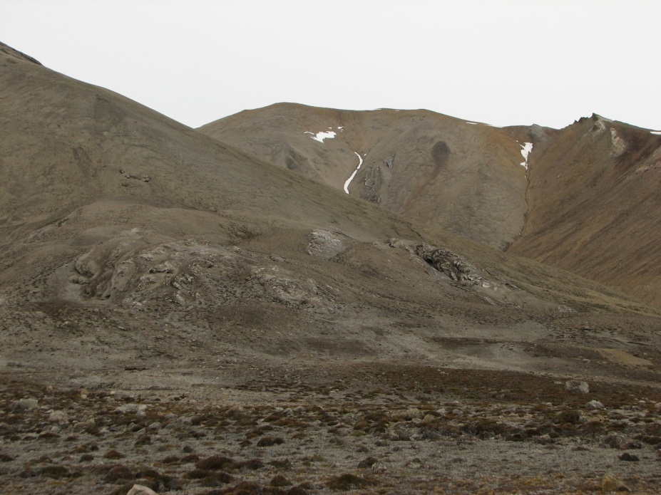
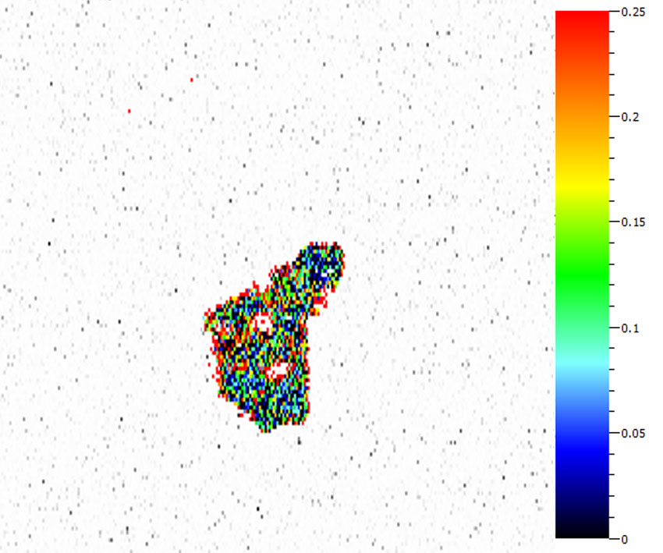
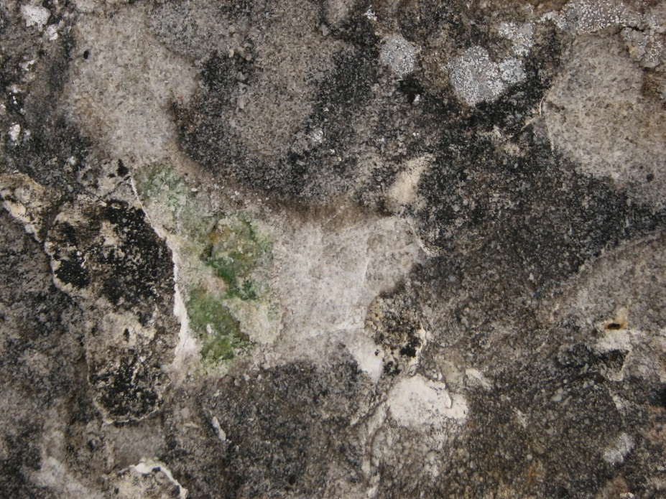
JQ1208
Substrate: sandstone
F_{V}/F_{M}: 0.09
F₀ - Biomass
F_{V} /F_{M} - Physiology

Slide 13
Result summary
Endilithic communities are detectable using variable chloropyll fluorescence approach
  Problems with combinations of visual and fluorescence images
  Low resolution
Cyanobacteria-dominant communities
  Total of 12 species/genera observed in 11 samples
  Substrate influence?
Low photochemical activity of studied commmunities
  Stress conditions in situ?
  Effects of ex situ sample manipulation?

Slide 14
Conslusions and future development
Variable chlorophyll fluorescence approach could be suitable method for life detection
  At present, limited to chlorophyll containg microorganisms (cyanobacteria and algae)
  Supplementary to other detection techniques (e.g. Raman spectrometry)
Possible future developments
  Miniaturization and connection to miniaturized microscope/camera for in situ measrements using high resolution
  Implementation of other fluorescence-based techniques, e.g. microsopy

Slide 15
Thank you for your attention!
Acknowledgement
The lecture was supported
in frame of project of the Ministry of Education, Youth and Sports of the Czech Republic no. LM2010009 CzechPolar - Czech polar stations: Construction and logistic expenses,
by project Creating of the Working Team and Pedagogical Conditions for Teaching and Education in the Field of Polar Ecology and Life in Extreme Environment, reg. No. CZ.1.07/2.2.00/28.0190 co-financed by the European Social Fund and the state budget of the Czech Republic,
as a long-term research development project no. RVO 67985939.

