Slide 1

Ice melting by radiantly heated dust grains on the Martian Northern Pole
Anna Losiak¹, Leszek Czechowski², Michael A. Velbel³
1) ING PAN Wrocław, Poland (anna.losiak@twarda.pan.pl); 2) Instytut Geofizyki Uniwersytet Warszawski, Poland; 3) Department of Geological Science, Michigan State University, US.

Slide 2
Outline
Background information:
  Evaporites on Mars
  Evaporites on Antartica
Aim: Is current evaporate formation possible on the Martian Northern Polar Cap?
Numerical modeling: the first results

Slide 3
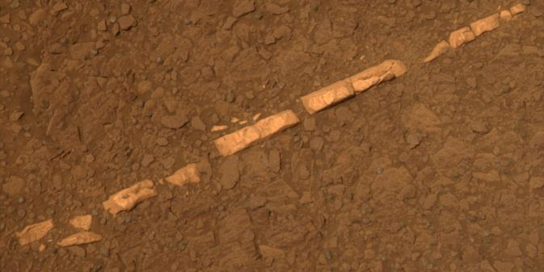
Evaporites on surface of Mars
Meteorites (Wentworth et al. 2005, Velbel 2012),
In situ (Clark and Van Hart 1981, Wang et al. 2006),
Satellite observations (Kuzmin et al. 2009).
Homestake vein of gypsum observed by Opportunity on the rim of Endeavour Crater (NASA).

Slide 4
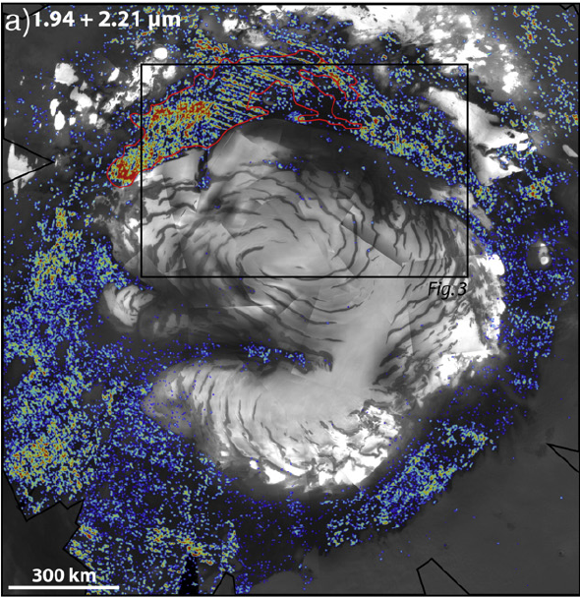
Martian evaporites distribution
Evaporites were detected all over the planet.
Olympia Planum region, fragment of the Circumpolar Dune Field (Langevin et al., 2005, Horgan et al. 2009, Masse et al. 2010, 2012) are stratigraphically young.

Slide 5
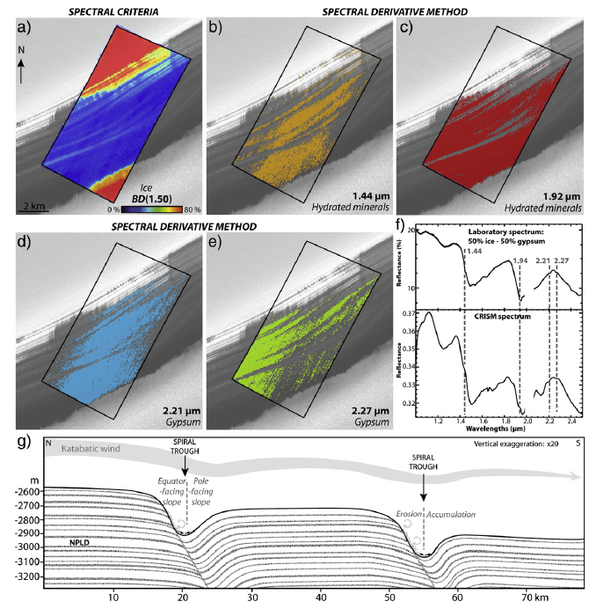
Evaporites on North Polar Cap
Evaporites were detected also on the Northern Ice Cap (Masse et al. 2012).
How and when was this gypsum formed?
  Formation elsewhere and deposition on ice.
  Formation within ice (Catling et al. 2006, Zolotov and Mironenko 2007, Niles and Michalski 2009).
(Masse et al. 2012)

Slide 6
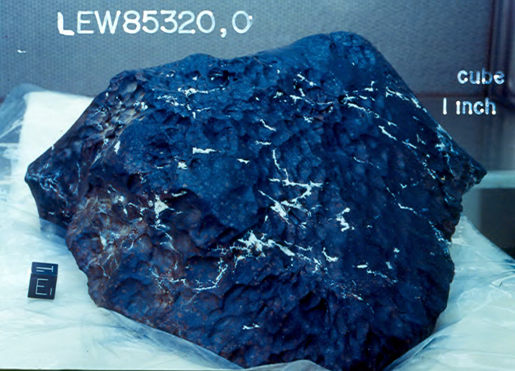
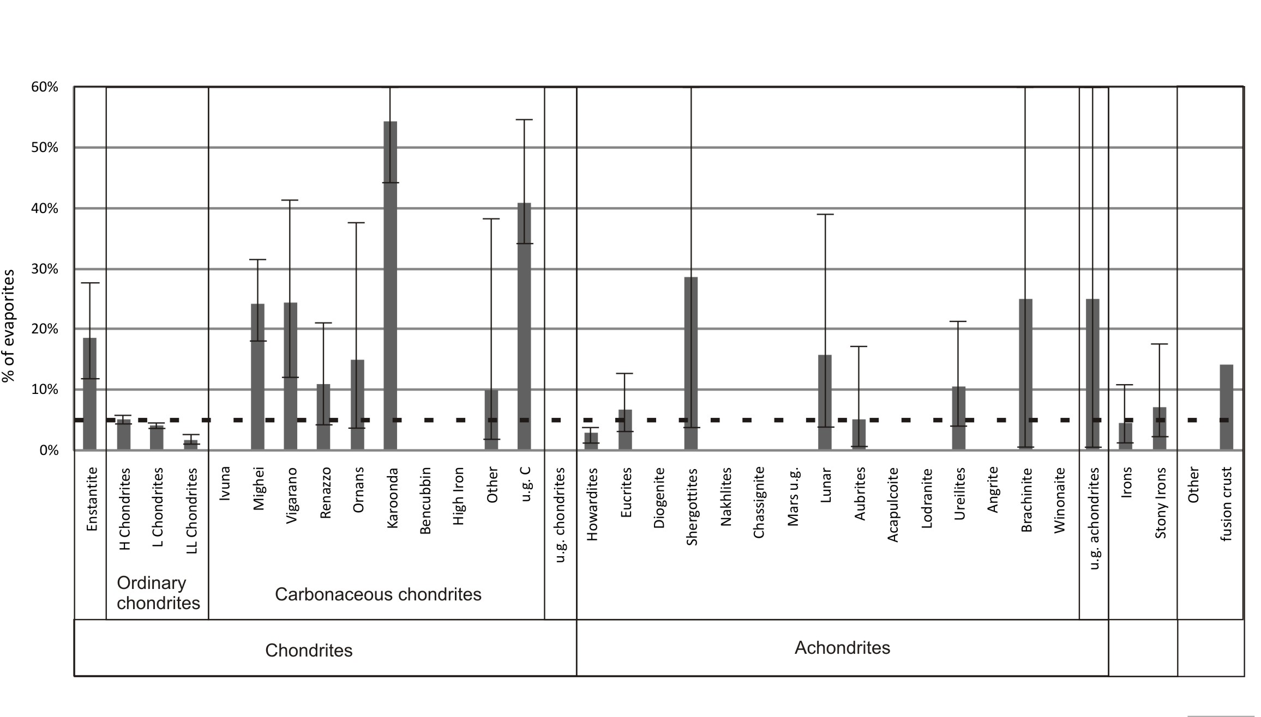
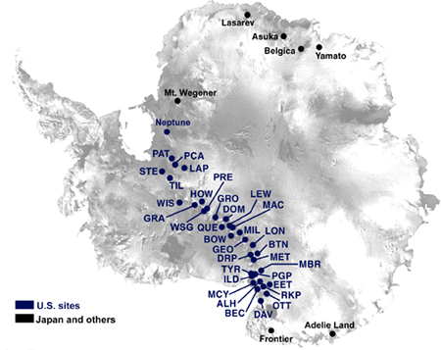
Evaporites on Antarctic Meteorites
(Losiak and Velbel 2011)
Nesquehonite Mg(HCO₃)(OH)·2H₂O
Hydromagnesite Mg₅(CO₃)₄(OH)₂·4H₂O
Epsomite MgSO₄·7H₂O
Starkeyite MgSO₄·4H₂O
Gypsum CaSO₄·2H₂O
Jarosite KFe₃(OH)₆(SO₄)₂
Smectites
(Yabuki et al. 1976, Marvin 1980, Gooding 1986, Jull et al. 1988, Velbel et al. 1991)

Slide 7
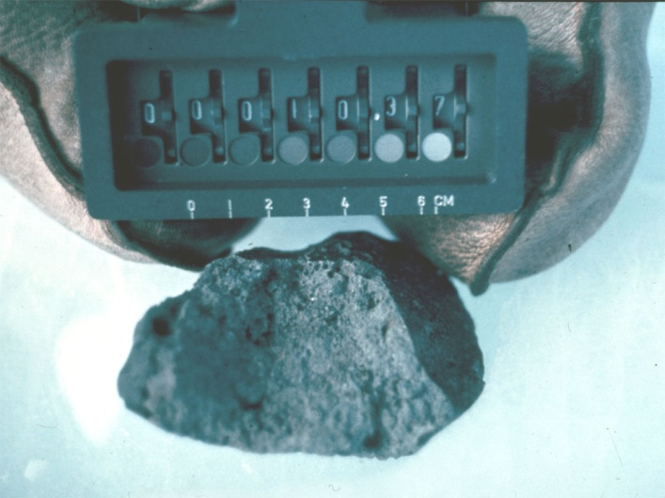
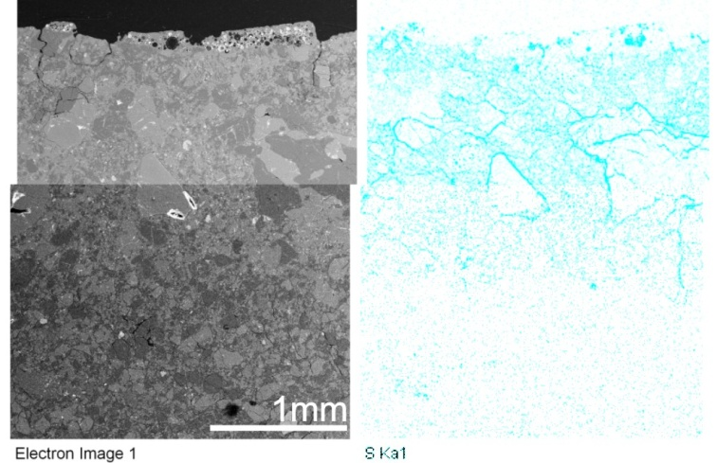
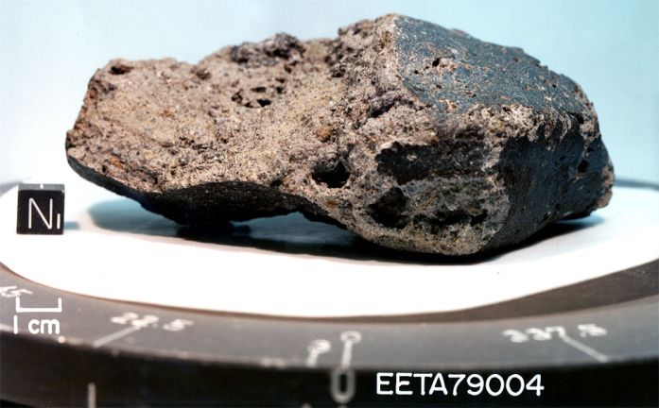
Evaporites on Antarctic meteorites
EETA79004: polymict eucrite labeled as one without evaporites
Ca-S phase
Ka-Al-S phase
px
pl
(Losiak 2009)

Slide 8
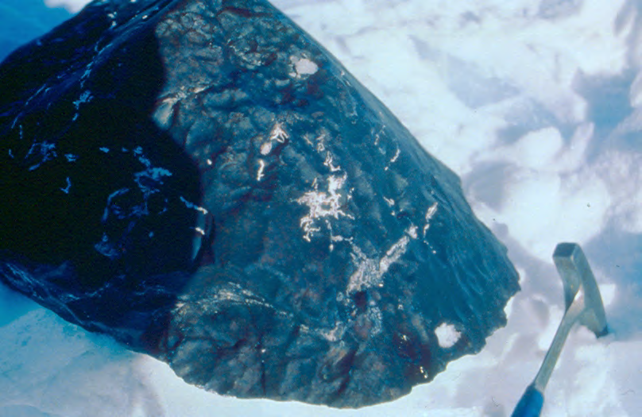
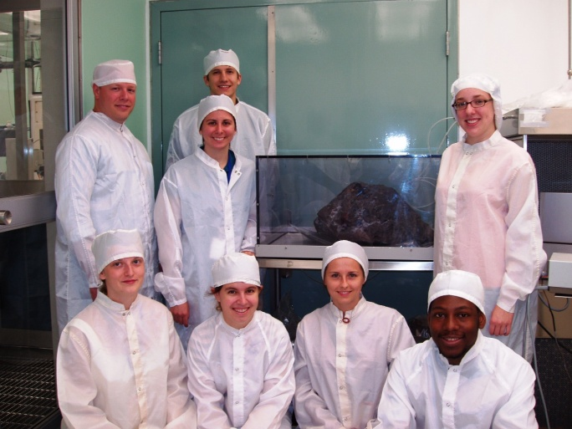
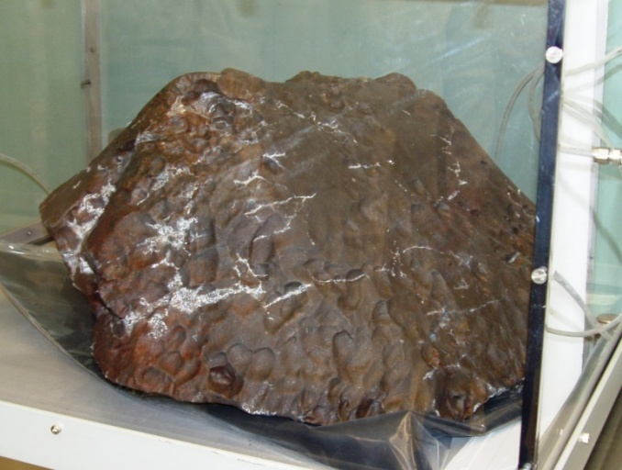
Rapid formation of evaporites on meteorites
Evaporites on Antarctic meteorites
In the field
After shiping
Recently
110 kg H5 chondrite (Jull et al. 1988)
  Meteorites enclosed within ice: Harvey and Score 1991, Krahenbuhl and Langenauer 1994).

Slide 9
Cryoconite holes
(Harpel et al. 2008)
(Paerl and Priscu 1998)

Slide 10
Aim
Is contemporary evaporate formation at the Martian Northern Polar Cap possible?

Slide 11
Numerical modeling
Test if radiant heating is sufficient to melt a thin layer of ice surrounding a single dust grain exposed within the south facing side of the Martian North Polar Cap trench.

Slide 12

The model
T_{low}
T_{ini}
e
S
ρ
d
k
c_{p}
c_{m}
d_{d}
ρ_{d}
A
A numerical model based on the equation of the heat transfer
(Czechowski 2012):
where symbols are explained in Table 1. The equation is solved for x=[0, D] with the following boundary conditions:
for x = 0 (the surface)
T = T_{low} for x = D (the lower boundary).

Slide 13
Input parameters
On flat surface
On inclined surface up to 450 W/m2
Pressure >700 Pa
(above triple point of water)

Slide 14
Input parameters
Name | Symbol | Unit | Value | Comment
General properties
Solar constant | S | W m⁻² | 300-450 | Northern pole summer (e.g., Levine et al. 1977).
Temperature | T_{low} | [K] | 185 | Conservative estimation based on Paige et al. (1994) & Larsen and Dahl-Jensen (2000) and Mars Climate Database.
 | T_{ini} |  | 215
Dust grain properties
Diameter | d_{d} | [µm] | 200 | Upper limit of grains that can be moved by wind on Mars (Greeley and Iversen 1985, Vaughan et al. 2010).
 |  |  | 20 | Upper limit of dust that can be moved in suspension on Mars.
 |  |  | 2 | The average size of dust gains on Mars (Lemmon et al. 2004).
Density | ρ_{d} | [kg m⁻³] | 3000 | Average density of basalt.
VR Albedo | A | 1 | 0.13 | Albedo of the Olympia Planum region dunes measured by M. Masse in agreement with older estimates (Paige et al. 1994).
IR Emissivity | e | 1 | 0.72-0.87

Slide 15
Input parameters
Name | Symbol | Unit | Value | Comment
Dirty-porous ice properties
Composition |  |  | % | MIX 2: 15% Air, 10% Silicates, 75% Ice.
Thickness of layer | d | [m] | 0.5
Density of dusty ice | ρ | [kg m⁻³] | 990 | MIX 2
Specific heat | c_{p} | [J kg⁻¹ K⁻¹] | 1500 | MIX 2
Coefficient of heat conduction | k | [J m⁻¹ K⁻¹ s⁻¹] | 0.1 | Experimentally derived values vary between <0.015 to >3.06 J m⁻¹ K⁻¹ s⁻¹ (Shoshany et al. 2002, Schneebeli and Sokratov 2004, Seiferlin et al. 1996, Clifford 1987). Values derived from measured thermal inertia for Northern Polar Cap for assumed dirty-porous ice properties vary between 0.04 and 0.7.
 |  |  | 0.5
 |  |  | 0.7
 |  |  | 1
 |  |  | 2
Specific heat for melting | c_{m} | [J kg⁻¹] | 133480
Heat source/sink | Q | [W m⁻³] | Q<0 | for melting.
 |  |  | Q>0 | for freezing.
 |  |  | Q=0 | otherwise.

Slide 16
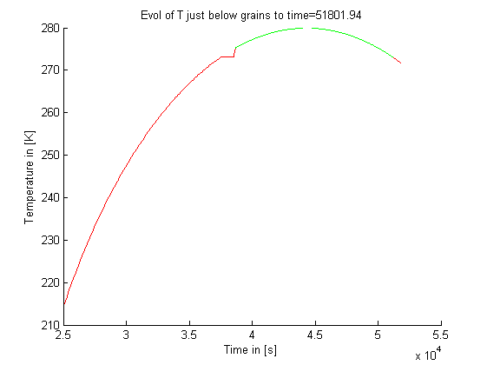
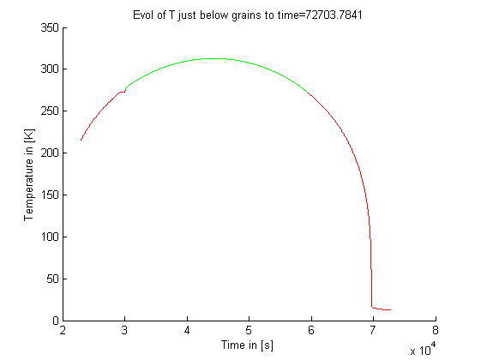
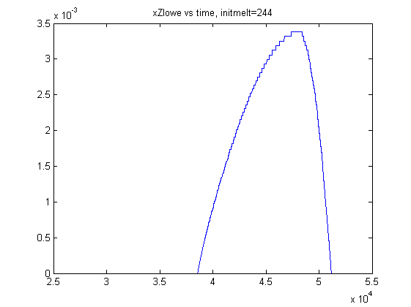
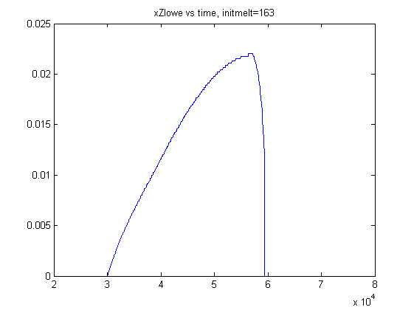
Ice melting on Mars
Solar constant – check
IR emissivity: 0.72
Grain size: 2 μm
Heat conduction: 0.4 J m-1 K-1 s-1
320 W/m2
450 W/m2
~2.7 hours
~8 hours
Temperature [K]
Thickness of melted layer [m]
Time [s]
Time [s]

Slide 17
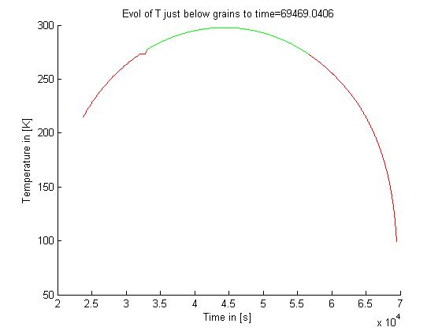
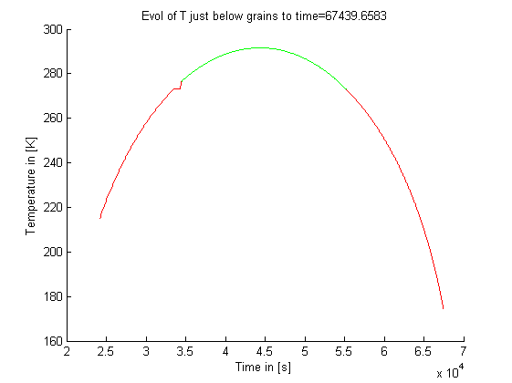
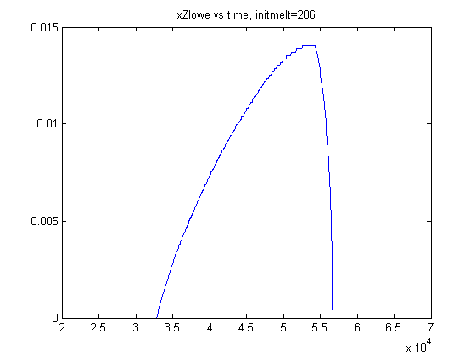
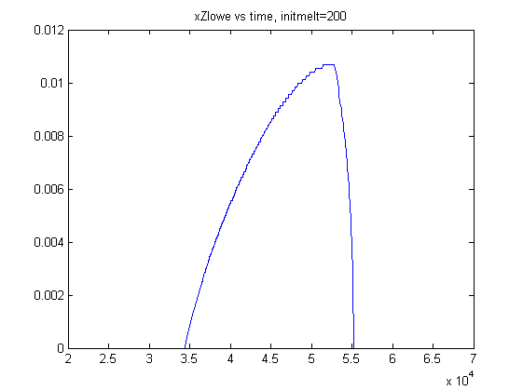
Ice melting on Mars
IR Emissivity of basalt
Solar constant: 410 W/m2
Grain size: 2 μm
Heat conduction: 0.4 J m-1 K-1 s-1
0.8
0.87
Temperature [K]
Thickness of melted layer [m]
Time [s]
Time [s]

Slide 18
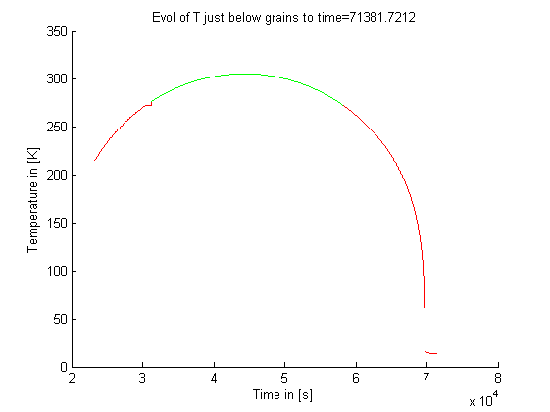

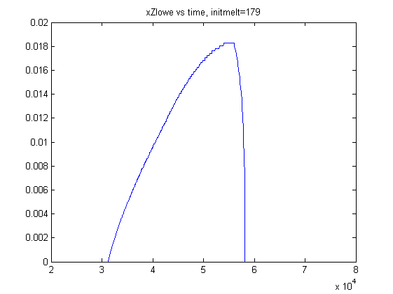

Ice melting on Mars
Grain size
Solar constant: 410 W/m2
IR emissivity: 0.72
Heat conduction: 0.4 J m-1 K-1 s-1
20 μm
200 μm
Temperature [K]
Thickness of melted layer [m]
Time [s]
Time [s]

Slide 19
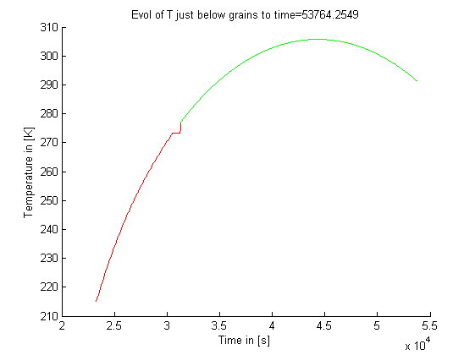
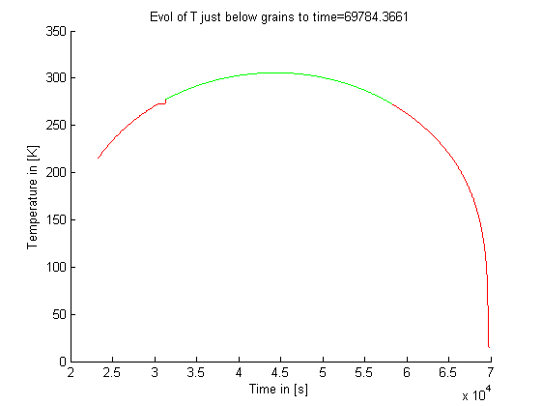

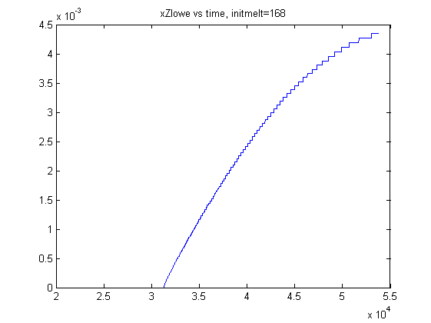
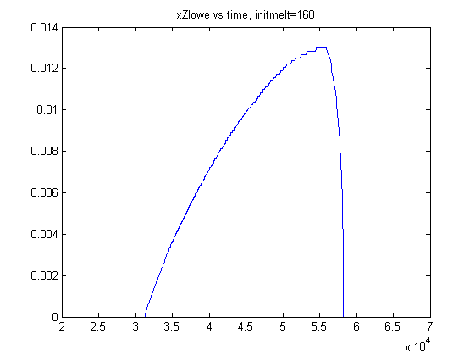
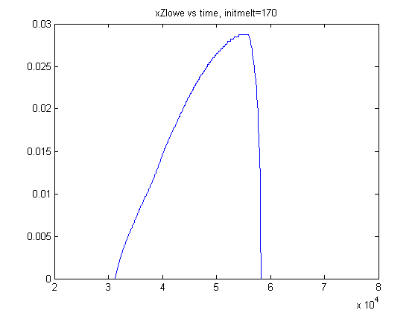
Ice melting on Mars
Heat conduction (dirty ice)
Solar Constant: 410 W/m2
Grain size: 2 μm
Emissivity: 0.72
0.02 J m-1 K-1 s-1
0.2 J m-1 K-1 s-1
1 J m-1 K-1 s-1
Temperature [K]
Thickness of melted layer [m]
Time [s]
Time [s]
Time [s]

Slide 20
Conclusions
Current melting of Northern Ice Sheet is possible.
  Melting depends on
    solar constant
    heat conduction of dirty ice
    IR emissivity of a grain
    NOT on grain size
  Ice melting for up to few hours.

Slide 22
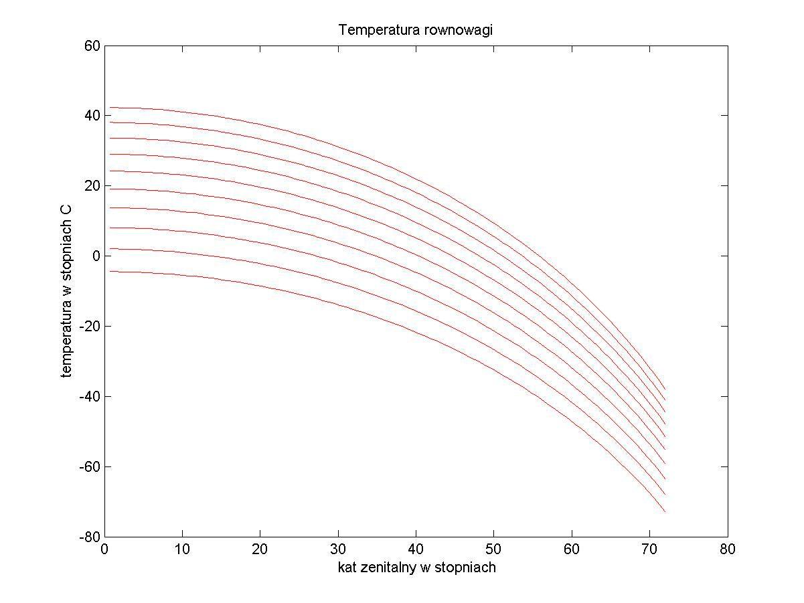
Equilibrium temperature
Equilibrium temperature (in °C) depending on the zenithal angle and albedo.
40
0.0 albedo
20
0
Temperature [°C]
-20
-40
0.5 albedo
-60
0
10
20
30
40
50
60
70
80
Zenithal angle [°]
Figure 5. Temperature profile below the grain (200 µm) vs. time. The panels correspond to different values of thermal conductivity (MIX1). Simulation covers 0.4 Martian day. The local noon is approximately at time = 5 h.

Slide 23
Blue Ice Areas
  Locations in Antarctica where glacial ice is exposed on the surface (Bintanja 1999) and surface mass balance is negative.

Slide 24
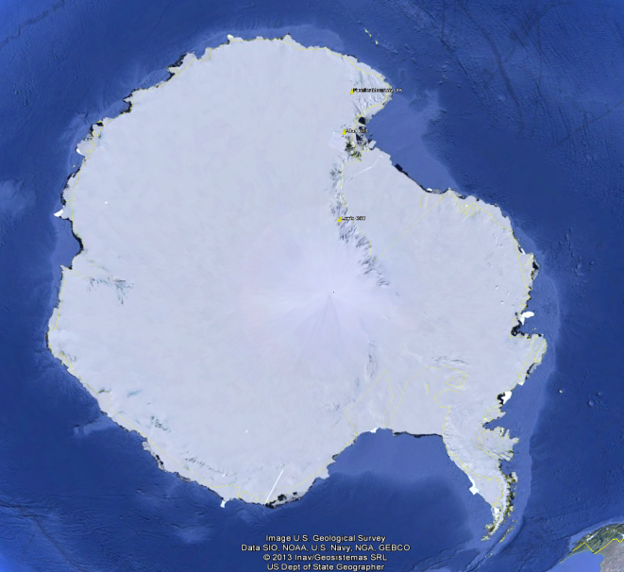
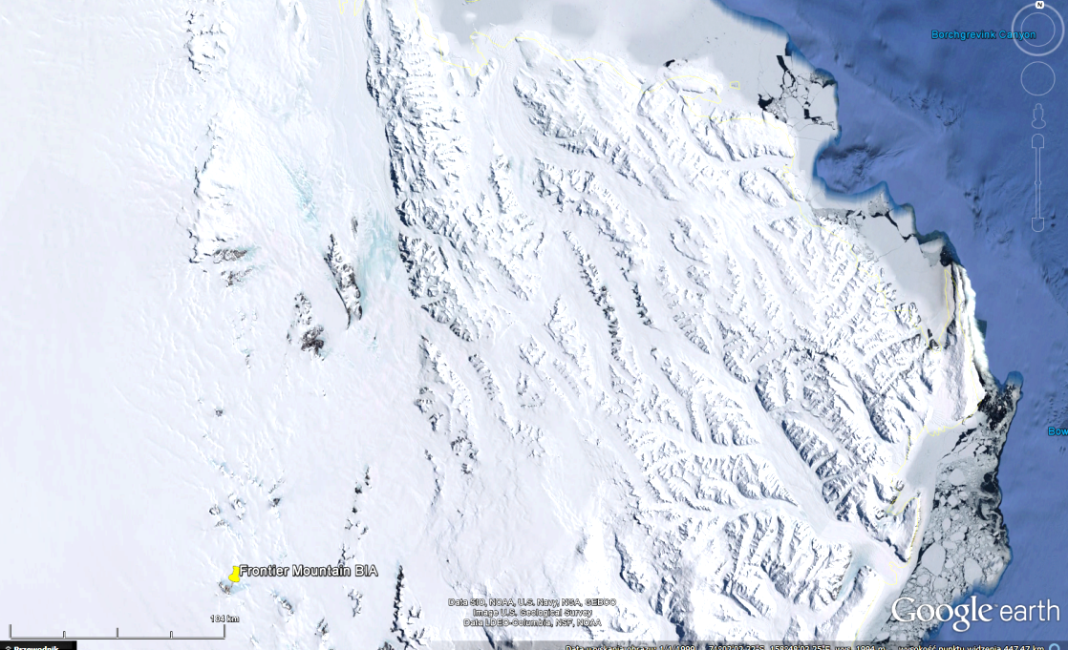
Distribution of Blue Ice Areas
0.8-1.6% of the Antarctic Ice Sheet (Winther et al. 2001, Van den Broeke et al. 2006).
Net ablation mainly by sublimation (Bintanja 1999).

Slide 25
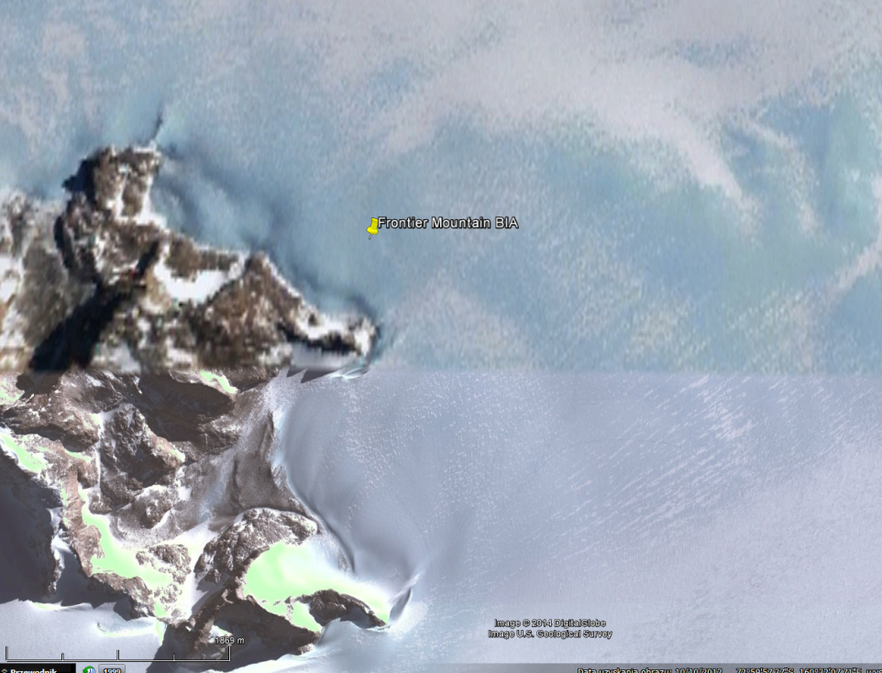
Meteorological differences over BIAs
1-6°C higher surface temperatures due to lower albedo 0.56-0.69 (snow: 0.8-0.85).
Stronger, more turbulent winds.
7°C higher ice temperatures due to smaller shortwave extinction coefficient of BIAs.
1889 m

Slide 26
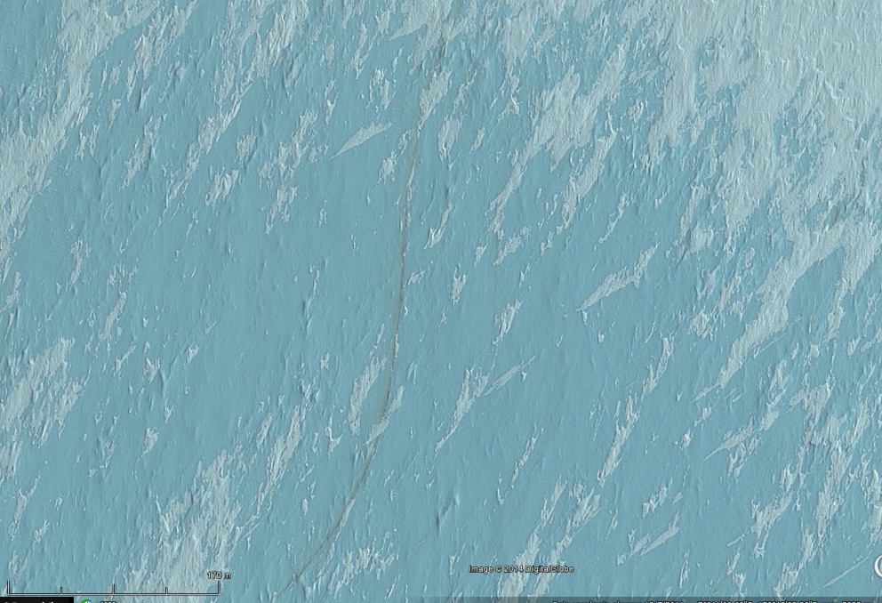
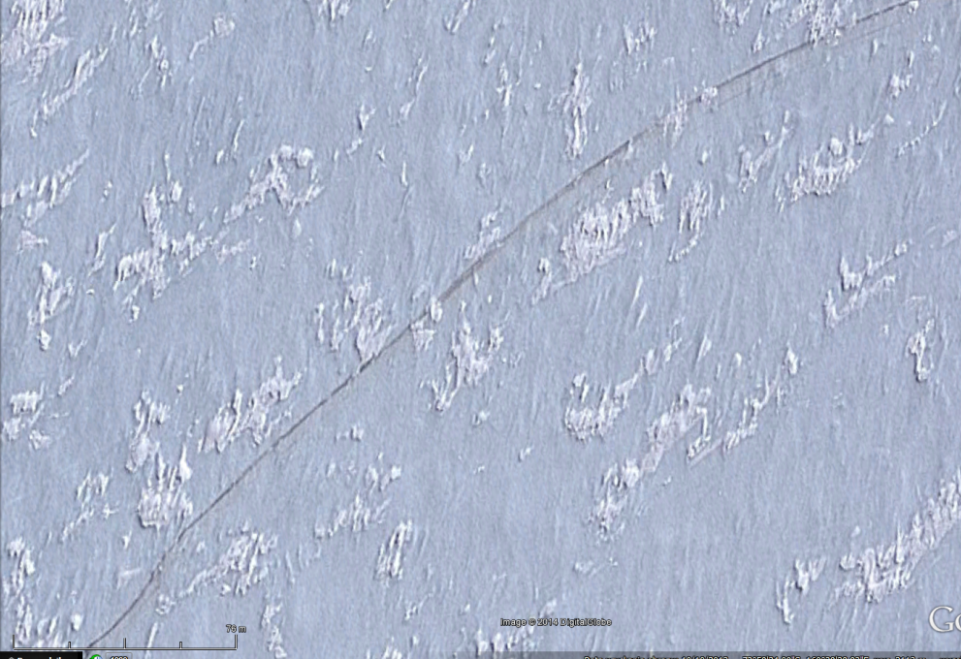
Dust within BIAs
Dust layers within ice.
  Tephra or moraine Debris
  Enchanced sublimation.
Allan Hills
Frountier Mountain
170 m
76 m

Slide 27
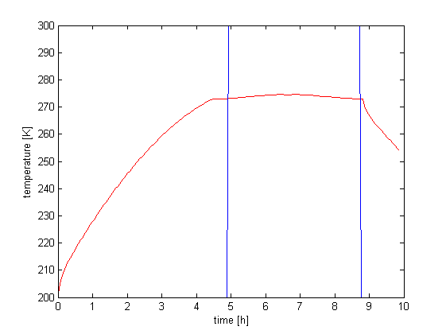
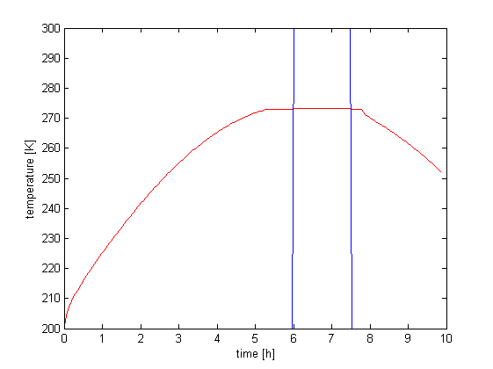
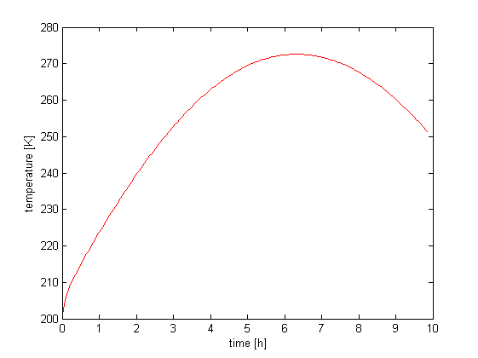
Melting of ice on Mars
S=492 W m⁻²
k=0.09 W K⁻¹ m⁻¹
k=0.12 W K⁻¹ m⁻¹
k=0.14 W K⁻¹ m⁻¹
270
250
Temperature [K]
230
210
melting
melting
0
2
4
6
8
0
2
4
6
8
0
2
4
6
8
10
Time [h]
Temperature profile below the grain (200 µm) vs. time. The panels correspond to different values of thermal conductivity (MIX1). Simulation covers 0.4 Martian day. The local noon is approximately at time = 5 h.

Slide 28
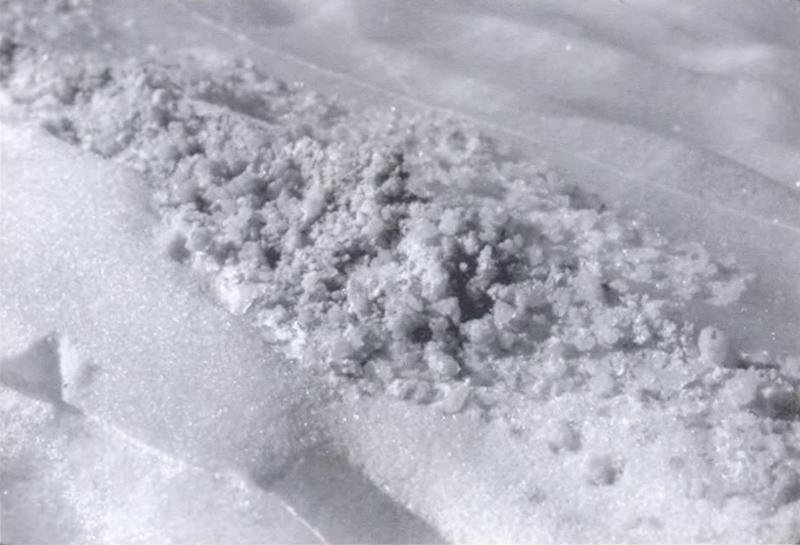
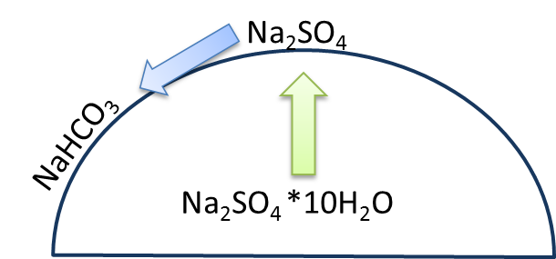
Evaporites on Antarctic Ice
Lewis Cliff:
Na-sulfate
  Mirabilite Na₂SO₄ *10H₂O
  Thenardite Na₂SO₄
Na-bicarbonate
  Nahcolite NaHCO₃
  Trona Na₃(CO₃)(HCO₃)*2H₂O
Na-borate
  Borax Na₂B₄O₇ * 10H₂O
  Qilianshanite NaHCO₃* H₃BO₃*2H₂O
Other
  Halite NaCl
  K- S mineral (possibly arcanite K₂SO₄)
(Cassidy 2003)
Harvey et al. 2006, Socki et al. 2008, 2012, Liu and Bish 2008

Slide 29
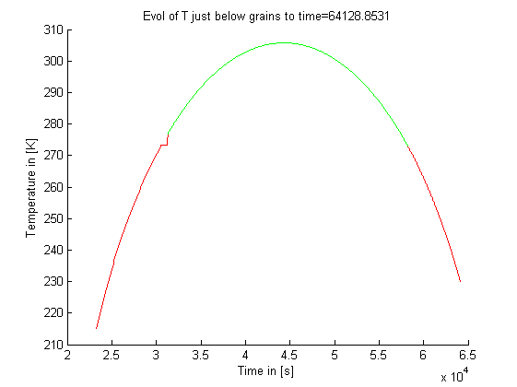
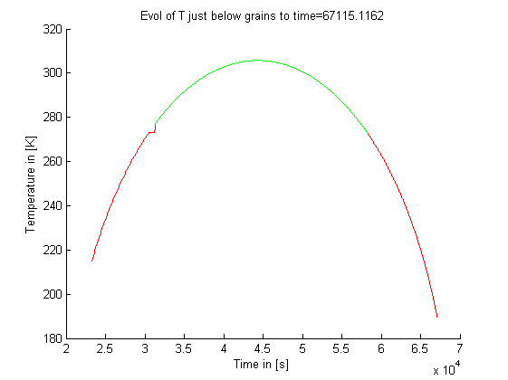
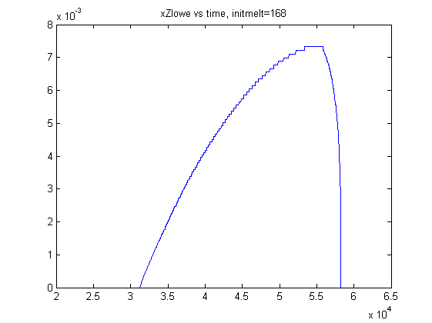
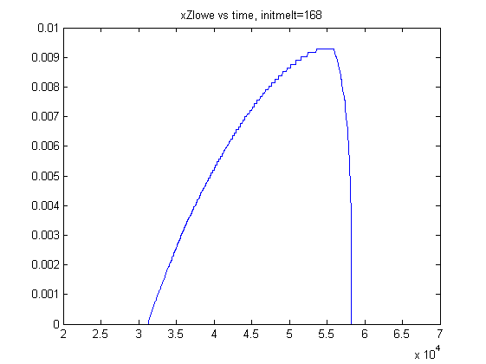
Ice melting on Mars
Heat conduction (dirty ice)
Solar Constant: 410 W/m2
Grain size: 2 μm
Emissivity: 0.72
0.02
0.06
0.1
Temperature [K]
Thickness of melted layer [m]
Time [s]
Time [s]
Time [s]

Slide 30
Ice melting on Mars
Heat conduction (dirty ice)
Solar Constant: 410 W/m2
Grain size: 2 μm
Emissivity: 0.72
0.2
0.4
1
Temperature [K]
Model 2?
Thickness of melted layer [m]
Time [s]

Slide 31
Antarctica: Martian ice shield analog
Antarctic Dry Valleys as an „average Mars” analog (e.g., Anderson et al. 1972, Gibson et al. 1983, Wentworth et al. 2005).
Continental-Antarctica as a Martian Northern Ice Shield analogue.
  Ice– rock interactions
  Limitation of sea spray contamination
  Lower temperature and humidity
  Water present only very ephemerally

Slide 32
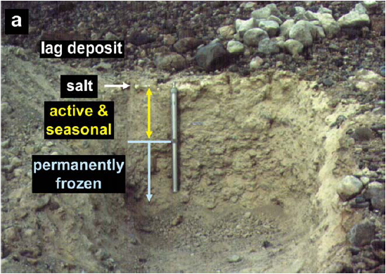
Evaporites in Antarctica
Dry Valleys
  Soils (e.g., Campbell and Claridge 1987, Wentworth et al. 2005, Bao et al. 2006)
  Lakes (e.g., Lyons et al. 2005)
On ice
  Directly on ice or on moraines
    Aragonite from the Vestfold Hills (Aharon 1988)
    Calcite clasts in Elephant Morraine (Faure et al. 1988).
    Na-sulfates and borates on Lewis Cliff.
  On meteorites
Wright Valley, Antarctica, prospect Mesa soil pit (Wentworth et al. 2005)

