Slide 1
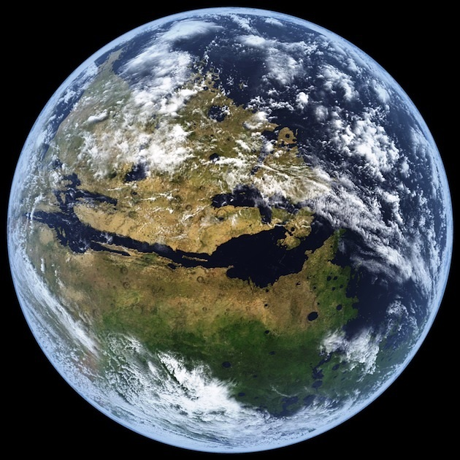
Martian Beach Sands The Characteristics Of Olivine Weathering In A Beach Environment
Anna Losiak¹, Barbara Woronko², Robert A. Craddock³
1 Instytut Nauk Geologicznych Polish Academy of Sciences (anna.losiak@twarda.pan.pl),
2 Wydział Geografii i Studiów Regionalnych, Warsaw University (bworonko@uw.edu.pl),
3 Center for Earth and Planetary Studies, National Air and Space Museum, Smithsonian Institution (craddockb@si.edu)

Slide 2
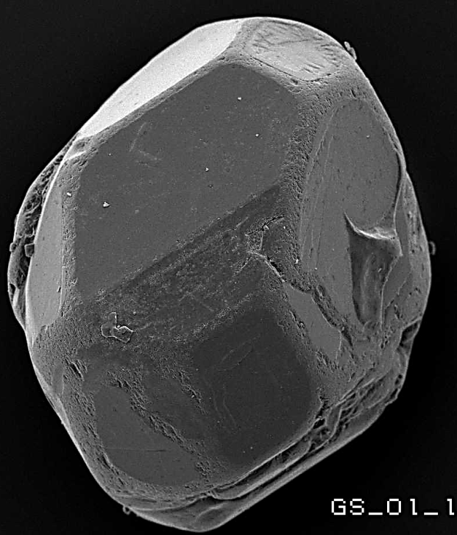
Outline
Quartz sand grains microstructures characteristic for aquatic environment
Martian aquatic environments and sediments
Aim: Determine the microstructures of olivine characteristic for weathering in aquatic environment
Initial results

Slide 3
Aquatic quartz sand
  Aeolian Aquatic

Slide 4
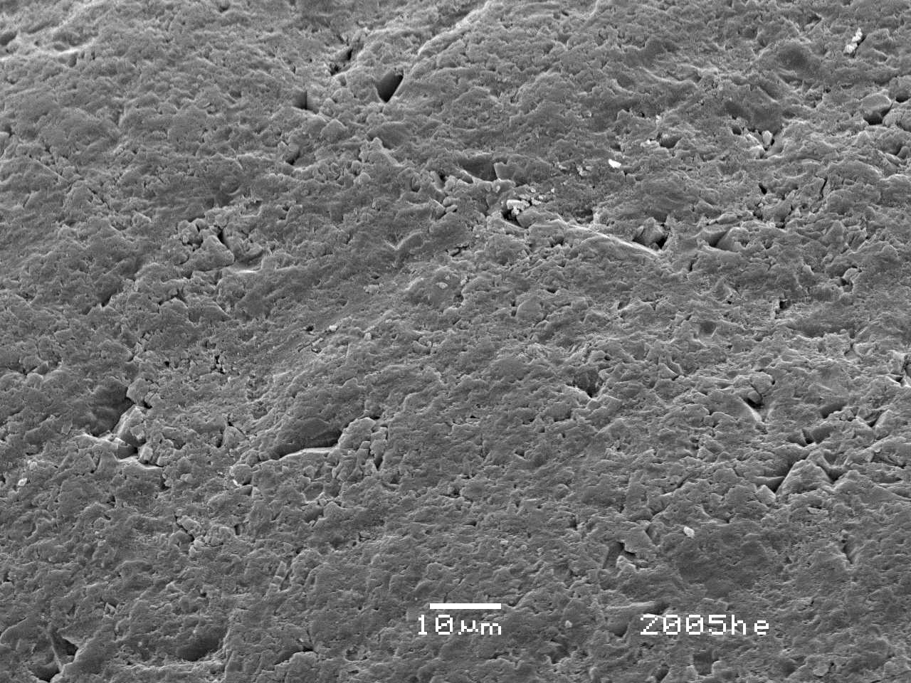
Aquatic quartz sand
  V-shaped percussion cracks - mechanical

Slide 5
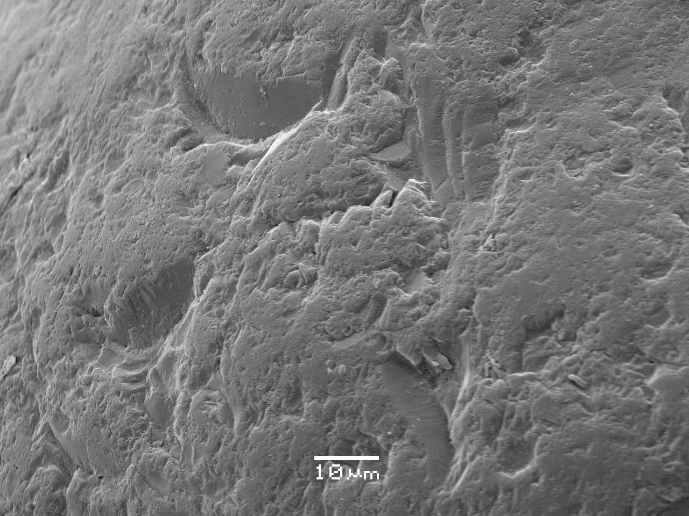
Aquatic quartz sand
  Crescentic gouges - mechanical

Slide 6
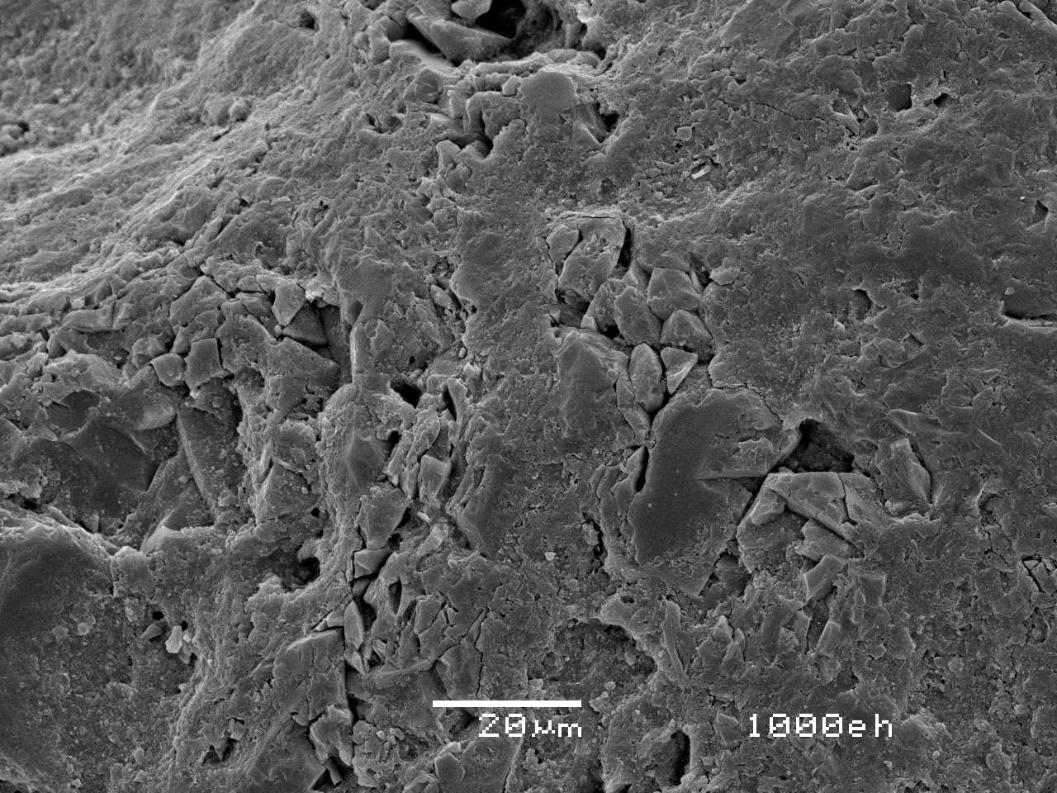
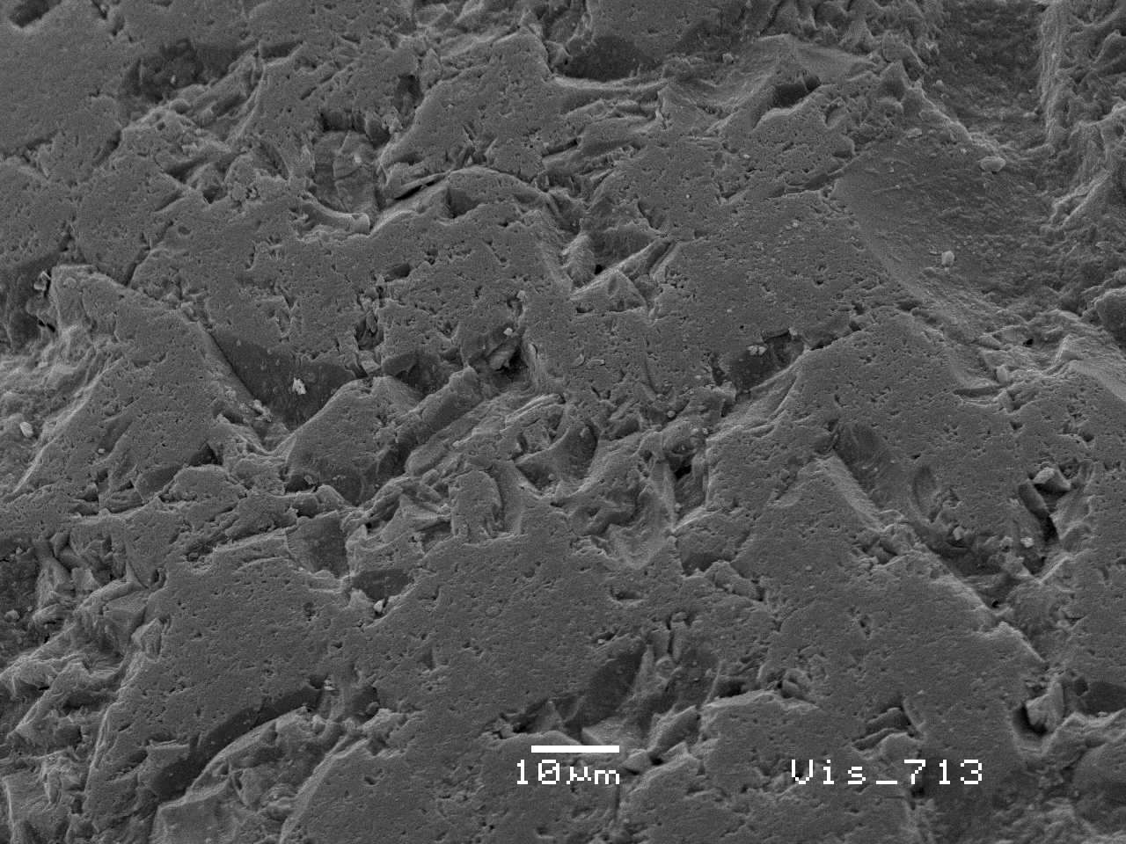
Aquatic quartz sand
  Breakage blocks - mechanical

Slide 7
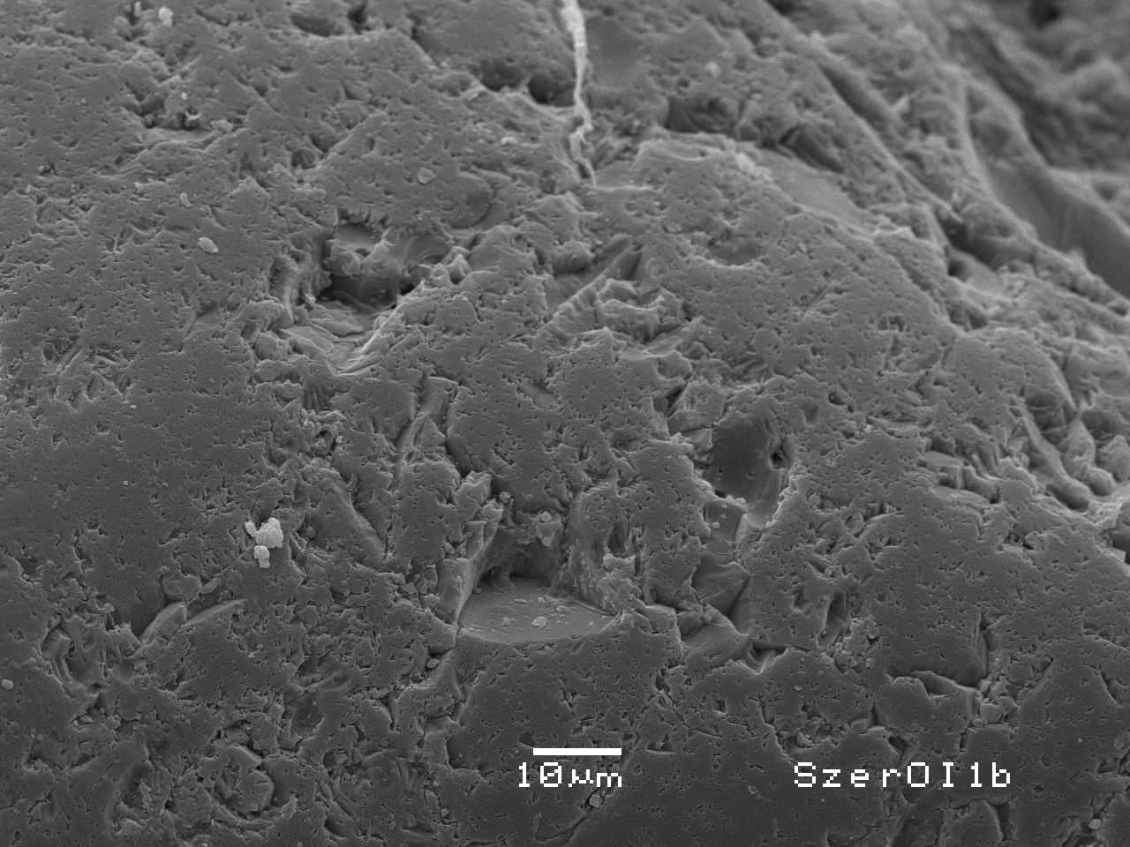
Aquatic quartz sand
  Dulled surface - chemical

Slide 8
Aquatic environments on Mars
Valleys
Viking image 063A08, NASA
(Luo and Stepinski 2009)
(Fassett and Head 2008)

Slide 9
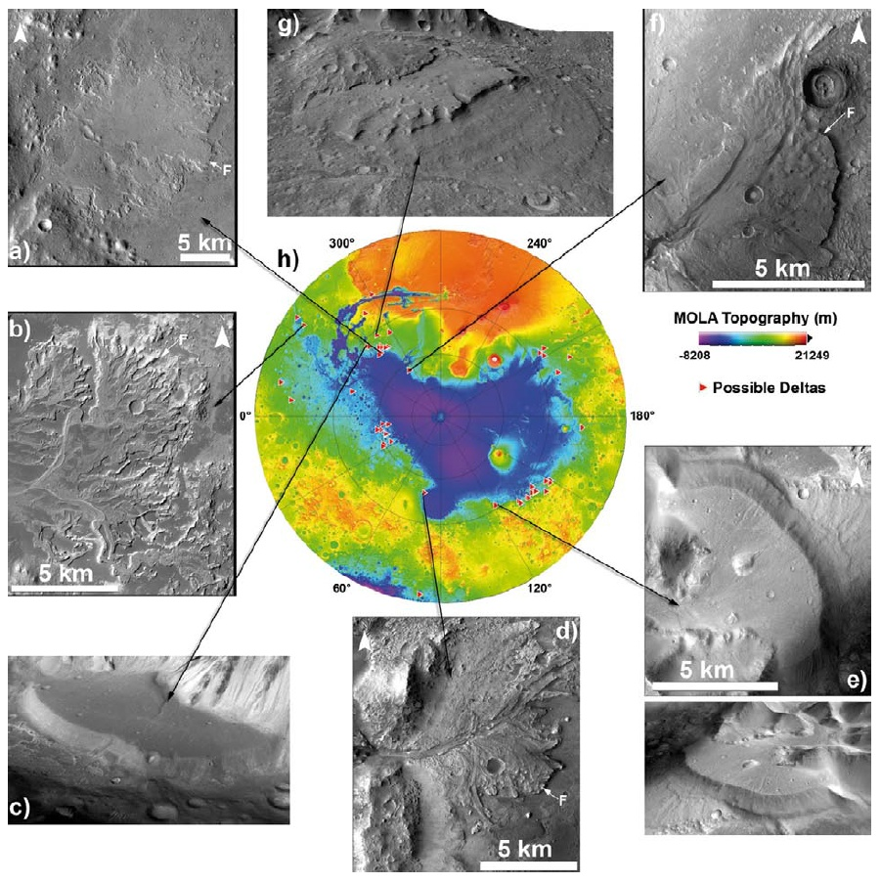
Aquatic environments on Mars
Deltas
(Di Achille and Hynek 2010)

Slide 10
Aquatic environments on Mars
Schorelines
(Clifford and Parker 2001)
(Ghantan and Zimbelman 2006)

Slide 11
Aquatic environments on Mars

Slide 12
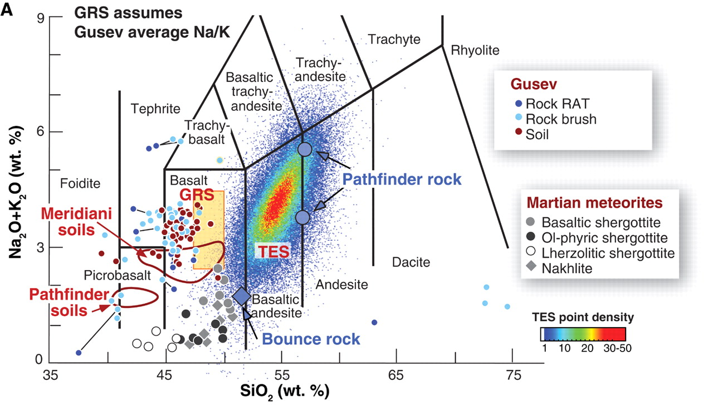
Sediments on Mars
Basaltic: glass, pyroxene, plagioclase and olivine (Hamilton et al. 2005, Rogers & Aharonson 2008, Soderblom and Bell 2008, Chojnacki et al. 2014).
  Segregation of sediments -> increase of olivine (Mangold et al. 2011, McGlynn et al. 2011).
  Similar to Hawaiian basalts (Minitti et al. 2007)
(McSween et al. 2009)

Slide 13

Aim
Determine the microstructures present on the surface of basalt-derived sand weathered in a aquatic environment to estimate the extent and duration of those processes on the surface of Mars.

Slide 14
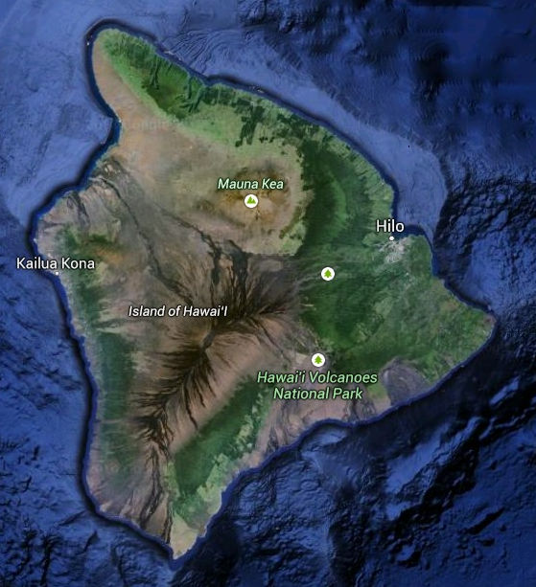
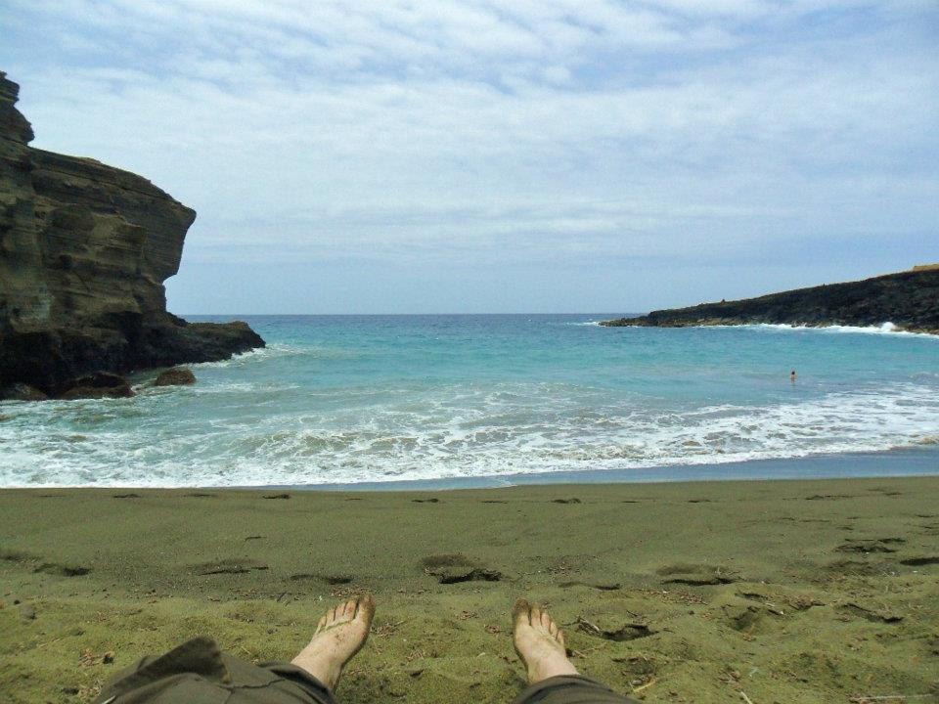
Methods
40 transparent grains (volcanic glass and olivine) randomly selected from the ~300 g sample of sand from the Green Sand Beach
SEM with energy-dispersive X-ray spectroscope
protocol developed for quartz grains.

Slide 15
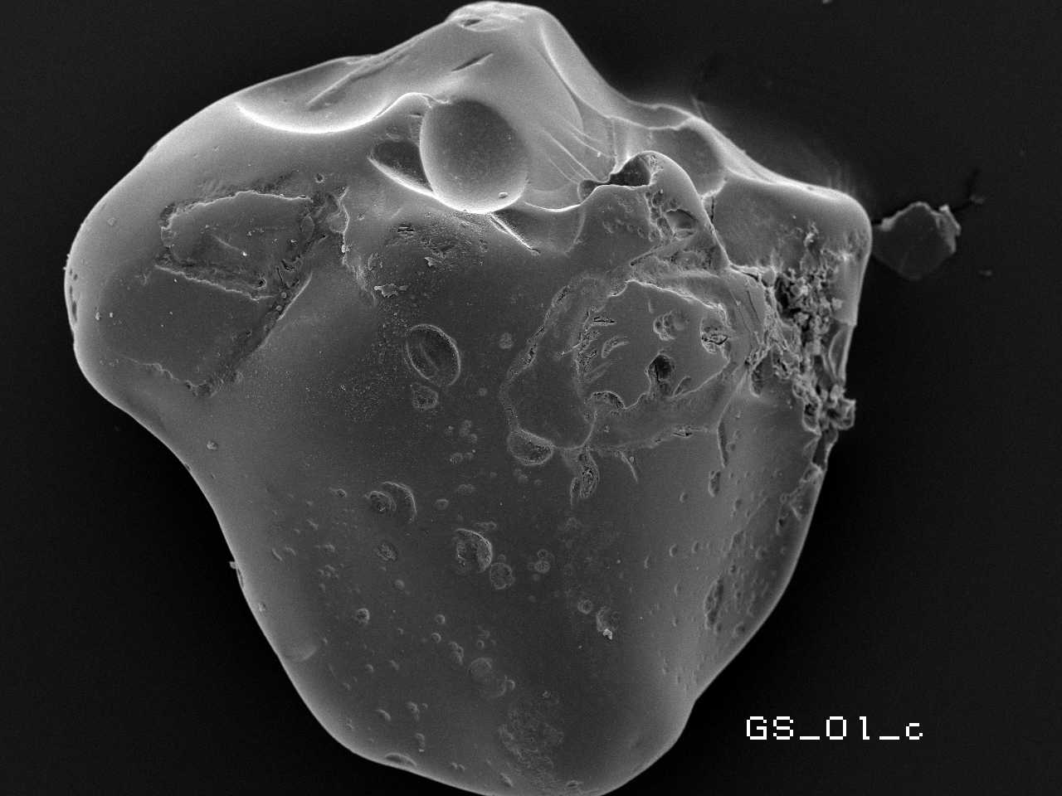
Results
Degasing void
Dulled surface
Linear step
Conchoidal fracture
Solution crevasse

Slide 16
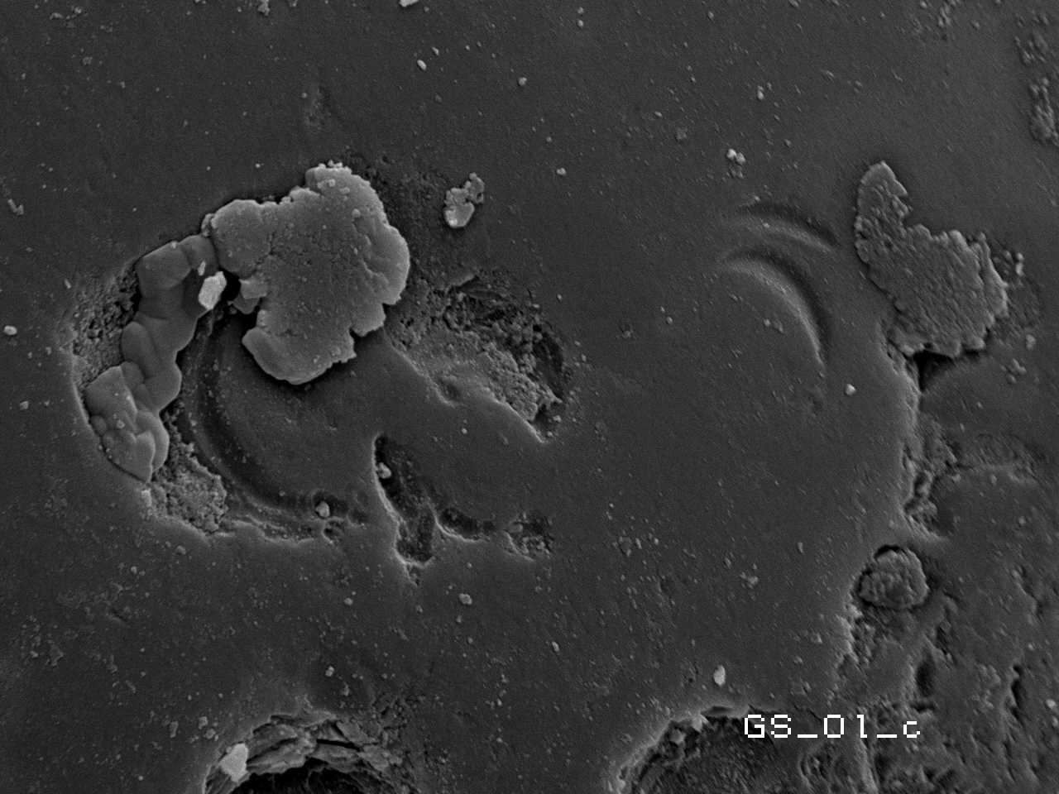
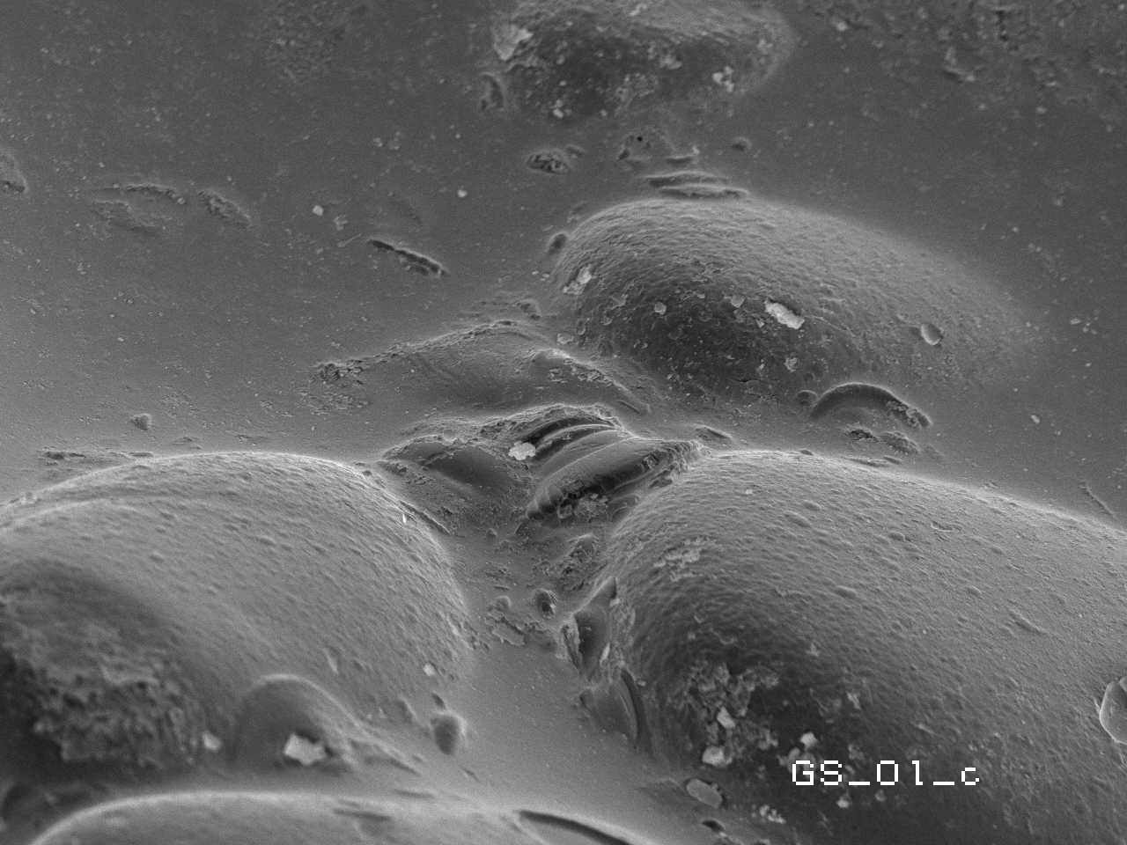
Aquatic microstructures

Slide 17
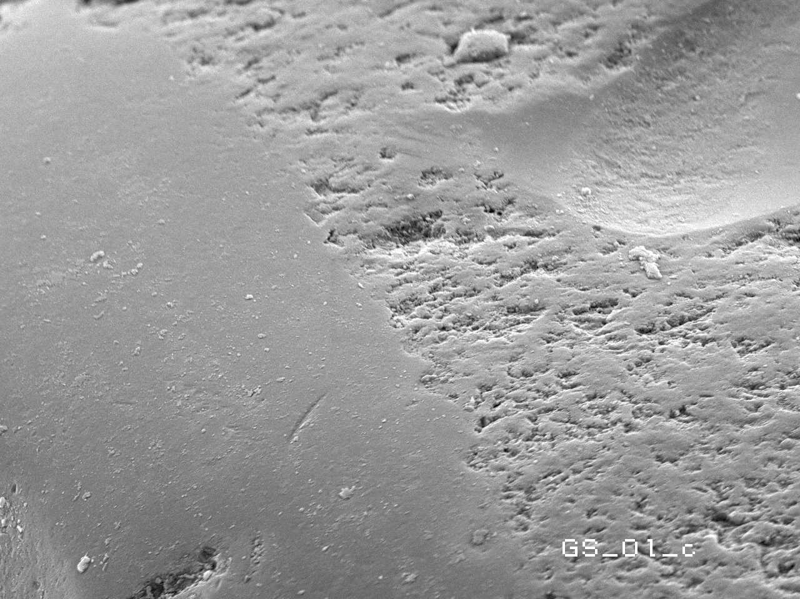
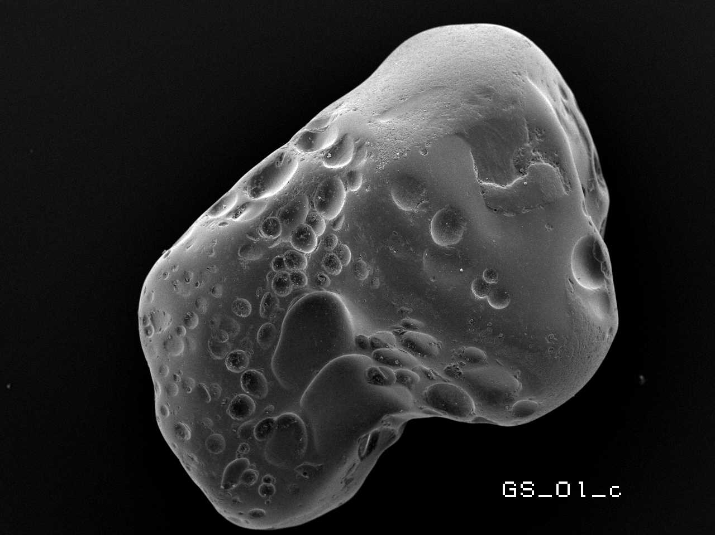
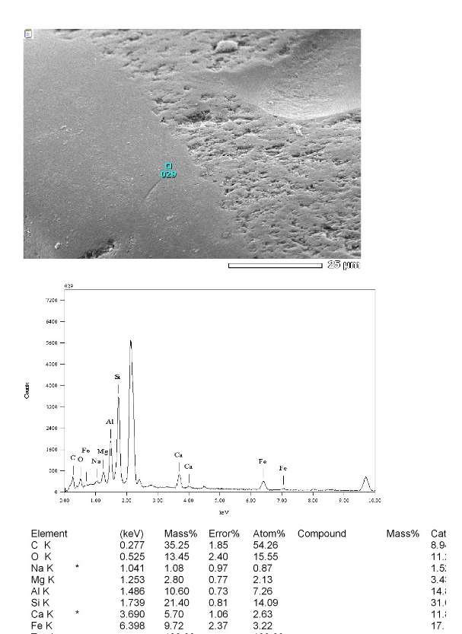
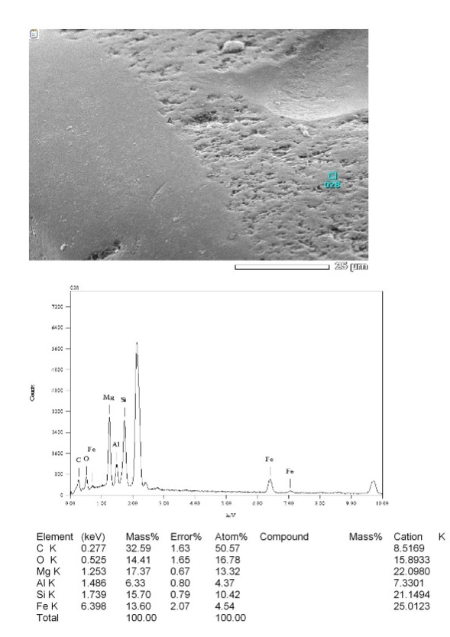
Glass grains
Glass
Pyroxene

Slide 18

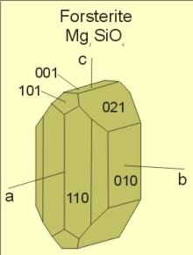
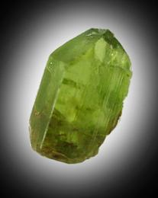
Olivines

Slide 19
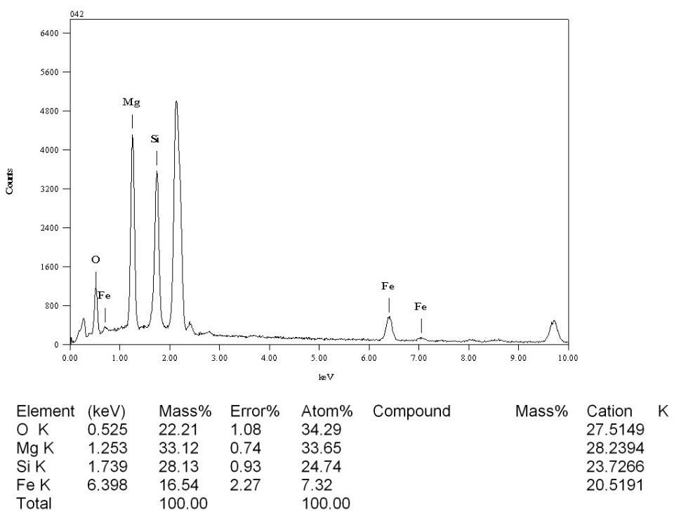
Olivines

Slide 20
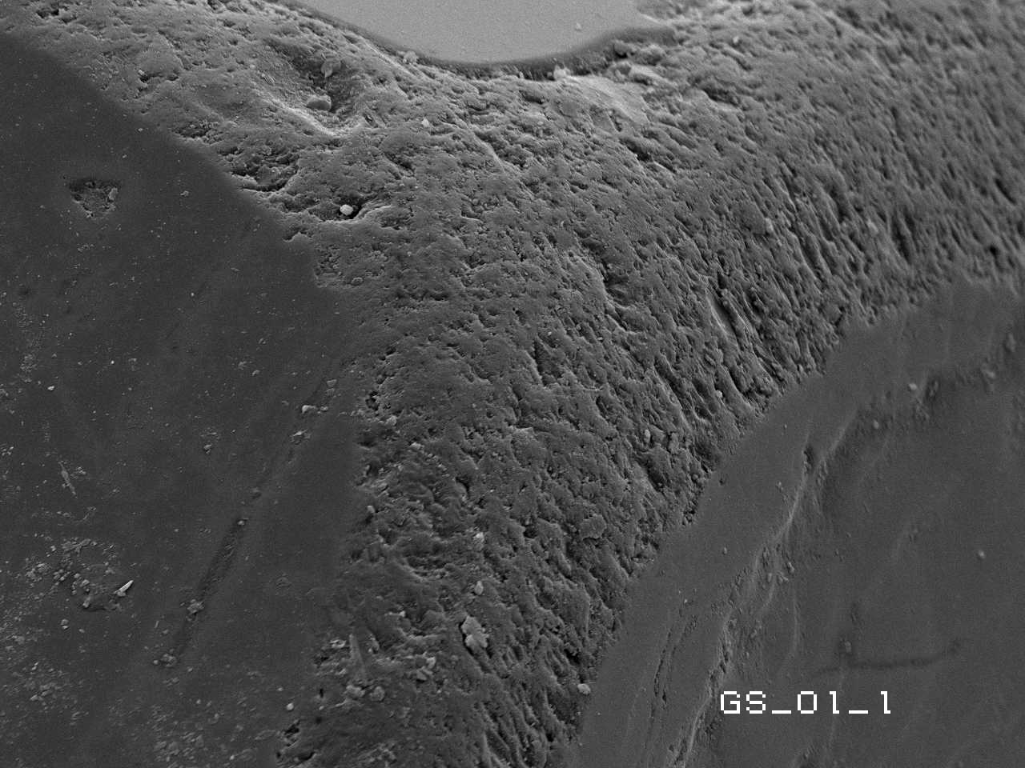
Olivines

Slide 21
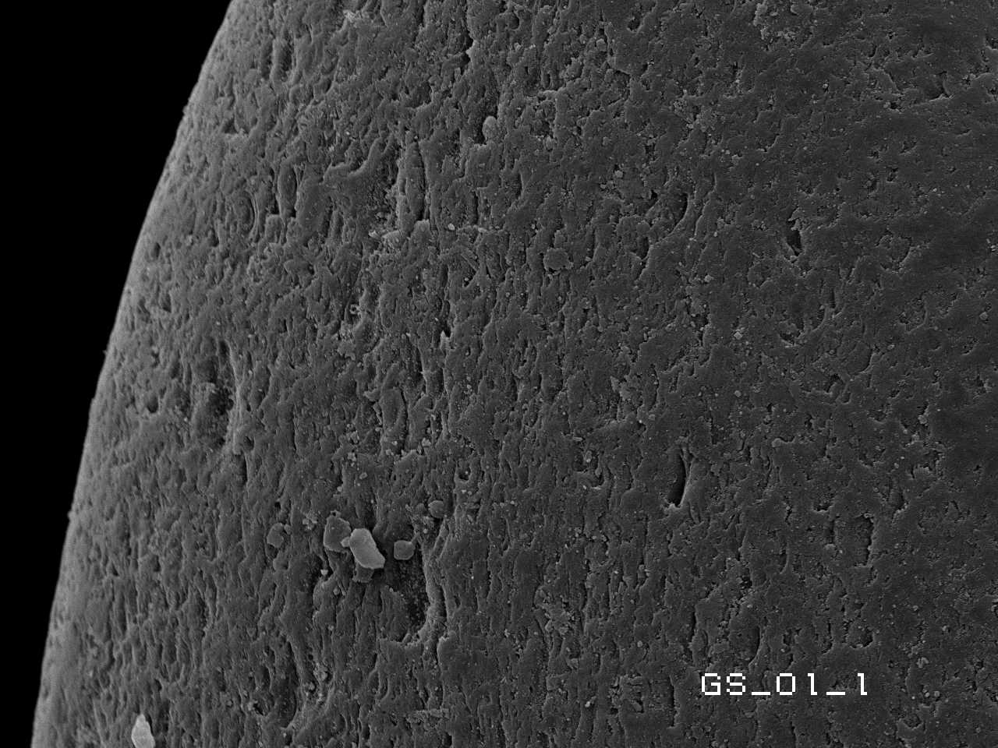
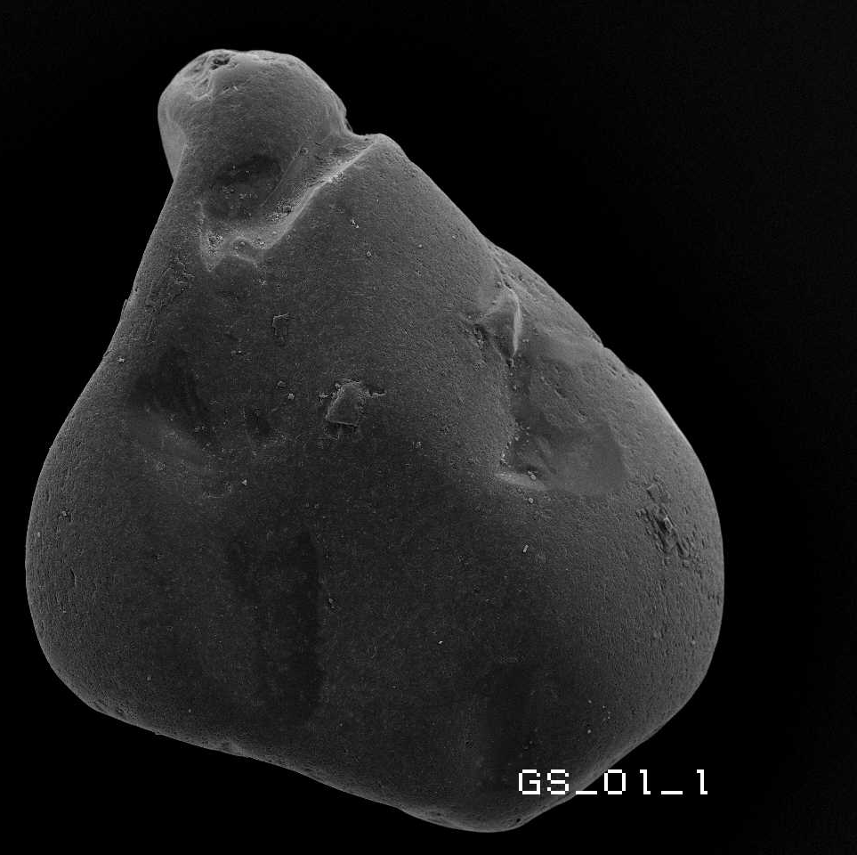
Olivines
Dulled surface

Slide 22
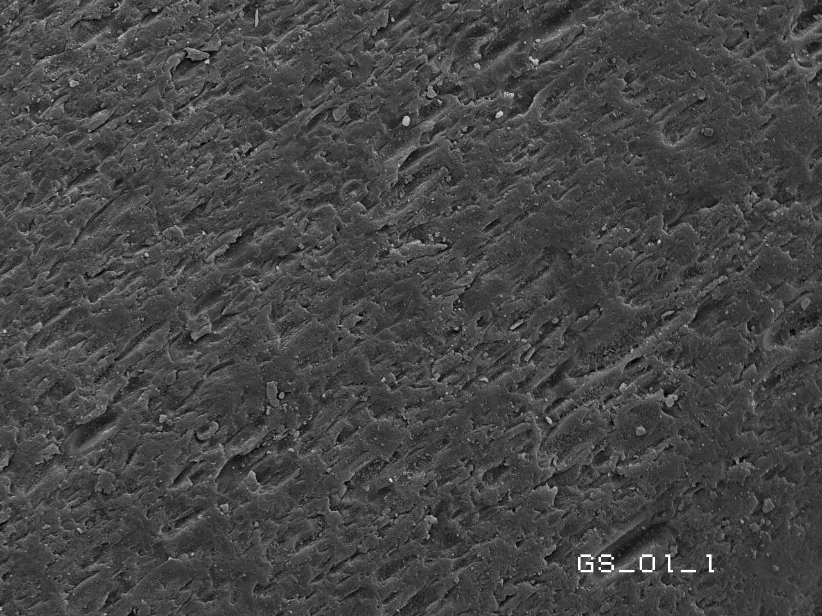
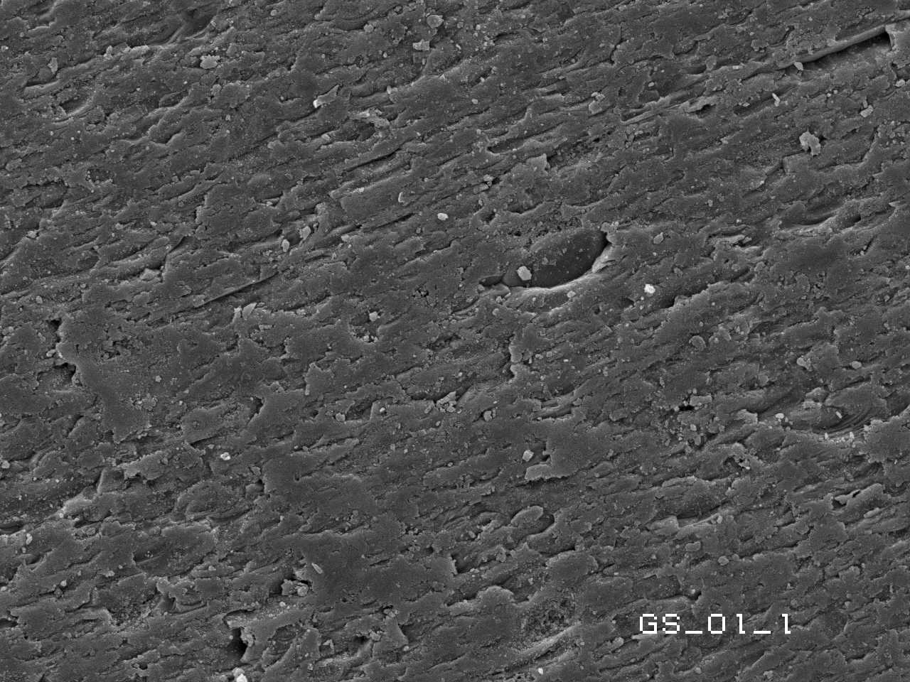
Olivine
Oriented elongated solution crevasses
No V-shaped percussion cracks !!!

Slide 23
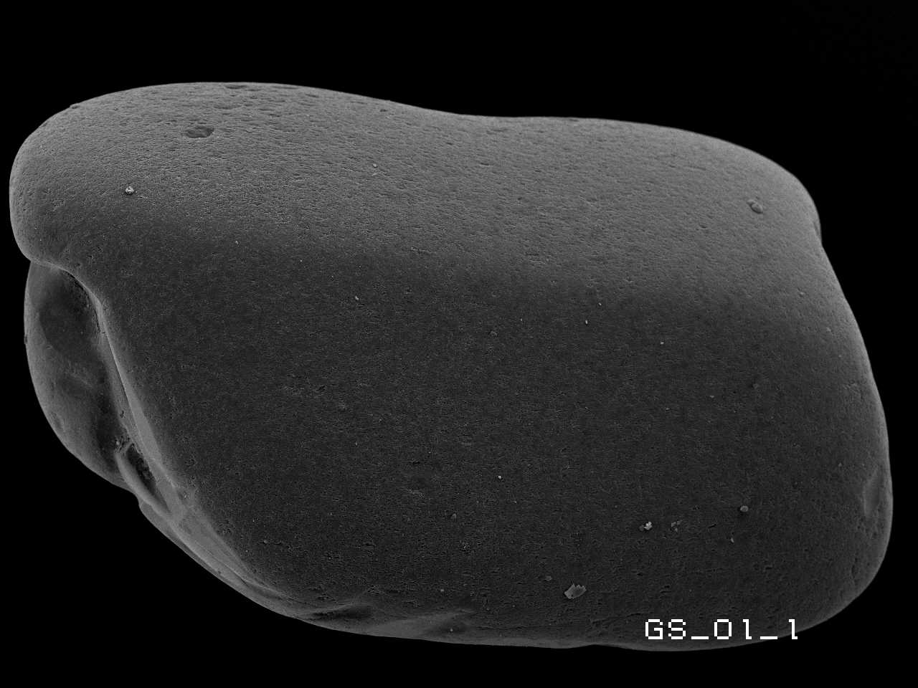
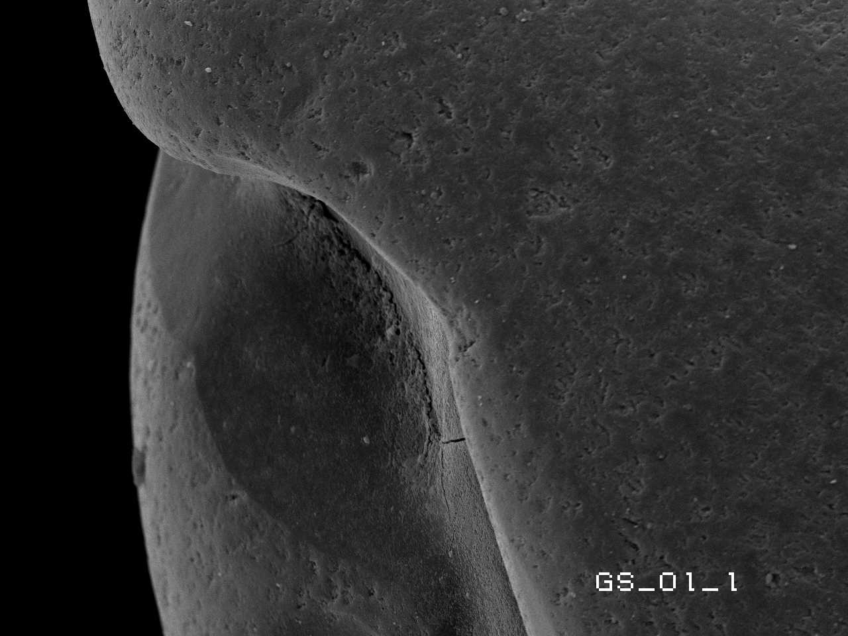
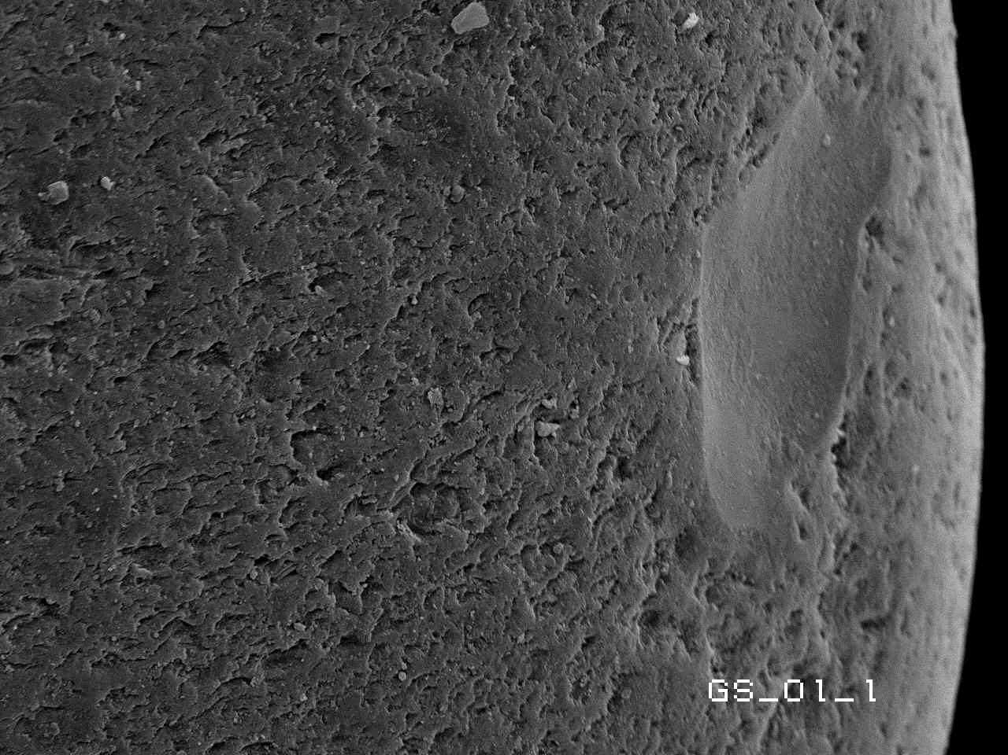
Olivines

Slide 24
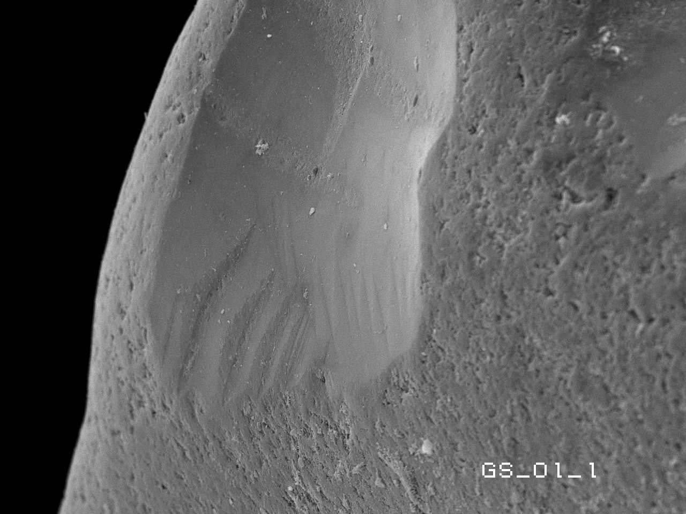
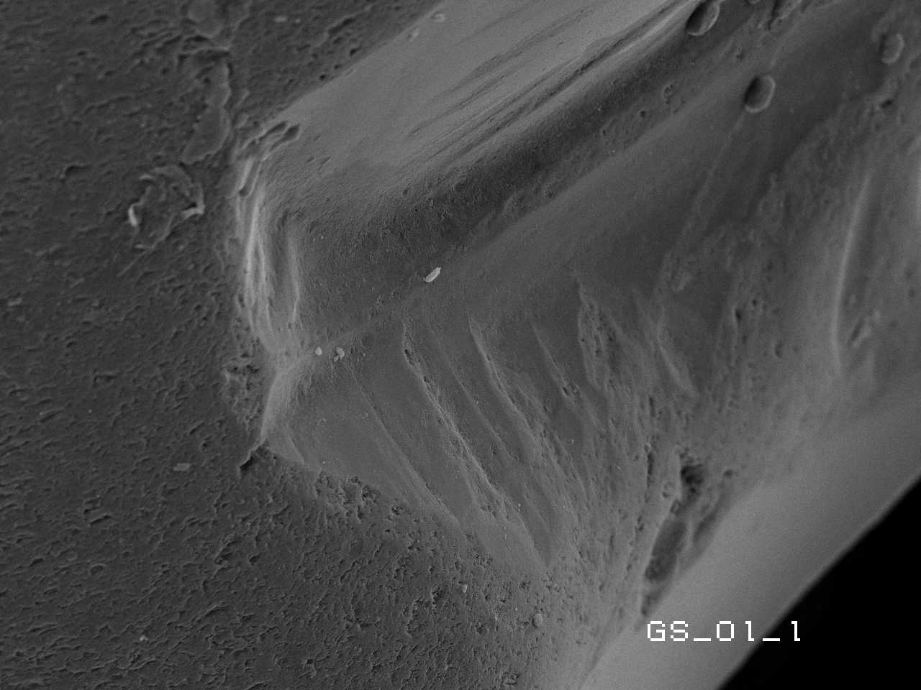
Olivines
Conchoidal fractures
Linear steps

Slide 25
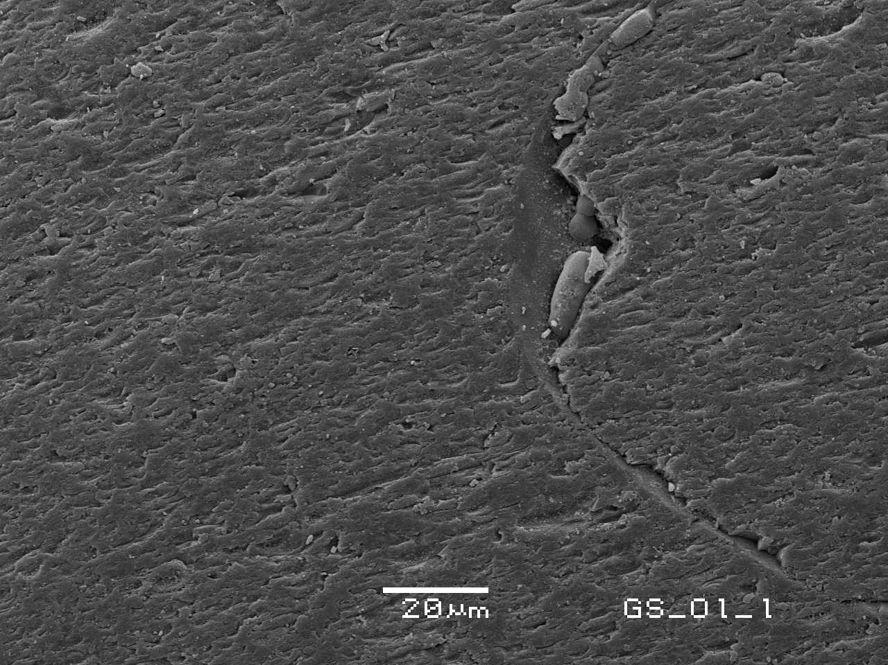
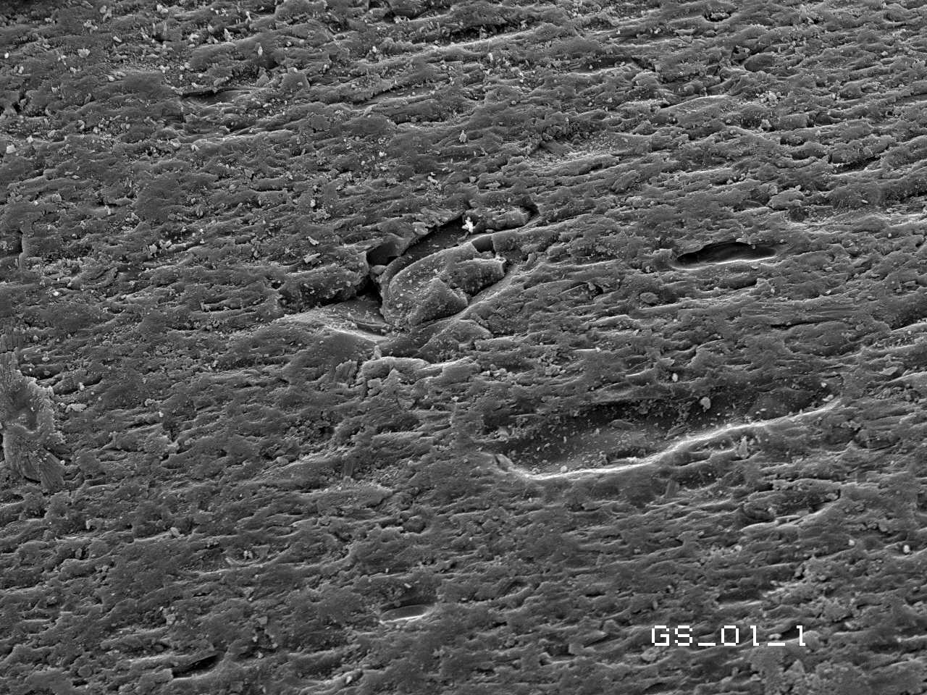
Olivines
Abrasion microstuructures

Slide 26
Conclusions
Volcanic glass microstructures:
  Dulled surface
  Degassing voids
  Low frequency mechanical microstrucures.
Olivines microstructures:
  Dulled surface
  Oriented solution crevasses
  Low frequency mechanical microstrucures
    No V-shaped percussion cracks

Slide 27
Conclusions
It is possible to recognize olivine grain that was transported in aquatic environment (beach and fluvial):
  Short processing is sufficient to significantly modify olivine and glass grain surface.
  The duration of exposure to aquatic environment can be recognized by
    Increasing degree of roundness of grain and
    Increase percent covered by dulled surfaces.
    Oriented solution crevasses.
Applications to Mars missions

Slide 28
Questions?

