Slide 1
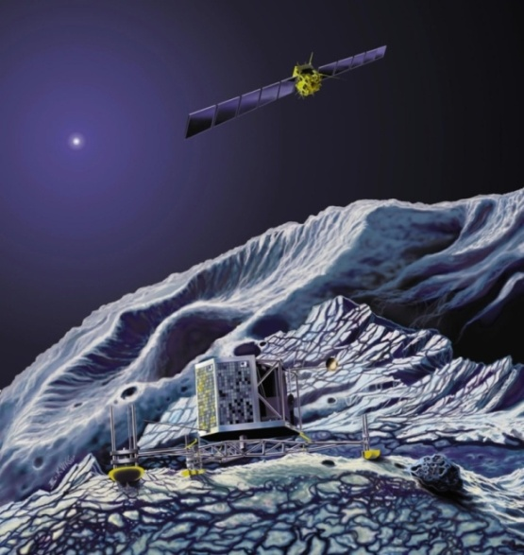
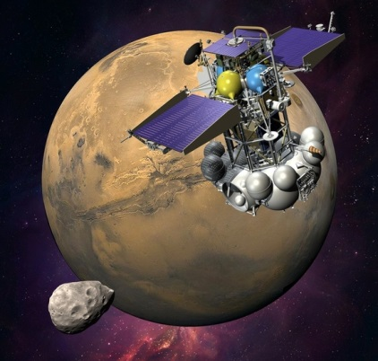
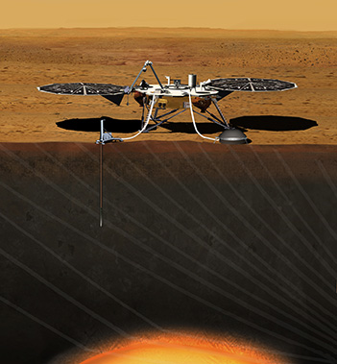
PENETRATORS FOR PLANETARY SUBSURFACE EXPLORATION
Rosetta
MUPUS
Fobos
Grunt
CHOMIK
InSight HP3
credit JPL/NASA
credit DLR/ESA
credit ROSKOSMOS
Grygorczuk J.^{(1,2)}, Kedziora B.^{(1,2)}, Wisniewski L.^{(1,2)}, Dobrowolski M.^{(1,2)},Tokarz M.^{(1,2)},
Banaszkiewicz M.⁽¹⁾, Seweryn K.⁽¹⁾, Wawrzaszek R.⁽¹⁾, Krasowski J.⁽¹⁾, Borys M.⁽¹⁾,
⁽¹⁾ CBK PAN Space Research Centre of the Polish Academy of Sciences, Warsaw, (jurekgry@cbk.waw.pl); ⁽²⁾ ASTRONIKA Sp. z o.o., Warsaw
Presented by: Jerzy Grygorczuk

Slide 2
OUTLINE
1. Introduction
■ MUPUS Penetrator
■ What kind of EMDD we use?
2. HEEP (High Energy and Efficiency Penetrator)
■ Design features
■ Tests
EMOLE – mole with EMDD
■ Principle of design and testing mode
EMDD for future drills & penetrators
■ Penetrator with sampling features

Slide 3
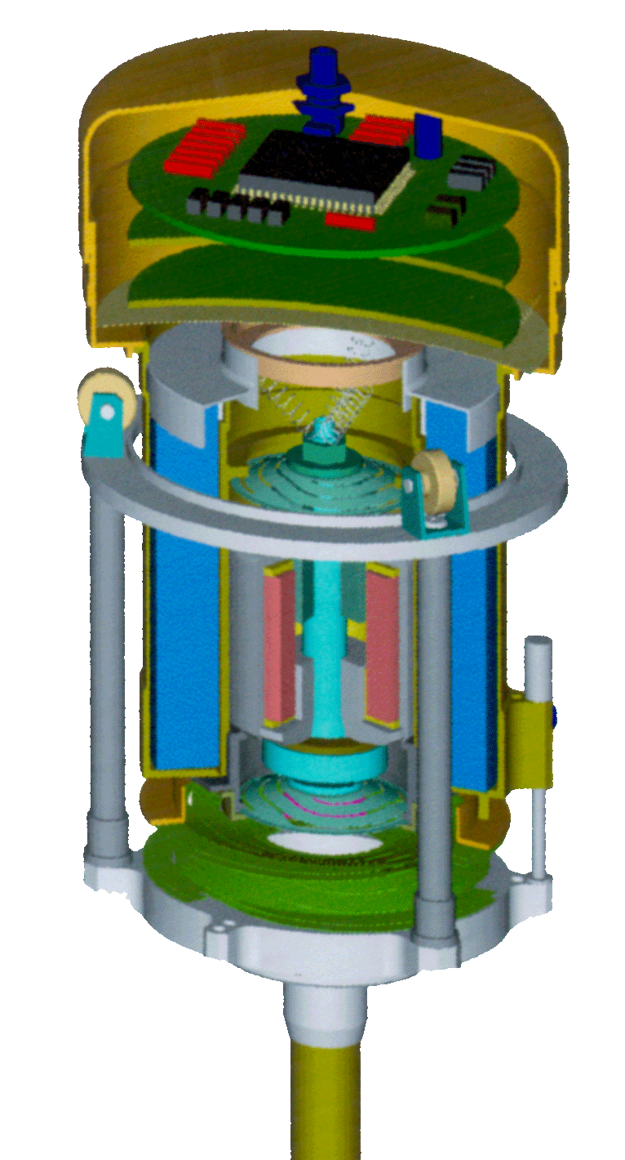
MUPUS Hammering Device with EMDD
SENSORS
ELECTRONICS (ASIC)
HAMMER CONTROL
ELECTRONICS
CAPACITOR
25 µF, 600 V
RELUCTANT
MAGNETIC CIRCUITRY
HAMMER
ELASTIC
SUSPENSION
ROD’S
END PLATE

Slide 4
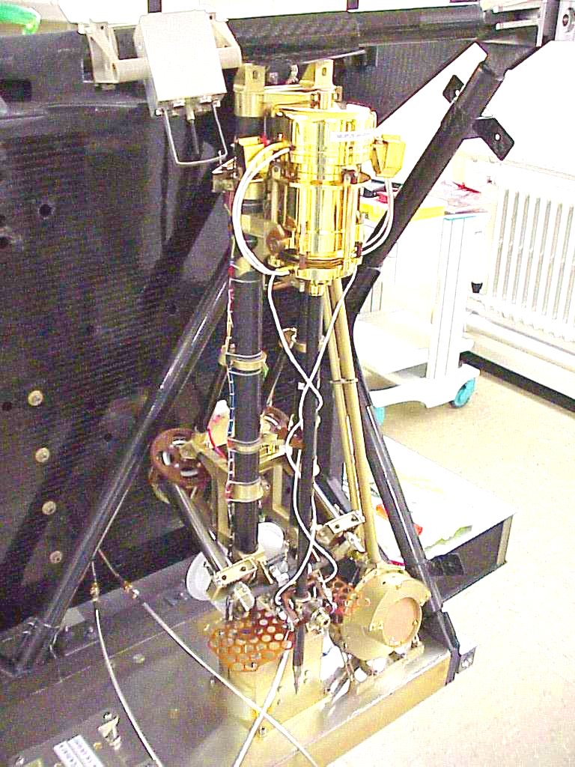
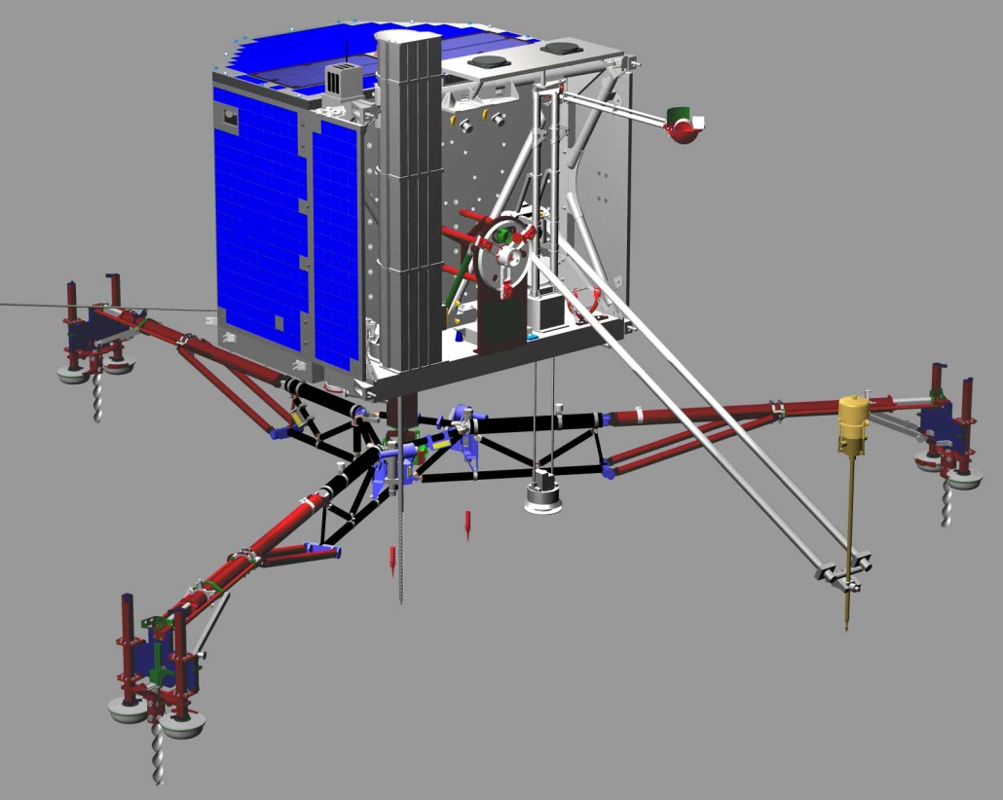
Integration of the FM
at Katlenburg - Lindau
MUPUS - TP
Credit DLR
MUPUS on the PHILE
STM MODEL

Slide 5
What kind of EMDD (Electro-Magnetic
Direct Drive) for Penetrators we prefer?
■ much higher reliability of the drive (because this is direct drive)
■ feasible for Power Settings (4-8 PS)
VOICE COIL (laudspeakers)
COILGUN (solenoid)
LINEAR DRIVE
(straightened version of permanent magnet rotor motors)
RELUCTANT ELECTROMAGNET

Slide 6
Motor drive / Hammering drive
Force
Hammering drive
Torque
Gear
Dc motor
Dc motor
Time
Time

Slide 7
Electrical power supply
VIBRATIONS
STROKES
+
+
Single coil
-
-
Multi coils

Slide 8
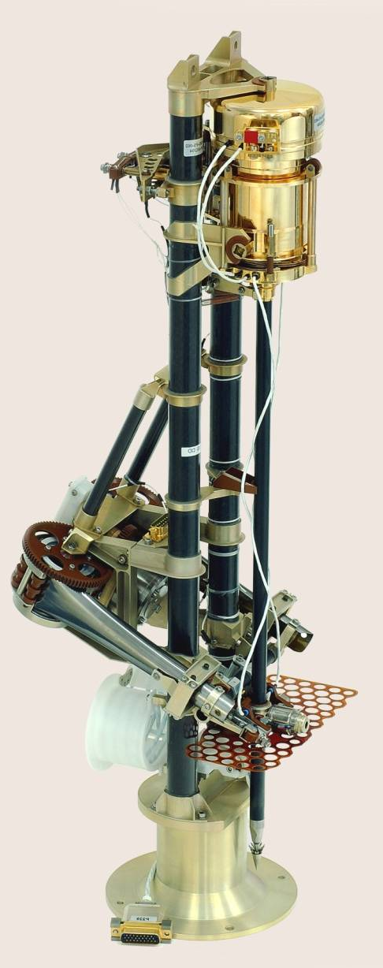
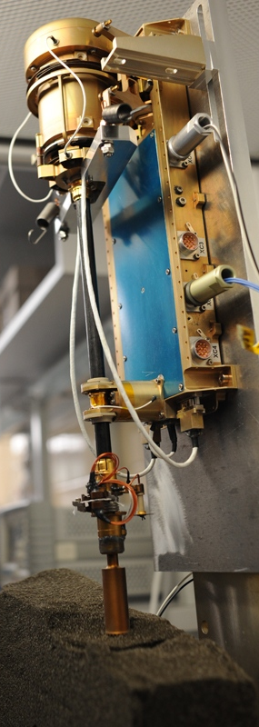
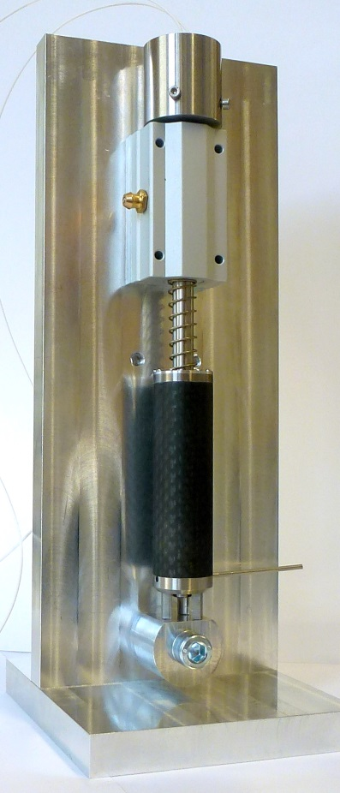
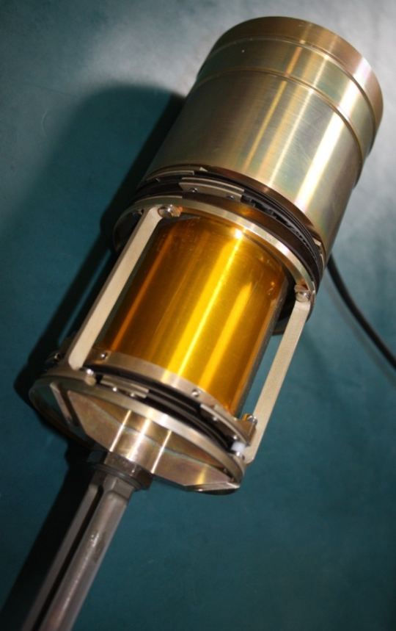
CBK hammer penetrators with EMDD
OLD
NEW
HEEP
High
Energy and
Efficiency
Penetrator
MUPUS
CHOMIK
E-MOLE

Slide 9
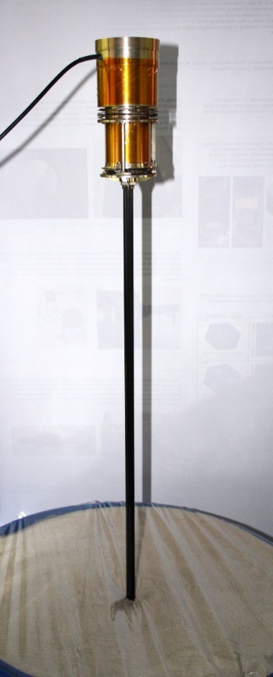
HEEP design features
Stroke energy >3.7 [J];
8 Power Settings;
Various penetrating rods possible to implement
Penetrator driven by EMDD;
Consists of three major masses:
Counter-mass with the capacitor (energy storage);
Hammer (moving part of the EMDD
that is accelerated);
Penetrating rod.
Ø 84mm
0.8 m
180mm
HEEP with 0.8m-long penetrating rod
High Energy and Efficiency Penetrator HEEP

Slide 10
HEEP capabilities and application
Carrying varied sensors;
Determination of mechanical properties of the regolith;
Subsurface ground sampling;
Disintegrating of the solid ground ;
Anchoring (e.g. landers in μ-gravity or coupling seismometers to the ground);
Generating vibrations and high pulse force (2000-4000N);
Tests in loose materials
Penetration into depth of >800mm in regolith analogue and sand took just a few minutes;
Dependence between numbers of strokes and depth progress in various materials (in Earth gravity)

Slide 11
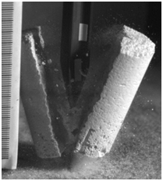
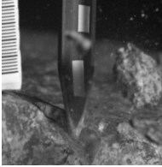
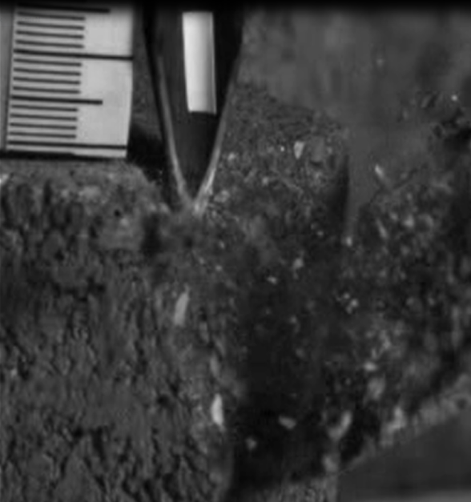
HEEP capabilities and application
Tests in porous materials
Tests with solid materials
HEEP can easily break and penetrate porous materials.
Solid rocks (e.g. granite) can be broken at their edge, generating pieces of few to 20 mm in size.
Breaking Ø30x57mm block of YTONG
Breaking pavement brick
(compressive strength 35-50 MPa)
Breaking granite
(compressive strength 160-190 MPa)

Slide 12
Functional test with PS
It is not necessarily justified to use the highest power setting in all cases;
It is possible to penetrate using lower power setting and consuming over two times less energy (for PS 2 or 3), than for instance for PS 8,
PS 8 is surprisingly not the most effective one in that particular case (penetrating the Foamglass).
Progress per stroke in Foamglass T4 (0.85 MPa) material with crossed-profile rod for different PS
PS | Avg. progr. /stroke [mm]
1 | 0.2
2 | 1.9
3 | 8.1
4 | 13.0
5 | 17.8
6 | 27.8
7 | 37.4
8 | 40.5
Energetic efficiency for power settings in reference to PS8 (penetrating in Foamglass T4)

Slide 13
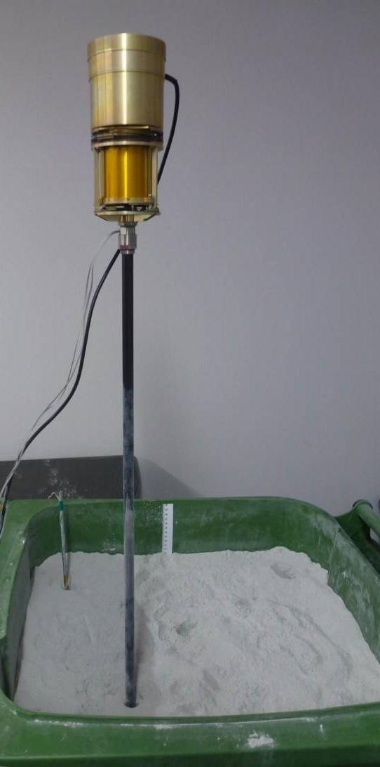
Test with sampling device
(Φ22mm)
HEEP
SAMPLING
DEVICE
SD warming up – less than 0.3°C
Retracting force – 80N

Slide 14
Principle of design
EMOLE
Return Spring
Return Drive
Linear
Guide
Lock
Driving
Sections
Scientific Payload
Linear
Guide
Casing with Tip
Sampling Device
PENETROMETRY IN THE SOLAR SYSTEM Seggau, 19-21 May 2014

Slide 15
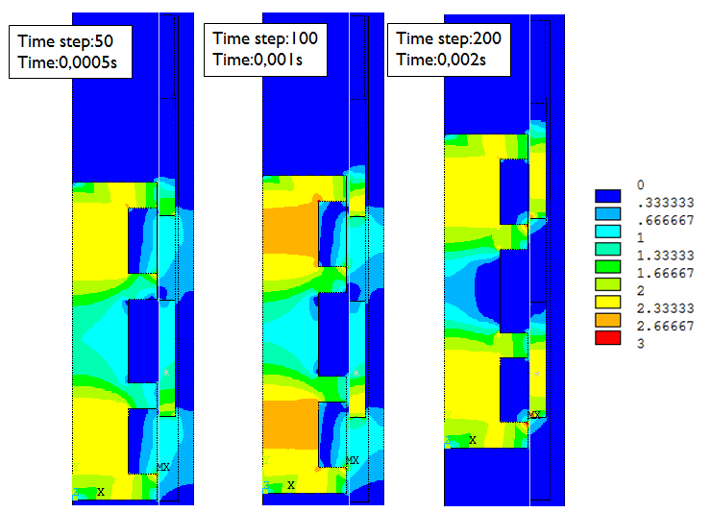
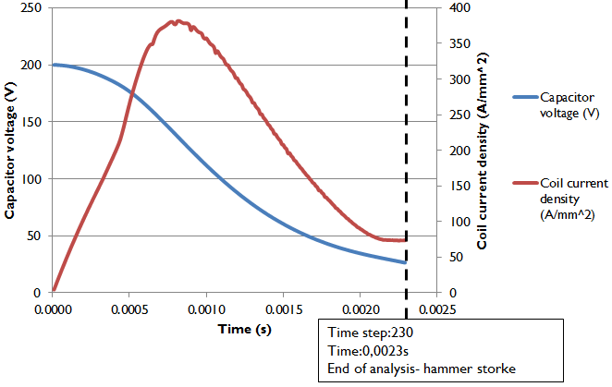
EMOLE
Testing model
Linear
Guide
Driving
Sections
Linear
Guide
Magnetic flux density (Tesla) for selected time steps and capacitor voltage and coil current density in the time.

Slide 16
EMOLE
Design
outer casing
electromagnets
wire helix
linear guiding + hammer return springs
brake spring

Slide 17
Drills & Penetrators
D R I L L S
P E N E T R A T O R S
D1
P2
P1
PENETROMETRY IN THE SOLAR SYSTEM Seggau, 19-21 May 2014

Slide 18
PENETRATION METHODS
WOODEN
WASP (WW)
(Yang Gao et al. 2006)
DOUBLE ACTION PENETRATION
WW concentric (outside Casing, inner Tip)
REGULAR

Slide 19
Interactions in double drived
hammering penetrator
COUNTER
MASS 2
COUNTER
MASS 1
ROD
TIP
C
CASING
HAMMER 2
HAMMER 1
Positive action (insertion)
Negative action (recoils)
Drive
patent pending
PENETROMETRY IN THE SOLAR SYSTEM Seggau, 19-21 May 2014

Slide 20
Penetrator with Sampling Features
E-MOLE with double drive
HEEP with double drive

Slide 21
Drills & Penetrators
D R I L L S
P E N E T R A T O R S
D1
D2
P3
P2
P1

Slide 22
Axial / rotary hammering drive
principle
PENETROMETRY IN THE SOLAR SYSTEM Seggau, 19-21 May 2014

Slide 23
Drills & Penetrators
D R I L L S
P E N E T R A T O R S
D1
D2
D3
P3
P2
P1

Slide 24
Rotary / axial hammering drive
Electromagnetic
circuit
Capacitor,
electronics
Coil
Rotary hammer
Chamfers on hammer
and shaft protrusions
Output shaft

Slide 25
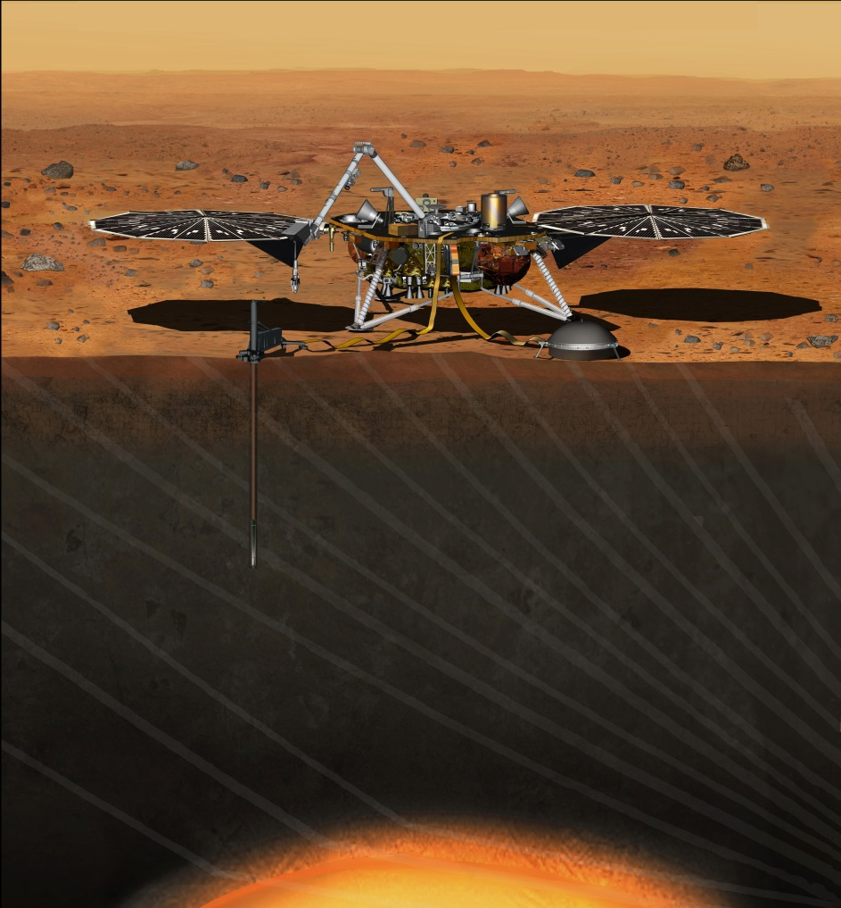
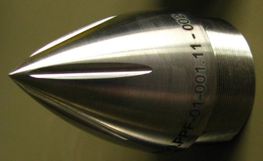
HP3 MOLE
DLR Bremen
Outer Hull
Back Cap
Motor
Payload Compartment
ASTRONIKA / CBK Warsaw
Hammering mechanism
Tip
Locking mechanism
DLR Cologne
STATIL
DLR Berlin
TEM-A, TEM-P
thank you
for your attention
credit JPL/NASA

