Slide 1



MEASURMENTS OF PHYSICAL PARAMETERS OF THE REGOLITH DURING OPERATION OF ULTRALIGHT MOBILE DRILLING SYSTEM
K. Seweryn
PROJECT TEAM
CBK PAN: Karol Seweryn, Tomasz Kuciński, Kamil Grassmann, Paweł Paśko, Janusz Nicolau-Kukliński, Jakub Lisowski, Konrad Rutkowski, Roman Wawrzaszek
WWNiG AGH: Andrzej Gonet, Stanisław Bednarz, Mirosław Rzyczniak, Adam Jan Zwierzyński, Wojciech Teper, Albert Złotkowski
KRiM AGH: Tadeusz Uhl, Tomasz Buratowski, Alberto Gallina, Grzegorz Chmaj
MARS – Connecting Planetary Scientists in Europe, Warsaw, 3‐5 June 2014

Slide 2
Outline
    System description and major requirements
    Main design features
    Possible measurements using ultralight drilling system
    Status of the project
MARS – Connecting Planetary Scientists in Europe, Warsaw, 3‐5 June 2014

Slide 3
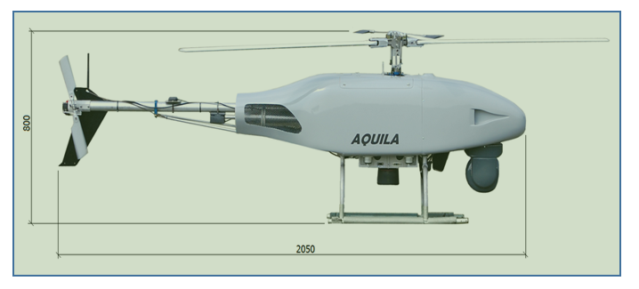
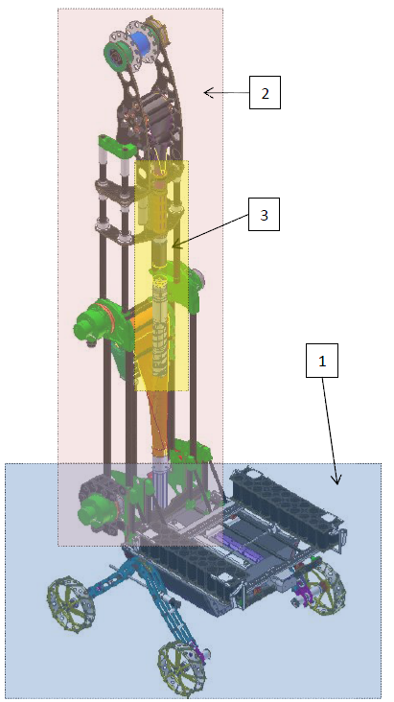
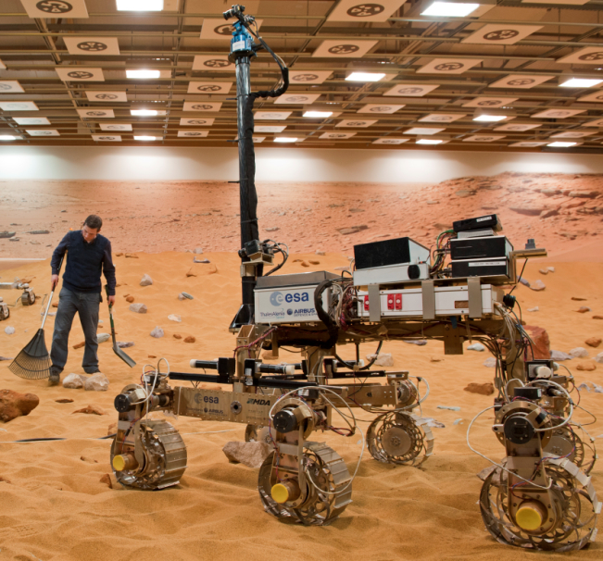
System description
4
2
3
1
Source: ESA web page
1 - Mobile Robot – RM
2 - Drilling Support System - SM
3 - Drilling Head – DR
4 - UAV Helicopter – RC
MARS – Connecting Planetary Scientists in Europe, Warsaw, 3‐5 June 2014

Slide 4
Major Requirements
    Drilling up to 2m depth in the rocks below 40-50 MPa
    Sample acquisition from whole of the borehole
    The mass in range of 12-15 kg
    The drilling power requirements below 100W
    Mobility of the whole system up to 100m and automatic operations
    Testing with using UAV helicopter
MARS – Connecting Planetary Scientists in Europe, Warsaw, 3‐5 June 2014

Slide 5
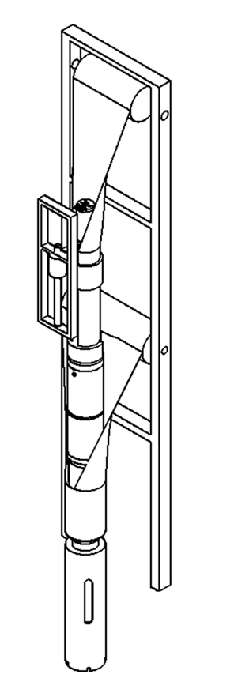
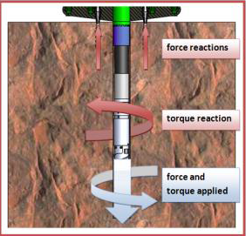
Main design features
    Linear force – up to 500N (not transmitted to mobile rover)
    Torque up to 6Nm (not transmitted on surface)
    Sampling container on surface
    Tubular booms used for force application and borehole safety
    All battery and OBC on mobile robot
MARS – Connecting Planetary Scientists in Europe, Warsaw, 3‐5 June 2014

Slide 6
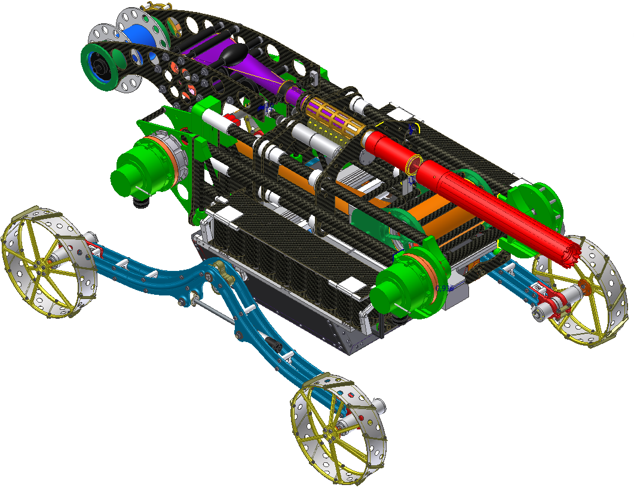
Main design features cont.
MARS – Connecting Planetary Scientists in Europe, Warsaw, 3‐5 June 2014

Slide 7
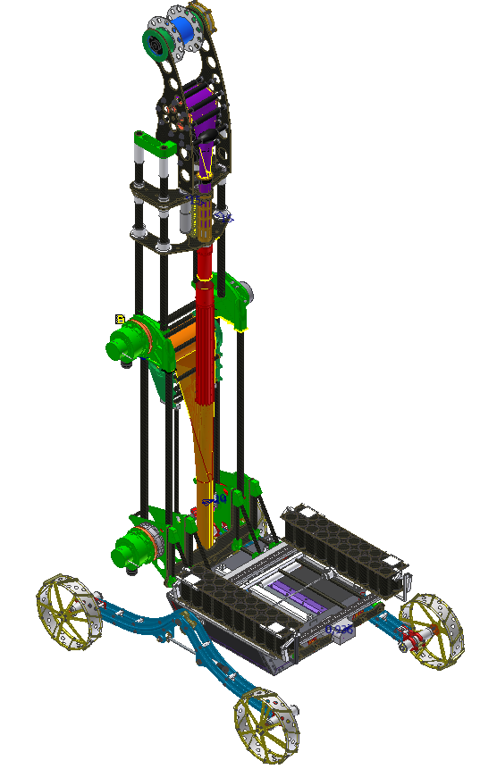
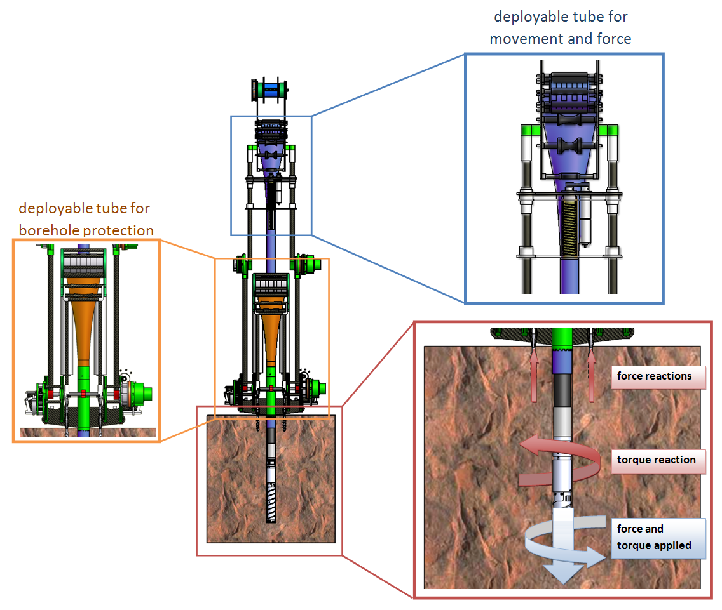
Main design features cont.
MARS – Connecting Planetary Scientists in Europe, Warsaw, 3‐5 June 2014

Slide 8
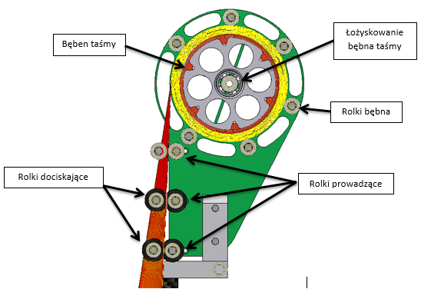
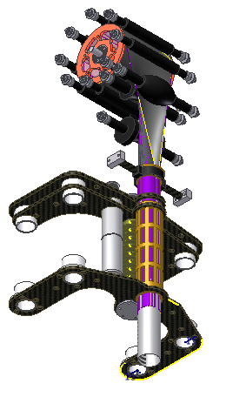
Main design features cont.
    Design details will be provided on ASCE Earth and Space 2014 conf.
MARS – Connecting Planetary Scientists in Europe, Warsaw, 3‐5 June 2014

Slide 9
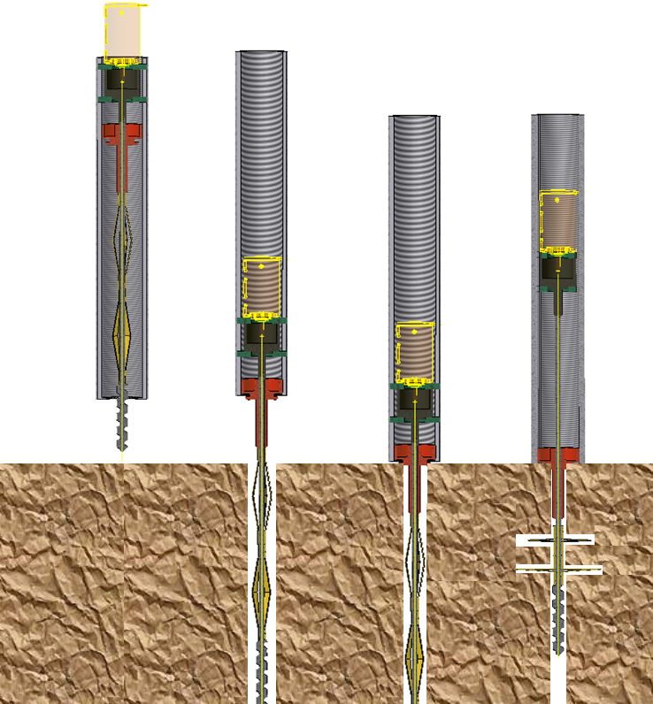
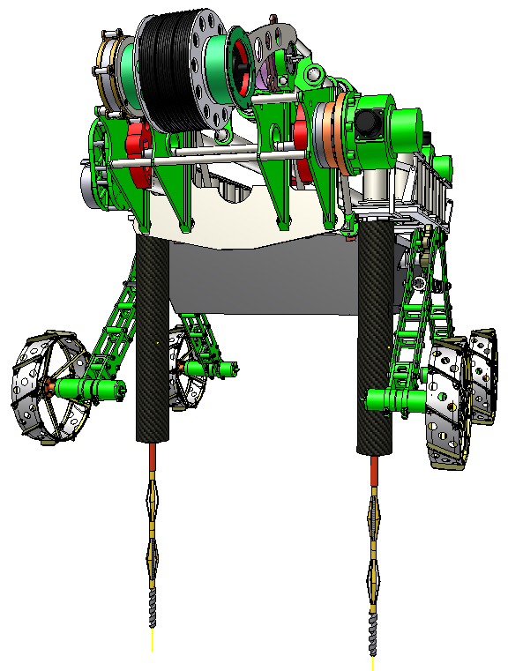
Anchoring
PENETROMETRY IN THE SOLAR SYSTEM III, Seggau, 19‐21 May 2014

Slide 10
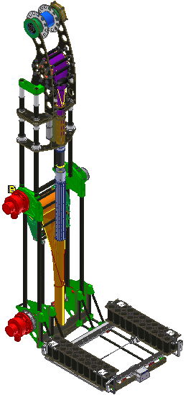
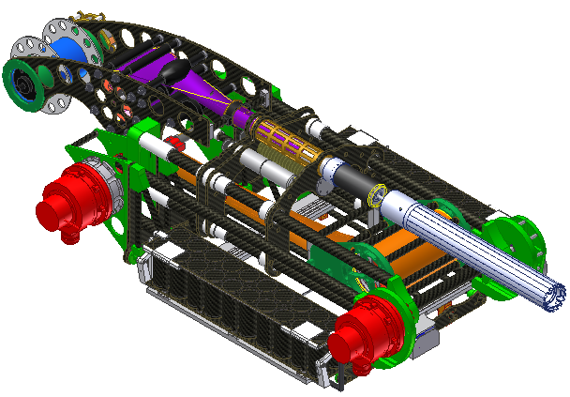
Deployment of the Drilling support system
Joint 1
Joint 2
Time of operation: ~5s
Energy requirement: 0.06Wh
PENETROMETRY IN THE SOLAR SYSTEM III, Seggau, 19‐21 May 2014

Slide 11
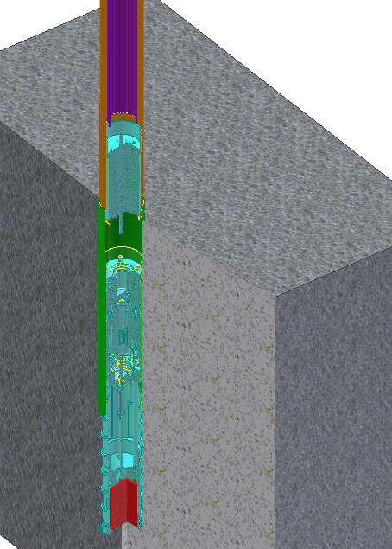
Drilling
Force appl. Mech.
TB1
Drill string (TB2)
Time of operation: 50s/5000s
Nominal length: 50mm
Energy requirements: 2,2Wh+1,1Wh (per nominal length)
DR
Debris container
Core drill
Sample
PENETROMETRY IN THE SOLAR SYSTEM III, Seggau, 19‐21 May 2014

Slide 12
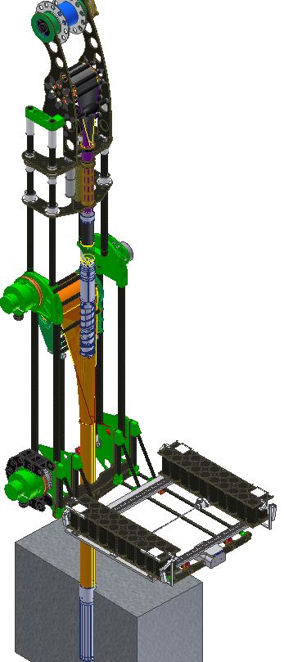
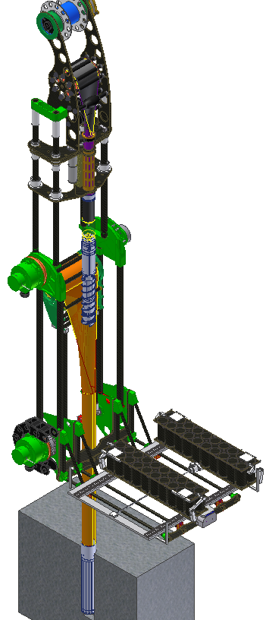
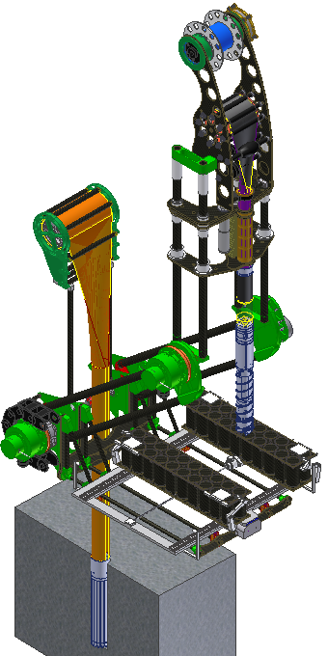
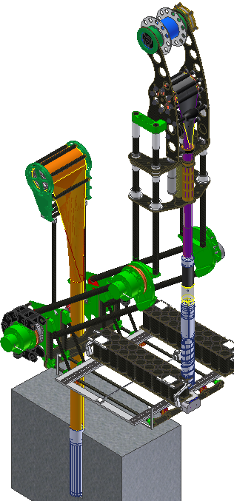
DR positioning above the sample magazine
TB1
Force appl. Mech.
DR
Joint 2
Joint 1
Sampling containers
PENETROMETRY IN THE SOLAR SYSTEM III, Seggau, 19‐21 May 2014

Slide 13
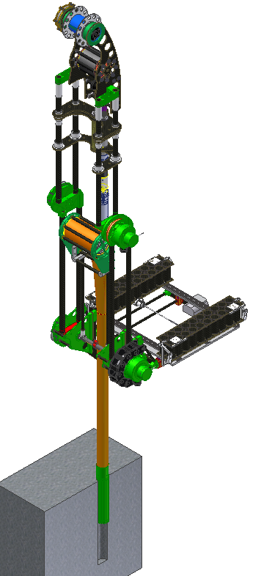
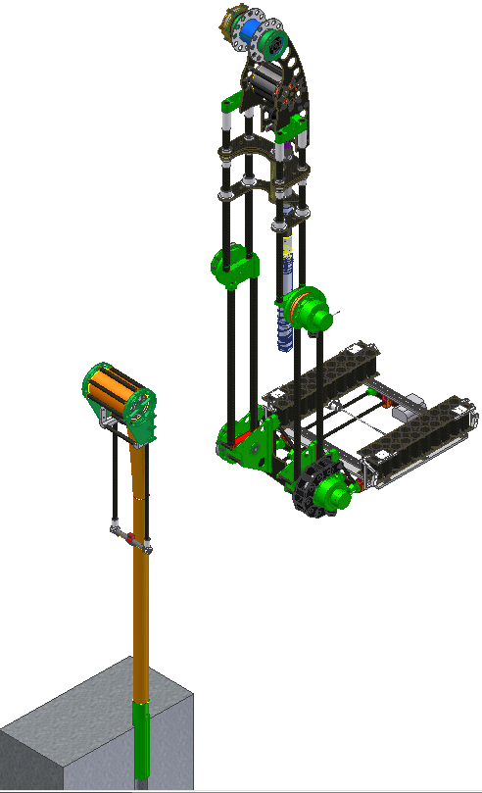
Drill string disconnections
Interfejs:
Tubular boom 2 - SM
Mobile robot motion
PENETROMETRY IN THE SOLAR SYSTEM III, Seggau, 19‐21 May 2014

Slide 14

Possible measurements
    Measurements on sample
    Possible measurements in borehole:
    Geotechnical parameters determination (Seweryn et al. Determining the geotechnical properties of planetary regolith using Low Velocity Penetrometers, PSS, 2014)
    Heat flow measurements (Banaszkiewicz et al., A sensor to perform in-situ thermal conductivity determination of cometary and asteroid material. Advances in Space Research, 2007)
    Chemical composition determination
MARS – Connecting Planetary Scientists in Europe, Warsaw, 3‐5 June 2014

Slide 15

Geotechnical measurements
    The geotechnical sensor has safe access to the bore hole bottom at different depth (each time when DR is outside)
    There is possible to perform: static penetration tests (horizontal direction), Dynamic cone penetration test (vertical direction), photogrammetry analysis
Drill string
Sensor
Regolith / rock
MARS – Connecting Planetary Scientists in Europe, Warsaw, 3‐5 June 2014

Slide 16
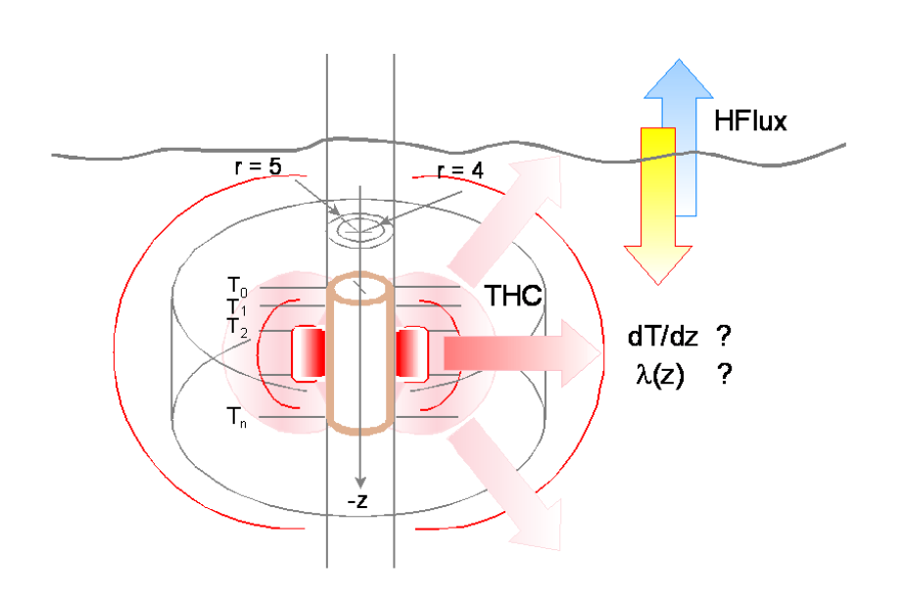
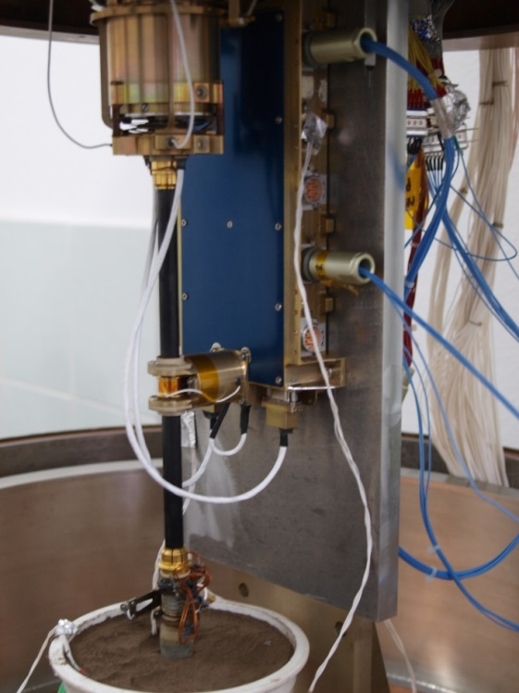
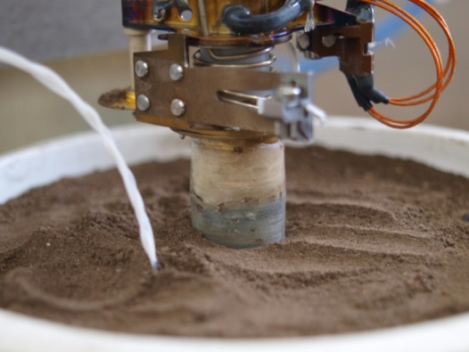
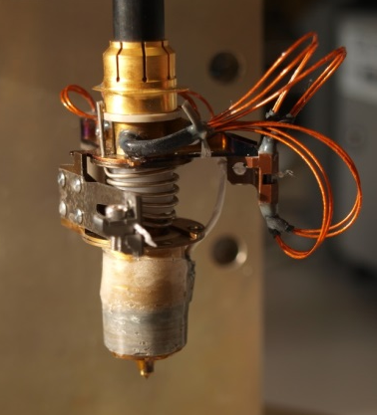
Heat flow measurements
    Thermal properties determination of the regolith or rock surrounding borehole
    Short cylindrical sensor with separate measurement and heating circuit
MARS – Connecting Planetary Scientists in Europe, Warsaw, 3‐5 June 2014

Slide 17
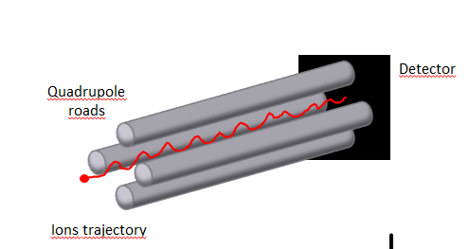
Chemical composition determination
    The spectrometer has safe access to the bore hole bottom at different depth (each time when DR is outside)
    The quadropole sensor can be use for chemical analysis (details in next presentation)
Drill string
Sensor
Regolith / rock
MARS – Connecting Planetary Scientists in Europe, Warsaw, 3‐5 June 2014

Slide 18
Project status
WP1 – Requirements definition - done
WP2 – Trade off analysis - done
WP3 – Design - done
WP4 – Initial project validation - ongoing
MARS – Connecting Planetary Scientists in Europe, Warsaw, 3‐5 June 2014

Slide 19
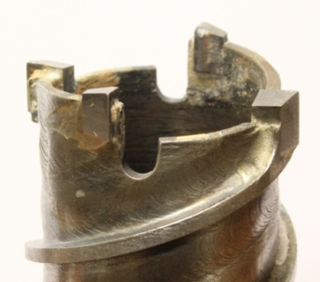
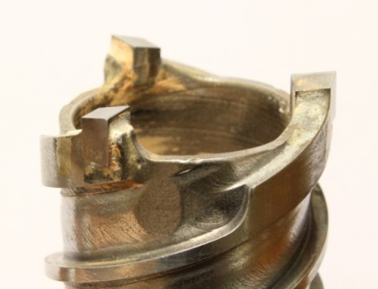
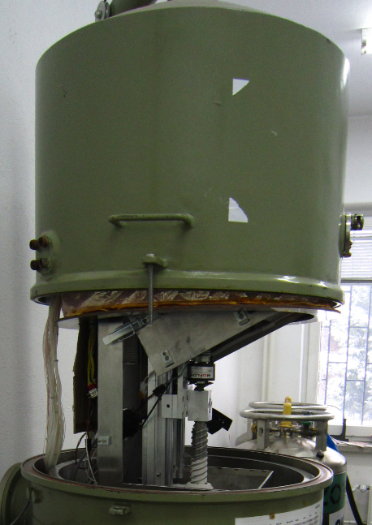
Different drill head testing
MARS – Connecting Planetary Scientists in Europe, Warsaw, 3‐5 June 2014

Slide 20
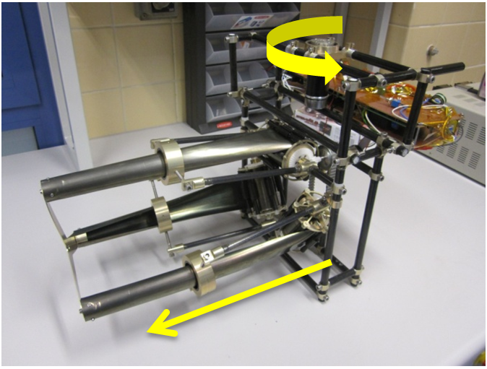
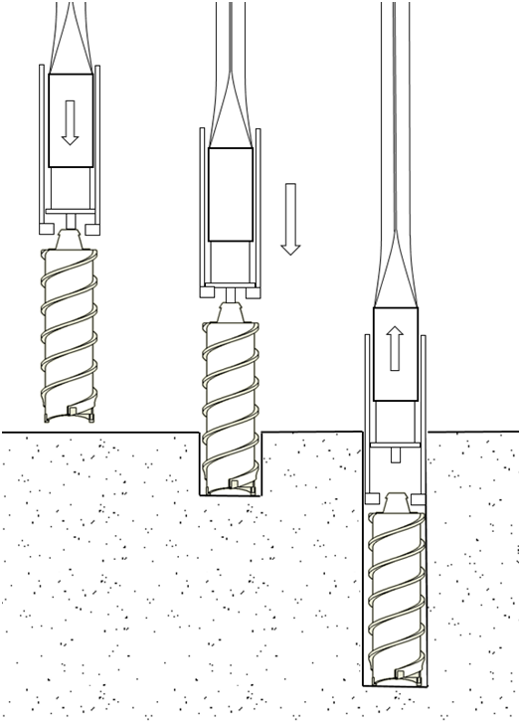
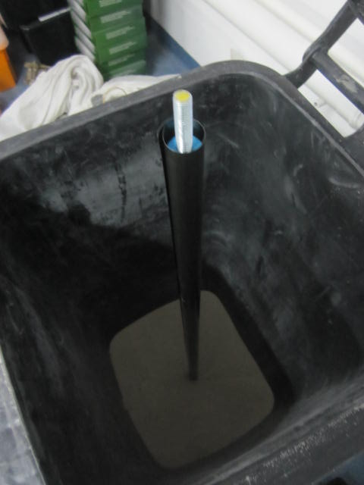
Tubular boom testing
MARS – Connecting Planetary Scientists in Europe, Warsaw, 3‐5 June 2014

Slide 21
Conclusions
The ultralight mobile drilling system (UMDS) has several specific features
the torque is not transmitted to the surface. The force is not transmitted to the rover
the drill motor is on drill head
the tubular booms are used to transfer forces and secure the borehole
The application is either terrestrial and planetary
The possible measurements technique applicable for such system was discussed
MARS – Connecting Planetary Scientists in Europe, Warsaw, 3‐5 June 2014

Slide 22
Thank you for attention
Acknowledgments
The work presented in this presentation was done in the framework of a research project PBS1/A2/2/2012 "Developing a model of automatic coring drilling machine to operate in extreme conditions, in particular in the space environment" financed by the National Centre for Research and Development (NCBR)
MARS – Connecting Planetary Scientists in Europe, Warsaw, 3‐5 June 2014

