Slide 1

Thermal conductivity determination from active measurements – influence of the boundary conditions
Agata Białek, Marek Banaszkiewicz, Roman Wawrzaszek, Jerzy Grygorczuk and Karol Seweryn
Space Research Centre Polish Academy of Sciences
MPSE 2014
Warsaw, June 3rd 2014

Slide 2
Outline
Regolith
Active measurements and data interpretation
Theory
Experiments

Slide 3
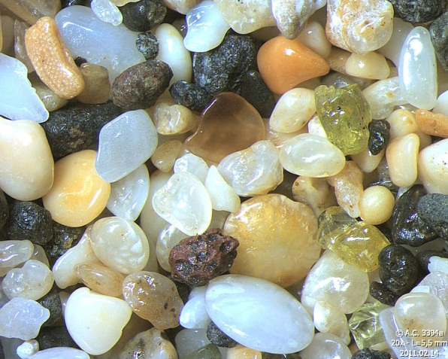
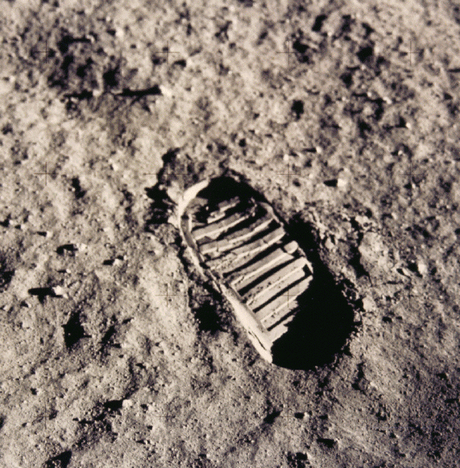
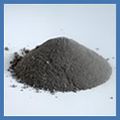
The regolith
Regolit = rhegos + lithos (grec.)
1mm
Mean size of the grains:
40-800 μm (average – 60-80 μm)
Średnia gęstość, g/cm³
Thermal conductivity, W/K/m
Porosity: 44-54%
Lunar regolith | Typical beach sand | Concrete
1.45-1.79 | 1.52 | 2.40
Lunar regolith | Basalt | Water
1.72 – 2.95·10⁻² | 3.5 | 0.58
AS11‑40‑5877HR
Credit: Orbital Technologies Corporation
Notes:
***Changed*** Image number for footprint: AS11‑40‑5877HR
Generally speaking lunar regolith is a very fine-grained, loose and clastic material. It is porous, cohesive. Its color is dark grey to light grey. Regolith is originated from modification of basaltic and anorthostic rocks [LSB].
→This picture (pointing on it) presents astronaut’s footprint on Lunar surface.
!!! Credits for those pictures !!!!
→First one is Photomicrograph sand beach Kalalau - Kauai Island - Hawaii (Field width = 5.5 mm)
→Bottom one – NASA lunar analog JSC-1A – picture from the Orbital Technologies Corporation website (http://www.orbitec.com/store/simulant.html), who sells the analogs
Sand from Kalalau Beach, Hawaii (Field width = 5.5 mm). We see a few grains of olivine, which is the green sand of some beaches of Hawaii.
The lunar regolith behavior reminds the flour behavior. But its properties change with depth.
In our studies we made a review of all properties which were listed in the [LSB] and we prioritized them taking into account human issues.
We also did the review to get some information about the landing sites, what are their main features and characteristic and what kind of regolith we can find there. Based on data from Apollo missions we were able to compare i.e. bulk and mineralogy composition for different locations within PKT Mare and nearby highlands. → charts and explanation of them → 3 charts….. (maybe as backup slides???) → The conclusion is that even within one type of terrain there may be differentiation of lunar regolith composition, which affects its properties.

Slide 4
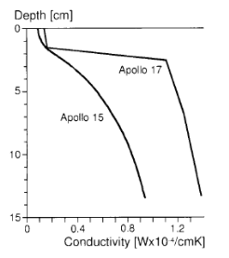
Regolith

Slide 5
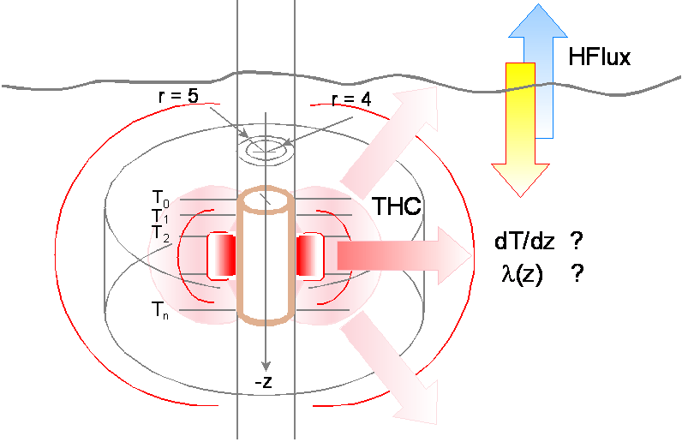
Active measurements
Credit: W. Marczewski
Ref.: Wojciech Marczewski

Slide 6

Data interpretation
Thermal conductivity is proportional to $P\frac{dlnt}{dT}$

Slide 7
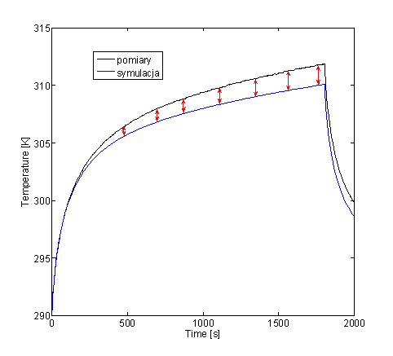
Data interpretation

Slide 8
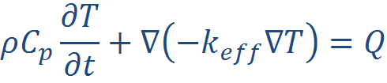


Theory
where
with boundary condition:

Slide 9
Theory
H in W/m²/K

Slide 10
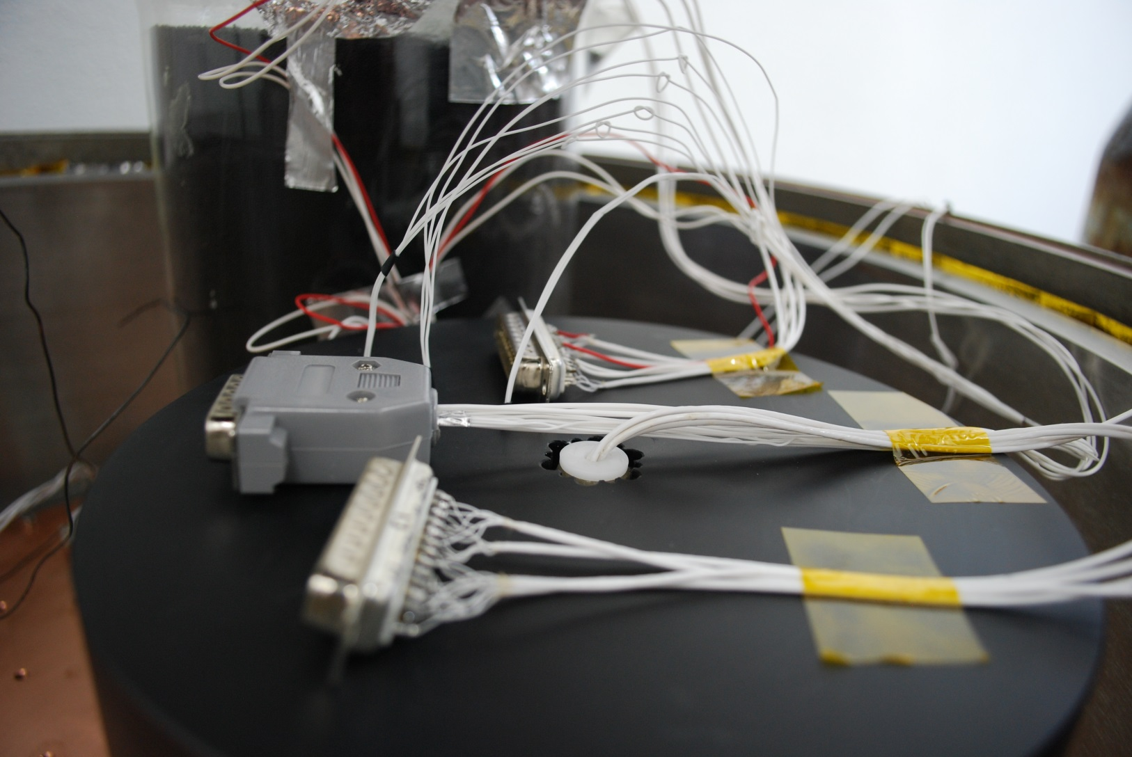
Experiment

Slide 11
Experiment
Contact area 1 < Contact area 2 < Contact area 3

Slide 12
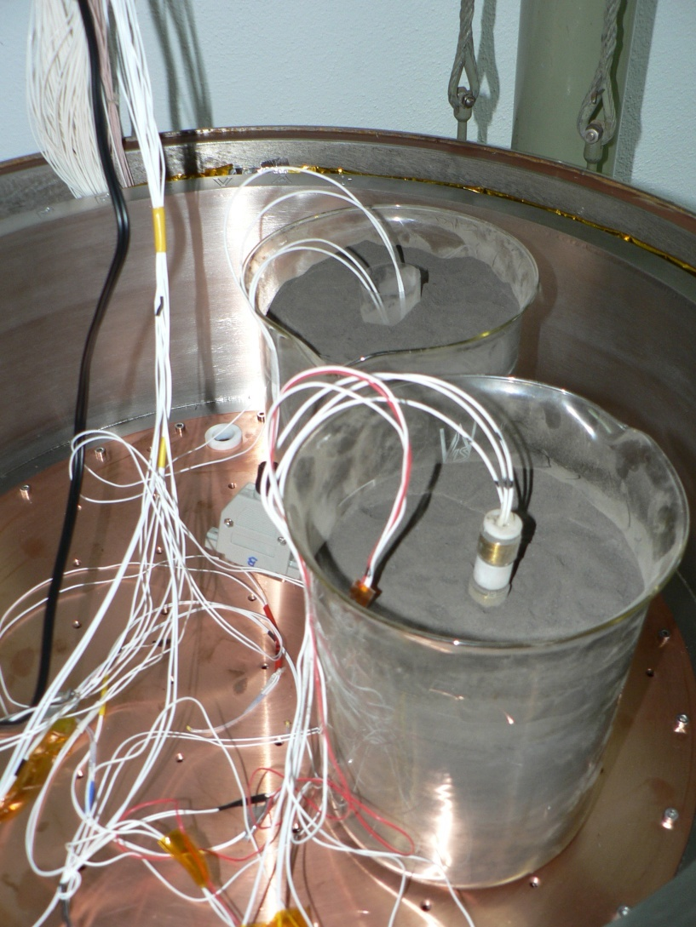
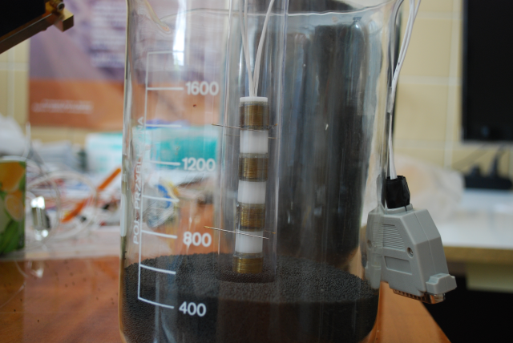
Experiment

Slide 13
Experiment

Slide 14
Experiment

Slide 15
Thank you!

