Slide 1
Numerical simulations of the quadrupole mass analyser in context of its potential application on the Low Velocity Penetrator
Agata Nicolau-Kuklińska
Karol Seweryn
MPSE 2014

Slide 2
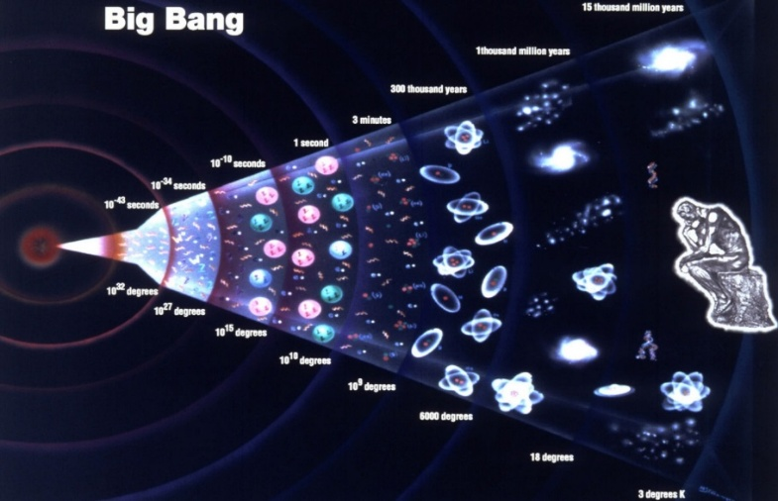
We Are All Made Of Stars
„Of all objects, the planets are those which appear to us under the least varied aspect. We see how we may determine their forms, their distances, their bulk, and their motions, but we can never known anything of their chemical or mineralogical structure; and, much less, that of organized beings living on their surface ...”
Auguste Comte, The Positive Philosophy, Book II, Chapter 1 (1842)

Slide 3
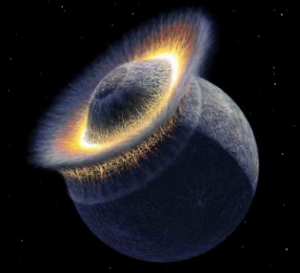
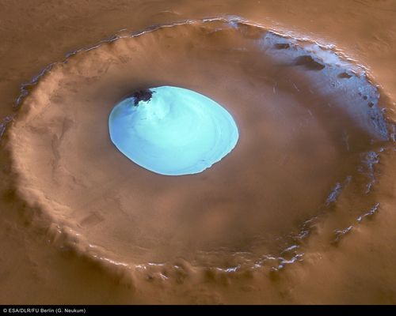
Mineralogy and chemical composition - important role in the knowledge about Universe
Trevor, R.; Recent developments in isotope-ratio mass spectrometry for geochemistry and cosmochemistry. Rev. Sci. Instrum. 2013, 84, 011101.
Boynton, W., V.; Evidence for Calcium Carbonate at the Mars Phoenix Landing Site. Science, July 2009, vol. 325.
Wanke, H.; Bruckner, J.; Dreibus, G.; Rieder, R.; Ryabchikov, I.: Chemical composition of rocks and soils at the Pathfinder site. Space Sci Rev 2001, 96, 317-330.
Wurz, P.; Abplanalp, D.; Tulej, M.; Iakovleva, M.; Fernandes, V. A.; Chumikov, A.; Managadze, G. G.: Mass spectrometric analysis in planetary science: Investigation of the surface and the atmosphere. Solar Syst Res 2012, 46, 408-422.
Yen, A., S.; An integrated view of the chemistry and mineralogy of martian soils. Nature, July 2005, vol 436.
The origin of the Earth's Moon
Hunt for life on Mars
Planning future exploration
Search and mining of space resources

Slide 4
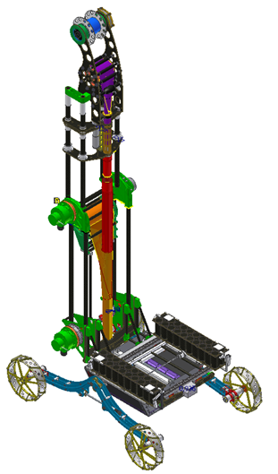
Mineralogy and chemical composition - - under surface development
Depth profiling measurements of chemical composition by drill devices or penetrators
Mass spectrometer

Slide 5
The need for miniaturisation of the mass spectrometer
Benefits:
Low cost launch
Low power consumption
Possibility to place many instruments on board rover or satellite
Possibility to place instrument under surface

Slide 6
Mass spectrometry - principle of operation
Inductively Coupled Plasma (ICP)
Electron Impact Ionization (EI)
Chemical Ionization (CI)
Matrix Assisted Laser Desorption Ionization (MALDI)
Laser Desorption Ionisation (LI)
Sample Preparation
Sample
Introduction
Ioniser
Mass
Analyser
Detector
Computer
Time-Of-Flight (TOF)
Magnetic Sector
Quadrupole Ion Trap
Quadrupole Mass Analyzer (QMS)

Slide 7
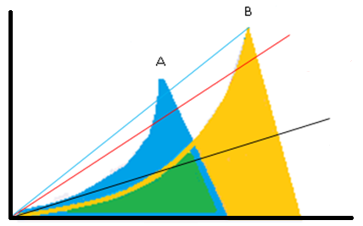
Qadrupole mass analyser
Detector
Quadrupole roads
Ions trajectory
Mass scan line
U_{dc} – DC voltage
V_{ac} – AC voltage
m_{i} - ion mass
r₀ - rod radius
ω – angular frequency
e – elektron charge
a$=\frac{8Udce}{miω^{2}{r0}^{2}}$
q$=\frac{4Vace}{miω^{2}{r0}^{2}}$
The a-q stability diagram

Slide 8
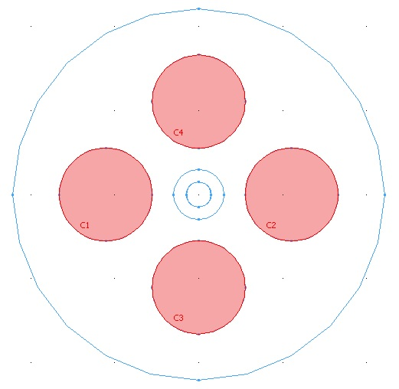
Qadrupole mass analyser - parameters
Qadrupole mass analyser – geometry
Name | Value
a | 0.05
q | 0.7
f | 4 MHz
mi | 40 amu
Udc | 9.60 V
Vac | 268.83 V
d₀
d₁
/m
d₂
d₀ = 2r₀ = 4.536 mm
d₁ = 1.5 mm
d₂ = 9.072 mm
Ref. Gibson, JR.; Taylor, S,; Leck, HJ,: Detailed simulation of mass spectra for quadrupole mass spectrometer systems. J. Vac. Sci. Technol. A 2000, vol. 18, no. 1.

Slide 9
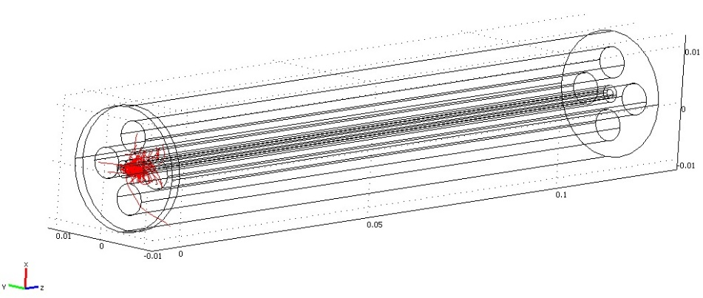
Computation of ions propagation
end
start
m_{i} = 30 amu
m_{i} = 10 amu

Slide 10
Parameters study - frequency

Slide 11
Parameters study – ion source radius

Slide 12
Parameters study – initial velocity
Accelerating voltage A = 3 V
Initial ions velocity v = 3889 m/s
Accelerating voltage A = 2 V
Initial ions velocity v = 3175 m/s
Accelerating voltage A = 1 V
Initial ions velocity v = 2245 m/s

Slide 13
Parameters study – a, q parameter
100%a = 0.05 100%q=0.7 a/q = const

Slide 14
Parameters study – a, q parameter
a/q = eta = variable

Slide 15
Future work
Increase the resolution of the quadrupole mass analyser
Optimalisation mass analyser with a smaller size
Miniaturization of other analyser types (e.g. time of flight)
After trade-off of mass spectrometer we plan to build breadbord and integrate with mole penetrator or drill system
number of cycles
geometry of the mass analyser
velocity of the ions
fraquency of the ac field

Slide 16
Thank you for your attention

